Slide 1
Chapter 7: Normalization

Slide 2
Outline
Features of Good Relational Design
Functional Dependencies
Functional Dependency Theory
Normal Forms
Algorithms for Decomposition using Functional Dependencies
Database-design process and First Normal Form
※ More Normal Form: 4NF

Slide 3
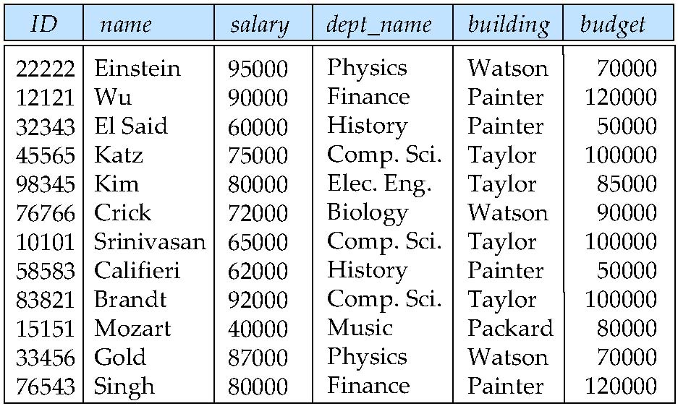
Features of Good Relational Designs
Suppose we combine instructor and department into in_dep, which represents the natural join on the relations instructor and department
There is repetition of information (建築物和預算)
Need to use null values (if we add a new department with no instructors)
刪掉就無EE資訊
重複

Slide 4
Decomposition
The only way to avoid the repetition-of-information problem in the in_dep schema is to decompose it into two schemas – instructor and department schemas.
Not all decompositions are good. Suppose we decompose
employee(ID, name, street, city, salary)
into
employee1 (ID, name)
employee2 (name, street, city, salary)
The problem arises when we have two employees with the same name
The next slide shows how we lose information -- we cannot reconstruct the original employee relation -- and so, this is a lossy decomposition.

Slide 5
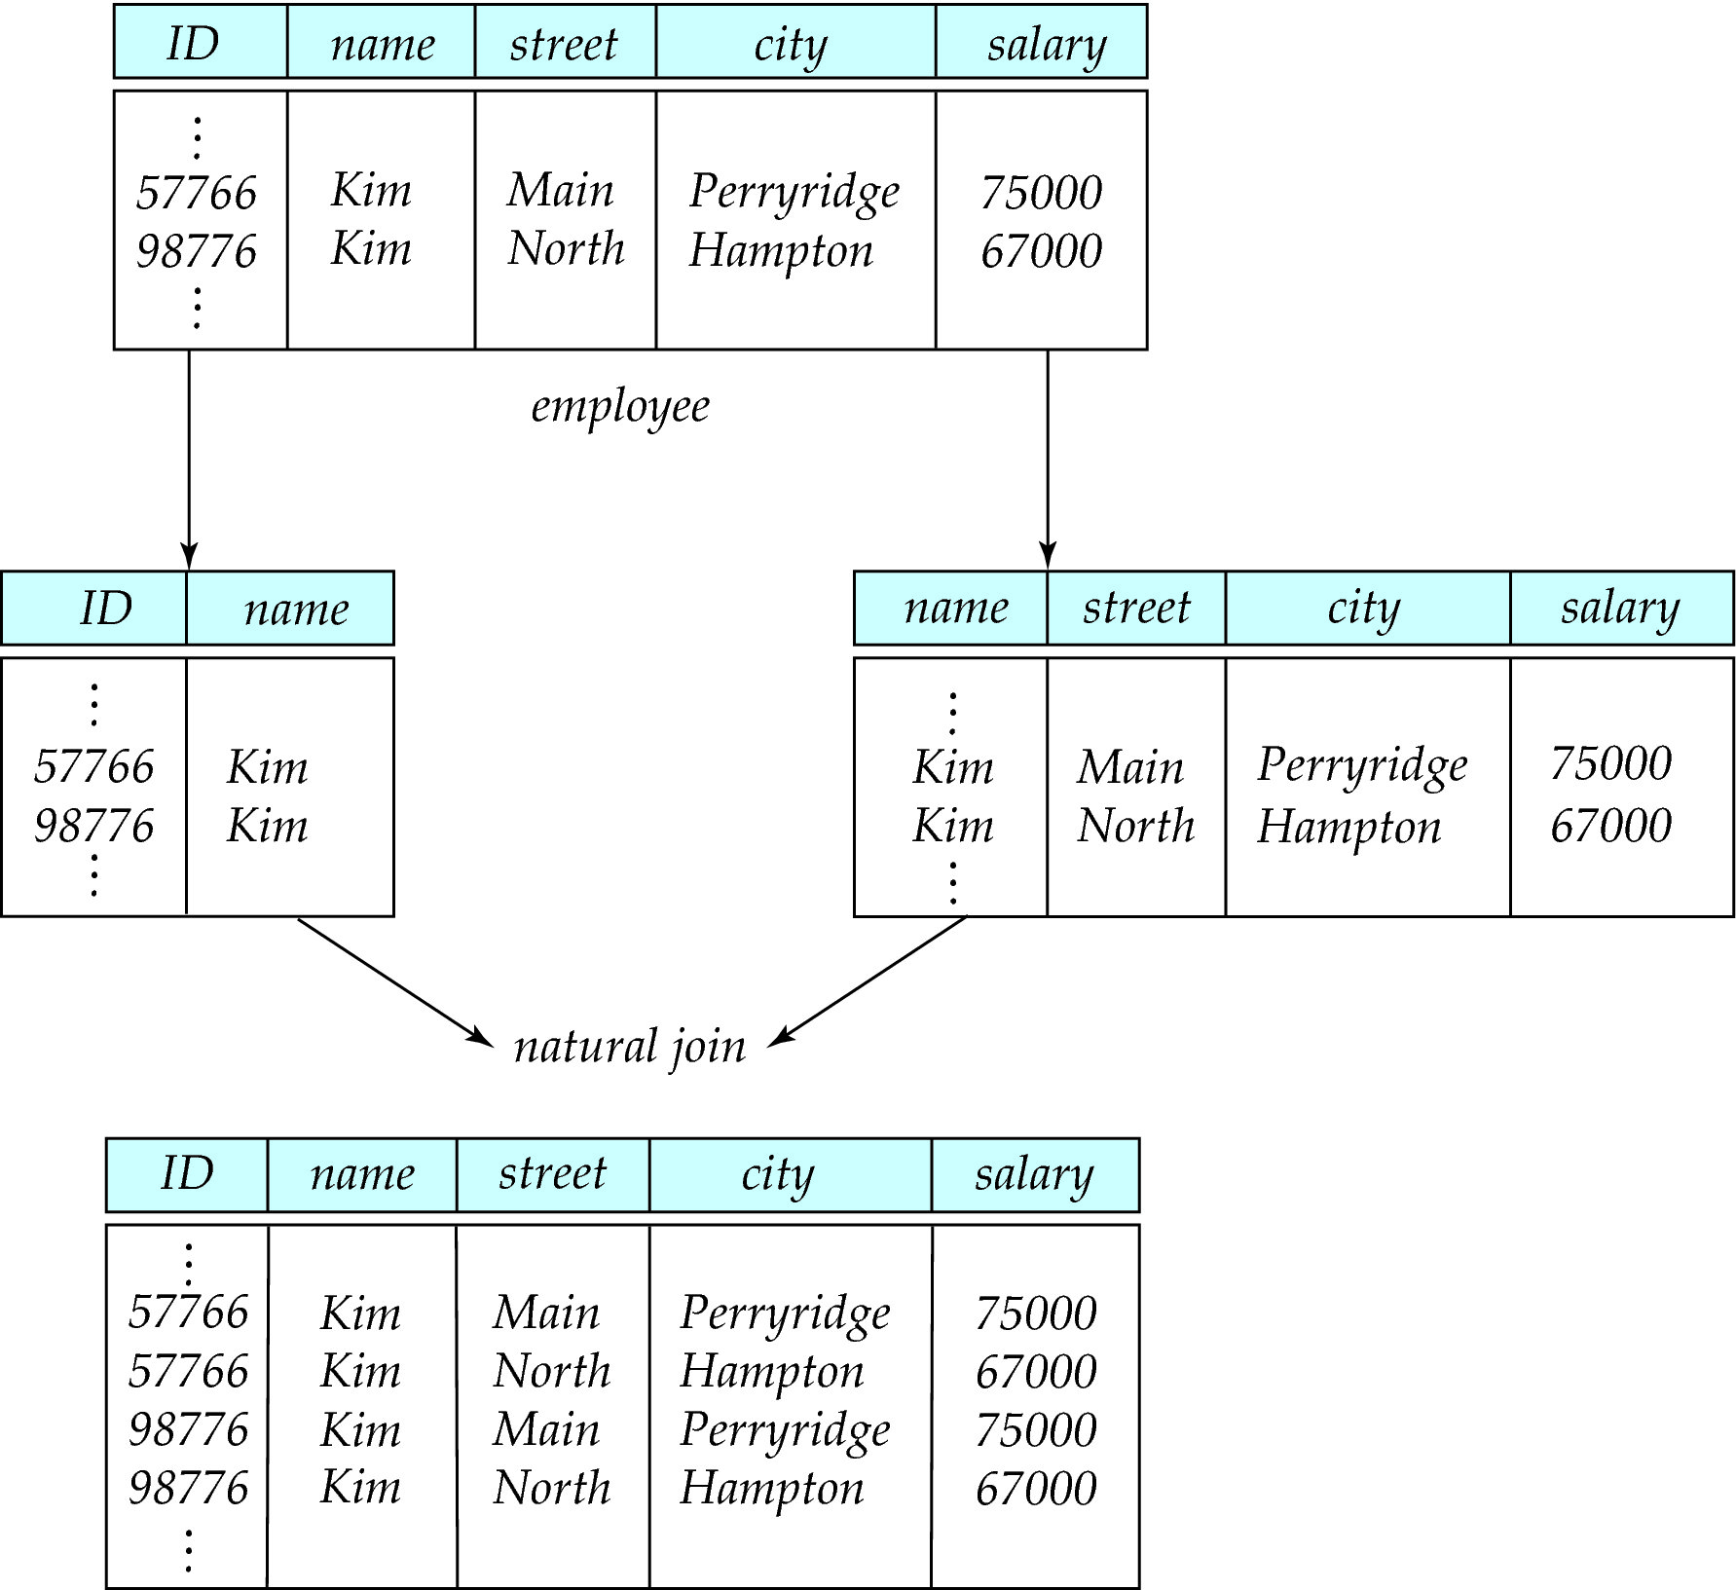
A Lossy Decomposition

Slide 6
Lossless Decomposition
Let R be a relation schema and let R₁ and R₂ form a decomposition of R . That is R = R₁ U R₂
We say that the decomposition is a lossless decomposition if there is no loss of information by replacing R with the two relation schemas R₁ U R₂
Formally,
∏ _{R1} (r) ∏ _{R2} (r) = r
And, conversely a decomposition is lossy if
  r ⊂ ∏ _{R1} (r) ∏ _{R2} (r)

Slide 7
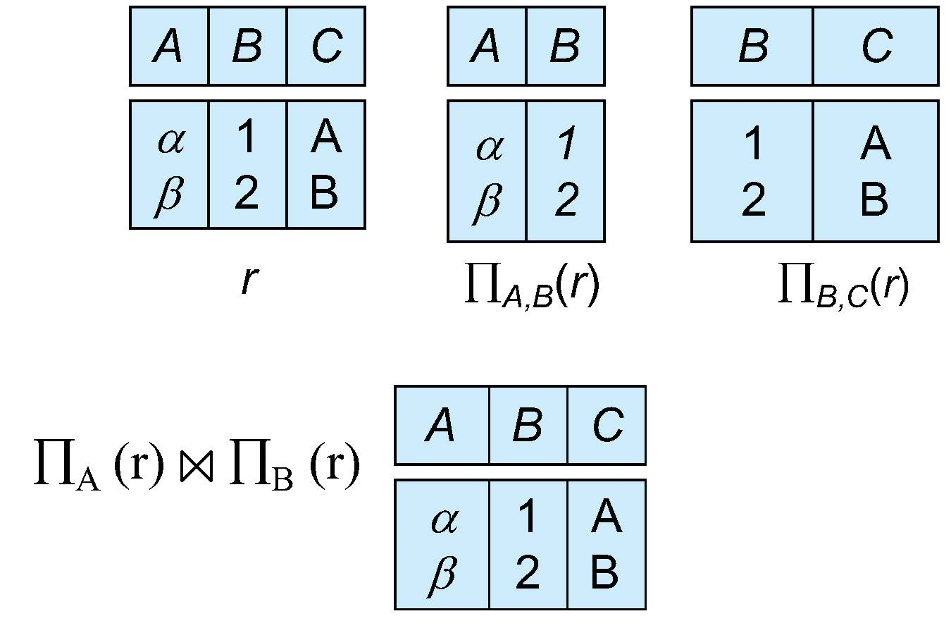
Example of Lossless Decomposition
Decomposition of R = (A, B, C)
R₁ = (A, B) R₂ = (B, C)

Slide 8
Normalization Theory
Decide whether a particular relation R is in “good” form.
In the case that a relation R is not in “good” form, decompose it into set of relations {R₁, R₂, ..., R_{n}} such that
  Each relation is in good form
  The decomposition is a lossless decomposition
Our theory is based on:
  Functional dependencies
  ※ Multivalued dependencies

Slide 9
Functional Dependencies
There are usually a variety of constraints (rules) on the data in the real world.
For example, some of the constraints that are expected to hold in a university database are:
  Students and instructors are uniquely identified by their ID.
  Each student and instructor has only one name.
  Each instructor and student is (primarily) associated with only one department.
  Each department has only one value for its budget, and only one associated building.
functional dependency
  require that the value for a certain set of attributes determines uniquely the value for another set of attributes.
  is a generalization of the notion of a key.

Slide 10
Functional Dependencies Definition
Let R be a relation schema
α ⊆ R and β ⊆ R
The functional dependency
α → β
holds on R if and only if for any legal relations r(R), whenever any two tuples t₁ and t₂ of r agree on the attributes α, they also agree on the attributes β. That is,
t₁[α] = t₂ [α] ⇒ t₁[β ] = t₂ [β ]
Example: Consider r(A,B ) with the following instance of r.
On this instance, B → A hold; A → B does NOT hold,
β
β
α
α
A B
4
1 5
3 7

Slide 11
Keys and Functional Dependencies
K is a superkey for relation schema R if and only if K → R
K is a candidate key for R if and only if
  K → R, and
  for no α ⊂ K, α → R
範例: employee = (ID, name, street, city, salary),
  {ID} is a superkey iff ID-> ID, name, street, city, salary
  {ID, name} is a superkey iff ID, name -> ID, name, street, city, salary
  {ID} is a candidate key, but {ID, name} is NOT.
Functional dependencies allow us to express constraints that cannot be expressed using superkeys. Consider the schema:
in_dep (ID, name, salary, dept_name, building, budget ).
We expect these functional dependencies to hold:
dept_name→ building
ID → building
but would not expect the following to hold:
dept_name → salary

Slide 12
※ Use of Functional Dependencies
We use functional dependencies to:
  To test relations to see if they are legal under a given set of functional dependencies.
    If a relation r is legal under a set F of functional dependencies, we say that r satisfies F.
  To specify constraints on the set of legal relations
    We say that F holds on R if all legal relations on R satisfy the set of functional dependencies F.
Note: A specific instance of a relation schema may satisfy a functional dependency even if the functional dependency does not hold on all legal instances.
  For example, a specific instance of instructor may, by chance, satisfy
  name → ID.

Slide 13
Closure of a Set of Functional Dependencies
Given a set F of functional dependencies, there are certain other functional dependencies that are logically implied by F.
  If A → B and B → C, then we can infer that A → C
  etc.
The set of all functional dependencies logically implied by F is the closure of F.
We denote the closure of F by F⁺.

Slide 14
Trivial Functional Dependencies
A functional dependency is trivial if it is satisfied by all instances of a relation
Example:
  ID, name → ID
  name → name
In general, α → β is trivial if β ⊆ α

Slide 15
Lossless Decomposition
We can use functional dependencies to show when certain decomposition are lossless.
For the case of R = (R₁, R₂), we require that for all possible relations r on schema R
r = ∏_{R1} (r ) ∏_{R2} (r )
A decomposition of R into R₁ and R₂ is lossless decomposition if at least one of the following dependencies is in F⁺:
  R₁ ∩ R₂ → R₁
  R₁ ∩ R₂ → R₂

Slide 16
Example
R = (A, B, C)
F = {A → B, B → C)
R₁ = (A, B), R₂ = (B, C)
  Lossless decomposition:
  R₁ ∩ R₂ = {B} and B → BC
R₁ = (A, B), R₂ = (A, C)
  Lossless decomposition:
  R₁ ∩ R₂ = {A} and A → AB
Note:
  B → BC
  is a shorthand notation for
  B → {B, C}

Slide 17
Dependency Preservation
Testing functional dependency constraints each time the database is updated can be costly
It is useful to design the database in a way that constraints can be tested efficiently.
If testing a functional dependency can be done by considering just one relation, then the cost of testing this constraint is low
When decomposing a relation it is possible that it is no longer possible to do the testing without having to perform a Cartesian Produced.
A decomposition that makes it computationally hard to enforce functional dependency is said to be NOT dependency preserving.

Slide 18
Dependency Preservation Example
Consider a schema:
dept_advisor(s_ID, i_ID, dept_name)
With function dependencies:
  i_ID → dept_name (一個老師只能在一系)
  s_ID, dept_name → i_ID (學生可以在多系，但在一個系只有一個指 導老師 )
In the above design we are forced to repeat the department name once for each time an instructor participates in a dept_advisor relationship.
To fix this, we need to decompose dept_advisor
Any decomposition will not include all the attributes in
s_ID, dept_name → i_ID
Thus, the composition NOT
be dependency preserving
s_id | i_id | dept_name
1 | John | CS
2 | John | CS
1 | Mary | EE

Slide 19
Functional-Dependency Theory

Slide 20
※ Closure of a Set of Functional Dependencies
We can compute F⁺, the closure of F, by repeatedly applying Armstrong’s Axioms:
  Reflexive rule: if β ⊆ α, then α → β . 譬如: AB->A.
  Augmentation rule: if α → β, then γ α → γ β.
  譬如: A->B 則 DA-> DB.
  Transitivity rule: if α → β, and β → γ, then α → γ
  譬如: A->B, B->C 則 A-> C.
These rules are
  Sound -- generate only functional dependencies that actually hold, and
  Complete -- generate all functional dependencies that hold.
A | B | C | D | E
a1 | b1 | c1 | d1 | e1
a1 | b1 | c1 | d1 | e2
a2 | b2 | c2 | d2 | e3

Slide 21
※ Example of F⁺
R = (A, B, C, G, H, I)
F = { A → B
A → C
CG → H
CG → I
B → H}
Some members of F⁺
  A → H
    by transitivity from A → B and B → H
  AG → I
    by augmenting A → C with G, to get AG → CG
    and then transitivity with CG → I
  CG → HI
    by augmenting CG → I to infer CG → CGI,
    and augmenting of CG → H to infer CGI → HI,
    and then transitivity

Slide 22
※ Closure of Functional Dependencies (Cont.)
Additional rules:
  Union rule: If α → β holds and α → γ holds, then α → β γ holds.
  Decomposition rule: If α → β γ holds, then α → β holds and α → γ holds.
  Pseudotransitivity rule: If α → β holds and γ β → δ holds, then α γ → δ holds.
  例子: 如上頁 A-> C, CG-> I => AG->I
The above rules can be inferred from Armstrong’s axioms.

Slide 23
Closure of Attribute Sets
Given a set of attributes α, define the closure of α under F (denoted by α⁺) as the set of attributes that are functionally determined by α under F
Algorithm to compute α⁺, the closure of α under F
result := α;
while (changes to result) do
for each β → γ in F do
begin
if β ⊆ result then result := result ∪ γ
end
補充說明: α → result, result → β, β → γ => α → γ

Slide 24
Example of Attribute Set Closure
R = (A, B, C, G, H, I)
F = {A → B
A → C
CG → H
CG → I
B → H}
(AG)⁺
  1. result = AG
  2. result = ABCG (A → C and A → B)
  3. result = ABCGH (CG → H and CG ⊆ AGBC)
  4. result = ABCGHI (CG → I and CG ⊆ AGBCH)
Is AG a candidate key? (參考p7.11 candidate key的定義)
  Is AG a super key?
    Does AG → R? == Is R = (AG)⁺
  Is any subset of AG a superkey?
    Does A → R? == Is R = (A)⁺
    Does G → R? == Is R = (G)⁺
    In general: check for each subset of size n-1

Slide 25
Uses of Attribute Closure
There are several uses of the attribute closure algorithm:
Testing for superkey:
  To test if α is a superkey, we compute α^{+,} and check if α⁺ contains all attributes of R.
Testing functional dependencies
  To check if a functional dependency α → β holds (or, in other words, is in F⁺), just check if β ⊆ α⁺.
  That is, we compute α⁺ by using attribute closure, and then check if it contains β.
  Is a simple and cheap test, and very useful
※ Computing closure of F
  For each γ ⊆ R, we find the closure γ⁺, and for each S ⊆ γ⁺, we output a functional dependency γ → S.

Slide 26
Normal Forms

Slide 27
Boyce-Codd Normal Form
A relation schema R is in BCNF with respect to a set F of functional dependencies if for all functional dependencies in F⁺ of the form
α → β
where α ⊆ R and β ⊆ R, at least one of the following holds:
  α → β is trivial (i.e., β ⊆ α)
  α is a superkey for R
在後續的討論中，有時為了簡化起見，我們會直接使用F而不是F⁺

Slide 28
Boyce-Codd Normal Form (Cont.)
Example schema that is not in BCNF:
in_dep (ID, name, salary, dept_name, building, budget )
because :
  dept_name→ building, budget
    holds on in_dep
    but
  dept_name is not a superkey
When decompose in_dept into instructor and department
  instructor is in BCNF
  department is in BCNF

Slide 29
Decomposing a Schema into BCNF
Let R be a schema R that is not in BCNF. Let α →β be the FD that causes a violation of BCNF.
We decompose R into:
  (α U β )
  ( R - β )
In our example of in_dep,
  α = dept_name
  β = building, budget
  and in_dep is replaced by
  (α U β ) = ( dept_name, building, budget ) <- department relation
  ( R - β ) = ( ID, name, dept_name, salary ) <- instructor relation

Slide 30
Example
R = (A, B, C)
F = {A → B, B → C}
=> A⁺ = ABC = R, B⁺ = BC 非 R.
=> B不是superkey
=> B->C 使得R不符合BCNF
R₁ = (A, B), R₂ = (B, C)
  R1和R2都符合BCNF
  Lossless-join decomposition:
  R₁ ∩ R₂ = {B} and B → BC

Slide 31
Dependency Preservation
Let F_{i} be the set of dependencies F ⁺ that include only attributes in R_{i}.
  A decomposition is dependency preserving, if
  (F₁ ∪ F₂ ∪ … ∪ F_{n} )⁺ = F ⁺
Note that if a decomposition is NOT dependency preserving then checking updates for violation of functional dependencies may require computing joins, which is expensive.
※ Example: (對照p7.16)
R = (A, B, C)
F = {A → B, B → C}
=> F⁺ = {A → B, B → C, A-> C} 只套用transitive rule.
R₁ = (A, B), R₂ = (B, C)
=> F₁ = {A → B}, F₂ = {B → C}
因為 (F₁ ∪ F₂ )⁺ = {A → B, B → C} ⁺ = F⁺
所以上述切割亦為dependency preserving.
但是若R₁ = (A, B), R₂ = (A, C)，則無法達到dependency preservation。

Slide 32
Third Normal Form
It is not always possible to achieve both BCNF and dependency preservation.
A relation schema R is in third normal form (3NF) if for all:
α → β in F⁺
at least one of the following holds:
  α → β is trivial (i.e., β ∈ α)
  α is a superkey for R
  Each attribute A in β is contained in a candidate key for R.
    此處的意思是, A被α 所決定,也被某個CK所決定.
  (NOTE: each attribute may be in a different candidate key)
If a relation is in BCNF it is in 3NF (since in BCNF one of the first two conditions above must hold).
Third condition is a minimal relaxation of BCNF to ensure dependency preservation (proof omitted).

Slide 33
3NF Example
Consider a schema: (例子同前)
dept_advisor(s_ID, i_ID, dept_name)
With function dependencies:
i_ID → dept_name
s_ID, dept_name → i_ID
Two candidate keys = {s_ID, dept_name}, {s_ID, i_ID }
We have seen before that dept_advisor is not in BCNF
R, however, is in 3NF
  s_ID, dept_name is a superkey
  i_ID → dept_name and i_ID is NOT a superkey, but:
    dept_name is contained in a candidate key

Slide 34

Redundancy in 3NF
Consider the schema R below, which is in 3NF
What is wrong with the table?
  R = (J, K, L )
  F = {JK → L, L → K }
  And an instance table:
對照上一頁和p7.18的 dept_advisor表格:
J: s_ID, K: dept_name, L:i_ID
  Repetition of information
  Need to use null values (e.g., to represent the relationship l₂, k₂
  where there is no corresponding value for J)

Slide 35
Comparison of BCNF and 3NF
Advantages to 3NF over BCNF. It is always possible to obtain a 3NF design without sacrificing losslessness or dependency preservation.
Disadvantages to 3NF.
  We may have to use null values to represent some of the possible meaningful relationships among data items.
  There is the problem of repetition of information.

Slide 36
Goals of Normalization
Let R be a relation scheme with a set F of functional dependencies.
Decide whether a relation scheme R is in “good” form.
In the case that a relation scheme R is not in “good” form, need to decompose it into a set of relation scheme {R₁, R₂, ..., R_{n}} such that:
  Each relation scheme is in good form
  The decomposition is a lossless decomposition
  Preferably, the decomposition should be dependency preserving.
對照第7.8頁

Slide 37
Algorithm for Decomposition Using
Functional Dependencies

Slide 38
Testing for BCNF
To check if a non-trivial dependency α →β causes a violation of BCNF
  1. compute α⁺ (the attribute closure of α), and
  2. verify that it includes all attributes of R, that is, it is a superkey of R.
Simplified test: To check if a relation schema R is in BCNF, it suffices to check only the dependencies in the given set F for violation of BCNF, rather than checking all dependencies in F⁺.
  If none of the dependencies in F causes a violation of BCNF, then none of the dependencies in F⁺ will cause a violation of BCNF either.
※ However, simplified test using only F is incorrect when testing a relation in a decomposition of R
  Consider R = (A, B, C, D, E), with F = { A → B, BC → D}
    Decompose R into R₁ = (A, B) and R₂ = (A,C,D, E)
    Neither of the dependencies in F contain only attributes from
    (A,C,D,E) so we might be mislead into thinking R₂ satisfies BCNF.
    In fact, dependency AC → D in F⁺ shows R₂ is not in BCNF.

Slide 39
Testing Decomposition for BCNF
To check if a relation R_{i} in a decomposition of R is in BCNF
Either test R_{i} for BCNF with respect to the restriction of F⁺ to R_{i} (that is, all FDs in F⁺ that contain only attributes from R_{i})
※ Or use the original set of dependencies F that hold on R, but with the following test:
    for every set of attributes α ⊆ R_{i}, check that α⁺ (the attribute closure of α) either includes no attribute of R_{i}- α, or includes all attributes of R_{i}.
  If the condition is violated by some α → β in F⁺, the dependency
  α → (α⁺ - α) ∩ R_{i}
  can be shown to hold on R_{i}, and R_{i} violates BCNF.
  We use above dependency to decompose R_{i}

Slide 40
BCNF Decomposition Algorithm
result := {R };
done := false;
compute F⁺; (實務上用transitivity rule和pseudotransitivity rule 即可，為了簡
化討論有時只用F)
while (not done) do
if (there is a schema R_{i} in result that is not in BCNF)
then begin
let α → β be a nontrivial functional dependency that
holds on R_{i} such that α → R_{i} is not in F ⁺,
result := (result – R_{i} ) ∪ (R_{i} – β) ∪ (α, β );
end
else done := true;
Note: each R_{i} is in BCNF, and decomposition is lossless-join.

Slide 41
Example of BCNF Decomposition
class (course_id, title, dept_name, credits, sec_id, semester, year, building, room_number, capacity, time_slot_id)
Functional dependencies:
  course_id→ title, dept_name, credits
  building, room_number→capacity
  course_id, sec_id, semester, year→building, room_number, time_slot_id
A candidate key {course_id, sec_id, semester, year}.
BCNF Decomposition:
  course_id→ title, dept_name, credits holds
    but course_id is not a superkey.
  We replace class by:
    course(course_id, title, dept_name, credits)
    class-1 (course_id, sec_id, semester, year, building,
    room_number, capacity, time_slot_id)

Slide 42
BCNF Decomposition (Cont.)
course is in BCNF
  How do we know this?
building, room_number→capacity holds on class-1
  but {building, room_number} is not a superkey for class-1.
  We replace class-1 by:
    classroom (building, room_number, capacity)
    section (course_id, sec_id, semester, year, building, room_number, time_slot_id)
classroom and section are in BCNF.
注意: Final decomposition: course, classroom, section.

Slide 43
練習
Decompose
inst_dept(ID, name, dept_name, salary, building, budget, SID)
based on the following set of functional dependency:
{dept_name → building budget,
ID → name salary,
SID dept_name → ID}

Slide 44
Third Normal Form
a weaker normal form than BCNF
  Allows some redundancy (with resultant problems; we will see examples later)
  But functional dependencies can be checked on individual relations without computing a join.
There is always a lossless-join, dependency-preserving decomposition into 3NF.

Slide 45
Testing for 3NF
Need to check only FDs in F, need not check all FDs in F⁺.
Use attribute closure to check for each dependency α → β, if α is a superkey.
If α is not a superkey, we have to verify if each attribute in β is contained in a candidate key of R
  This test is rather more expensive, since it involve finding candidate keys
  Testing for 3NF has been shown to be NP-hard
  Interestingly, decomposition into third normal form can be done in polynomial time (省略建立的說明)

Slide 46
Comparison of BCNF and 3NF
It is always possible to decompose a relation into a set of relations that are in 3NF such that:
  The decomposition is lossless
  The dependencies are preserved
It is always possible to decompose a relation into a set of relations that are in BCNF such that:
  The decomposition is lossless
  It may not be possible to preserve dependencies.

Slide 47
Design Goals
Goal for a relational database design is:
  BCNF.
  Lossless join.
  Dependency preservation.
If we cannot achieve this, we accept one of
  Lack of dependency preservation
  Redundancy due to use of 3NF
Interestingly, SQL does not provide a direct way of specifying functional dependencies other than superkeys.

Slide 48
Additional issues

Slide 49
Overall Database Design Process
We have assumed schema R is given
R could have been generated when converting E-R diagram to a set of tables.
R could have been a single relation containing all attributes that are of interest (called universal relation).
R could have been the result of some ad hoc design of relations.
We then test R and use normalization to break R into smaller relations.

Slide 50
ER Model and Normalization
When an E-R diagram is carefully designed, identifying all entities correctly, the tables generated from the E-R diagram should not need further normalization.
However, in a real (imperfect) design, there can be functional dependencies from non-key attributes of an entity to other attributes of the entity
  Example: an employee entity with
    attributes
    department_name and building,
    functional dependency
    department_name→ building
    Good design would have made department an entity
Functional dependencies from non-key attributes of a relationship set possible, but rare

Slide 51
Denormalization for Performance
May want to use non-normalized schema for performance
For example, displaying prereqs along with course_id, and title requires join of course with prereq
Alternative 1: Use denormalized relation containing attributes of course as well as prereq with all above attributes
  faster lookup
  extra space and extra execution time for updates
  extra coding work for programmer and possibility of error in extra code
※ Alternative 2: use a materialized view defined a course prereq
  Benefits and drawbacks same as above, except no extra coding work for programmer and avoids possible errors

Slide 52
Other Design Issues
Some aspects of database design are not caught by normalization
Examples of bad database design, to be avoided:
Instead of earnings (company_id, year, amount ), use
  earnings_2004, earnings_2005, earnings_2006, etc., all on the schema (company_id, earnings).
    Above are in BCNF, but make querying across years difficult and needs new table each year
  company_year (company_id, earnings_2004, earnings_2005,
  earnings_2006)
    Also in BCNF, but also makes querying across years difficult and requires new attribute each year.
    Is an example of a crosstab, where values for one attribute become column names
    Used in spreadsheets, and in data analysis tools

Slide 53
First Normal Form
Domain is atomic if its elements are considered to be indivisible units
  Examples of non-atomic domains:
    Set of names, composite attributes
    Identification numbers like CS101 that can be broken up into parts
A relational schema R is in first normal form if the domains of all attributes of R are atomic
Non-atomic values complicate storage and encourage redundant (repeated) storage of data
  Example: Set of accounts stored with each customer, and set of owners stored with each account
  We assume all relations are in first normal form (and revisit this in Chapter 22: Object Based Databases)
customer_name | account_number
John | {A_101, A_201}
{John, Mary} | A_101

Slide 54
First Normal Form (Cont.)
Atomicity is actually a property of how the elements of the domain are used.
  Example: Strings would normally be considered indivisible
  Suppose that students are given roll numbers which are strings of the form CS0012 or EE1127
  If the first two characters are extracted to find the department, the domain of roll numbers is not atomic.
  Doing so is a bad idea: leads to encoding of information in application program rather than in the database.

Slide 55
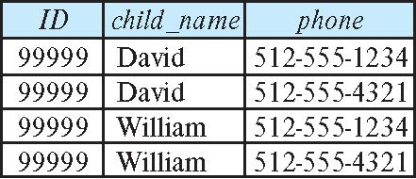
※ How good is BCNF?
There are database schemas in BCNF that do not seem to be sufficiently normalized
Consider a relation
inst_info (ID, child_name, phone)
  where an instructor may have more than one phone and can have multiple children
  Instance of inst_info

Slide 56
※ How good is BCNF? (Cont.)
There are no non-trivial functional dependencies and therefore the relation is in BCNF
Insertion anomalies – i.e., if we add a phone 981-992-3443 to 99999, we need to add two tuples
(99999, David, 981-992-3443)
(99999, William, 981-992-3443)

Slide 57
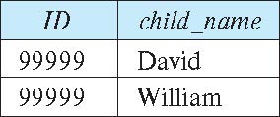
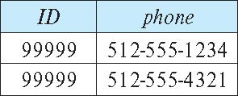
※ Higher Normal Forms
It is better to decompose inst_info into:
  inst_child:
  inst_phone:
This suggests the need for higher normal forms, such as Fourth Normal Form (4NF), which we shall see later

