Slide 1
Solving Problems by Searching
Chapter 3.1~4

Slide 2
Outline
Problem-solving agents
Problem types
Problem formulation
Example problems
Basic search algorithms

Slide 3
Problems in this Chapter
In this chapter, we first learn a kind of problems where a solution is a sequence of actions.
Ex. 8-puzzles, pancake problem
In most time, we want a solution with least cost.
3
2
1
2
━━━━━━━━
━━━━━━━━━━
━━━━━━
━━━━
━━━━━━━━━━━━
━━━━━━━━━━
━━━━━━━━
━━━━━━
━━━━
━━━━━━━━━━━━
━━━━
━━━━━━
━━━━━━━━
━━━━━━━━━━
━━━━━━━━━━━━
━━━━━━━━━━━━
━━━━
━━━━━━
━━━━━━━━━━
━━━━━━━━
━━━━━━━━━━
━━━━━━
━━━━
━━━━━━━━━━━━
━━━━━━━━
3

6
1
4
5

7

6
4
7
8

Slide 4
Problems in this Chapter
The world in a problem is represented by states.
problem的呈現由states代表
An action can change one state into another state.
Action可以將結果從A狀態=>B狀態
The final state that we want to achieve is the goal state.
最後的結果(狀態)：goal state
A solution can be a sequence of actions.
solution可以是一連串接續的action(從頭到尾的states)
An optimal solution is the solution with the least cost (such as least actions)
optimal：最佳解(成本最低者)

Slide 5
Problem-Solving Agents
function Simple-Problem-Solving-Agent(percept) returns an action
static: seq, an action sequence, initially empty
state, some description of the current world state
goal, a goal, initially null
problem, a problem formulation
state ← Update-State(state, percept)
if seq is empty then do
goal ← Formulate-Goal(state)
problem ← Formulate-Problem(state,goal)
seq ← Search(problem)
action ← First(seq)
seq ← Rest(seq)
return action

Slide 6
Example: Romania

Slide 7
Example: Romania
Story:
On holiday in Romania; currently in Arad.
Flight leaves tomorrow from Bucharest
Formulate goal:
To be in Bucharest
Formulate problem:
states: various cities
actions: drive between cities
Find solution:
sequence of cities, e.g. Arad→Sibiu→Fagaras→Bucharest

Slide 8
More Problem Types
Deterministic, fully observable
Non-observable
Nondeterministic and/or partially observable
Unknown state space

Slide 9
More Problem Types
Deterministic, fully observable → single-state problem
Non-observable
Nondeterministic and/or partially observable
Unknown state space

Slide 10
More Problem Types
Deterministic, fully observable → single-state problem
Agent knows exactly which state it will be in; solution is a sequence
Non-observable
Nondeterministic and/or partially observable
Unknown state space

Slide 11
More Problem Types
Deterministic, fully observable → single-state problem
Agent knows exactly which state it will be in; solution is a sequence
Non-observable → sensorless problem (conformant problem)
Nondeterministic and/or partially observable
Unknown state space

Slide 12
More Problem Types
Deterministic, fully observable → single-state problem
Agent knows exactly which state it will be in; solution is a sequence
Non-observable → sensorless problem (conformant problem)
Agent may have no idea where it is; solution is a sequence
Nondeterministic and/or partially observable
Unknown state space

Slide 13
More Problem Types
Deterministic, fully observable → single-state problem
Agent knows exactly which state it will be in; solution is a sequence
Non-observable → sensorless problem (conformant problem)
Agent may have no idea where it is; solution is a sequence
Nondeterministic and/or partially observable → contingency problem
Unknown state space

Slide 14
More Problem Types
Deterministic, fully observable → single-state problem
Agent knows exactly which state it will be in; solution is a sequence
Non-observable → sensorless problem (conformant problem)
Agent may have no idea where it is; solution is a sequence
Nondeterministic and/or partially observable → contingency problem
percepts provide new information about current state
often interleave search, execution
Unknown state space

Slide 15
More Problem Types
Deterministic, fully observable → single-state problem
Agent knows exactly which state it will be in; solution is a sequence
：給出一個states序列
Non-observable → sensorless problem (conformant problem)
Agent may have no idea where it is; solution is a sequence
：給出一個保守解答(默認策略，因無法感知環境)
Nondeterministic and/or partially observable → contingency problem
percepts provide new information about current state
often interleave search, execution
：根據外界輸入的情況，做出回應
Unknown state space → exploration problem
：透過與環境互動、學習，給出解答

Slide 16
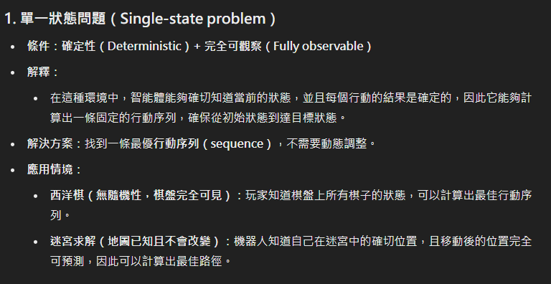

Slide 17
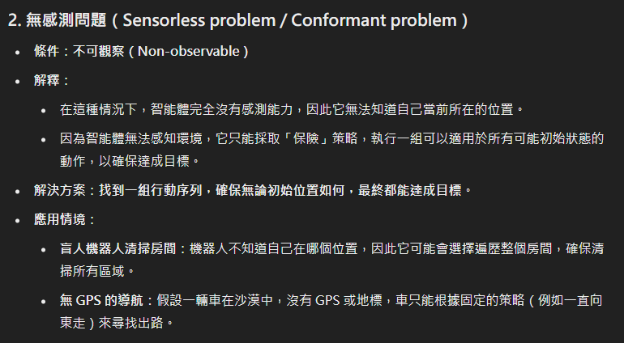

Slide 18
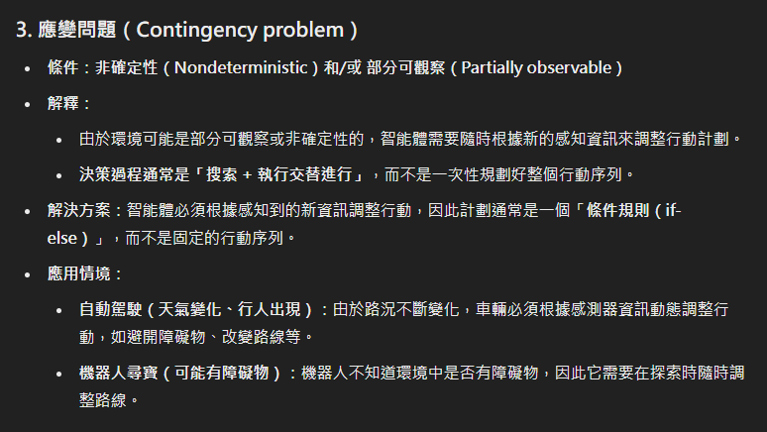

Slide 19
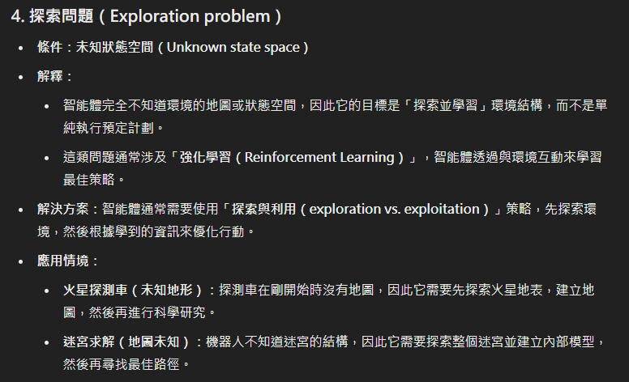

Slide 20
Example: Vacuum
Single-state: start in #5 Solution?

Slide 21
Example: Vacuum
Single-state: start in #5 Solution? [Right, Suck]

Slide 22
Example: Vacuum
Single-state: start in #5 Solution? [Right, Suck]
Sensorless: start in {1,2,3,4,5,6,7,8} e.g., Right goes to {2,4,6,8} Solution?

Slide 23
Example: Vacuum
Single-state: start in #5 Solution?(直接給解) [Right, Suck]
Sensorless: start in {1,2,3,4,5,6,7,8} e.g., Right goes to {2,4,6,8} Solution?(給保守解) [Right, Suck, Left, Suck]

Slide 24
Example: Vacuum
Contingency:
Nondeterministic: Suck may dirty a clean carpet
Partially observable: location, dirt at current location.
Percept: [L, Clean], i.e., start in #5 or #7 Solution?

Slide 25
Example: Vacuum
Contingency:
Nondeterministic: Suck may dirty a clean carpet
Partially observable: location, dirt at current location.
Percept: [L, Clean], i.e., start in #5 or #7 Solution? (根據輸入判) [Right, if dirt then Suck]

Slide 26
Single-State Problem Formulation
A problem is defined by four items:
Initial state e.g. “at Arad”
：初始狀態
Actions or successor function S(x) = set of action–state pairs
e.g. S(Arad) = {<Arad → Zerind, Zerind>, … }
：狀態的轉移
Goal test, can be
explicit, e.g. x = “at Bucharest”
implicit, e.g. Checkmate(x)
：結果狀態
Path cost (additive)
e.g., sum of distances, number of actions executed, etc.
c(x, a, y) is the step cost, assumed to be ≥ 0
：狀態轉移間導致的成本
A solution is a sequence of actions leading from the initial state to a goal state

Slide 27
Vacuum World State Space Graph
States?
Actions?
Goal test?
Path cost?

Slide 28
Vacuum World State Space Graph
States? Integer; dirt and robot location
Actions?
Goal test?
Path cost?

Slide 29
Vacuum World State Space Graph
States? Integer; dirt and robot location
Actions? Left, Right, Suck
Goal test?
Path cost?

Slide 30
Vacuum World State Space Graph
States? Integer; dirt and robot location
Actions? Left, Right, Suck
Goal test? No dirt at all locations
Path cost?

Slide 31
Vacuum World State Space Graph
States? Integer; dirt and robot location
Actions? Left, Right, Suck
Goal test? No dirt at all locations
Path cost? 1 per action

Slide 32
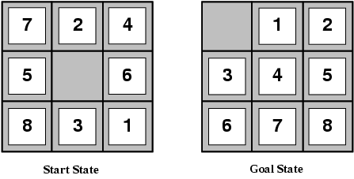
Example: The 8-Puzzle
States?
Actions?
Goal test?
Path cost?
[Note: optimal solution of n-puzzle family is NP-hard]

Slide 33
Example: The 8-Puzzle
States? locations of tiles
Actions?
Goal test?
Path cost?
[Note: optimal solution of n-puzzle family is NP-hard]

Slide 34
Example: The 8-Puzzle
States? locations of tiles
Actions? move blank left, right, up, down
Goal test?
Path cost?
[Note: optimal solution of n-puzzle family is NP-hard]

Slide 35
Example: The 8-Puzzle
States? locations of tiles
Actions? move blank left, right, up, down
Goal test? = goal state (given)
Path cost?
[Note: optimal solution of n-puzzle family is NP-hard]

Slide 36
Example: The 8-Puzzle
States? locations of tiles
Actions? move blank left, right, up, down
Goal test? = goal state (given)
Path cost? 1 per move
[Note: optimal solution of n-puzzle family is NP-hard]

Slide 37
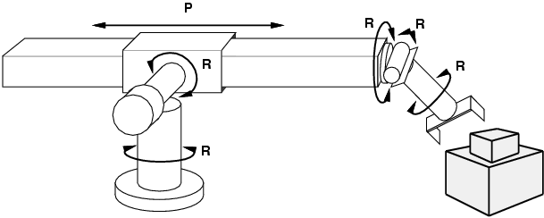
Example: robotic assembly
States? real-valued coordinates of robot joint angles parts of the object to be assembled
Actions? continuous motions of robot joints
Goal test? complete assembly
Path cost? time to execute

Slide 38
Finding Solution by Tree Search Algorithms
Each node represents a state.
And the depth, cost, or other information about the state
The root of the tree is the initial state.
If an action a can change a state S into S’, the node of S has a child node S’. I.e. edges represent actions.
All tree search algorithms can be used to find goal states.

Slide 39
Tree Search Example
Arad
Sibiu
Timisoara
Zerind
Arad
Fagaras
Oradea
Rimniou Vilcea
Arad
Lugoj
Arad
Oradea

Slide 40
Tree Search Example
Arad
Sibiu
Timisoara
Zerind
Arad
Fagaras
Oradea
Rimniou Vilcea
Arad
Lugoj
Arad
Oradea

Slide 41
Tree Search Example
Arad
Sibiu
Timisoara
Zerind
Arad
Fagaras
Oradea
Rimniou Vilcea
Arad
Lugoj
Arad
Oradea

Slide 42
Finding Solution by Tree Search Algorithms
The Successor(x) function defines all legal actions for a given state x.
：輸入一狀態，獲得子狀態(A狀態可轉移至那些狀態)
Which also defines the set of children of a node
A fringe is used to store nodes that are found and waiting to be visited during the tree search.
：存放接下來的所有狀態
When the fringe is a stack, it is depth-first search.
When the fringe is a queue, it is breadth-first search.
And more…

Slide 43
Search Strategies
A search strategy is defined by picking the order of node expansion.
Strategies are evaluated along the following dimensions
completeness: does it always find a solution if one exists?
如果有解，是否一定找的到?
time complexity: number of nodes generated
space complexity: maximum number of nodes in memory
optimality: does it always find a least-cost solution?
是否可以找到最佳解

Slide 44
Uninformed Search Strategies
Uninformed search strategies use only the information available in the problem definition (a.k.a. blind search)
Breadth-first search
Uniform-cost search
Depth-first search
Depth-limited search
Iterative deepening search

Slide 45
Breadth-First Search
Expand shallowest unexpanded node
Fringe is a FIFO queue, i.e., new successors go at end
A
B
C
D
E
F
G

Slide 46
Breadth-First Search
Expand shallowest unexpanded node
Fringe is a FIFO queue, i.e., new successors go at end
A
B
C
D
E
F
G

Slide 47
Breadth-First Search
Expand shallowest unexpanded node
Fringe is a FIFO queue, i.e., new successors go at end
A
B
C
D
E
F
G

Slide 48
Breadth-First Search
Expand shallowest unexpanded node
Fringe is a FIFO queue, i.e., new successors go at end
A
B
C
D
E
F
G

Slide 49
Properties of Breadth-First Search
Complete? Yes (if b(單層節點數) is finite)
Time? 1+b+b²+b³+… +b^{d} + b(b^{d}-1) = O(b^{d+1})
Space? O(b^{d+1}) (keeps every node in memory)
d表目前樹高
Optimal? Yes (if cost = 1 per step)
Space is the bigger problem (more than time)
b: maximum branching factor of the search tree
d: depth of the least-cost solution
m: maximum depth of the state space (may be ∞)

Slide 50
Depth-First Search
Expand deepest unexpanded node
Fringe = LIFO stack, i.e., put successors at front
A
B
C
D
E
F
G
H
I
J
K
L
M
N
O

Slide 51
Depth-First Search
Expand deepest unexpanded node
Fringe = LIFO stack, i.e., put successors at front
A
B
C
D
E
F
G
H
I
J
K
L
M
N
O

Slide 52
Depth-First Search
Expand deepest unexpanded node
Fringe = LIFO stack, i.e., put successors at front
A
B
C
D
E
F
G
H
I
J
K
L
M
N
O

Slide 53
Depth-First Search
Expand deepest unexpanded node
Fringe = LIFO stack, i.e., put successors at front
A
B
C
D
E
F
G
H
I
J
K
L
M
N
O

Slide 54
Depth-First Search
Expand deepest unexpanded node
Fringe = LIFO stack, i.e., put successors at front
A
B
C
D
E
F
G
H
I
J
K
L
M
N
O

Slide 55
Depth-First Search
Expand deepest unexpanded node
Fringe = LIFO stack, i.e., put successors at front
A
B
C
D
E
F
G
H
I
J
K
L
M
N
O

Slide 56
Depth-First Search
Expand deepest unexpanded node
Fringe = LIFO stack, i.e., put successors at front
A
B
C
D
E
F
G
H
I
J
K
L
M
N
O

Slide 57
Depth-First Search
Expand deepest unexpanded node
Fringe = LIFO stack, i.e., put successors at front
A
B
C
D
E
F
G
H
I
J
K
L
M
N
O

Slide 58
Depth-First Search
Expand deepest unexpanded node
Fringe = LIFO stack, i.e., put successors at front
A
B
C
D
E
F
G
H
I
J
K
L
M
N
O

Slide 59
Depth-First Search
Expand deepest unexpanded node
Fringe = LIFO stack, i.e., put successors at front
A
B
C
D
E
F
G
H
I
J
K
L
M
N
O

Slide 60
Depth-First Search
Expand deepest unexpanded node
Fringe = LIFO stack, i.e., put successors at front
A
B
C
D
E
F
G
H
I
J
K
L
M
N
O

Slide 61
Depth-First Search
Expand deepest unexpanded node
Fringe = LIFO stack, i.e., put successors at front
A
B
C
D
E
F
G
H
I
J
K
L
M
N
O

Slide 62
Properties of Depth-First Search
Complete? No: fails in infinite-depth spaces, spaces with loops
Complete in finite spaces if repeated states will no be expanded
Time? O(b^{m}): terrible if m is much larger than d
but if solutions are dense, may be much faster than breadth-first
Space? O(bm), i.e., linear space!
m表樹高
Optimal? No(解不保證深度，只是有解)
b: maximum branching factor of the search tree
d: depth of the least-cost solution
m: maximum depth of the state space (may be ∞)

Slide 63
Depth-Limited Search
Depth-first search with depth limit l
限制高度 l 的 DFS
Nodes at depth l will not be expanded.
高度 l 的子樹不會被展開

Slide 64
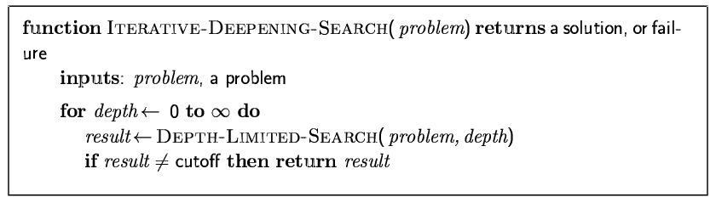
Iterative Deepening Search 限制高度的DFS

Slide 65
Iterative Deepening Search l =0

Slide 66
Iterative Deepening Search l =1

Slide 67
Iterative Deepening Search l =2

Slide 68
Iterative Deepening Search l =3

Slide 69
Iterative Deepening Search
Number of nodes generated in a depth-limited search to depth d with branching factor b:
N_{DLS} = b⁰ + b¹ + b² + … + b^{d-2} + b^{d-1} + b^{d}
Number of nodes generated in an iterative deepening search to depth d with branching factor b:
N_{IDS} = (d+1)b⁰ + d b¹ + (d-1)b² + … + 3b^{d-2} +2b^{d-1} + 1b^{d}
For b = 10, d = 5,
N_{DLS} = 1 + 10 + 100 + 1,000 + 10,000 + 100,000 = 111,111
N_{IDS} = 6 + 50 + 400 + 3,000 + 20,000 + 100,000 = 123,456
Overhead = (123,456 - 111,111)/111,111 = 11%

Slide 70
Properties of Iterative Deepening Search
Complete? Yes
Time? (d+1)b⁰ + d b¹ + (d-1)b² + … + b^{d} = O(b^{d})
每次深度+1，都要重做，故深度淺者執行次數隨深度而變
Space? O(bd)
Optimal? Yes, if step cost = 1
b: maximum branching factor of the search tree
d: depth of the least-cost solution
m: maximum depth of the state space (may be ∞)

Slide 71
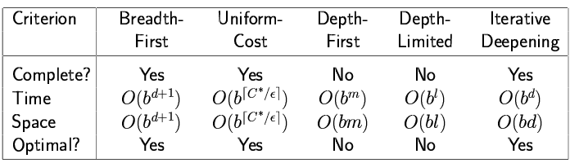
Summary of Algorithms

Slide 72
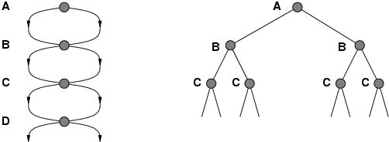
Repeated States in Graphs
Failure to detect repeated states can turn a linear problem into an exponential one!
可將重複狀態展開
Use a hash table to remember visited states.
Hash table可用來記錄被遍歷過之狀態

Slide 73
Summary
Problem formulation usually requires abstracting away real-world details to define a state space that can feasibly be explored
Variety of uninformed search strategies
Iterative deepening search uses only linear space and not much more time than other uninformed algorithms

