Slide 1
Informed Search and Heuristics
Chapter 3.5~7

Slide 2
Review: Finding Solution by Tree Search Algorithms
Each node represents a state.
And the depth, cost, or other information about the state
The root of the tree is the initial state.
If an action a can change a state S into S’, the node of S has a child node S’. I.e. edges represent actions.
All tree search algorithms can be used to find goal states.

Slide 3
Tree Search Example
Arad
Sibiu
Timisoara
Zerind
Arad
Fagaras
Oradea
Rimniou Vilcea
Arad
Lugoj
Arad
Oradea

Slide 4
Uninformed Search Strategies
Uninformed search strategies use only the information available in the problem definition (a.k.a. blind search)
Breadth-first search
Depth-first search…
Uninformed search is in fact enumerating all possible action sequences and find a solution.
Uninformed search 就是全部列舉，暴力展開找解

Slide 5
Uninformed Search Example
7
2
3
4
6
5
1
8
Up
Left
7
2
3
7
2
3
4
6
4
6
5
1
8
5
1
8
Down
Up
Left
Left
Up
Right
7
2
3
7
2
7
2
3
7
2
3
7
2
3
7
2
3
4
6
5
4
6
3
4
6
4
6
5
4
5
4
6
5
1
8
1
8
5
1
8
5
1
8
1
6
8
1
8

Slide 6
Review: Tree Search
A search strategy is defined by picking the order of node expansion
function Tree-Search(problem, fringe) return a solution or failure
fringe ← Insert(Make-Node(Initial-State[problem]), fringe)
loop do
if Empty?(fringe) then return failure
node ← Remove-First(fringe)
if Goal-Test[problem] applied to State[node] succeeds
then return Solution(node)
fringe ← Insert-All(Expand(node, problem), fringe)

Slide 7
Outline
Best-first search
Greedy best-first search
A* search
Heuristics

Slide 8
Best-First Search
Idea: use an evaluation function f(n) for each node
Estimate of “desirability”
Expand most desirable unexpanded node
以f(n)衡量此state是否值得被展開
Implementation: Order the nodes in fringe in decreasing order of desirability
用一fringe每次取出最值得被展開的state
Special cases:
greedy best-first search(不考慮目前成本)
A* search(目前成本 + 未來預估)

Slide 9
Example: Romania
Straight-line distance
Arad 366
Bucharest 0
Craiova 160
Dobreta 242
Eforie 161
Fagaras 176
Giurgiu 77
Hirsova 151
Iasi 226
Lugoj 244
Mehadia 241
Neamt 234
Oradea 380
Pitesti 100
Rimnicu Vilcea 193
Sibiu 253
Timisoara 329
Urziceni 80
Vaslui 199
Zerind 374
Cost measured in Km
➔GreedyBFS
➔A*

Slide 10
Greedy Best-First Search
Evaluation function f(n) = h(n) (heuristic)
= estimate of cost from n to goal
heuristic表示從狀態 n 到狀態 goal 要花多少成本
e.g., h_{SLD}(n) = straight-line distance(直線距離) from n to Bucharest
Greedy best-first search expands the node that appears to be closest (with less cost) to goal

Slide 11
Greedy Best-First Search Example
Arad
366
253
Sibiu
Timisoara
329
Zerind
374
366
Arad
176
Fagaras
Oradea
380
Rimnicu Vicea
193
253
Sibiu
Bucharest
0

Slide 12
Properties of Greedy BFS
Complete?
Time?
Space?
Optimal?
b: maximum branching factor of the search tree
d: depth of the least-cost solution
m: maximum depth of the state space (may be ∞)

Slide 13
Properties of Greedy BFS
Complete? No
can get stuck in loops, e.g., Arad → Sibiu → Arad → Sibiu → …
Time?
Space?
Optimal?
b: maximum branching factor of the search tree
d: depth of the least-cost solution
m: maximum depth of the state space (may be ∞)

Slide 14
Properties of Greedy BFS
Complete? No
can get stuck in loops, e.g., Arad → Sibiu → Arad → Sibiu → …
Time? O(b^{m})
but a good heuristic can give dramatic improvement
Space?
Optimal?
b: maximum branching factor of the search tree
d: depth of the least-cost solution
m: maximum depth of the state space (may be ∞)

Slide 15
Properties of Greedy BFS
Complete? No
can get stuck in loops, e.g., Arad → Sibiu → Arad → Sibiu → …
Time? O(b^{m})
but a good heuristic can give dramatic improvement
Space? O(b^{m})
keeps all nodes in memory
Optimal?
b: maximum branching factor of the search tree
d: depth of the least-cost solution
m: maximum depth of the state space (may be ∞)

Slide 16
Properties of Greedy BFS
Complete? No
can get stuck in loops, e.g., Arad → Sibiu → Arad → Sibiu → …
Time? O(b^{m})
but a good heuristic can give dramatic improvement
Space? O(b^{m}) 展開所有節點選擇未來成本最低者BFS
keeps all nodes in memory
Optimal? No
b: maximum branching factor of the search tree
d: depth of the least-cost solution
m: maximum depth of the state space (may be ∞)

Slide 17
A* search
Idea: avoid expanding paths that are already expensive
Evaluation function f(n) = g(n) + h(n)
g(n) = already-spent cost so far to reach n (目前成本)
h(n) = estimated cost from n to goal (未來預估成本)
f(n) = estimated total cost of path through n to goal

Slide 18
A* Search Example
Arad
sld=140
366=0+366
Sibiu
Timisoara
Zerind
393=140+253
447=118+329
449=75+374
sld=99
sld=80
Arad
Fagaras
Oradea
Rimnicu Vicea
646=280+366
415=239+176
671=291+380
413=220+193
sld=211
sld=97
Sibiu
Bucharest
Craiova
Pitesti
Sibiu
591=338+253
450=450+0
526=366+160
417=317+100
553=300+253
sld=101
Bucharest
Craiova
Rimniou Vicea
418=418+0
615=455+160
607=414+193

Slide 19
Admissible Heuristics
A heuristic h(n) is admissible(可接受) if for every node n,
h(n) ≤ h*(n), where h*(n) is the true cost to reach the goal state from n.
估計成本 ≤ 真實成本
An admissible heuristic never overestimates the cost to reach the goal, i.e., it is optimistic(樂觀估計)
Example: h_{SLD}(n) (straight-line distance never overestimates the actual road distance)
Theorem: If h(n) is admissible, A* using Tree-Search is optimal.

Slide 20
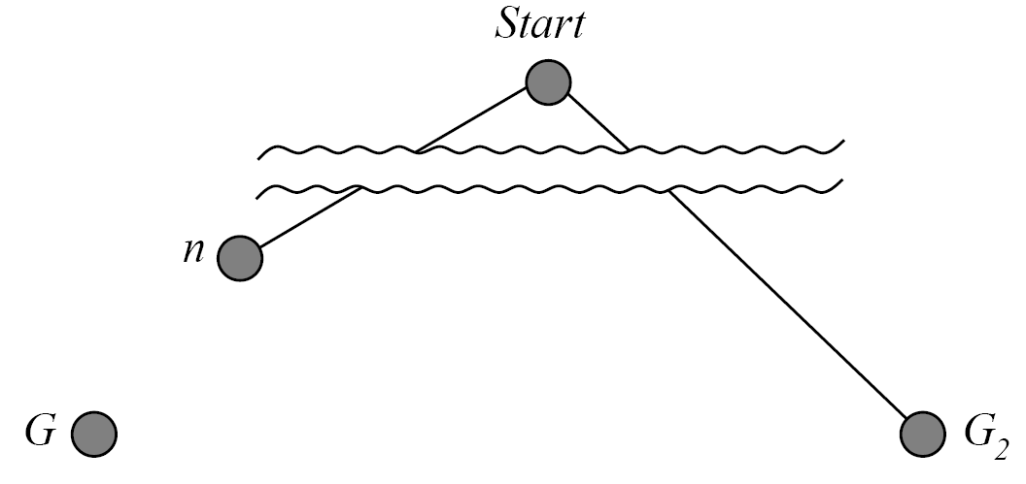
Optimality of A* (Proof)
Suppose some suboptimal goal G₂ has been generated and is in the fringe. Let n be an unexpanded node in the fringe such that n is on a shortest path to an optimal goal G.
f(G₂) = g(G₂) since h(G₂) = 0
f(G) = g(G) since h(G) = 0
g(G₂) > g(G) since G₂ is suboptimal
f(G₂) > f(G) from above

Slide 21
Optimality of A* (Proof)
Suppose some suboptimal goal G₂ has been generated and is in the fringe. Let n be an unexpanded node in the fringe such that n is on a shortest path to an optimal goal G.
h(n) ≤ h*(n) since h is admissible
g(n) + h(n) ≤ g(n) + h*(n) = f(G)
f(n) ≤ f(G) and we know f(G) < f(G₂) from previous page
Hence f(n) < f(G₂) , so A* will never select G₂ for expansion

Slide 22
BUT … Graph Search
Discards new paths to repeated state.
Previous proof breaks down
Solution:
Add extra bookkeeping 紀錄、比較額外訊息 i.e. remove more expensive of two paths.
Ensure that optimal path to any repeated state is always first followed. 諾重複state者成本較低，保留，高則捨棄
Extra requirement on h(n): consistency (monotonicity 單調性)

Slide 23
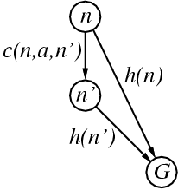
Consistent Heuristics
A heuristic is consistent if for every node n, every successor n' of n generated by any action a,
h(n) ≤ c(n,a,n') + h(n')
If h is consistent, we have
f(n') = g(n') + h(n')
= g(n) + c(n,a,n') + h(n')
≥ g(n) + h(n)
= f(n)
i.e., f(n) is non-decreasing along any path.
Theorem: If h(n) is consistent, A* using Graph-Ssearch is optimal.
從n到目標 比 到n‘再到目標 快

Slide 24
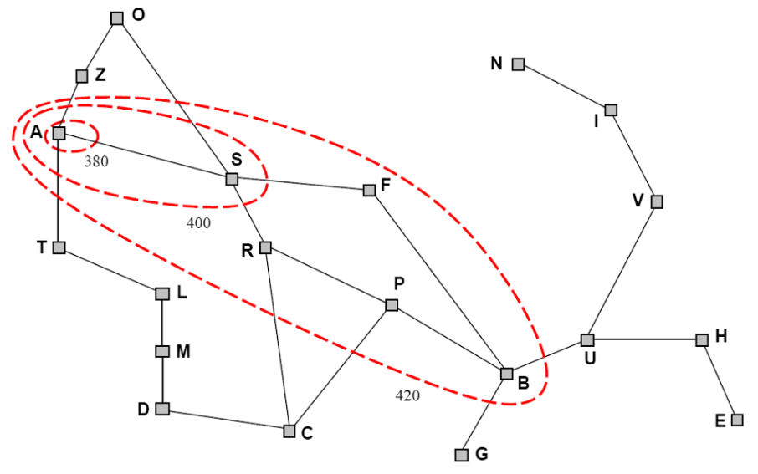
Optimality of A*
A* expands nodes in order of increasing f value
A* 由f(n)值 小者 擴展至 大者
Gradually adds “f-contours” of nodes
每次 擴展 f(n)值相同者(類等高線)
Contour i has all nodes with f = f_{i}, where f_{i} < f_{i+1}

Slide 25
Properties of A*
Complete?
Time?
Space?
Optimal?

Slide 26
Properties of A*
Complete? Yes
(unless there are infinitely many nodes with f ≤ f(G) )
Time?
Space?
Optimal?

Slide 27
Properties of A*
Complete? Yes
(unless there are infinitely many nodes with f ≤ f(G) )
Time? Exponential
Space?
Optimal?

Slide 28
Properties of A*
Complete? Yes
(unless there are infinitely many nodes with f ≤ f(G) )
Time? Exponential
Space? Keeps all nodes in memory
Optimal?

Slide 29
Properties of A*
Complete? Yes
(unless there are infinitely many nodes with f ≤ f(G) )
Time? Exponential
Space? Keeps all nodes in memory(BFS)
Optimal? Yes

Slide 30
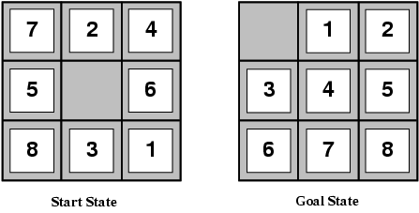
Admissible Heuristics for 8-Puzzle
h₁(n) = number of misplaced tiles
h₂(n) = total Manhattan distance (i.e., no. of squares from desired location of each tile)
h₁(S) = ?
h₂(S) = ?
8
3+1+2+2+2+3+3+2 = 18

Slide 31
Dominance
If h₂(n) ≥ h₁(n) for all n (both admissible) then h₂ dominates h₁
The heuristic function h₂ is better for search!
Typical search costs (average number of nodes expanded):
d=12 IDS = 3,644,035 nodes A*(h₁) = 227 nodes A*(h₂) = 73 nodes
d=24 IDS = too many nodes A*(h₁) = 39,135 nodes A*(h₂) = 1,641 nodes

Slide 32
Inventing Admissible Heuristics
A problem with fewer restrictions on the actions is called a relaxed problem
減少原本問題的限制：relaxed problem
The cost of an optimal solution to a relaxed problem is an admissible heuristic for the original problem
Relaxed proble最佳解 當作原問題 可接受的heuristic function
Admissible heuristics can be derived from the exact solution cost of a relaxed version of the problem:
Relaxed 8-puzzle for h₁ : a tile can move anywhere (misplaced tiles)每個 tile 可以直接跳到任何位置
Relaxed 8-puzzle for h₂ : a tile can move to any adjacent square (Manhattan distance) 不用配置空間，直接移動

Slide 33
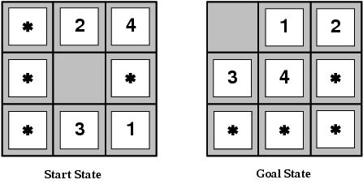
Inventing Admissible Heuristics
Admissible heuristics can also be derived from the solution cost of a subproblem of a given problem.
This cost is a lower bound on the cost of the real problem.
Pattern databases store the exact solution to for every possible subproblem instance.
The complete heuristic is constructed using the patterns in DB.

Slide 34
Inventing Admissible Heuristics
Another way to find an admissible heuristic is through learning from experience (透過經驗法則，用學的):
Experience = solving lots of 8-puzzles
An inductive learning algorithm can be used to predict costs for other states that arise during search.

