Slide 1
Local Search Algorithms and Optimization Problems
Section 4.3

Slide 2
Outline
Local search algorithms
Hill-climbing search
Simulated annealing search
Local beam search
Genetic algorithms

Slide 3
Local Search and Optimization
Previously: systematic exploration of search space
Path to goal is solution to problem.
YET, for some problems path is irrelevant(不相關的).
E.g. 8-queens
Different algorithms can be used
Local search

Slide 4
Example: N-Queens
Put n queens on an n × n board with no two queens on the same row, column, or diagonal

Slide 5
Local Search and Optimization
Local search = use single current state and move to neighboring states.
Local search：用現在的單一狀態轉移至鄰居狀態
Advantages:
Use very little memory
Find often reasonable solutions in large or infinite state spaces.
Also useful for pure optimization problems
Find best state according to some objective function.

Slide 6
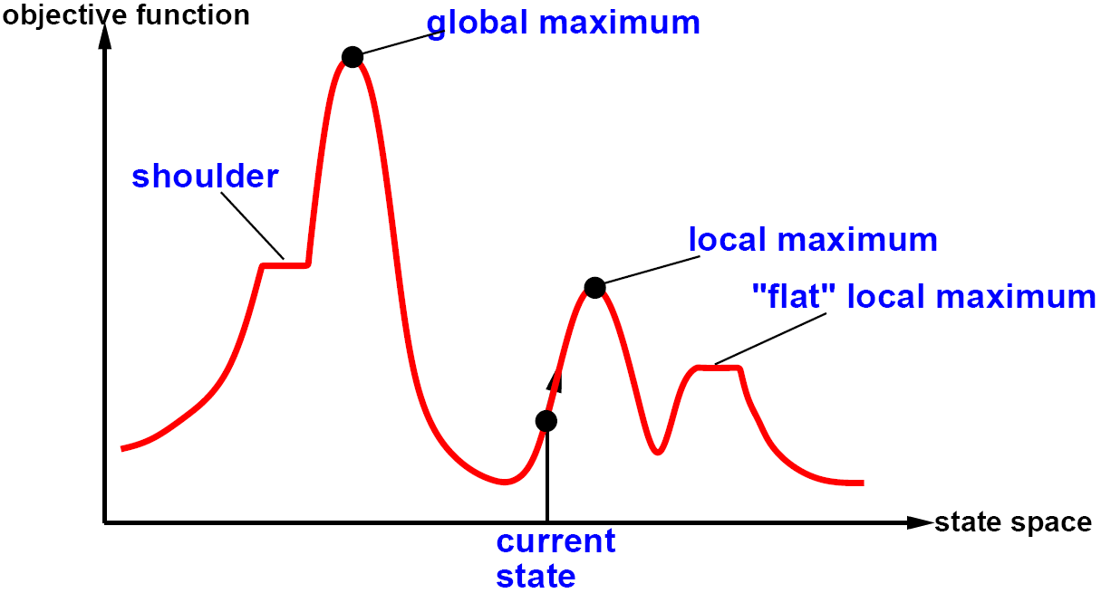
Hill-Climbing Search
"Like climbing Everest in thick fog with amnesia“
就像在濃霧中失憶地攀登聖母峰一樣，既看不到路，也不知道自己從哪裡來。

Slide 7
Hill-Climbing Search
function Hill-Climbing(problem) return a state that is a local maximum
input: problem, a problem
local variables: current, a node.
neighbor, a node.
current ← Make-Node(Initial-State[problem])
loop do
neighbor ← a highest valued successor of current
if Value [neighbor] ≤ Value[current]
then return State[current]
current ← neighbor

Slide 8
Hill-Climbing Search: 8-Queens Problem
h = number of pairs of queens that are attacking each other, either directly or indirectly
h = 有幾對互相攻擊
h = 17 for the state in this example
The next step can be any move which makes h = 12.

Slide 9
Drawbacks
Local maximum = a peak higher than its neighboring states but lower than the global maximum
為附近的最大值，但小於全部的最大值(相對極大值)
Ridge = sequence of local maxima difficult for greedy algorithms to navigate
山脊：最大值可能在另一個高點，greedy下不去
Plateaux, shoulder = an area of the state space where the evaluation function is flat.
高原：評估函數值皆相同，陷入無限嘗試(喪失方向感)
Gets stuck 86% of the time.

Slide 10
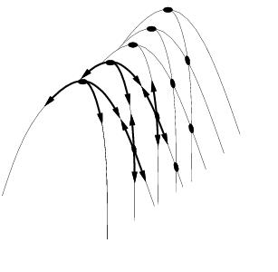
Drawbacks
ridge

Slide 11
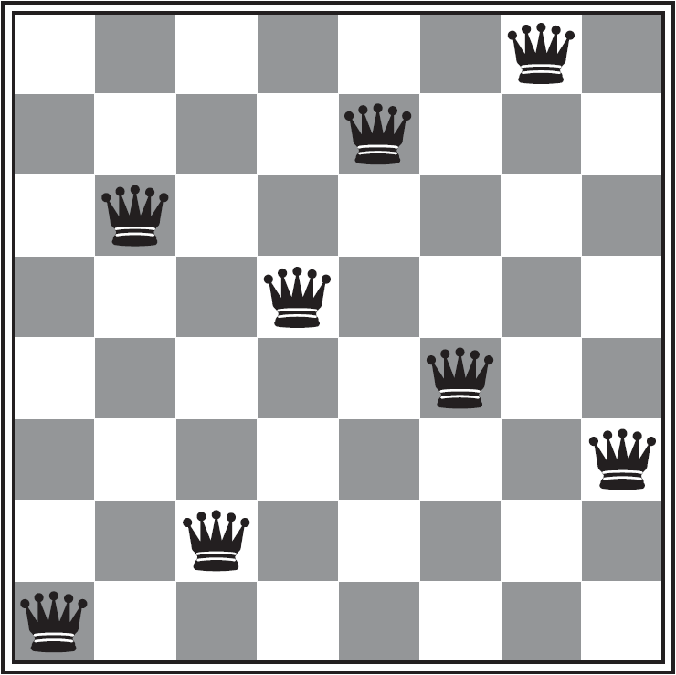
Hill-Climbing Search: 8-Queens Problem
A local minimum with h = 1

Slide 12
Simulated Annealing(退火)
Escape local maxima by allowing “bad” moves.
Idea: but gradually decrease their size and frequency.
一開始可接受壞解，隨次數慢慢只接受更好解
Origin; metallurgical annealing(金屬退火)
One can prove: If the temperature T decreases slowly enough, then best state is reached with probability approaching 1.
溫度降的足夠慢(收斂速度)，找到最佳解的機率趨近於一
Applied for VLSI layout, airline scheduling, etc.
VLSI電路布局、航班、銷售員問題、機器學習參數調整

Slide 13
Simulated Annealing Search
function Simulated-Annealing(problem, schedule) return a solution state
input: problem, a problem
schedule, a mapping from time to temperature
local variables: current, a node.
next, a node.
T, a “temperature” controlling the probability of downward steps
current ← Make-Node(Initial-State[problem])
for t ← 1 to ∞ do
T ← Schedule[t]
if T = 0 then return current
next ← a randomly selected successor of current
∆E ← Value[next] − Value[current]
if ∆E > 0 then current ← next
else current ← next only with probability e^{∆E /T}

Slide 14
Local Beam(光束) Search
Keep track of k states rather than just one
同時追蹤k個狀態
Start with k randomly generated states
由k個隨機產生的狀態開始
At each iteration, all the successors of all k states are generated
各自展開k個狀態
If any one is a goal state, stop; else select the k best successors from the complete list and repeat.
如果其中有goal，停止; 否則從中挑最高的k個狀態展開

Slide 15
Genetic Algorithms
A successor state is generated by combining two parent states
Start with k randomly generated states (population)
從隨機的k個狀態開始
A state is represented as a string over a finite alphabet (often a string of 0s and 1s)
字串表示一狀態
Evaluation function (fitness function). Higher values for better states.
使用評估函數，通常越高表此狀態越符合期待
Produce the next generation of states by selection, crossover, and mutation
藉由 篩選、交配、變異 產生下一世代

Slide 16
Genetic Algorithms
Fitness function: number of non-attacking pairs of queens (min = 0, max = 8 × 7/2 = 28)
max：8個 * (我 * 其他七個)/2(AB == BA)
24/(24+23+20+11) = 31%
23/(24+23+20+11) = 29% etc

Slide 17
Genetic Algorithms

