Slide 1
Constraint Satisfaction Problems
Chapter 5

Slide 2
Outline
CSP?
Backtracking for CSP
Local search for CSPs
Problem structure and decomposition

Slide 3
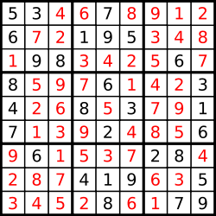
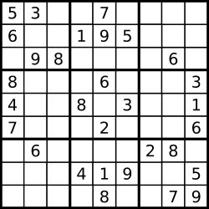
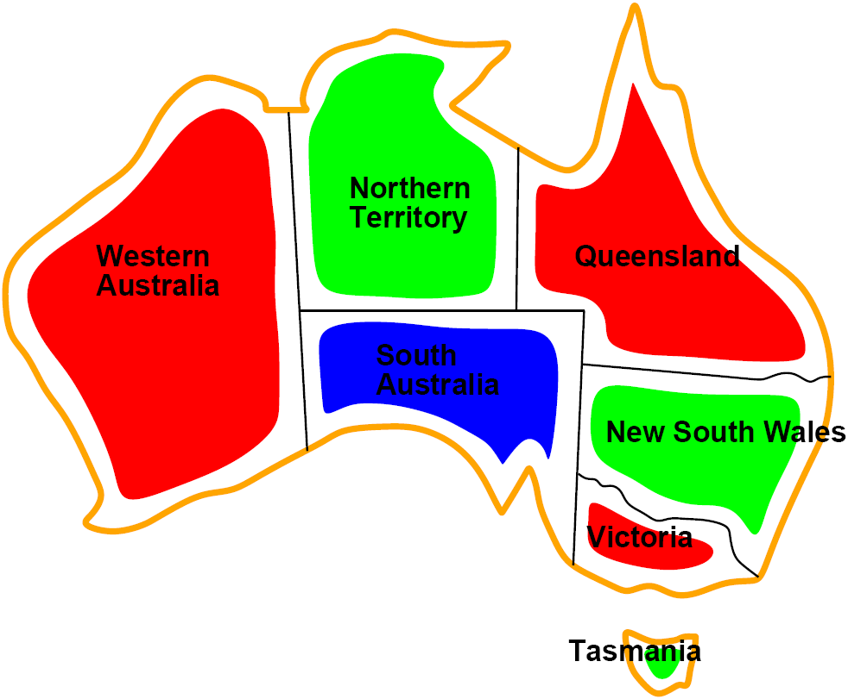
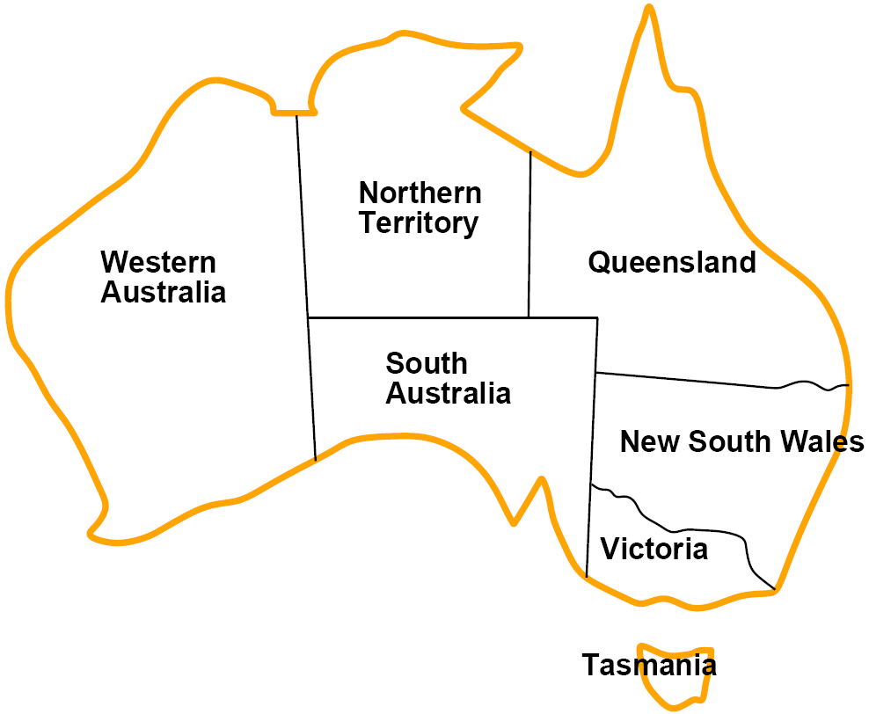
Problems in this Chapter
In this chapter, we learn the kind of problems where a solution is the goal state.
Ex. Map coloring, Sudoku
A solution should not violate any constraint(約束).

Slide 4
Constraint Satisfaction Problems
What is a CSP?
Finite set of variables(空缺) V₁, V₂, …, V_{n}
Non-emtpy domain of possible values(填值) for each variable D_{v1}, D_{v2}, …, D_{vn}
Finite set of constrains C₁, C₂, …, C_{m} (有限的約束)
Each constraint C_{i} limits the values that variables can take, e.g., V₁ ≠ V₂

Slide 5
CSP Example: Map Coloring
Variables: WA, NT, Q, NSW, V, SA, T
Domains: D_{i} = {red, green, blue}
Constraints: adjacent regions must have different colors.
E.g. WA ≠ NT (if the language allows this)
E.g. (WA, NT) = {(red, green), (red, blue), (green, red),…}

Slide 6
Constraint Satisfaction Problems
A state is defined as an assignment of values to some or all variables.
一個狀態表示 將某些變數負值 之結果
An assignment is consistent if the assignment does not violate any constraints.
一致性：目前的負值沒有違反約束
An assignment is complete when every value is mentioned.
完整性：所有變數皆被負值
A solution to a CSP is a complete and consistent assignment that satisfies all constraints.
一個 CSP 的解，是指 所有變數都被指派了值（完整），而且這
些指派 沒有違反任何限制（一致）。

Slide 7
CSP Example: Map Coloring
Solutions are assignments that are
Complete: all variables have values
Consistent: values satisfy all constraints
{WA = red, NT = green, Q = red, NSW = green, V = red, SA = blue, T = green}

Slide 8
Constraint Satisfaction Problems
Some CSPs require a solution that maximizes an objective function.
可能需要滿足目標函數
Applications:
Scheduling the time of observations on the Hubble Space Telescope
Floor planning
Map coloring
Cryptography
……

Slide 9
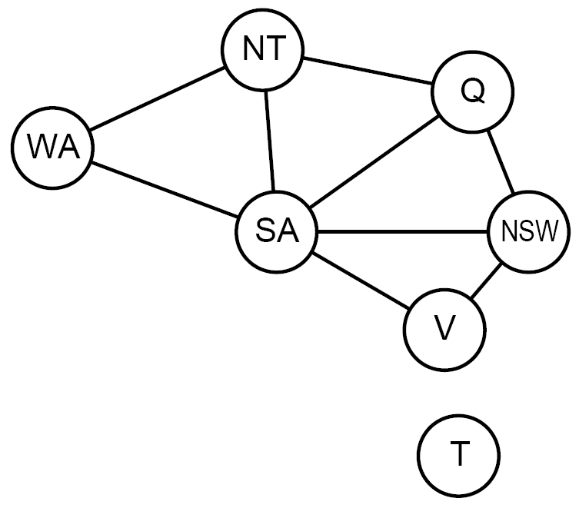
Constraint Graph
Represent a CSP by a constraint graph
Where nodes are variables and edges are constraints.
Graph can be used to simplify search.
e.g. Tasmania is an independent subproblem.

Slide 10
Varieties of CSPs
Discrete variables
Finite domains: for n variables with domains in size d, there are O(d^{n}) complete assignments.
=> (n個位置中，每個有d種選擇)
E.g. truth table (NP-complete); map coloring…
Infinite domains (integers, strings, etc.)
E.g. job scheduling, variables are start/end days for each job
Need a constraint language, e.g StartJob1 + 5 ≤ StartJob3
Linear constraints solvable; nonlinear undecidable.

Slide 11
Varieties of CSPs
Continuous variables(範圍而非固定值)
e.g. start/end times for Hubble Telescope observations.
Linear constraints solvable in polynomial time by linear programming methods.

Slide 12
Varieties of Constraints
Unary constraints involve a single variable.(單變數限制)
e.g. SA ≠ green
Binary constraints involve pairs of variables.(雙變數限制)
e.g. SA ≠ WA
Higher-order constraints involve 3 or more variables.
e.g. cryptarithmetic column constraints(字母算式)
Preference (soft constraints軟性限制) e.g. red is better than green often representable by a cost for each variable assignment  constrained optimization problems.

Slide 13
Example: Cryptarithmetic
T W O
+ T W O
F O U R
F
T
U
W
R
O
Variables: F T U W R O X₁ X₂ X₃
Domains: {0,1,2,3,4,5,6,7,8,9}
Constraints:
Alldiff(F,T,U,E,R,O)
O + O = R + 10X₁
X₁ + W + W = U + 10X₂
X₂ + T + T = O + 10X₃
X₃ = F
X₃
X₂
X₁

Slide 14
CSP as a Standard Search Problem
A CSP can easily expressed as a standard search problem.
Incremental formulation
Initial state: the empty assignment {}.
Successor function: Assign value to unassigned variable provided that there is not conflict.(單state保持consist)
Goal test: the current assignment is complete.
Path cost: as constant cost for every step.

Slide 15
CSP as a Standard Search Problem
This is the same for all CSP’s !!!
Solution is found at depth n (if there are n variables). Path is irrelevant(只在乎當下state，路徑不重要).
Hence depth first search can be used.
Given n variables, d possible values:
Branching factor b at the top level is nd.
=> (n個變數中選一個，每個有d種選擇)
b = (n − l)d at depth l, hence n!d^{n} leaves!! (only d^{n} complete assignments).
=> 深度l，表已決定l個變數，b = (剩下變數選一)*選擇
=> n! = n個變數被指派的順序，CSP中順序不重要，除掉

Slide 16
Commutativity
CSPs are commutative.
The order of any given set of actions has no effect on the outcome.
Example: choose colors for Australian territories
{WA , NT , Q , NSW , V , SA , T } is the same as {NT , WA , Q , NSW , V , SA , T }
All CSP search algorithms consider a single variable assignment at a time  there are d^{n} leaves.

Slide 17
Backtracking Search
(In depth-first search) (Stack can help backtracking)
Chooses values for one variable at a time and backtracks when a variable has no legal values left to assign.
Uninformed algorithm
No good general performance

Slide 18
Backtracking Example

Slide 19
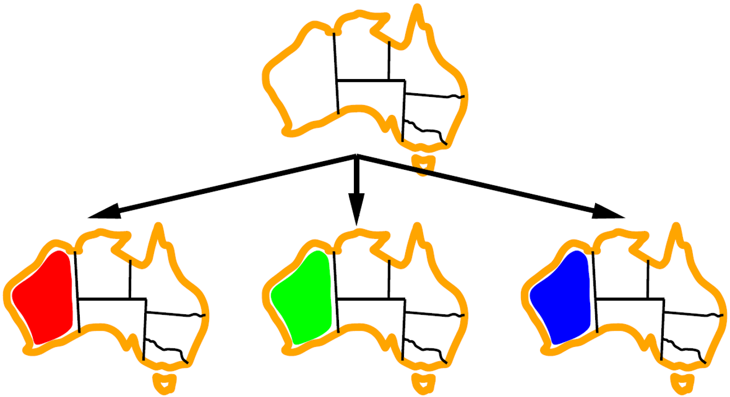
Backtracking Example

Slide 20
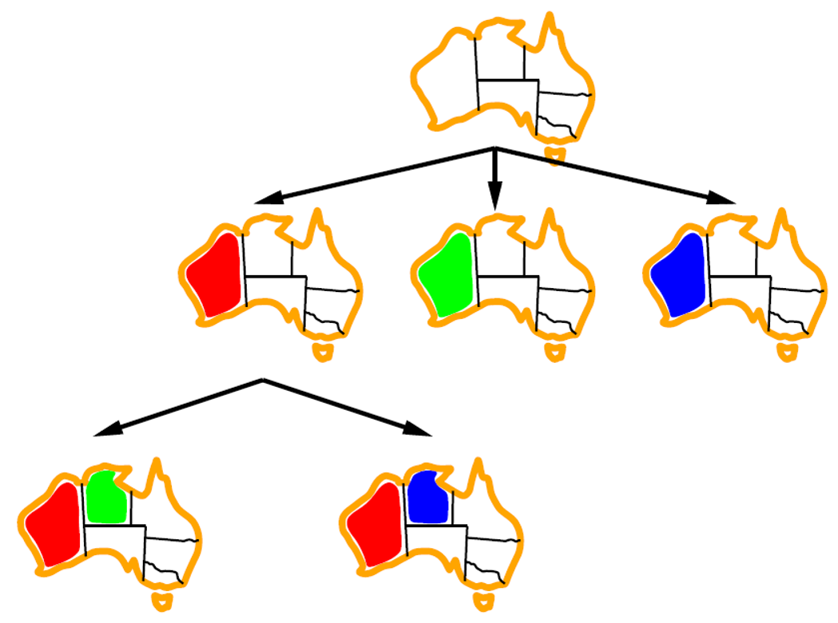
Backtracking Example

Slide 21
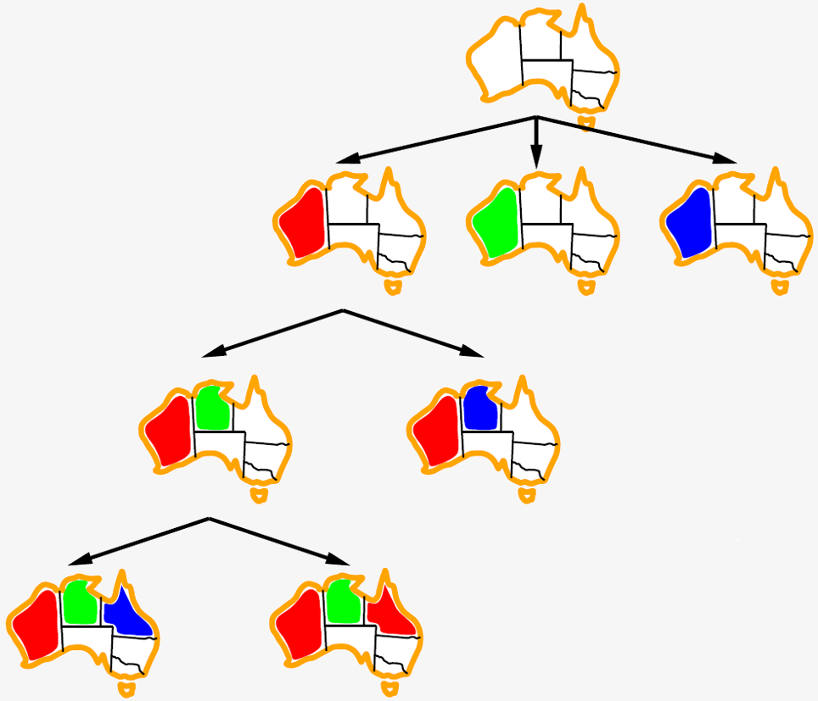
Backtracking Example

Slide 22
Backtracking Example


Slide 23
Improving Backtracking Efficiency
General-purpose methods can give huge gains in speed.
使用General-purpose方法加速
General-purpose methods:
Which variable should be assigned next?
In what order should its values be tried?
Can we detect inevitable failure early?
Can we take advantage of problem structure?

Slide 24

Minimum Remaining Values
var ← Select-Unassigned-Variable(Variables[csp], assignment, csp)
A.k.a. most constrained variable heuristic or “fail-first”
Rule: choose variable with the fewest legal moves(限制少先選)
Which variable shall we try first?

Slide 25

Degree Heuristic
Rule: select variable that is involved in the largest number of constraints on other unassigned variables.(限制多者先選)
Degree heuristic is very useful as a tie breaker.
In what order should its values be tried?

Slide 26
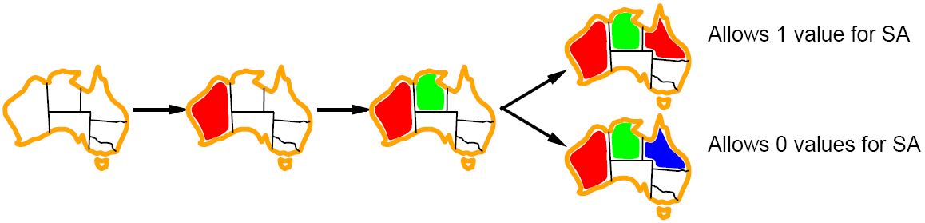
Least Constraining Value
Rule: given a variable choose the least constraining value, i.e. the one that leaves the maximum flexibility for subsequent variable assignments.

Slide 27
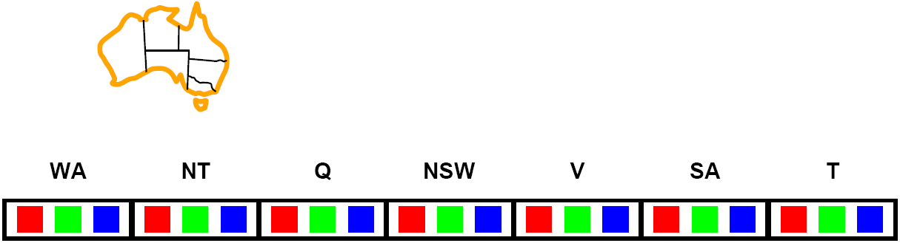
Forward Checking
Can we detect inevitable failure early?
And avoid it later?
Forward checking idea: keep track of remaining legal values for unassigned variables.
Terminate search when any variable has no legal values.

Slide 28
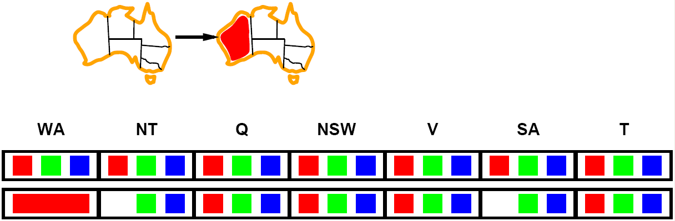
Forward Checking
Assign {WA=red}
Effects on other variables connected by constraints with WA
NT and SA can no longer be red

Slide 29
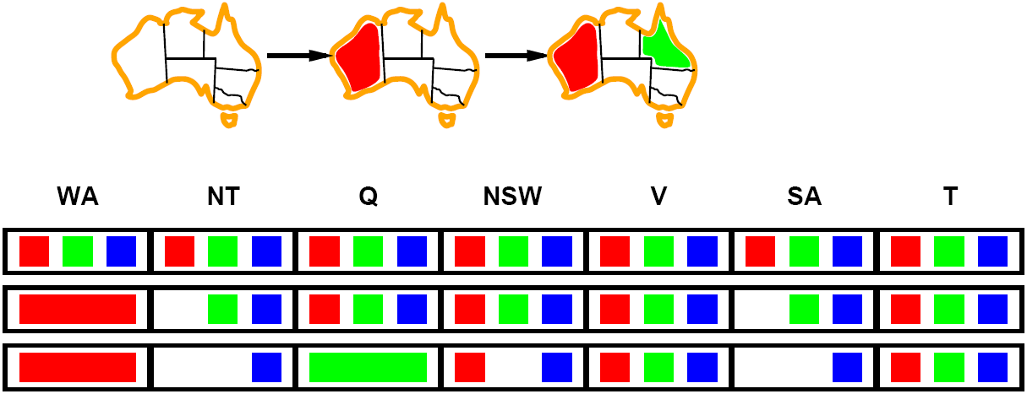
Forward Checking
Assign {Q=green}
Effects on other variables connected by constraints with Q
NT, NSW, and SA can no longer be green
MRV heuristic will automatically select NT and SA next, why?

Slide 30
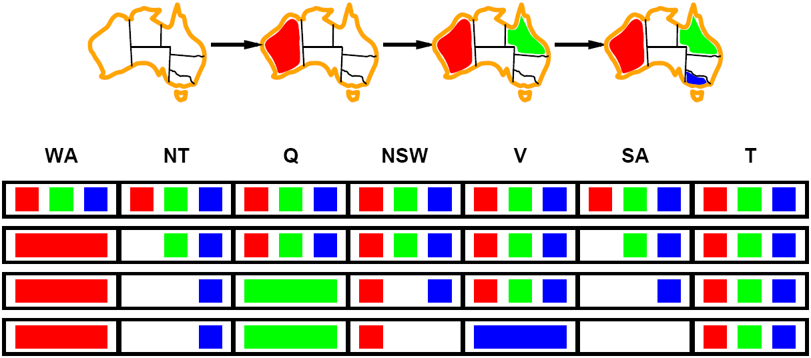
Forward Checking
If V is assigned blue
Effects on other variables connected by constraints with V
SA is empty; NSW can no longer be blue
FC has detected that partial assignment is inconsistent with the constraints and backtracking can occur.

Slide 31
Example: 4-Queens Problem
X1
{1,2,3,4}
X2
{1,2,3,4}
1
2
3
4
1
2
3
4
X3
{1,2,3,4}
X4
{1,2,3,4}
[4-Queens slides copied from B.J. Dorr CMSC 421 course on AI]

Slide 32
Example: 4-Queens Problem
X1
{1,2,3,4}
X2
{1,2,3,4}
1
2
3
4
1
2
3
4
X3
{1,2,3,4}
X4
{1,2,3,4}

Slide 33
Example: 4-Queens Problem
X1
{1,2,3,4}
X2
{ , ,3,4}
1
2
3
4
1
2
3
4
X3
{ ,2, ,4}
X4
{ ,2,3, }

Slide 34
Example: 4-Queens Problem
X1
{1,2,3,4}
X2
{ , ,3,4}
1
2
3
4
1
2
3
4
X3
{ ,2, ,4}
X4
{ ,2,3, }

Slide 35
Example: 4-Queens Problem
X1
{1,2,3,4}
X2
{ , ,3,4}
1
2
3
4
1
2
3
4
X3
{ , , , }
X4
{ ,2,3, }

Slide 36
Example: 4-Queens Problem
X1
{ ,2,3,4}
X2
{1,2,3,4}
1
2
3
4
1
2
3
4
X3
{1,2,3,4}
X4
{1,2,3,4}

Slide 37
Example: 4-Queens Problem
X1
{ ,2,3,4}
X2
{ , , ,4}
1
2
3
4
1
2
3
4
X3
{1, ,3, }
X4
{1, ,3,4}

Slide 38
Example: 4-Queens Problem
X1
{ ,2,3,4}
X2
{ , , ,4}
1
2
3
4
1
2
3
4
X3
{1, ,3, }
X4
{1, ,3,4}

Slide 39
Example: 4-Queens Problem
X1
{ ,2,3,4}
X2
{ , , ,4}
1
2
3
4
1
2
3
4
X3
{1, , , }
X4
{1, ,3, }

Slide 40
Example: 4-Queens Problem
X1
{ ,2,3,4}
X2
{ , , ,4}
1
2
3
4
1
2
3
4
X3
{1, , , }
X4
{1, ,3, }

Slide 41
Example: 4-Queens Problem
X1
{ ,2,3,4}
X2
{ , , ,4}
1
2
3
4
1
2
3
4
X3
{1, , , }
X4
{ , ,3, }

Slide 42
Example: 4-Queens Problem
X1
{ ,2,3,4}
X2
{ , , ,4}
1
2
3
4
1
2
3
4
X3
{1, , , }
X4
{ , ,3, }

Slide 43
Local Search for CSP
Use complete-state representation
For CSPs
allow states with unsatisfied constraints
operators reassign variable values
允許不符合約束的state，透過重新負值解決
Variable selection
Randomly select any conflicted variable
隨機選擇遇到衝突的變數
Value selection: min-conflicts heuristic
Select new value that results in a minimum number of conflicts with the other variables
透過選擇衝突最少的位置做為新的點位

Slide 44
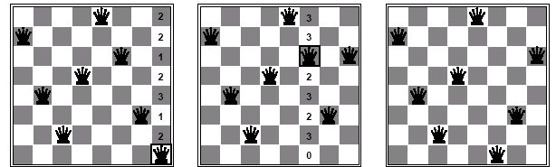
Min-Conflicts Example
At each step, an attacking queen is randomly chosen for reassignment in its column.(隨機選欄)
The algorithm moves the queen to the min-conflict square (breaking ties randomly).
(發生衝突，選衝突最小的點位)

Slide 45
Min-Conflicts Example

Slide 46
Problem Structure
Identifying special kinds of problem structures can greatly improve the efficiency.
E.g. Tasmania is an independent sub-problem.

Slide 47
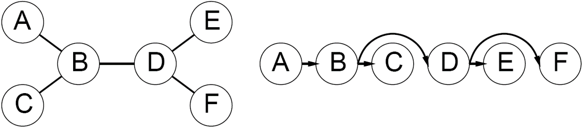
Tree-Structured CSPs
Theorem: if the constraint graph has no loops then CSP can be solved in O(nd²) time
(n個變數)*(只需考慮父節點不重複，可能性為 d²)
Compare to general CSPs, where worst case is O(d^{n})

Slide 48
Nearly Tree-Structured CSPs
Can more general constraint graphs be reduced to trees?
Two approaches:
Remove(拿除) certain nodes
Collapse(合併) certain nodes

Slide 49
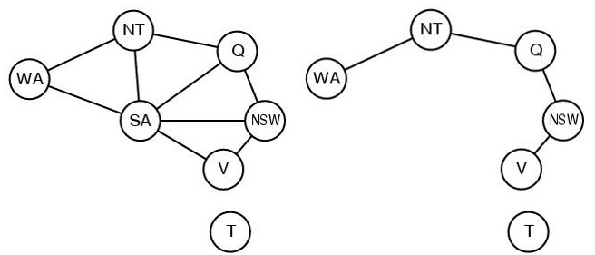
Nearly Tree-Structured CSPs
Cutset conditioning Remove some nodes and the graph becomes a tree.
E.g. cutSet = {SA} for map coloring
Deciding the cut set is NP-hard; worthy when the set is small

Slide 50
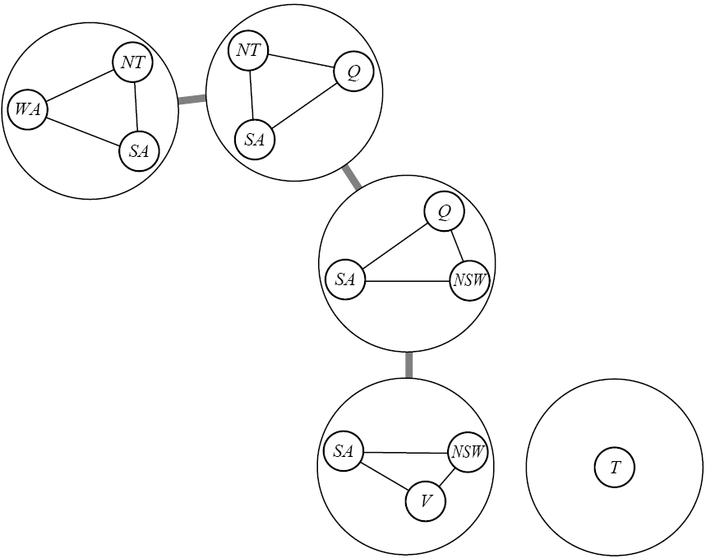
Nearly Tree-Structured CSPs
Tree decomposition of the constraint graph in a set of connected subproblems.
Each subproblem is solved independently
Resulting solutions are combined.
Necessary requirements:
Every variable appears in at least one of the subproblems.
：所有點都要出現在子問題中
If two variables are connected in the original problem, they must appear together in at least one subproblem.
：有連接的兩變數至少出現於一子問題
If a variable appears in two subproblems, it must appear in each node on the path.
：出現在兩子問題中的相同變數，須保證在兩子問題間路徑都出現過

Slide 51
Summary
CSPs are a special kind of problem: states defined by values of a fixed set of variables, goal test defined by constraints on variable values
狀態是由一組變數的值所定義，目標測試由限制條件定義
Backtracking = depth-first search with one variable assigned per node
Backtracking為將一變數分配一值，並做DFS
Variable ordering and value selection heuristics help significantly
用聰明的「變數排序」與「值選擇」策略，能大幅提高效率
Forward checking prevents assignments that lead to failure.
前向檢查（forward checking）是避免走向死路的一種技術

Slide 52
Summary
The CSP representation allows analysis of problem structure.
CSP 的表達方式讓我們可以「分析問題的結構」
Tree structured CSPs can be solved in linear time.
樹狀結構的 CSP 可以在「線性時間」內解決
Iterative min-conflicts is usually effective in practice.
反覆的「最少衝突策略」通常在實務中很有效

