Slide 1
Adversarial Search
Chapter 6
Some Slides are Adapted from Tom Lenaerts’ lecture notes

Slide 2
Outline
What are games?
Optimal decisions in games
Which strategy leads to success?
α-β pruning
Games of imperfect information
Games that include an element of chance

Slide 3
What and Why Study Games?
Games are a form of multi-agent environment
What do other agents do and how do they affect our success?
Cooperative vs. competitive multi-agent environments.
Competitive multi-agent environments give rise to adversarial problems a.k.a. games
Why study games?
Fun; historically entertaining
Interesting subject of study because they are hard
Easy to represent and agents restricted to small number of actions

Slide 4
Relation of Games to Search
Search – no adversary
Solution is (heuristic) method for finding goal
Heuristics and CSP techniques can find optimal solution
Evaluation function: estimate of cost from start to goal through given node
Examples: path planning, scheduling activities
Games – adversary
Solution is strategy (strategy specifies move for every possible opponent reply).
Time limits force an approximate solution
Evaluation function: evaluate “goodness” of game position
Examples: chess, checkers, Othello, backgammon

Slide 5
Types of Games
 | Deterministic | Chance
Perfect information | chess, checkers, go, othello | backgammon, monopoly
Imperfect information |  | bridge, poker, scrabble, nuclear war

Slide 6
Game Setup
Two players: MAX and MIN
MAX moves first and they take turns until the game is over. Winner gets award, loser gets penalty.
Games as search:
Initial state: e.g. board configuration of chess
Successor function: list of (move,state) pairs specifying legal moves.
Terminal test: Is the game finished?
Utility function: Gives numerical value of terminal states. E.g. win (+1), lose (-1) and draw (0)
MAX uses search tree to determine next move.

Slide 7
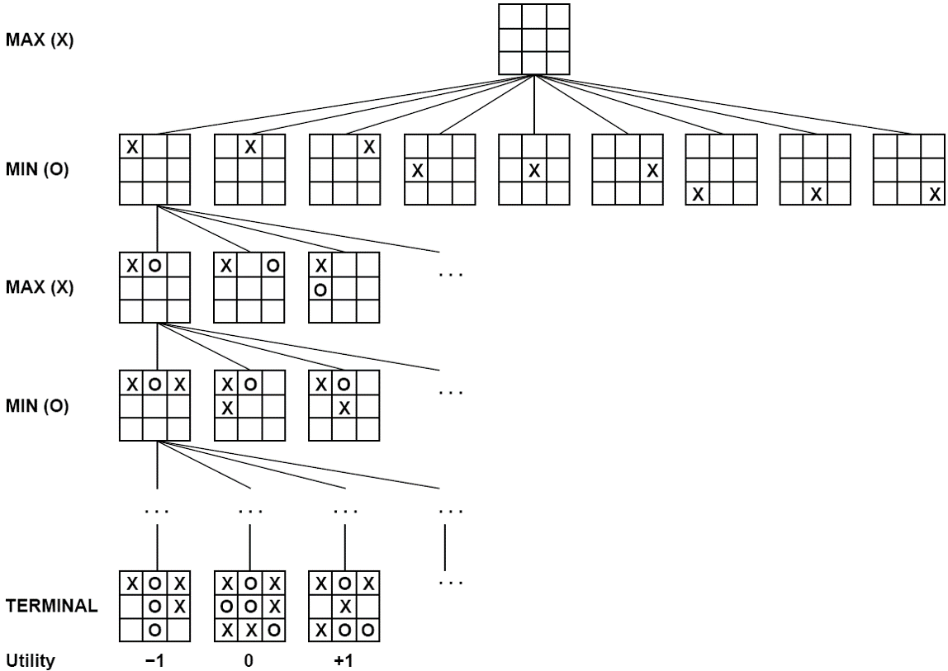
Partial Game Tree for Tic-Tac-Toe

Slide 8
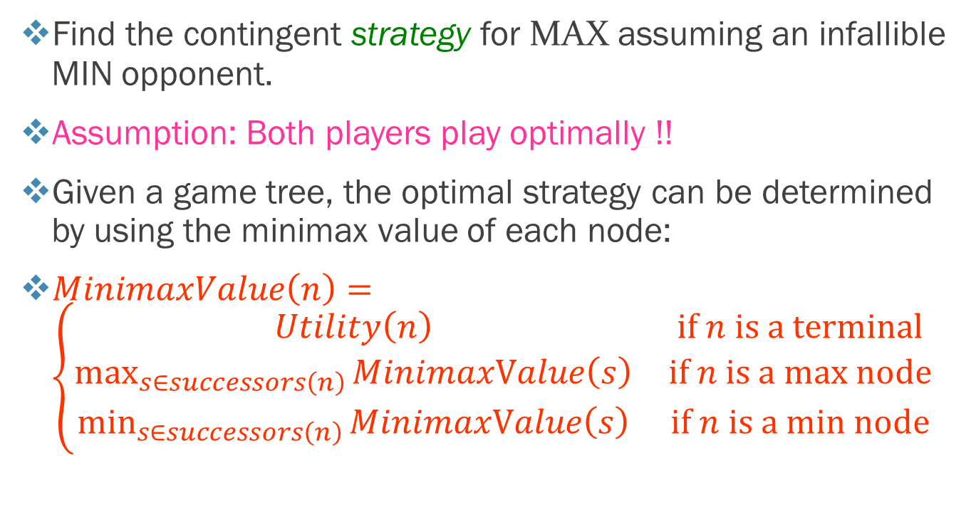
Optimal Strategies
Find the contingent strategy for MAX assuming an infallible MIN opponent.
Assumption: Both players play optimally !!
Given a game tree, the optimal strategy can be determined by using the minimax value of each node:
$MinimaxValue\left(n\right)=\left\{\begin{matrix}Utility\left(n\right) & \text{if} n is a terminal \\ \max_{s∈successors\left(n\right)}{MinimaxValue\left(s\right)} & \text{if} n is a \text{max} \text{node} \\ \min_{s∈successors\left(n\right)}{MinimaxValue\left(s\right)} & \text{if} n is a \text{m}\text{in} \text{node}\end{matrix}\right.$

Slide 9
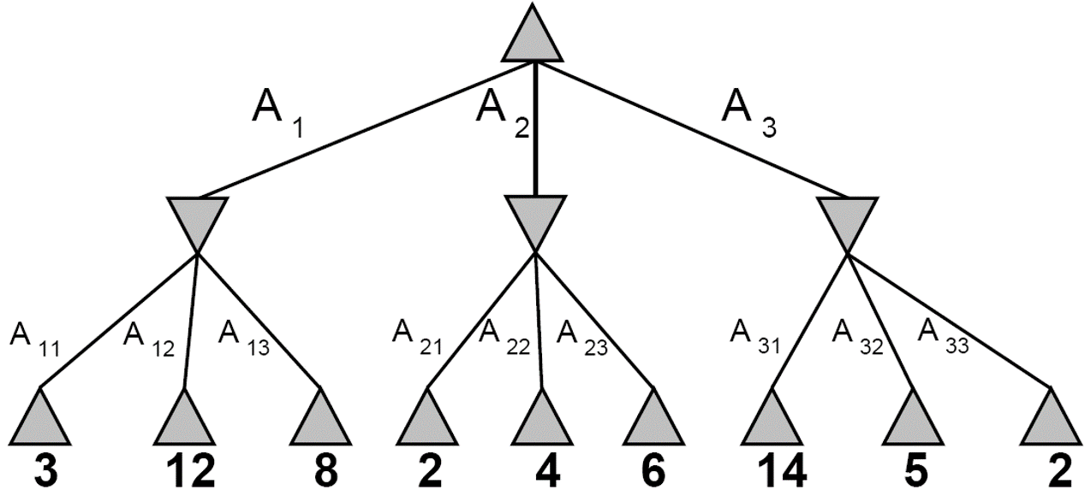


Two-Ply Game Tree
The minimax decision
MAX
MIN
Minimax maximizes the worst-case outcome for max.

Slide 10
What if MIN does not play optimally?
Definition of optimal play for MAX assumes MIN plays optimally: maximizes worst-case outcome for MAX.
在假設對手給出最糟的情況下選擇最佳解
But if MIN does not play optimally, MAX will do even better. [Can be proved.]

Slide 11
Minimax Algorithm
function Minimax-Decision(state) returns an action
inputs: state, current state in game
v ← Max-Value(state)
return the action in Successors(state) with value v
function MAX-VALUE(state) returns a utility value
if TERMINAL-TEST(state) then return UTILITY(state)
v ← -∞
for a,s in SUCCESSORS(state) do
v ← MAX(v, MIN-VALUE(s))
return v
function MIN-VALUE(state) returns a utility value
if TERMINAL-TEST(state) then return UTILITY(state)
v ← ∞
for a,s in SUCCESSORS(state) do
v ← MIN(v, MAX-VALUE(s))
return v

Slide 12
Properties of Minimax
Complete?
Optimal?
Time complexity?
Space complexity?

Slide 13
Properties of Minimax
Complete? Yes (if tree is finite)
Optimal?
Time complexity?
Space complexity?

Slide 14
Properties of Minimax
Complete? Yes (if tree is finite)
Optimal? Yes (against an optimal opponent)
Time complexity?
Space complexity?

Slide 15
Properties of Minimax
Complete? Yes (if tree is finite)
Optimal? Yes (against an optimal opponent)
Time complexity? O(b^{m})
Space complexity?

Slide 16
Properties of Minimax
Complete? Yes (if tree is finite)
Optimal? Yes (against an optimal opponent)
Time complexity? O(b^{m})
Space complexity? O(bm) (depth-first exploration)
For chess, b ≈ 35, m ≈100 for “reasonable” games → exact solution completely infeasible

Slide 17
Complexity of Games
Game | State-space complexity | Game-tree complexity
Go (19 × 19) 圍棋 | 10¹⁷² | 10³⁶⁰
Shogi 將棋 | 10⁷¹ | 10²²⁶
Connect6 六子棋 | 10¹⁷² | 10¹⁴⁰ ~ 10¹⁸⁸
Chinese chess 象棋 | 10⁴⁸ | 10¹⁵⁰
Chess 西洋棋 | 10⁴⁶ | 10¹²³
Hex (11 × 11) | 10⁵⁷ | 10⁹⁸
Go-Moku (15 × 15) 五子棋 | 10¹⁰⁵ | 10⁷⁰
Othello 黑白棋 | 10²⁸ | 10⁵⁸
Qubic | 10³⁰ | 10³⁴
Checkers 西洋跳棋 | 10²¹ | 10³¹
Connect-Four 四子棋 | 10¹⁴ | 10²¹

Slide 18
Multiplayer Games
Games allow more than two players
Single minimax values become vectors
To move
A
(1,2,6)
B
(1,2,6)
(-1,5,2)
C
(1,2,6)
X
(6,1,2)
(-1,5,2)
(5,4,5)
A
(1,2,6)
(4,2,3)
(6,1,2)
(7,4,-1)
(5,-1,-1)
(-1,5,2)
(7,7,-1)
(5,4,5)

Slide 19
Problem of Minimax Search
Number of games states is exponential to the number of moves.
Solution: Do not examine every node
 Alpha-beta pruning
α= value of best choice found so far at any choice point along the MAX path(選擇最高值)
β= value of best choice found so far at any choice point along the MIN path(選擇最低值)
Revisit example …

Slide 20
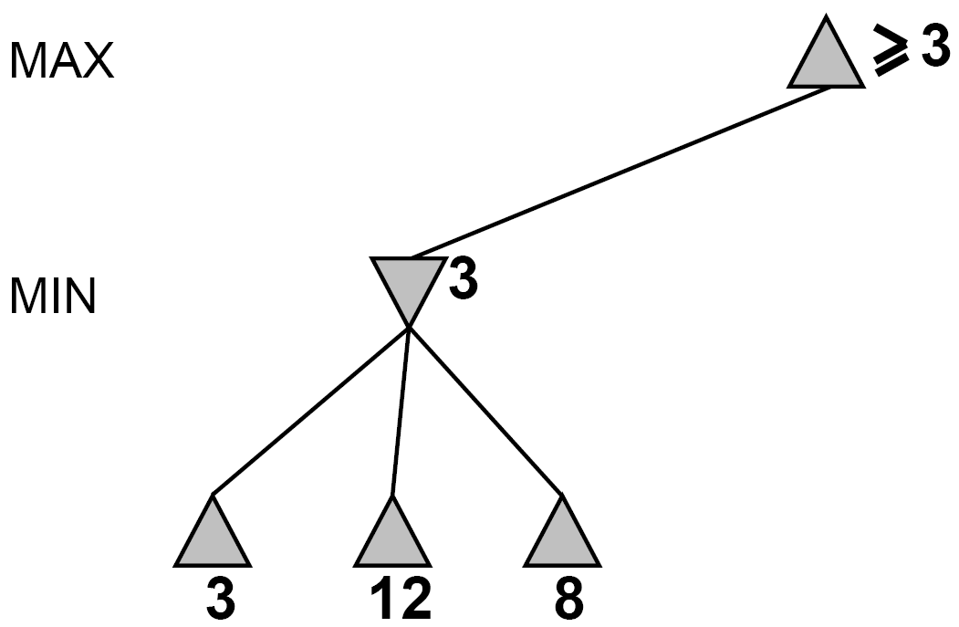
Alpha-Beta Pruning
Range of possible values [α,β]
[-∞,+∞]
≥3
[3,+∞]
[-∞, +∞]
≤3
[-∞, 3]
Do DF-search until first leaf
3
12
8

Slide 21
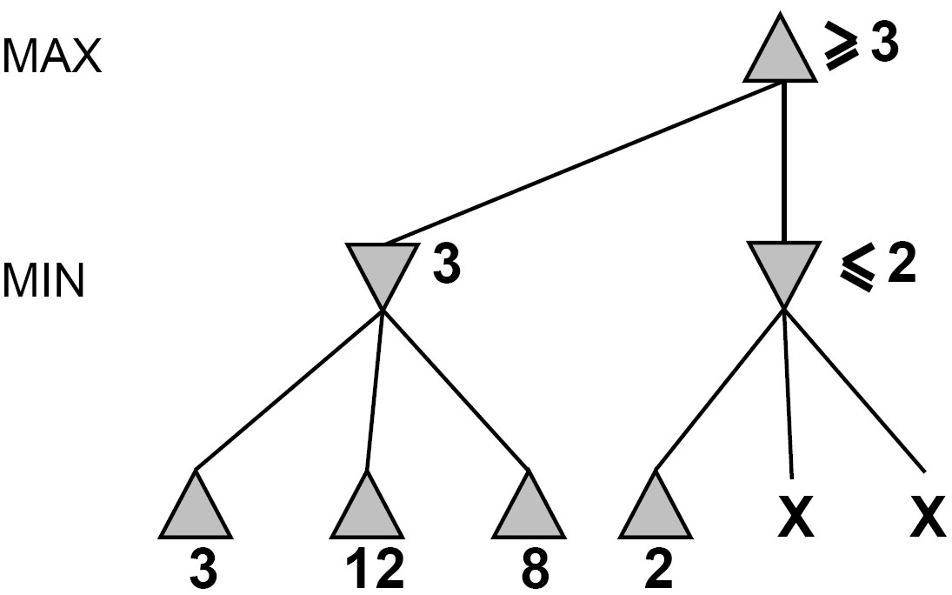
Alpha-Beta Pruning (continued)
[3,+∞]
≥3
[3,2]
≤2
[-∞, 3]
[3,+∞]
This node is worse for MAX
X
X
3
12
8
2

Slide 22
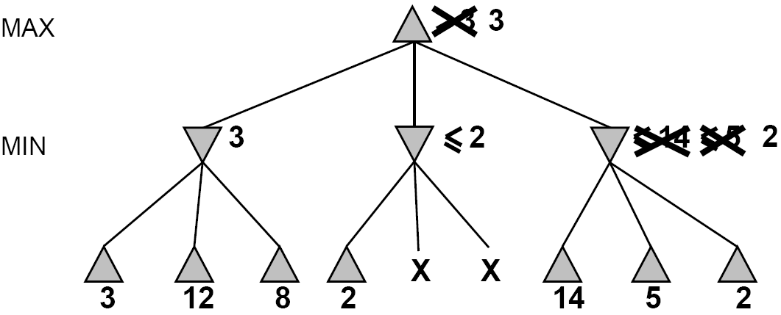
Alpha-Beta Pruning (continued)
[3, +∞]
≥3
worse for MAX
[3, +∞]
[-∞, 3]
[-∞,2]
[3,5]
[3,2]
≤14
≤5
[3,14]
≤2
X
X
3
12
8
2
14
5
2

Slide 23
Alpha-Beta Search Algorithm
function Alpha-Beta-Search(state) returns an action
inputs: state, current state in game
v ← Max-Value(state, −∞, +∞)
return the action in Successors(state) with value v
function Max-Value(state, α, β) returns a utility value
if Terminal-Test(state) then return Utility(state)
v ← -∞
for a,s in Successors(state) do
v ← Max(v, Min-Value(s, α, β))
if v ≥ β then return v
α ← Max(α, v)
return v

Slide 24
Alpha-Beta Search Algorithm
function Max-Value(state, α, β) returns a utility value
if Terminal-Test(state) then return Utility(state)
v ← -∞
for a,s in Successors(state) do
v ← Max(v, Min-Value(s, α, β))
if v ≥ β then return v
α ← Max(α, v)
return v
function Min-Value(state, α, β) returns a utility value
if Terminal-Test(state) then return Utility(state)
v ← +∞
for a,s in Successors(state) do
v ← Min(v, Max-Value(s, α, β))
if v ≤ α then return v
β ← Min(β, v)
return v

Slide 25
Alpha-Beta (Deep) Pruning
MAX
MIN
MAX
MIN
MAX
[30,+∞]
[-∞, 30]
[30,+∞]
[30,+∞]
30
55
[30,+∞]
[30,10]
This node is worse for MAX
The other children will be pruned
10
??
??

Slide 26
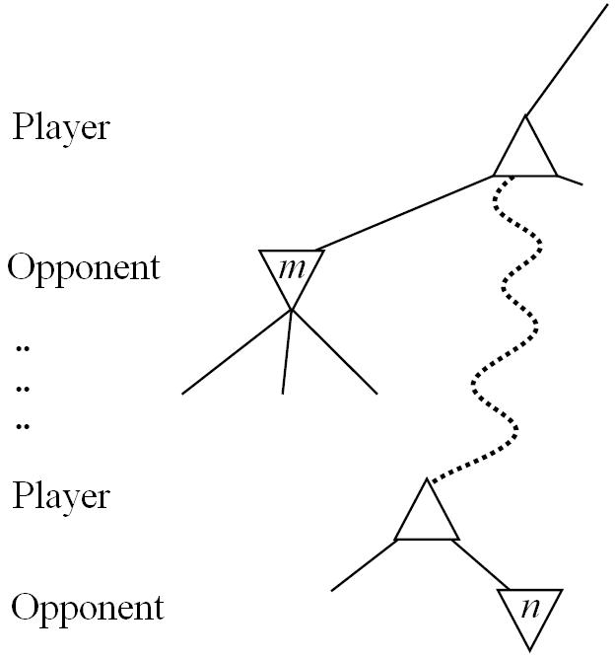
General Alpha-Beta Pruning
Consider a node n somewhere in the tree
If player has a better choice (e.g. node m) at
Parent node of n
Or any choice point further up
n will never be reached in actual play.
Hence when enough is known about n, it can be pruned.

Slide 27
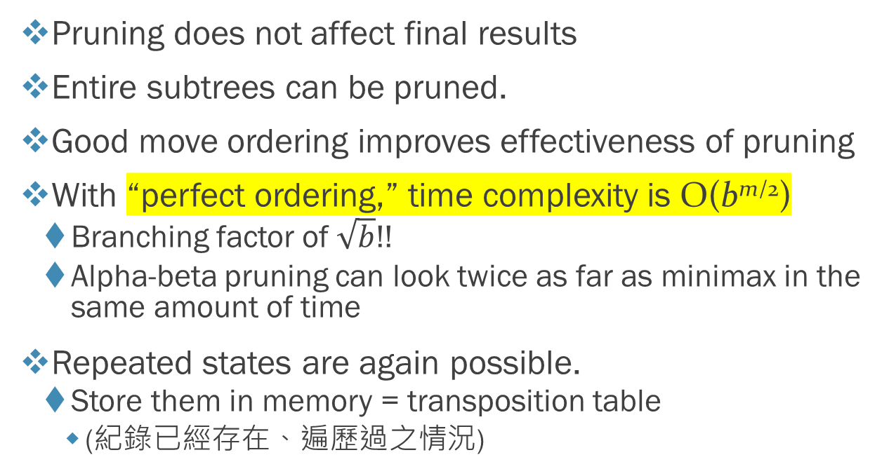
Final Comments about α-β Pruning
Pruning does not affect final results
Entire subtrees can be pruned.
Good move ordering improves effectiveness of pruning
With “perfect ordering,” time complexity is O(b^{m/2})
Branching factor of $\sqrt{b}$!!
Alpha-beta pruning can look twice as far as minimax in the same amount of time
Repeated states are again possible.
Store them in memory = transposition table
(紀錄已經存在、遍歷過之情況)

Slide 28
Games of Imperfect Information
Minimax and alpha-beta pruning require too much leaf-node evaluations.
May be impractical within a reasonable amount of time.
SHANNON (1950):
Cut off search earlier (replace TERMINAL-TEST by CUTOFF-TEST)
Apply heuristic evaluation function EVAL (replacing utility function of alpha-beta)

Slide 29
Cutting-off Search
Change: if Terminal-Test(state) then return Utility(state) Into if Cutoff-Test(state, depth) then return Eval(state)
Introduces a fixed-depth limit depth(限制樹高)
Is selected so that the amount of time will not exceed what the rules of the game allow.
When cutoff occurs, the evaluation is performed.

Slide 30
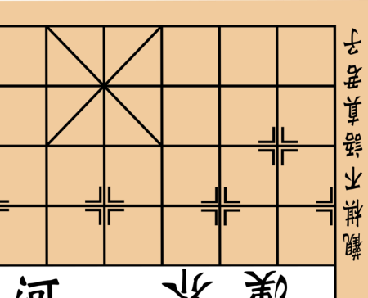




Cutting-off Search
70
100
-40

Slide 31
Heuristic EVAL
Idea: produce an estimate of the expected utility of the game from a given position.
Performance depends on quality of EVAL.
Requirements:
EVAL should order terminal-nodes in the same way as UTILITY.
Computation may not take too long.
For non-terminal states the EVAL should be strongly correlated with the actual chance of winning.
Only useful for quiescent (no wild swings in value in near future) states(只在平穩狀態下有用)

Slide 32
Heuristic EVAL example
♜ | ♞ | ♝ | ♛ | ♚ | ♝ | ♞ | ♜
♟ | ♟ | ♟ | ♟ | ♟ | ♟ | ♟ | ♟
♙ | ♙ | ♙ | ♙ | ♙ | ♙ | ♙ | ♙
♖ | ♘ | ♗ | ♕ | ♔ | ♗ | ♘ | ♖
♜ |  |  | ♛ | ♚ | ♝ |  | ♜
 |  | ♟ |  | ♞ | ♟ | ♟ | ♟
♟ | ♟ | ♞ | ♟
 |  |  | ♙ | ♟
 |  | ♙ |  | ♙
 |  | ♘ |  |  | ♗
♙ | ♙ |  |  |  | ♙ | ♙ | ♙
♖ |  | ♗ | ♕ |  | ♖ | ♔
♝
♘
(a) White to move; Fairly even
(b) Black to move; White slightly better

Slide 33
Heuristic EVAL example
♜ |  | ♝ |  | ♚ |  | ♞ | ♜
♟ | ♟ | ♟ |  |  | ♟ | ♟ | ♟
 |  |  | ♟
 |  |  |  | ♟
 |  | ♗ | ♞ | ♙
 |  | ♘
♙ | ♙ | ♙ |  |  | ♙ | ♛ | ♙
♖ |  |  | ♕ | ♔ |  |  | ♖
 |  |  |  |  |  | ♚
♟ | ♛ |  |  |  | ♞ | ♜
 | ♟ | ♘ | ♕ |  | ♟ | ♟
 | ♙ | ♟
♙ | ♝ | ♙ |  |  | ♙ | ♗
 | ♘ |  |  | ♖ | ♔ | ♙
♝♜
♞♟
♟♟
♝
♙♙
♙♗
♖
♘♙
♙♗
(c) White to move; Black winning
(d) Black to move; White about to lose

Slide 34
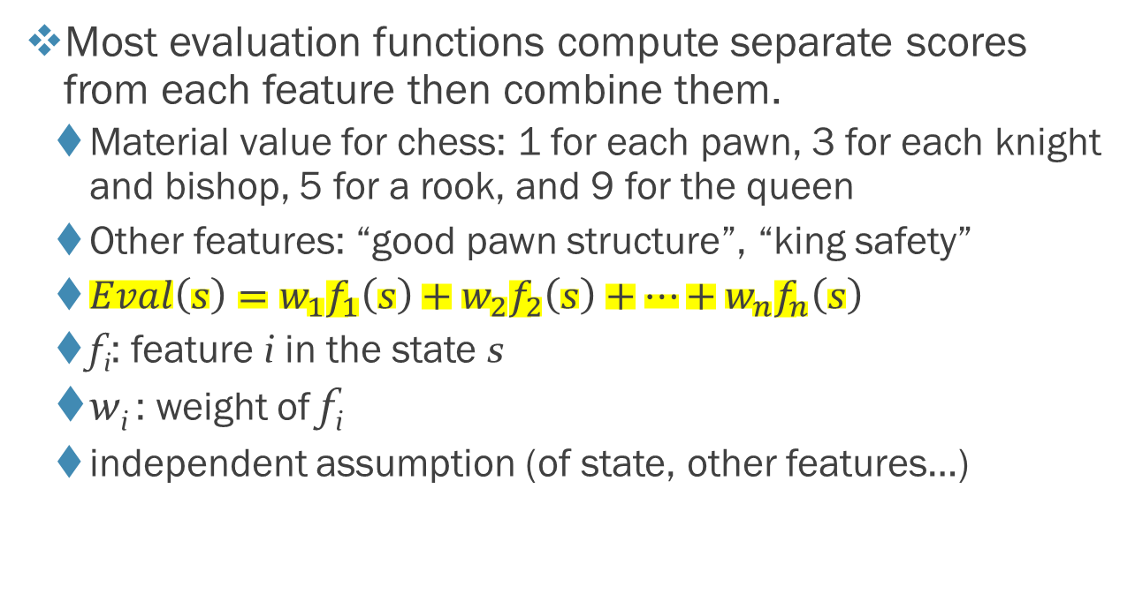
Heuristic EVAL Function
Most evaluation functions compute separate scores from each feature then combine them.
Material value for chess: 1 for each pawn, 3 for each knight and bishop, 5 for a rook, and 9 for the queen
Other features: “good pawn structure”, “king safety”
$Eval\left(s\right)=w_{1}f_{1}\left(s\right)+w_{2}f_{2}\left(s\right)+⋯+w_{n}f_{n}\left(s\right)$
f_{i}: feature i in the state s
w_{i} : weight of f_{i}
independent assumption (of state, other features…)

Slide 35
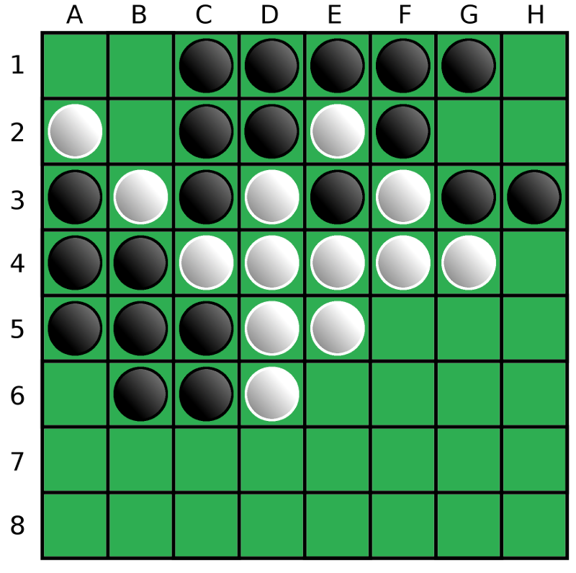
Heuristics for Othello
 | A | B | C | D | E | F | G | H
1 | 100 | -20 | 10 | 5 | 5 | 10 | -20 | 100
2 | -20 | -50 | -2 | -2 | -2 | -2 | -50 | -20
3 | 10 | -2 | -1 | -1 | -1 | -1 | -2 | 10
4 | 5 | -2 | -1 | -1 | -1 | -1 | -2 | 5
5 | 5 | -2 | -1 | -1 | -1 | -1 | -2 | 5
6 | 10 | -2 | -1 | -1 | -1 | -1 | -2 | 10
7 | -20 | -50 | -2 | -2 | -2 | -2 | -50 | -20
8 | 100 | -20 | 10 | 5 | 5 | 10 | -20 | 100
(From: http://play-othello.appspot.com/files/Othello.pdf )

Slide 36
Heuristic Difficulties
Heuristic counts pieces won, but the second try to take the queen.
♜ |  | ♝ |  | ♚ |  | ♞ | ♜
♟ | ♟ | ♟ |  |  | ♟ | ♟ | ♟
 |  |  | ♟
 |  |  |  | ♟
 |  | ♗ | ♞ | ♙
 |  | ♘
♙ | ♙ | ♙ |  |  | ♙ | ♛ | ♙
♖ |  |  | ♕ | ♔ |  |  | ♖
♜ |  | ♝ |  | ♚ |  | ♞ | ♜
♟ | ♟ | ♟ |  |  | ♟ | ♟ | ♟
 |  |  | ♟
 |  |  |  | ♟
 |  | ♗ | ♞ | ♙
 |  | ♘
♙ | ♙ | ♙ |  |  | ♙ | ♛ | ♙
♖ |  |  | ♕ | ♔ |  | ♖ | 
♝
♝
♘♙
♙♗
♘♙
♙♗
White to move
White to move

Slide 37
Monte-Carlo EVAL Function
For each possible next move:
Randomly walk through next N steps and estimate the score of winning
隨機走n步後評估贏的機率
If possible, walk until the end of the game to see the winner
如果走的到終點，評估輸贏
Repeat K times and average the scores
走K次取平均
 |  |  |  |  |  | ♚
♟ | ♛ |  |  |  | ♞ | ♜
 | ♟ | ♘ | ♕ |  | ♟ | ♟
 | ♙ | ♟
♙ | ♝ | ♙ |  |  | ♙ | ♗
 | ♘ |  |  | ♖ | ♔ | ♙

Slide 38
Horizon Effect
Caused when searching depth is not enough
深度不夠會發生地平線效應
(In this example; black to move)
Suggested move: Move the pawn to attack the king in order to keep the bishop
Better move: Exchange the bishop with a pawn but later attack by the row of pawns
 |  |  |  |  |  | ♚
 |  |  |  |  |  | ♟
 |  |  |  |  | ♟
 | ♟ |  |  | ♟
 | ♙
♝ |  | ♙ | ♔ |  |  |  | ♖

Slide 39
Horizon Effect - Example
What will the computer do if it thinks with
1 ply depth
2 ply depth
3 ply depth
4 ply depth
Solution: Quiescence Search
Expand a horizon node until no pieces can be captured
 |  |  |  |  |  |  | ♚
♜
♜
♟ |  | ♖ | ♖
 |  |  |  |  |  | ♔
(From: http://mediocrechess.blogspot.com/2006/12/guide-quiescent-search-and-horizon.html )

Slide 40

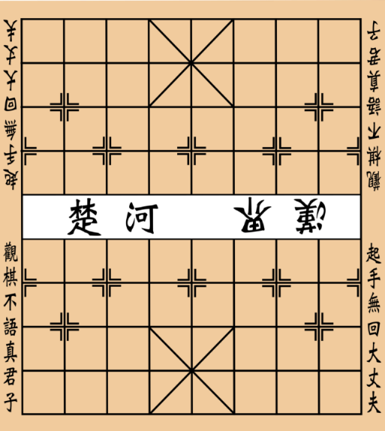

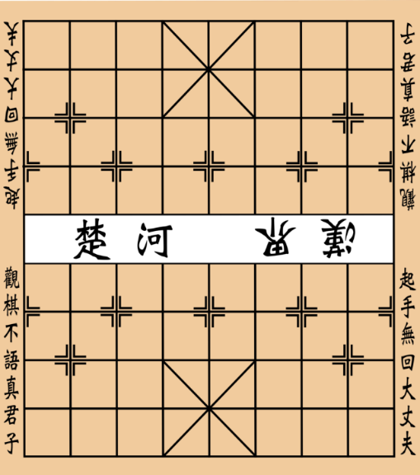








Fun Facts about Chinese Chess
Different strategies during different time
開局 (opening)
中局 (middle game)
殘局 (endgame)
Opening book
(Experts’ knowledge)
Alpha-beta search
Monte-Carlo tree search
Retrograde analysis
Endgame Database

Slide 41
Fun Facts about Chinese Chess
Evaluation function
Weights of pieces
將 (2000)、士 (40)、 象 (40)、車 (200)、 馬 (90)、包 (90)、 卒 (10)
Position
Heuristic scores for 車

Slide 42
However…
Expert
Computer

Slide 43
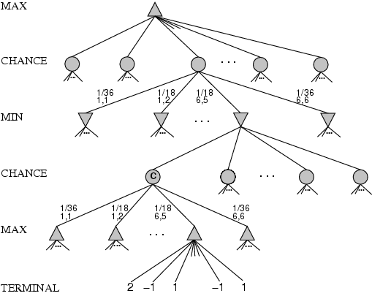
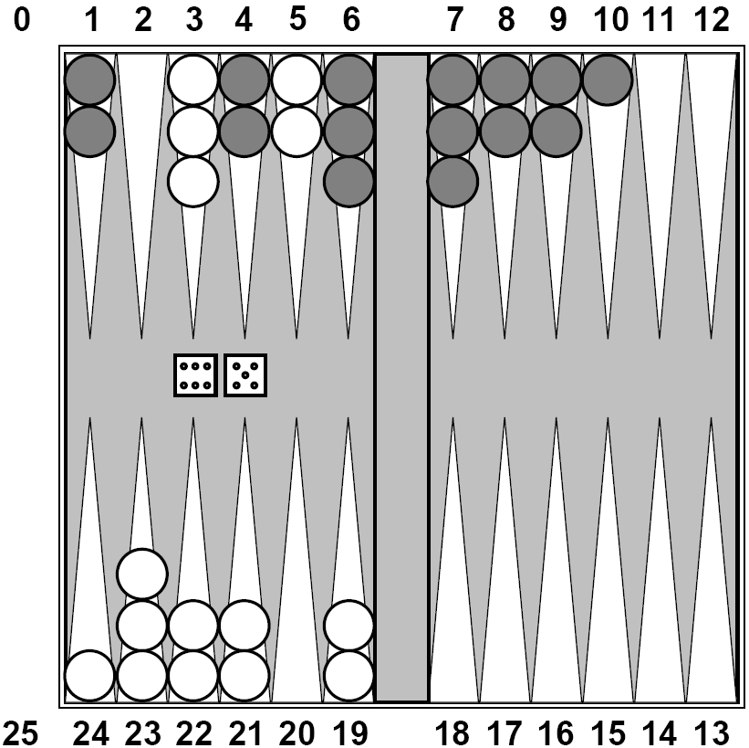
Games that Include Chance 西洋雙陸棋
chance nodes
Possible moves (5-10,5-11), (5-11,19-24),(5-10,10-16) and (5-11,11-16)

Slide 44
Games that Include Chance
chance nodes
[1,1], [6,6] chance 1/36, all other chance 1/18
Can not calculate definite minimax value, only expected value
跟機率有關不能取最大最小值，要求期望值

Slide 45
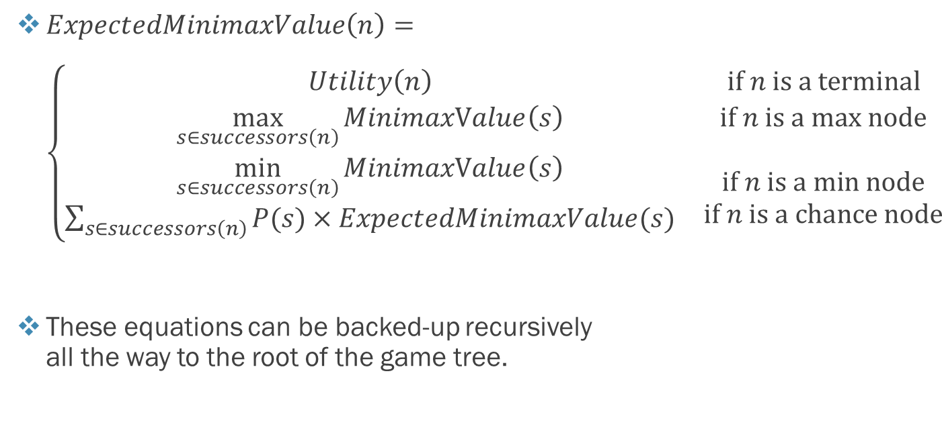
Expected Minimax Value
$ExpectedMinimaxValue\left(n\right)=\left\{\begin{matrix}Utility\left(n\right) & \text{if} n is a terminal \\ \max_{s∈successors\left(n\right)}{MinimaxValue\left(s\right)} & \text{if} n is a \text{max} \text{node} \\ \begin{matrix}\min_{s∈successors\left(n\right)}{MinimaxValue\left(s\right)} \\ \sum_{s∈successors\left(n\right)}{P(s)×ExpectedMinimaxValue(s)}\end{matrix} & \begin{matrix}\text{if} n is a \text{m}\text{in} \text{node} \\ \text{if} n is a \text{chance} \text{node}\end{matrix}\end{matrix}\right.$
These equations can be backed-up recursively all the way to the root of the game tree.

Slide 46
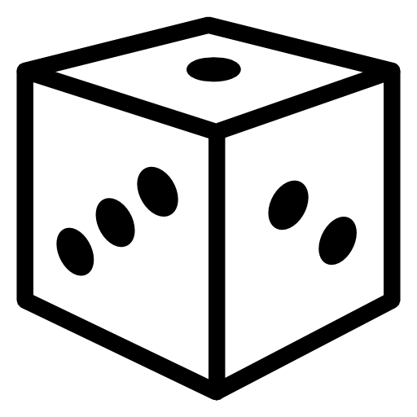
Games that Include Chance
Consider a simple game:
Two players are picking n (e.g. 4) stones💎 in turns.
In each turn, one player gets a number k ∈ [1, 2, 3] by rolling a dice . This player can pick p ∈ [1, k] stones.
The player who picks the last stone loses the game.

Slide 47
Games that Include Chance
MAX
-⅓
4💎,⚁
p=1
p=2
Chance (min)
-⅓
3💎
-1
2💎
⚀
⚁
⚂
⚀
⚁
⚂
MIN
+1
-1
-1
-1
-1
-1
p=1
p=1
p=2
p=1
p=2
p=3
p=1
p=1
p=2
p=1
p=2
Chance (max)
+1
2💎
+1
2💎
💎
+1
2💎
💎
Ø
💎
💎
Ø
💎
Ø
-1
-1
+1
-1
-1
+1
-1
+1
⚀
⚁
⚂
MAX
+1
+1
+1
p=1
p=1
p=2
p=1
p=2
💎
💎
Ø
💎
Ø
+1
+1
-1
+1
-1

Slide 49
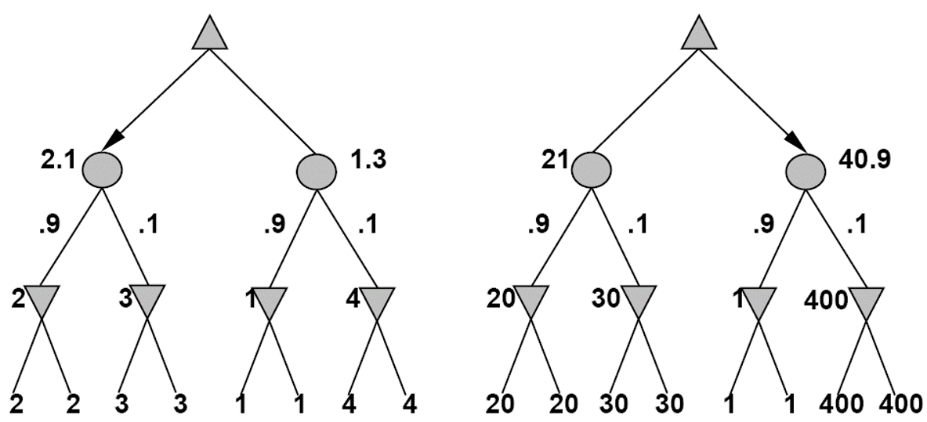
Position Evaluation with Chance Nodes
MAX
DICE
MIN
Outcome of evaluation function may not change when values are scaled differently.
Behavior is preserved only by a positive linear transformation of EVAL.

Slide 50
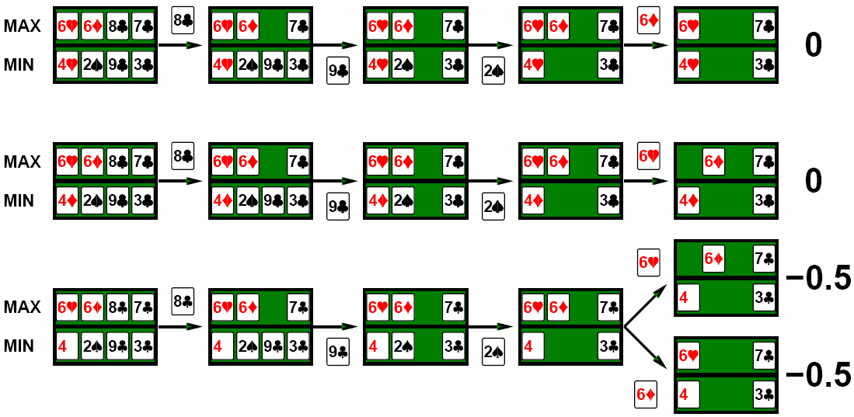
Card Games
Idea: choose the action with highest expected value over all deals.

Slide 51
Commonsense
Day1
Road A leads to a small heap of gold pieces
Road B leads to a fork:
take the left fork and you'll find a mound of jewels;
take the right fork and you'll be run over by a bus.
Road A leads to a small heap of gold pieces
Road B leads to a fork:
take the left fork and you'll be run over by a bus;
take the right fork and you'll find a mound of jewels.
Road A leads to a small heap of gold pieces
Road B leads to a fork:
guess correctly and you'll find a mound of jewels;
guess incorrectly and you'll be run over by a bus.
😐 What to do in Day3?
Day2
Day3

Slide 52
Proper Analysis
Intuition that the value of an action is the average of its values in all actual states is WRONG
One should collect more information during the game.

Slide 53
Summary
Games are fun (and dangerous)
They illustrate several important points about AI
Perfection is unattainable -> approximation
Good idea to think about what to think about
Uncertainty constrains the assignment of values to states
Games are to AI as grand prix racing is to automobile design.

