Slide 1
Website
html
js
Make request for data to visualize
REST Server
Util
View
Resources
Model
Logic
papers.json
Make request for data

Slide 2
Website
REST Server
Resouces
Get raw data
parsePaper()
loop
GET request
executeCommand()
JSON representation

Slide 3
Logic
TopCommand
Command
JsonFileParser
TrendCommand
CommandParser
FileParser
…
Controller
FileParserManager
UserInterface
Model
Paper
HttpUI
ModelManager
Author
View
Model

Slide 4
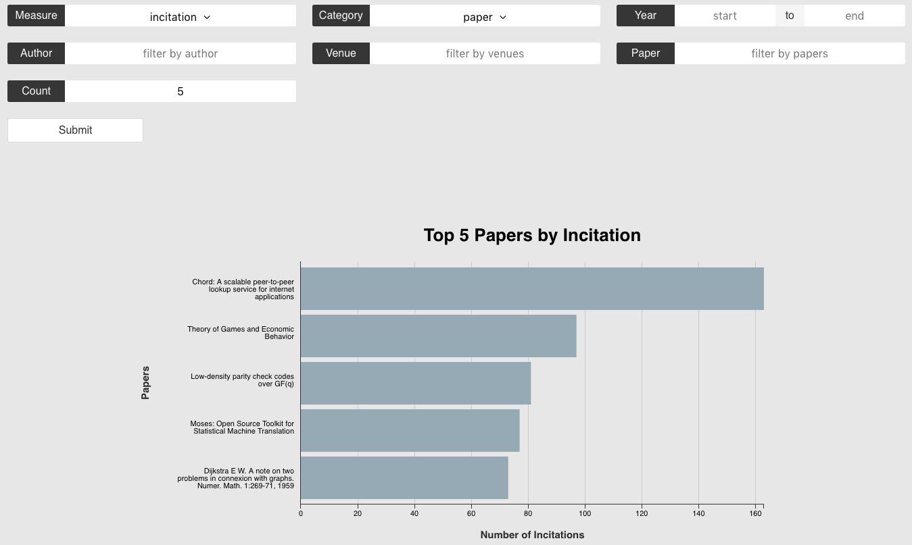
Sum data using
Categorize data using
Period of data (Optional)
Possible filters
(Optional)
Number of items
to display

Slide 5
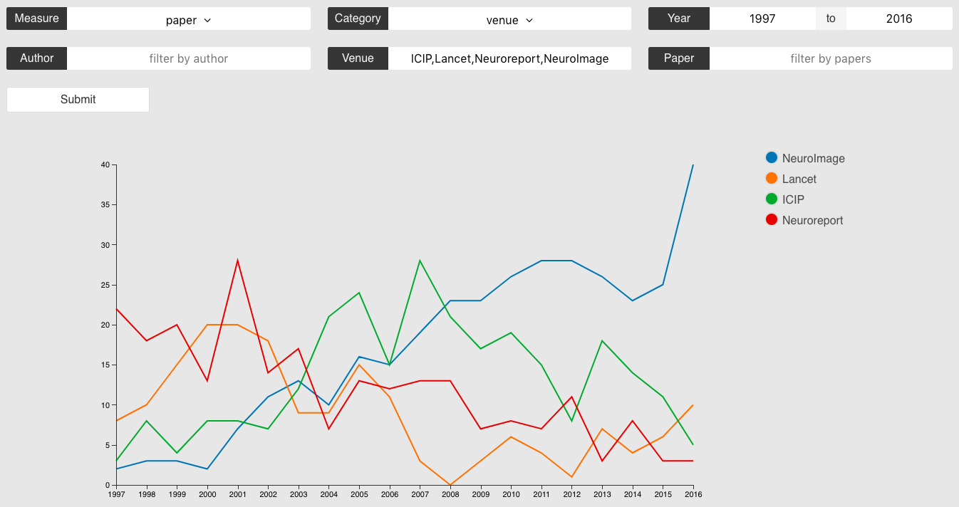
Sum data using
Categorize data using
Period of data (Optional)
Possible filters
(Optional)
Toggle the
line visibility

Slide 6
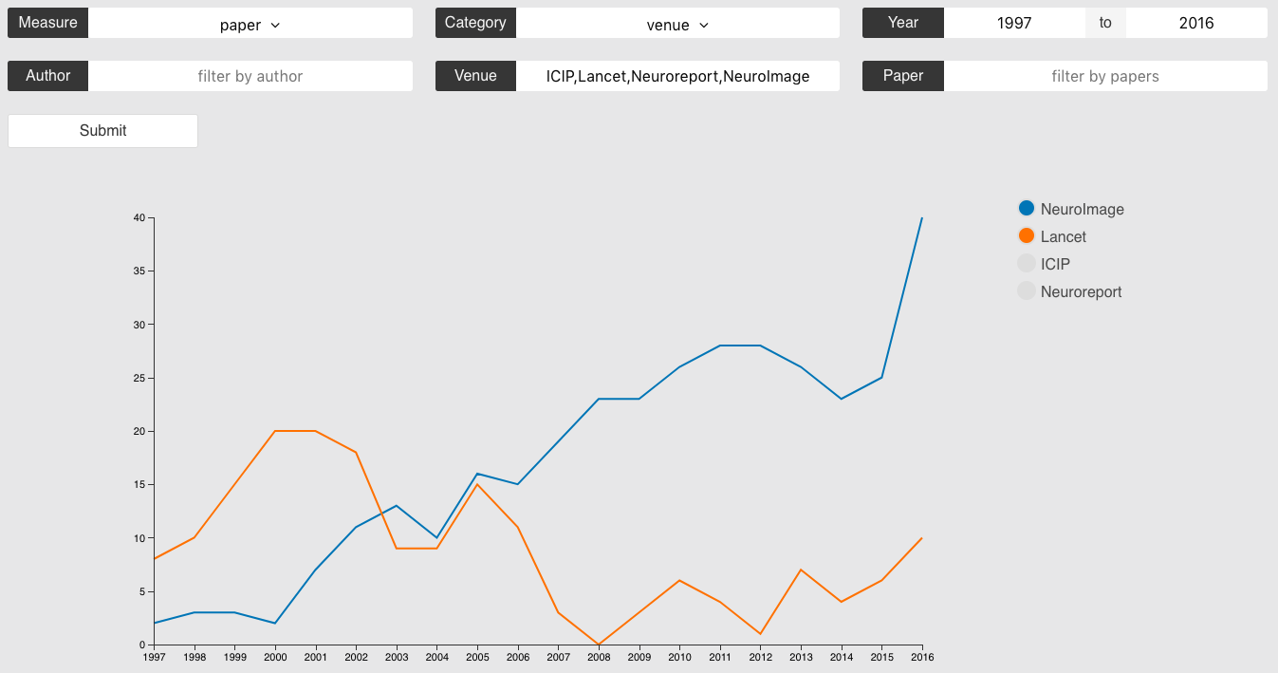
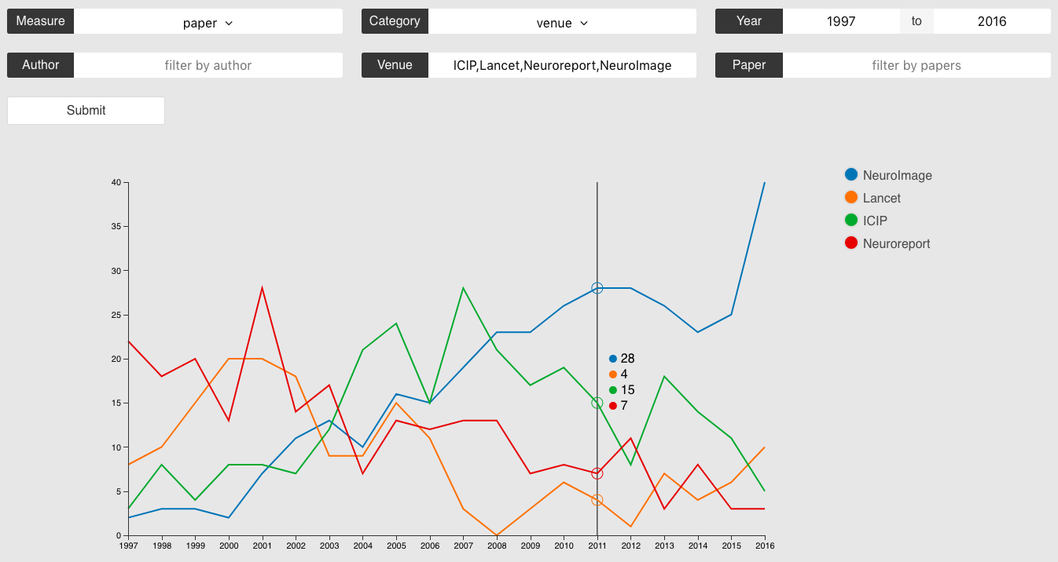

Slide 7
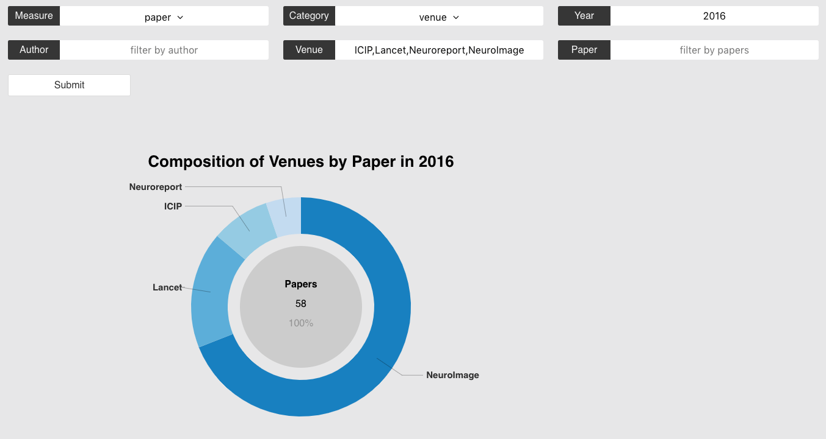
Sum data using
Categorize data using
Period of data (Optional)
Possible filters
(Optional)
Mouse over any slice
to view percentage

Slide 8
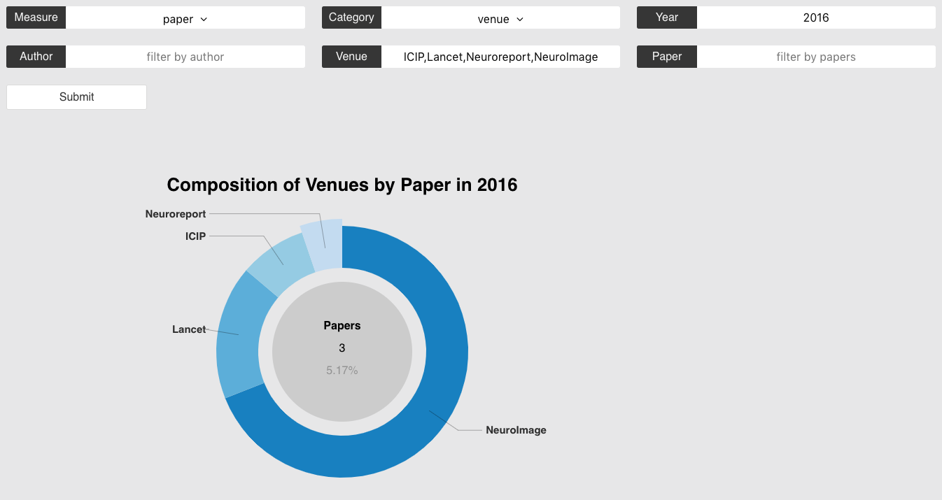
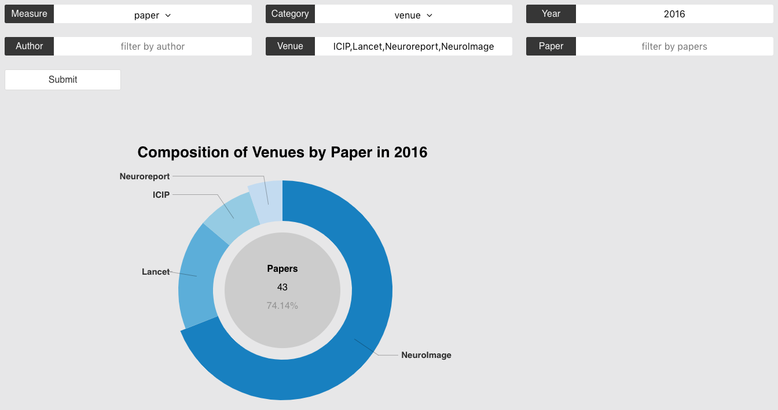

Slide 9
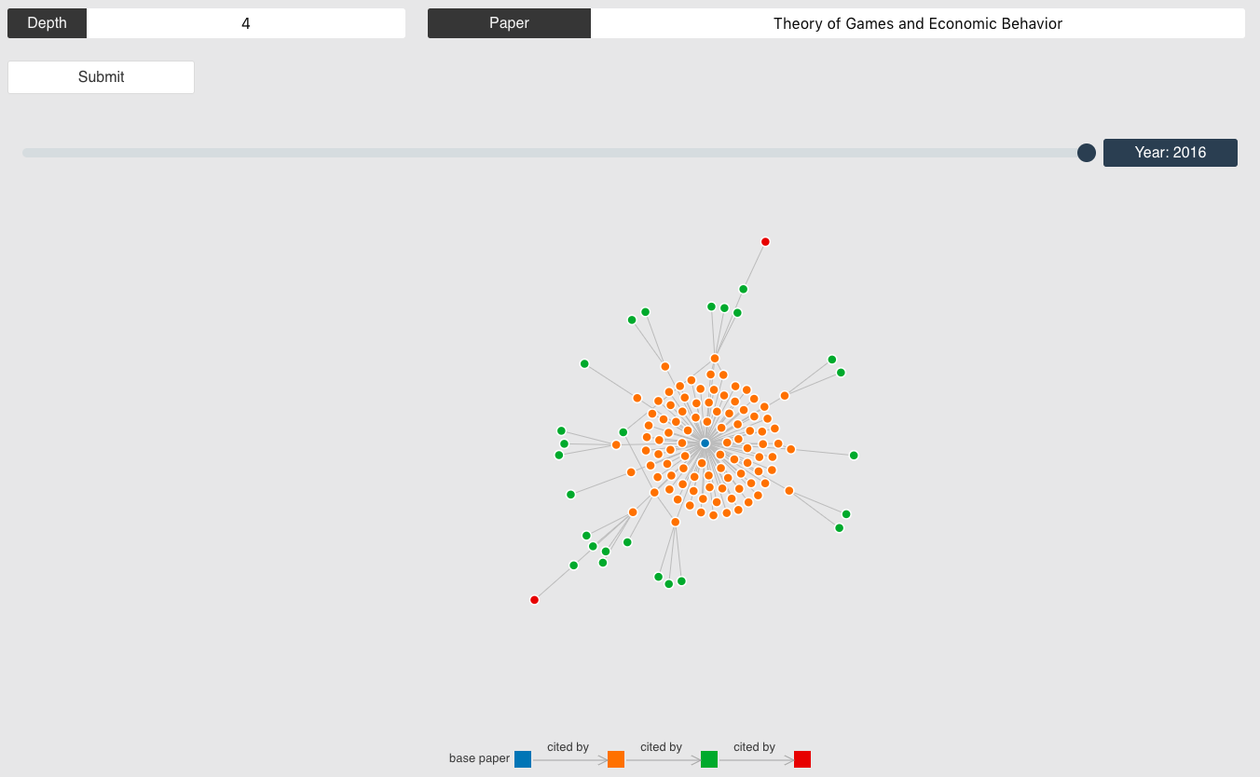
Depth of network
Center of network
Slider to control year

Slide 10
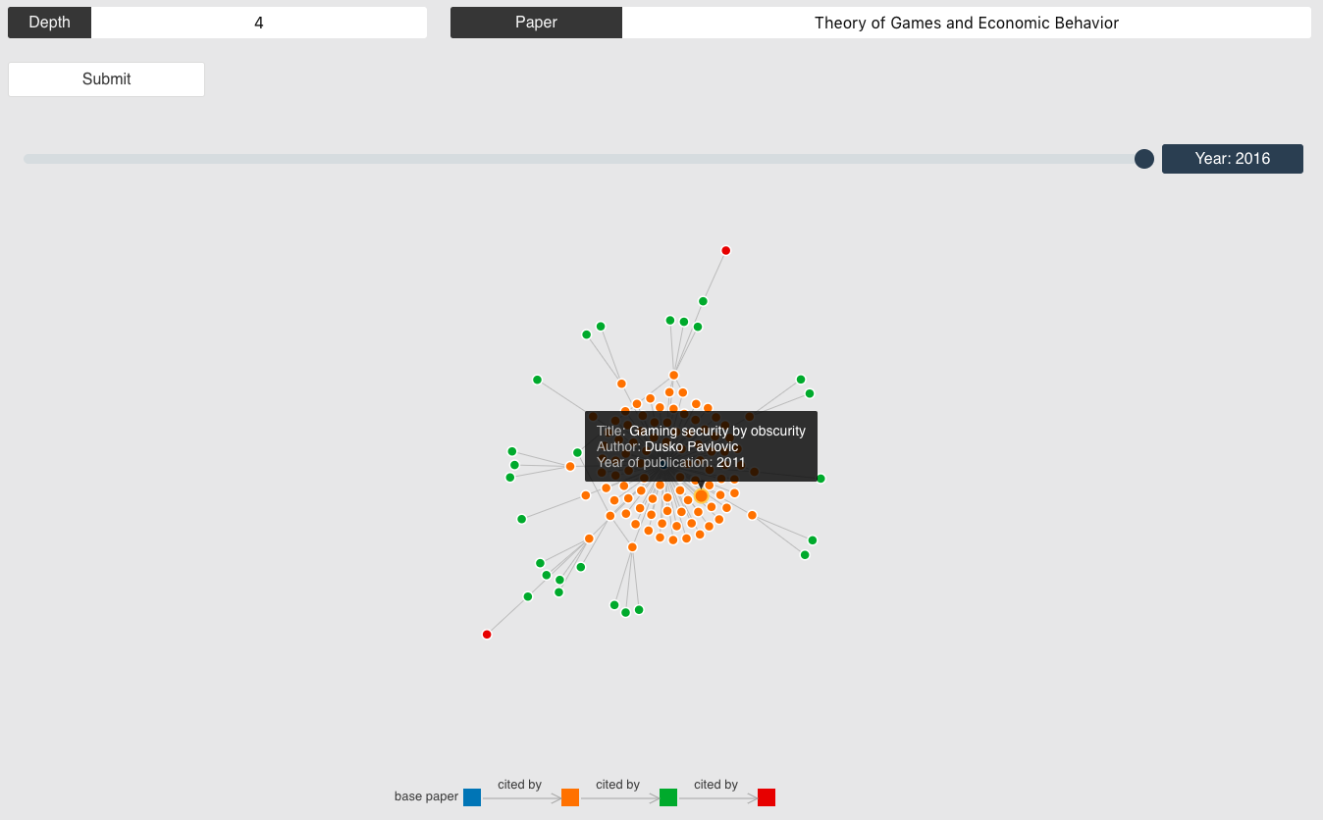
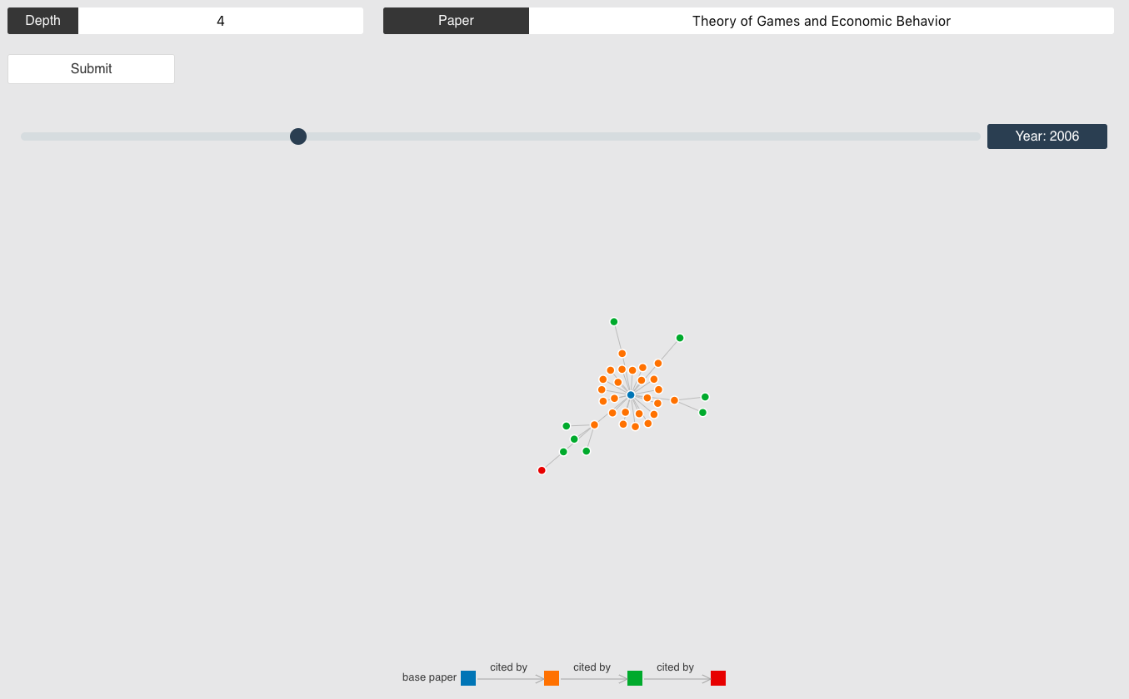

Slide 11

Words from category
Words to remove (Optional)

