Slide 1
Test task solution
Author: Yan Vlasov
Solution repository

Slide 2
Task description
The dataset in “2022_Test_ML.csv” consists of 4 features (s_mt, s_mq, d, h_p) and of 2 objectives (QW, DP). The goal of the task is to build the model which approximates and generalizes QW and DP for arbitrary values of s_mt, s_mq, d, h_p within the range of their variation ( Table 1 ).
 | s_mt | s_mq | d | h_p
Min | 0.8 | 0.8 | 1.0 | 4.0
Max | 2.7 | 2.1 | 3.0 | 10.0

Slide 3
EDA results
Please refer to notebook/profiling_report.html in the solution repository to see graphs described below.
Both features and objectives have no missing values and no zeros.
All limits (min-max) for the features are set correctly according to the table in the description.
Distributions:
All features have uniform distribution.
QW looks like normal or bimodal distribution.
DP looks like log-normal.
Interactions and Correlations:
Quadratic relationship between the variables h_p and DP.
Relationship between h_p and QW looks linear.
Spearman's correlation shows strong negative dependency between h_p-DP and h_p-QW. It means that with h_p increasing both objectives are decreased.
Strong positive correlation between 2 objectives QW-DP. According to the graph it looks quadratic.
Slight positive dependency between d and the both objectives.
Both s_mt and s_mq graphs against QW looks like a normal noise.

Slide 4
Baseline
Train-test split: random strategy of choosing 70% of the data for training set was applied.
Validation scheme: holdout with calculating confidence interval on the test set based on bootstrapped samples.
Scoring: R2 score
Data: features without any modifications were chosen for building the baseline.
Models: LinearRegression, Lasso, Ridge, RandomForestRegressor, GradientBoostingRegressor were tested
Results: Lasso and GradientBoostingRegressor were choosen for further development with 0.744 and 0.965 r2 scores accordingly.

Slide 5
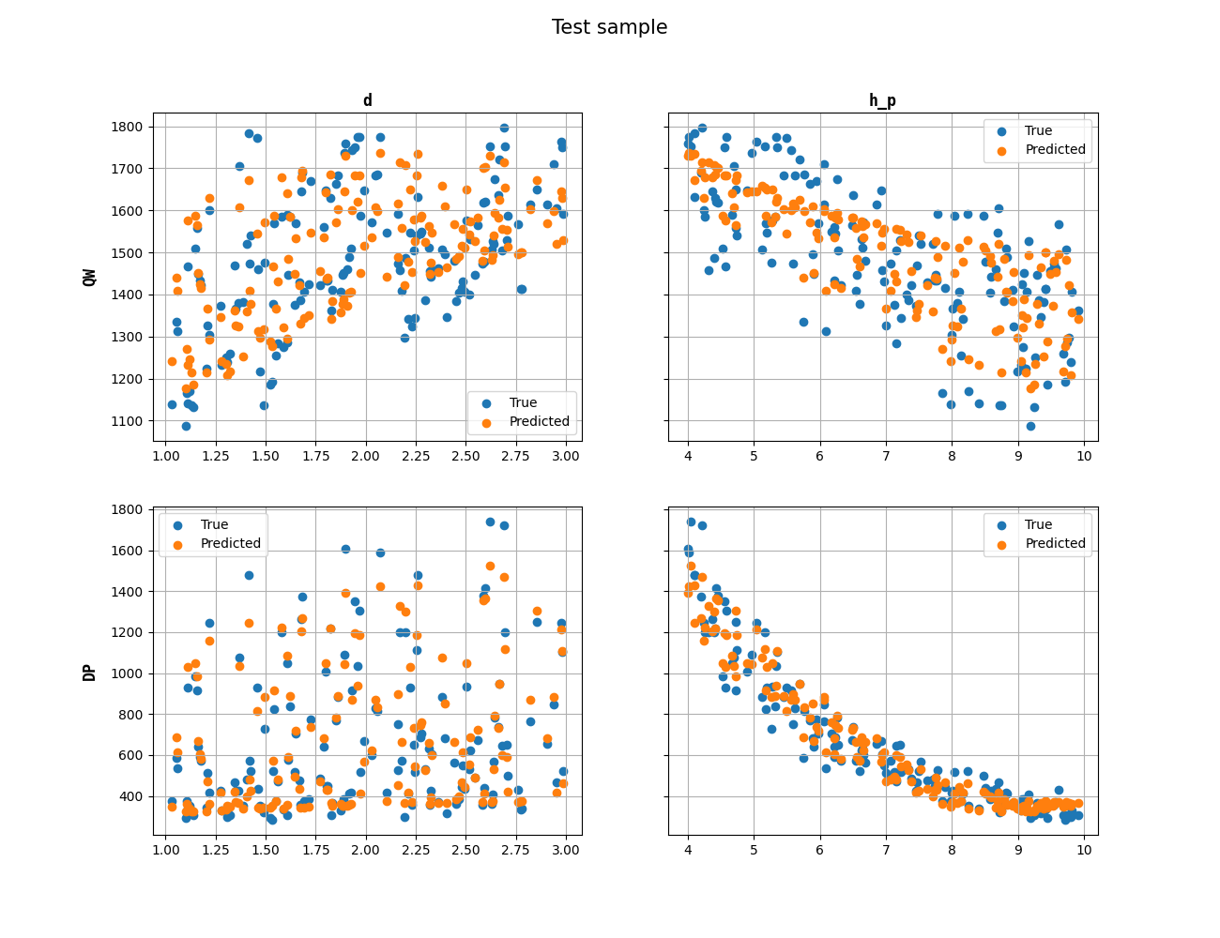
Best Lasso model
Data
s_mt and s_mq features were removed.
Polynomial features with the power of 2 were built on the rest features.
Hyperparameters:
Alpha: 0.5
Score on test sample: 0.826

Slide 6
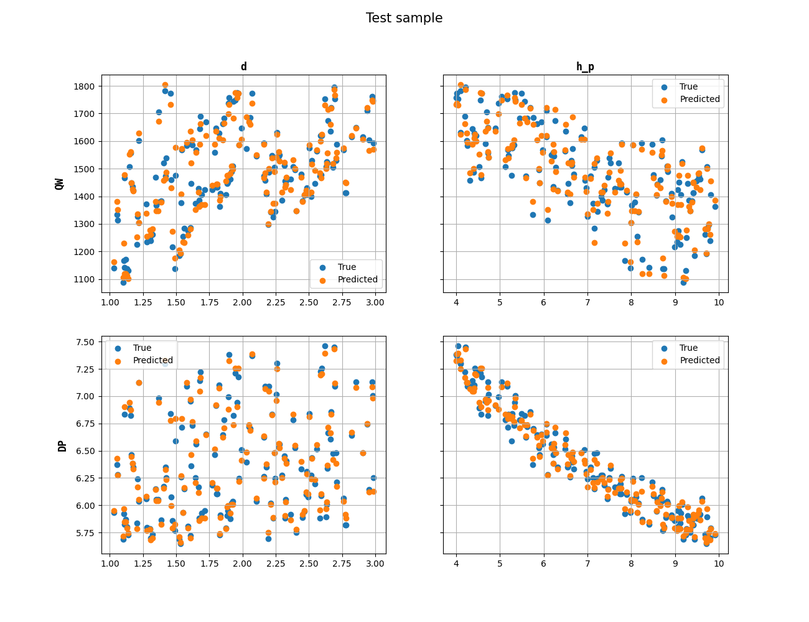
Best Gradient Boosting model
Data
s_mt and s_mq features were removed.
Polynomial features with the power of 2 were built on the rest features.
Log transformation was applied on DP target.
Model type: chained regressor.
Hyperparameters:
Learning rate: 0.2
Max_depth: 2
N_estimators: 500
N_iter_no_change: 20
Score on test sample: 0.978

Slide 7
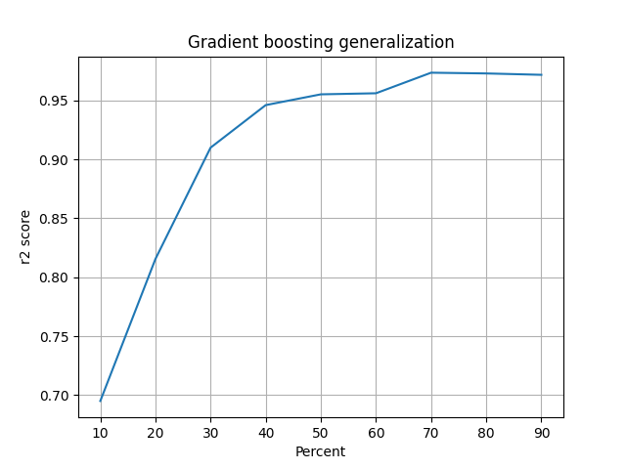
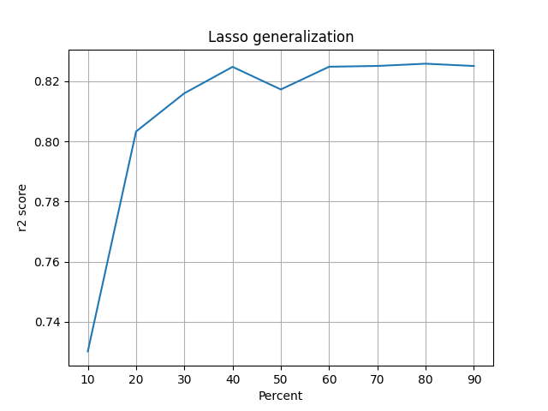
Generalization ability
30% of the training data (105 samples) is enough to reach r2_score higher than 0.9 for Gradient Boosting model which is better than Linear model results.
Both models are quite good in generalization and their ability to predict good results does not suffer to much with the small number of training samples.
Gradient boosting model works better than Linear models despite additional manipulation with the data.

