Slide 1

DMX
Lightshow controller
Clubbing for Coders™

Slide 2

Why the name :
“clubbing for coders”

Slide 3

Why DMX lightshow controller?

Slide 4
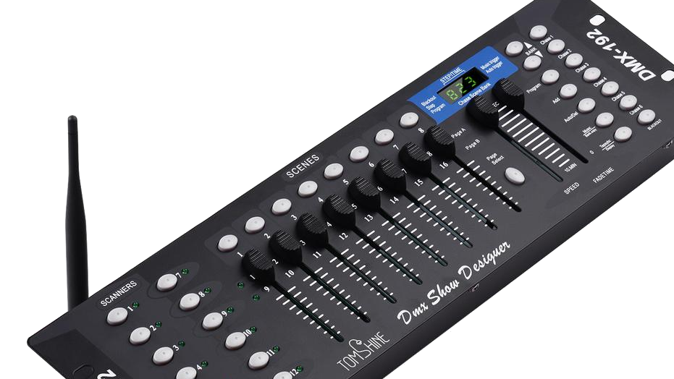
HardWare
Experience

Slide 5

Inexperienced Clubbers

Slide 6

Roles

