Slide 1
Data Analysis
Country Vaccinations
Team: Data Vizards

Slide 2
Summary
Case
Methodology
Results
Conclusion
Appendix

Slide 3
Case
Main Question:
Which are the next most cost effective countries to roll out vaccines?
________________________________________________________________________
Secondary Question:
Which would be the best vaccine to roll out?

Slide 4
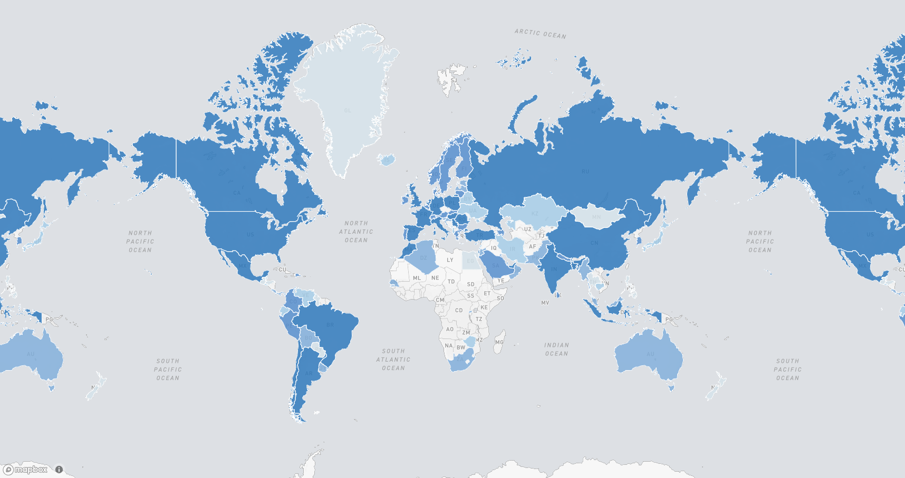
Case
Notes:
Map dictates # of vaccinations sent out to each country based on the clients’ data. Location of Current countries (is this title ok?)

Slide 5
Methodology
The main idea applied was to gather variables that represent the cost-effectiveness of each country and summarize them through specific weights. In doing so, we will have a hierarchy where every country is represented by a single score.
SUM
Variables
Weights
Country’s Score

Slide 6
Methodology
Selected Variables:
Predicted daily vaccination per citizen (“Vaccination Efficiency”)
40% correlation with HDI and GDP
Population
Logistics Performance index (“LPI”)
PS: each variable was processed and converted in a score, with 1 being the highest score.

Slide 7
Methodology
Model:
LPI
Vaccination Efficiency
POPULATION
DISTRIBUTION CENTERS
QUICKJAB
POPULATION
POPULATION

Slide 8
Methodology
Predicting daily vaccination for new countries:
Unlike most of the selected variables, that can be directly retrieved, the daily vaccination is a more complex variable.
Using the client’s dataset and demographic informations, we structured the data and built a predictive model for the expected daily vaccination in the new countries.

Slide 9
Methodology
Weights:
The weights were assigned through discussion and consensus of the Analyst Team.
Predicted Daily Vaccinations
Population
Logistics Performance Index
40%
40%
20%

Slide 10
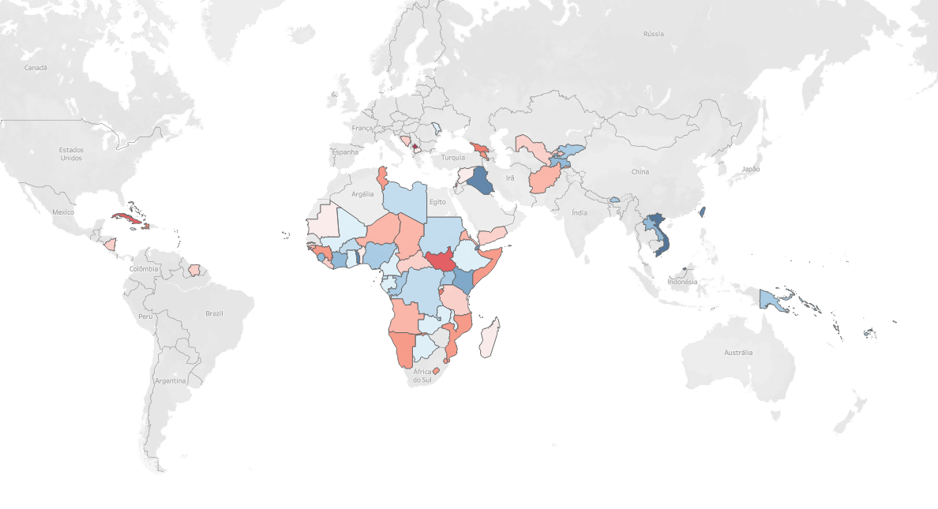

Results
Notes:
Map dictates # of vaccinations sent out to each country based on the clients’ data. Location of Current countries (is this title ok?)

Slide 11
Results
Top 5 Final Scores
Country | Vaccination Efficiency | Population | LPI | Final Score
Vietnam | 0.1 | 1 | 0.9 | 0.62
Iraq | 0.5 | 0.9 | 0.2 | 0.6
Taiwan | 0.2 | 0.8 | 1 | 0.6
Togo | 0.6 | 0.7 | 0.4 | 0.6
Brunei | 0.9 | 0.3 | 0.5 | 0.58

Slide 12
Results
Top 5 Final Scores
Country | Vaccination Efficiency | Population | LPI | Final Score
Vietnam | 0.1 | 1 | 0.9 | 0.62
Iraq | 0.5 | 0.9 | 0.2 | 0.6
Taiwan | 0.2 | 0.8 | 1 | 0.6
Togo | 0.6 | 0.7 | 0.4 | 0.6
Brunei | 0.9 | 0.3 | 0.5 | 0.58
Sensitivity (15%)
0.54 - 0.62
0.60 - 0.65
0.53 - 0.60
0.60 - 0.62
0.58 - 0.63

Slide 13
Results
Vaccines
Vaccine | Moderna | Pfizer
Effective Age | 18+ | 16+
Efficacy | 94.1% | 95%
Doses | 2 | 2
Time Between Doses | 28 Days | 21 Days

Slide 14
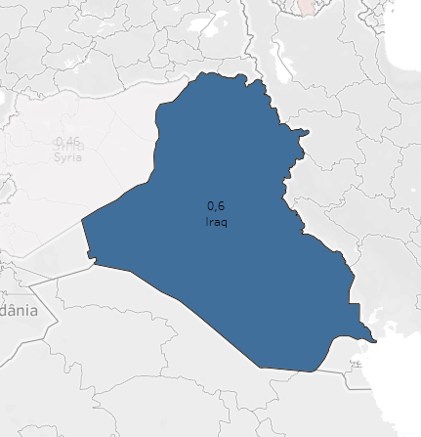
Conclusion
Main Question:
Which is the next most cost effective countries to roll out vaccines?
Country | Expected Vaccines per day | Population | Expected duration of Rollout (70%)
Iraq | 180 000 | 40.2 M | 150 - 300 days

Slide 15
Conclusion
Secondary Question:
Which would be the best vaccine to roll out?
Pfizer-BioNTech vaccine
Contingency Plan: If supply of the Pfizer-BioNTech vaccine is insufficient, we recommend QuickJab use any vaccine available as they are all effective in reducing hospitalizations and deaths.
Notes:
We recommend using the Pfizer-BioNTech vaccine as it is widely available and is able to treat the most amount of people. This recommendation is contingent on actually getting the amount of doses required. Then, we recommend that QuickJab uses any available vaccine, as they are all effective at reducing the amount of deaths and hospitalizations, which is the main goal of the vaccinations.

Slide 16
Appendix
Data Sources
Existing client’s dataset of country vaccinations
Daily vaccinations and total vaccinations
List of countries with vaccinations rolled-out
Our World in Data¹
Demographic information
Population size, GDP per capita, Human Development Index (HDI)
Contains data for countries from client’s dataset and new countries
94 countries to select from that isn’t from client’s data

Slide 17
Google’s Countries Coordinates dataset²
Coordinates (latitude and longitude) of each country were used to calculate distance to the United States
Logistics Performance Index³
Score used to rank countries capabilities of rolling out the new vaccination
¹ https://ourworldindata.org/coronavirus
² https://developers.google.com/public-data/docs/canonical/countries_csv
³ https://datacatalog.worldbank.org/dataset/logistics-performance-index

Slide 18
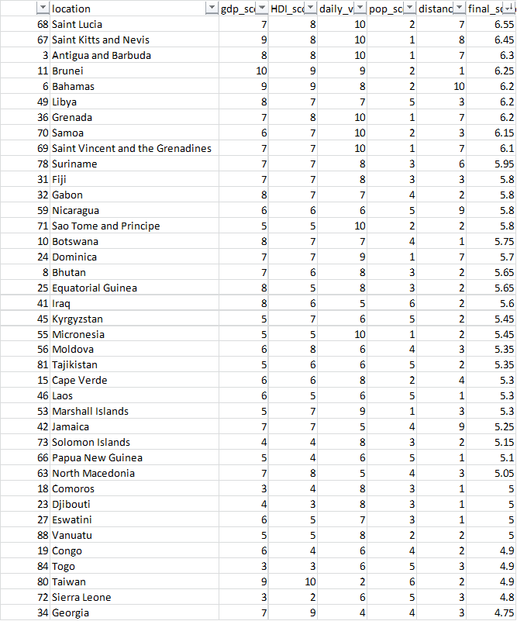
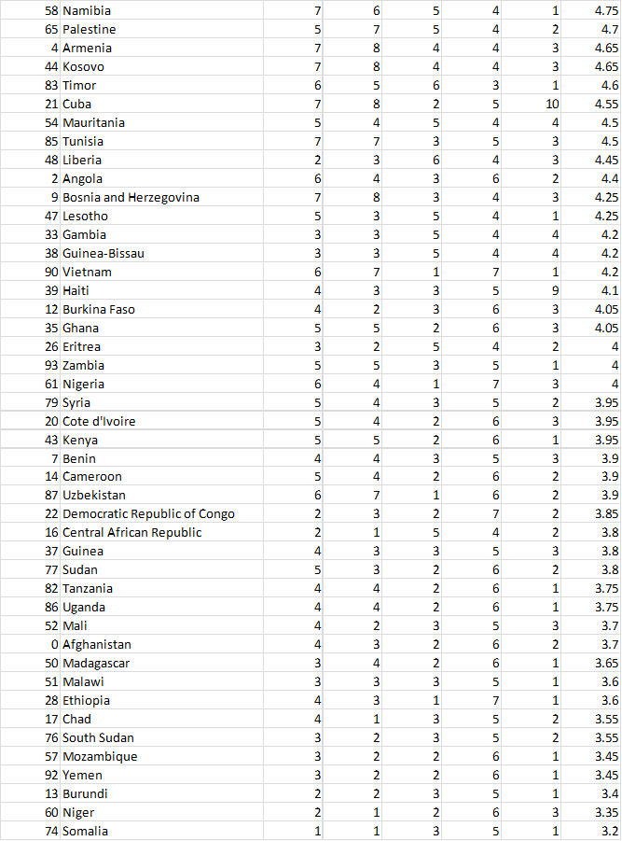
Reference - final score for all countries

Slide 19
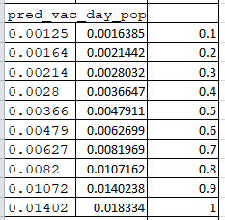
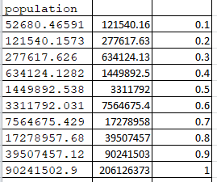
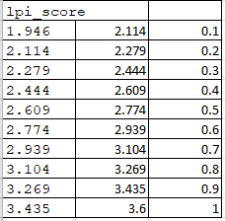
Reference - high and low ends of the scores

Slide 20
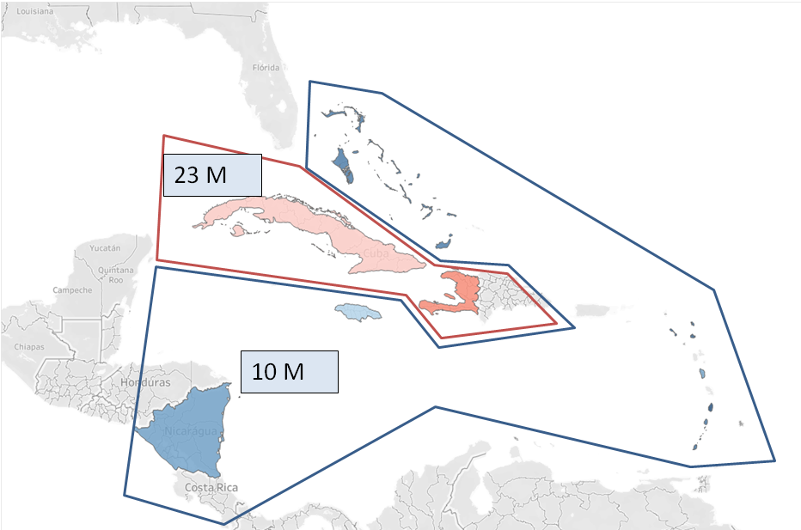
Results
Closer Look - Central America

Slide 21
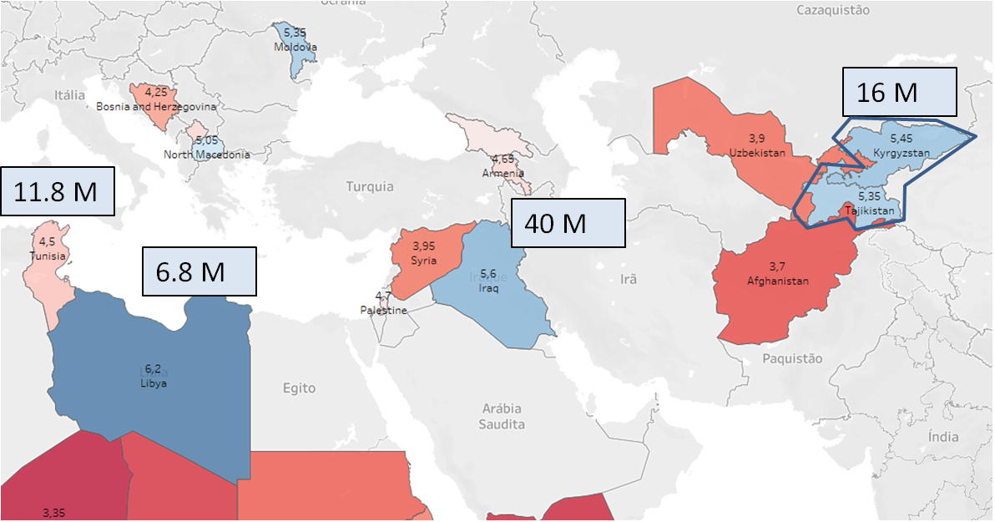
Results
Closer Look - Middle East

Slide 22
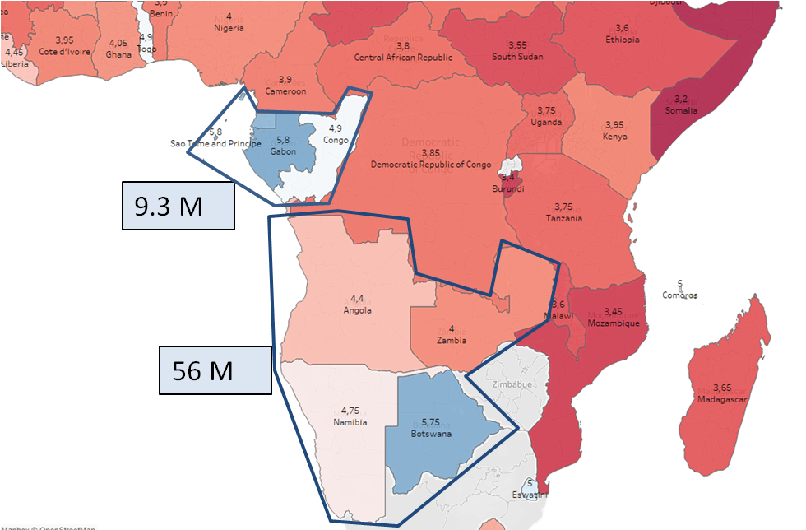
Results
Closer Look - Africa

Slide 23
Conclusion - Country
Instead of regarding individual countries to roll out, here we suggest to also consider blocks of countries with favorable conditions, in an attempt to profit from economy of scale. Those block being:
1º - Central America, with possible inclusion of Cuba and Haiti
2º - Libya and Tunisia
3º - Iraq
4º - Gabon,São tome e principe and Congo
5º - Kyrgyzstan and Tajikistan
6º - Botswana, Namibia, Angola and Zambia

Slide 24
Results
Best vaccine to roll out
In respect to the effectivity of the vaccines, it is very tricky to draw comparisons. It should be taken in account that studies of effectivity for different vaccines happened in distinct populations, locations and timeframes, rendering the comparisons questionable.
The best criteria found for selecting a vaccine to roll out was market acceptance, in which the Pfizer-BioNTech has been more successful.

