Slide 1

Res_fc_pgs/03_genotype_processing
Genotype data
Downstream data
TOPMed genotype
TOPMed helper files
Helper files
qc_flow.txt
qc_helper.txt
QC-ed genotype
CHR:POS to rsID
QC-ed genotype
(brain cohort)
Bolt-lmm.txt
map.R
GWAS summary statistics
(CHR:POS)
GWAS summary statistics
(rsID)
ldpred2.R
manhattan_qq_sigsnps.R
ldsc.py
Manhattan plot and
QQ plot
LDSC heritability
PGS

Slide 2
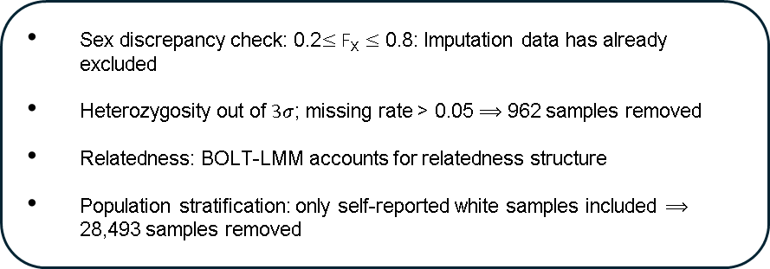
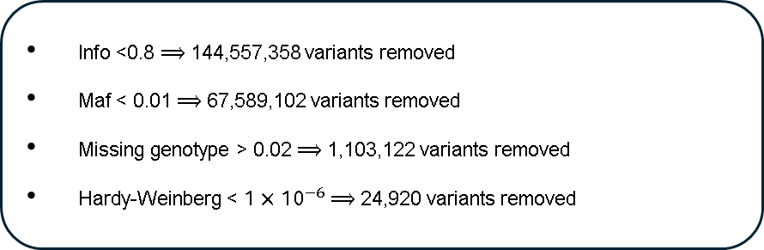
Genotype QC flow
Sex discrepancy check: 0.2$≤F_{X}≤$ 0.8: Imputation data has already excluded
Heterozygosity out of $3σ$; missing rate > 0.05 $⟹$ 962 samples removed
Relatedness: BOLT-LMM accounts for relatedness structure
Population stratification: only self-reported white samples included $⟹$ 28,493 samples removed
TOPMed genotype
486,935 samples
231,538,213 variants
qc_flow.txt
Sample QC
QC-ed genotype
SNP QC
Info <0.8 $⟹$ 144,557,358 variants removed
Maf < 0.01 $⟹$ 67,589,102 variants removed
Missing genotype > 0.02 $⟹$ 1,103,122 variants removed
Hardy-Weinberg < $1×{10}^{−6}$ $⟹$ 24,920 variants removed
457,030 samples
7,559,516 variants
Participants with BRS score and baseline covariates
GWAS cohort
130,394 samples
Other participants
159,243 samples
7,559,516 variants
BWAS cohort
28,849 samples
Participants with valid rsfMRI data

