Slide 1


Slide 2

Christopher Shannon
Brian Del Carpio
Melvin Wong
Ian Wu
Simon Fraser University
CMPT 276

Slide 3
Project Overview

Slide 4
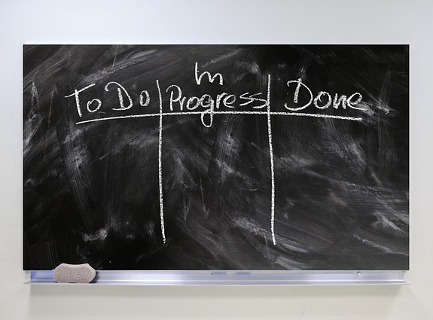
Kanban
Benefits:
- Simplicity of use
- Flexibility
- Adaptability to unforeseen issues
Concerns:
- The project could get very complex
- “Never-ending list”
Board Columns:
- To-Do: list of tasks that need to be actioned
- In Progress: list of tasks currently being worked on
- Review: completed tasks waiting to be inspected
- Completed: tasks that passed inspection

Slide 5

User Stories

