Slide 1


Slide 2

Christopher Shannon
Brian Del Carpio
Ian Wu
Simon Fraser University
CMPT 276

Slide 3
PROJECT OVERVIEW
Objective:
- Deliver an application to streamline the process of tracking workout schedules
- Bridge between Strava and Google Calendar
Technologies and Process:
- JavaScript/React, HTML, CSS
- Agile Kanban SDLC

Slide 4

GOOGLE CALENDAR API
1) Create Events in google calendar
2) Recall past Events
3) Store events title, date, time and description

Slide 5

STRAVA API
1) Create Events in Strava
2) Recall past Events
3) Store the events, date, time and descriptions

Slide 6
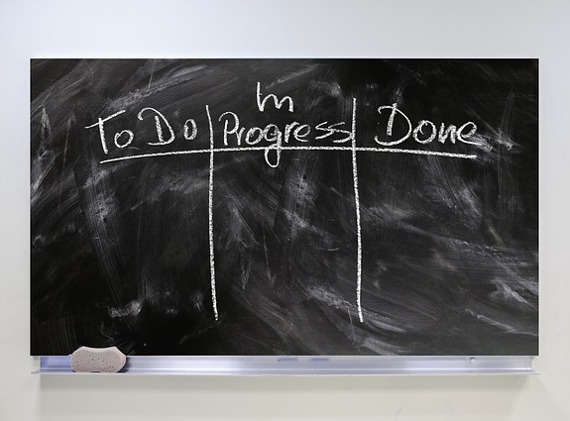
Benefits:
- Simplicity of use
- Flexibility
- Adaptability to unforeseen issues
Concerns:
- The project could get very complex
- “Never-ending list”
Board Columns:
- To-Do: list of tasks that need to be actioned
- In Progress: list of tasks currently being worked on
- Review: completed tasks waiting to be inspected
- Completed: tasks that passed inspection
SD/LC: KANBAN

Slide 7
PROJECT FEATURES
Plan Future Workouts:
- user inputs date and time
- uploads to google calendar
See Upcoming Workouts:
- user receives list of date and times of upcoming workouts
Input Workouts:
- user inputs distance and duration of workout
- uploads to Strava
Recall Past Workouts:
- user receives list of past workouts date times

Slide 8
CI/CD

Slide 9
Challenges
Group Member Missing
collectively had to pick up slack
Api Integration
properly handling security measures
navigating rate limits and usage quotas
Onboarding Project Members
setting up environments for everyone

Slide 10
Takeaways
Kanban board devolved into messaging chat
Scope of project too large given our skill level and time constraints
-choosing two api’s that both require authentication

Slide 11
Questions?

