Slide 1


Slide 2

Christopher Shannon
Brian Del Carpio
Melvin Wong
Ian Wu
Simon Fraser University
CMPT 276

Slide 3
PROJECT OVERVIEW
Objective:
Deliver an application to streamline the process of tracking workout schedules
Bridge between Strava and Google Calendar
Technologies and Process:
JavaScript/React, HTML, CSS
Agile Kanban SDLC

Slide 4

TECHNOLOGY STACK
JavaScript/React – Frontend library used to build interactive user interfaces
HTML – Markup language, structures web applications
CSS - Styles websites aesthetically
Github - Version Control Software

Slide 5
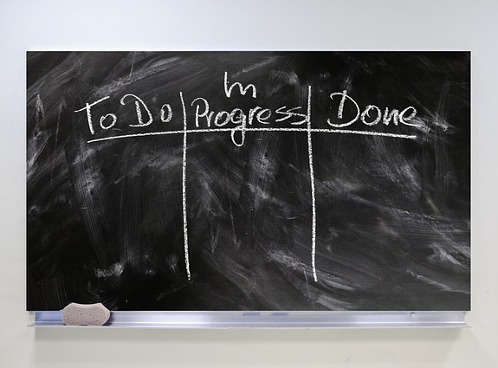
SD/LC: KANBAN
Benefits:
- Simplicity of use
- Flexibility
- Adaptability to unforeseen issues
Concerns:
- The project could get very complex
- “Never-ending list”
Board Columns:
- To-Do: list of tasks that need to be actioned
- In Progress: list of tasks currently being worked on
- Review: completed tasks waiting to be inspected
- Completed: tasks that passed inspection

Slide 6

GOOGLE CALENDAR API
1.Create Events in google calendar
2.Recall past Events
Events store title, date, time and a description

Slide 7

STRAVA API
1.Create Events in strava
2.Recall past Events
Events store, date, time and a description

Slide 8
PROJECT FEATURES
Plan Future Workouts
-user inputs date and time
-uploads to google calendar
See Upcoming Workouts
-user receives list of date and times of upcoming workouts
Input Workouts
-user inputs distance and duration of workout
-uploads to strava
Recall Past Workouts
-user receives list of pastworkouts date times

Slide 9
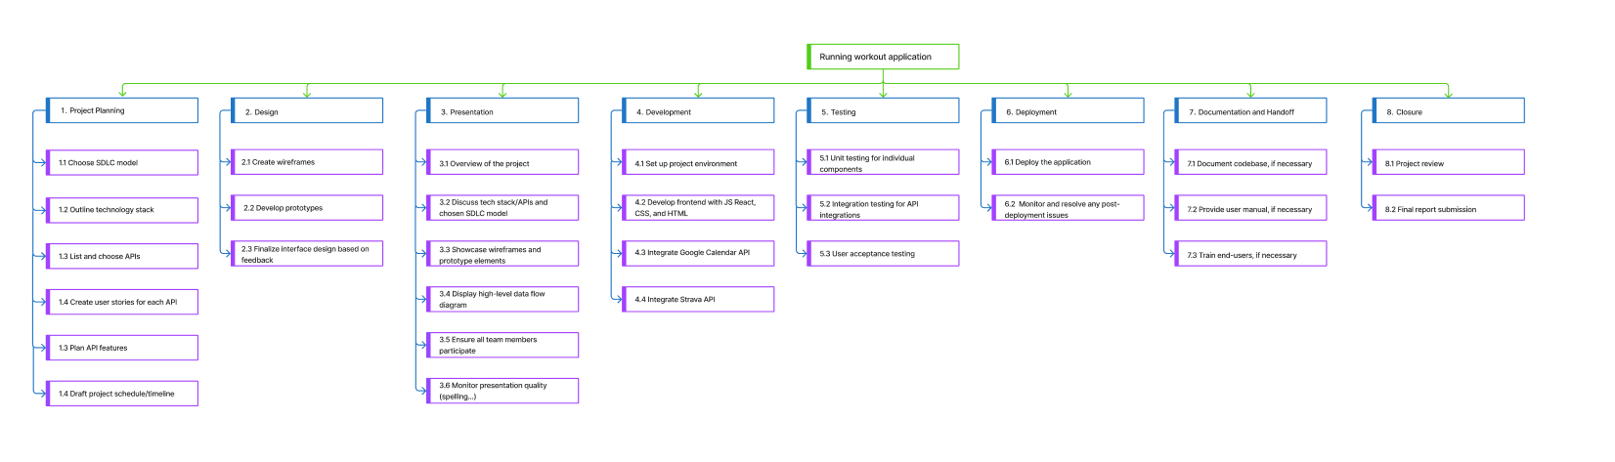
WORK BREAKDOWN STRUCTURE

Slide 10
PROJECT TIMELINE

Slide 11
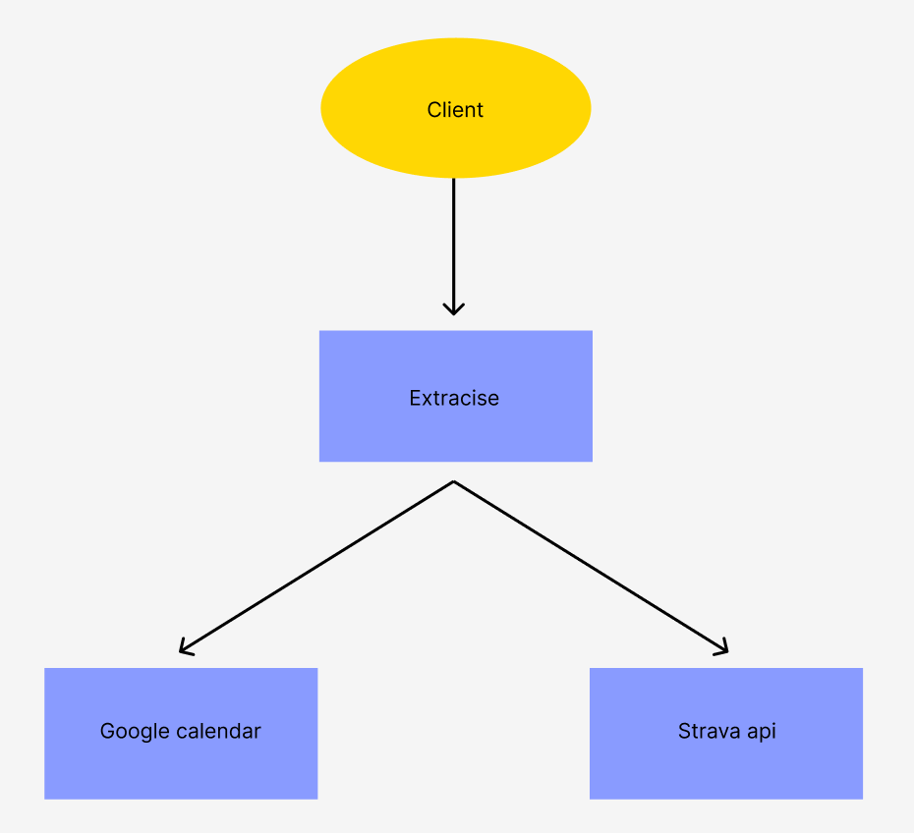
DFD LEVEL 0

Slide 12
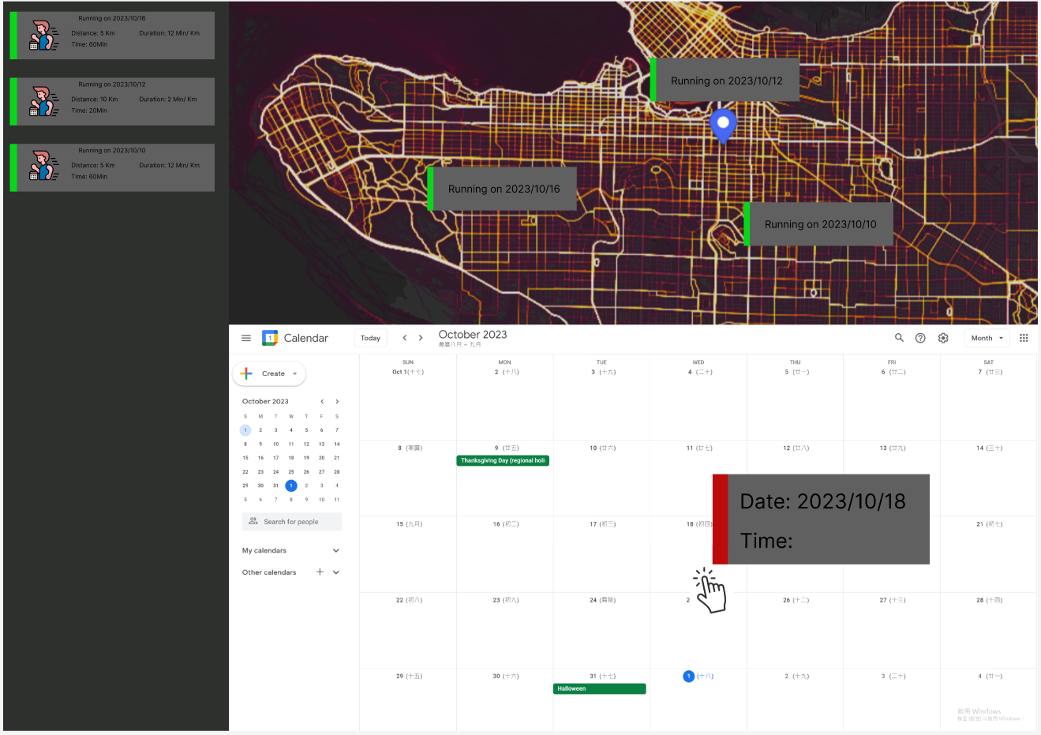
PROJECT PROTOTYPE

Slide 13
Thank you!

