Slide 1
Team Covert
Students: Ian Armstrong, John Schlagbaum, Noah Orr
Advisor: Professor John Franco

Slide 2
Our Problem
Covert channels of communication are a serious threat to technical systems, hardware and software alike. They can be virtually undetectable and leak sensitive data from systems.
A covert channel is a method of transmitting data between two different objects, in a way such that the overarching system does not know they are transmitting data. Typically, this is done by exploiting a part of the system that was not intended for communication.
Upon initial research, we saw that education on the matter was cryptic and hard to understand, specifically on how covert channels were built from scratch.

Slide 3
Our Solution
We set out to build a library of covert channels in different domains, with a priorities on readability and proof-of-concept.
Originally, we wanted to build a framework that would generalize how covert channels were built. This was going to be abstract and high level, but after speaking with our Advisor, we realized covert channels could not all be grouped together.
Our project covers over three covert channels, a Networking Channel, an Operating System Channel, and a Printer Channel. More in-depth details about these later.

Slide 4
Definitions
Sender: The entity sending the data.
Receiver: The entity receiving the data.
Observer: The entity that is trying to detect the covert channel or that monitors the system.
Our Sender and Receiver are working against the Observer. The Observer may or may not know that there is a covert channel in place.

Slide 5
What is a Covert Channel?
A covert channel, in our case, is when two separate entities (Sender and Receiver) communicate by exploiting a system, using a feature in the system that was not intended for communication, all while hiding the fact that they are communicating from the system (Observer).
An example of a non-technical covert message can be showcased by a story about Commander Jeremiah A. Denton of the US Navy in the Vietnam War. In 1966, Commander Denton was interviewed by the North Vietnamese as a POW. While speaking on camera, he blinked in Morse Code the word "T-O-R-T-U-R-E.". Denton's one-word report, delivered in Morse Code, was the first clear confirmation received by the U.S. Intelligence that American POWs were being tortured.

Slide 6
Use Cases of Covert Channels
Like stated before, covert channels are used for transmitting data secretly. They can be used for good and bad.
Covert channels can help protect data privacy and critical communication. Government entities could develop channels to communicate to ensure other governments are not seeing this communication. Citizens who live in a country/area where internet and freedom of speech is restricted or monitored, could develop channels to communicate freely.
Covert channels can also be used to leak sensitive data from unware systems. A malicious actor could gain access to a company’s file system, let’s say by using social engineering, with the goal to leak the company’s secrets over a long period of time. This actor could set up a channel to transmit the data to the company's competitors, while climbing the corporate ladder.

Slide 7
Classification of Covert Channels
Traditionally, researchers have suggested that covert channels can be classified as either a Storage Channel or a Timing Channel. Other classifications such as a Hybrid Channel and a Transitional Channel are known as well.
Storage Channel: A Sender sends data to a storage location (ex. Computer memory) where a Receiver can access and read the data. Typically, in these channels, the Sender has more privileged access and wants to send privileged data to the unprivileged Receiver.
Timing Channel: A Sender sends data by manipulating the timing properties of a system resource (ex. Central processing unit time) in a way that the Receiver can observe the real-response time of that system resource to extract the data.

Slide 8
Steganography
Covert Channels of communication heavily rely on the field of Steganography.
Steganography: A technique of hiding secret data within an ordinary non-secret object to preserve the fact that data is being transmitted.
This field dates to Ancient Greece, where the famous historian Herodotus writes about a tyrant shaving the head of a slave to put a message on their bald head. When the hair grew back, the messenger was then sent to the receiving party.
Steganography is described as the cousin of Cryptography. One hides the fact that data is being transmitted at all, and the other manipulates the data so it can't be compromised.

Slide 9
How to Detect a Covert Channel
As mentioned before, covert channels can be extremely hard to detect. Current research has shown multiple approaches.
Metrics: Bit rate, noise, and capacity are metrics we can use to measure covert channels. System performance is another way of detection. If a system is notably not performing well, this could indicate unknown data transmissions.
Machine Learning: Research has shown that certain ML algorithms can detect covert channels with high precision. Algorithms such as Support Vector Machines, k-Nearest Neighbors, and Deep Neural Networks have proven to be successful.

Slide 10
Challenges in Building Covert Channels
Covert Channels take a certain level of ingenuity and creativity. One must be very knowledgeable in the domain they want to build a channel in. Typically, like most exploits, strong skills in low-level programming is a requirement. They also must be creative in how they build the channel so that it does not get detected easily. This plays back into domain knowledge. The more you know about the system (how it should behave, the assumptions the system was built under, etc.), the more creative you can be when building covert channels.
Computer security expert Jon Erickson says in his famous book, Art of Hacking, "Hacking is more about following the law than breaking it. The essence of hacking is finding unintended or overlooked uses for the laws and properties of a given situation and then applying them in new and inventive ways to solve a problem."

Slide 11
An Overview of our Library of Covert Channels
For our project, we spent time building three covert channels in different domains. Our main priorities in building these channels were readability and proof of concept. Our library can be found at https://github.com/Ianarm11/senior-design/tree/master/library.
Network Covert Channel: A channel that transmits data by hiding bits in a TCP/IP Header field. TCP/IP packets are used for communications across networks but has a specific block for actual data. The TCP/IP Header is meta data to ensure the protocol works. By hiding data in the header, a network administrator would not catch wind of it.
Operating System Covert Channel: A channel that is used in the famous exploit, Meltdown. This channel is used to read and transmit a kernel’s protected memory by exploiting the CPU cache. Due to the complexity of Meltdown, we were only able to simulate this channel.
Printer Channel: A channel that uses a printer to transmit data. The Sender creates a printer form in the printer and hides a message in a field. A Receiver can query the printer forms to extract the message then delete the form. This channel is not as technical as the others, but rather to be seen as a proof-of-concept and for fun.

Slide 12
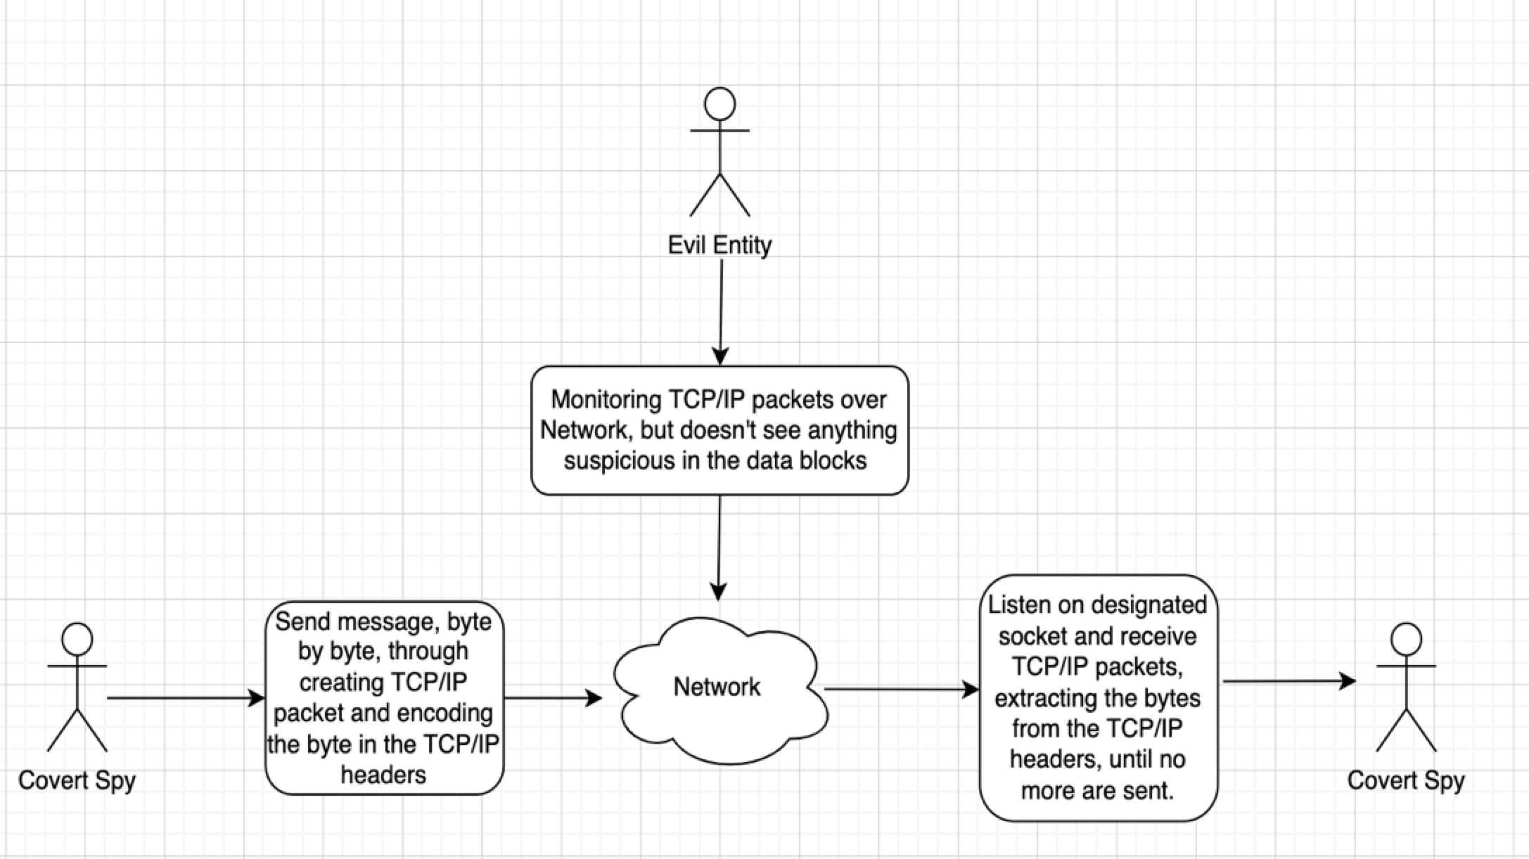
Network Channel
Overview:
Our network covert channel takes advantage of using TCP/IP protocol to allow a Sender to send a covert message over the course of many data packets to a Receiver. TCP/IP packets reserve a data block for data to be stored in but using this would expose our covert operation. To avoid this, we transmit the covert message, bit by bit, in the Flags field of the TCP/IP header.
Packet Creation:
For our network channel, we used IP protocol to create and send our covert packets. For the sake of education, we set up these IP packets to mirror the layout of a TCP packet. This allows for others to toy with the packet information freely, without violating TCP protocols.

Slide 13
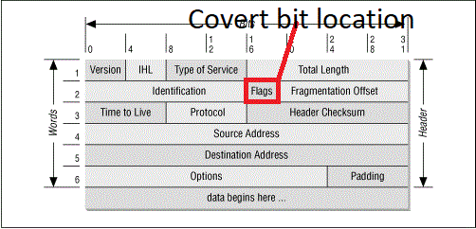
Network Channel
Encoding the Bit:
Given a hexadecimal message, the sender converts that message to a binary representation. For each bit (1 or 0) in that message, we make a packet to be sent to the receiver. That bit is then stored where the PSH flag is located.
Decoding the Bit:
Once the receiver has collected all the sent packets, they simply pull out the PSH flag for each packet and put it into a string. After all the packets have been looked through, they have received our entire binary covert message. The last step is to simply encode it back to hexadecimal and print it out to read.

Slide 14
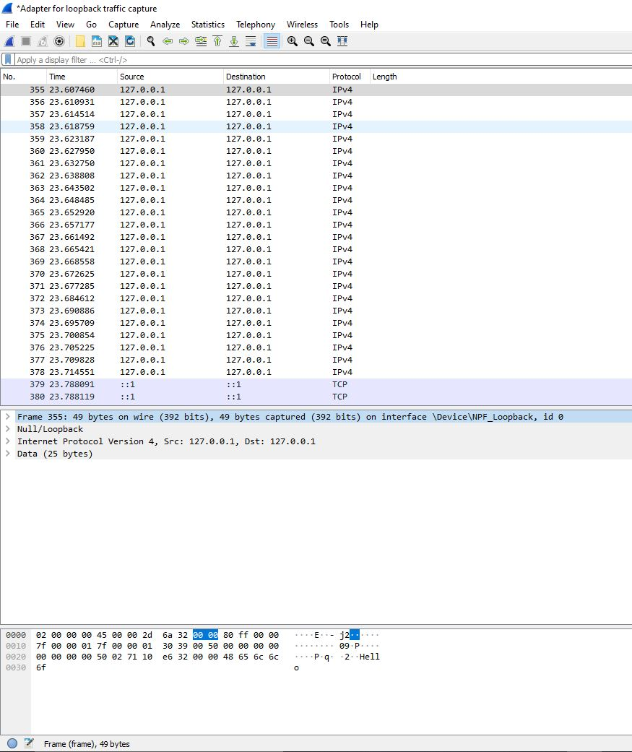
Network Channel
We can view the network traffic using a popular tool, Wireshark. The Observer in this scenario could be a Network Administrator. Our covert message gets by undetected upon a simple eye test.

Slide 15
Network Channel
Improvements:
1. Allow the Sender to change which field the covert bit(s) will reside in (ex. Flags, Version, etc.)
2. Switch between IPv4 and TCP protocols.
3. Switch between ascii messages and hexadecimal messages.
4. Add more "noise" to the packets to make them more covert (blend in more when viewing from Wireshark).
5. Add in timing functionality.

Slide 16
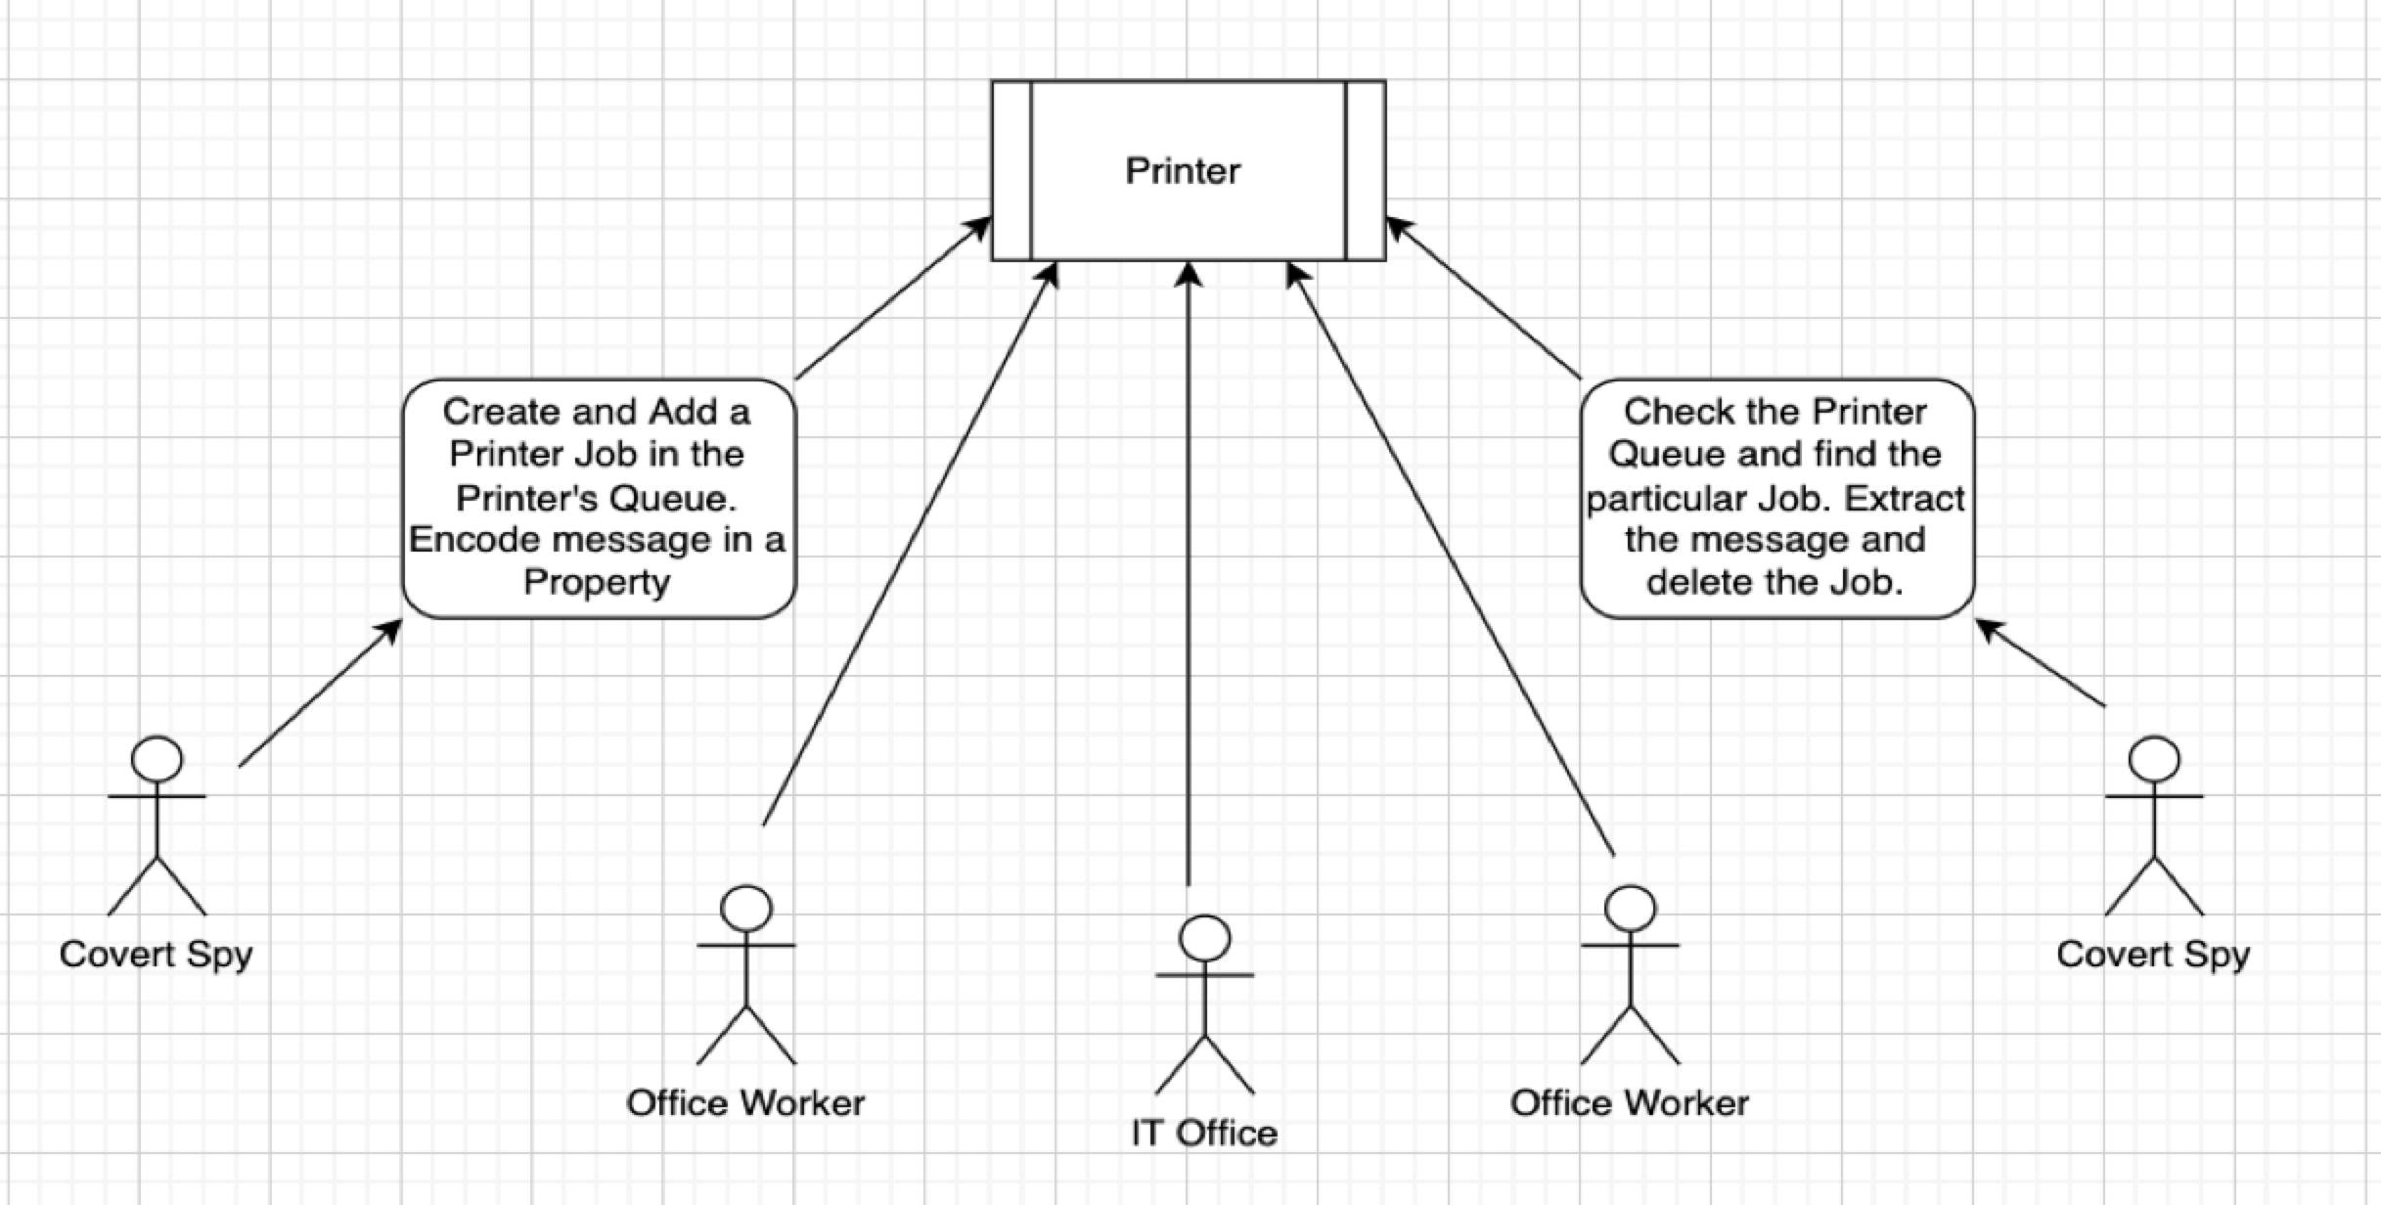
Printer Channel
Overview:
A Sender connects to a printer and creates a form (1098, W2, employee contract, etc.). They hide a covert message in the newly created form and programmatically add it to the printer. The Receiver queries the form and parses through it to find the message. The Receiver then deletes this form from the printer. Typically, a printer's log system only records information such as time of print, document title, name of user who printed, and meta data about the document. The contents inside the document are not visible.

Slide 17
Reflection of Our Project
Our team has learned a great deal in completing this project. It was challenging and exciting. Going in, we knew little to nothing about covert channels. Program exploitation was also an area of Computer Science we did not feel like experts in. It was fulfilling to research a completely new topic.
Our library of channels aren’t perfect. We struggled a lot creating them because of lack of experience. For example, we were aware of the TCP/IP protocol at a high-level but have never programmed with it before. As well, socket programming was very new to us as well.
Truly great covert channels take time to build, and with research taking a lot of time away from coding, we had to sacrifice certain qualities on our channels. Qualities such as performance, flexibility, and making our channels difficult to detect, was not a priority. We view our library as a proof-of-concept, to make sure potential students can understand the basics of how covert channels are built.

Slide 18
References
[1] Tian, J, Xiong, G, Li, Z, Gou, G, 2020, A Survey of Key Technologies for Constructing Network Covert Channels.
[2] Okhravi, H, Bak, S, King, S, Design, Implementation and Evaluation of Covert Channel Attacks.
Lipp, M, Schwarz, M, Gruss, D, Prescher, T, Haas, W, Fogh, A, Horn, J, Mangard, S, Kocher, P, Genkin, D, Yarom, Y, Hamburg, M, Meltdown: Reading Kernel Memory from User Space.
[3] Kocher, P, Horn, J, Fogh, A, Genkin, D, Gruss, D, Haas W, Hamburg, M, Lipp, M, Mangard, S, Prescher, T, Schwarz, M, Yarom, Y, Spectre Attacks: Exploiting Soeculative Execution.
[4] Bharti, V, Snigdh, I, Benalia, H, Mahmood, R, 2007, Practical Development and Deployment of Covert Communication in IPv4.
[5] Du, Wenliang, seedsecuritylabs.org, Syracuse University.
[6] Cilli, C, 2017, Understanding Covert Channels of Communication.
[7] Chourib, M, Detecting Selected Networks Covert Channels using Machine Learning.
[8] archives.gov, Comdr. Jermiah A. Denton, Jr - Report from Inside a Hanoi Prison, 1966
Other resources we used can be found at https://github.com/Ianarm11/senior-design/tree/master/research-content

