Slide 1

G2M Insight for Cab Investment
Virtual Internship
21-Jan-2023

Slide 2
EXECUTIVE SUMMARY
Following your company engaging us to provide actionable insights to help you in identifying the right cab company for making an investment; we recommend the Yellow Cab company for investment after performing a through analysis.
The Yellow Cab company outperformed the Pink Cab company on the following aspects:
Customer reach
Total profit across income groups
Revenue generation
Market share
Age-wise reach
Popularity across trip categories
Preference across gender roles.

Slide 3
Background –G2M(cab industry) case study
XYZ is a private firm in US. Due to remarkable growth in the Cab Industry in last few years and multiple key players in the market, it is planning for an investment in Cab industry and as per their Go-to-Market(G2M) strategy they want to understand the market before taking final decision.
Objective : Provide actionable insights to help XYZ firm in identifying the right company for making investment.
The analysis has been divided into four parts:
Data Extract Transform Load(ETL) Processes
Exploratory Data Analysis(EDA)
Exploratory Data Analysis Summary
Recommendations for investment

Slide 4
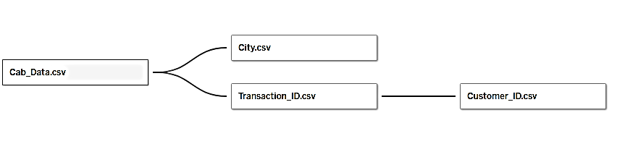
Data ETL Process
Relationship between the data files
17 Total Features( excluding derived features)
Timeframe of the data: 2016-01-31 to 2018-12-31
I performed a cross merge based on the relationship between the files above to create a master data file. I also cleaned and transformed the data to the appropriate format for analysis using Python(pandas) and exported the data to a csv file.
Later I performed exploratory data analysis using Tableau from which I generated the insights for investment recommendation.

Slide 5
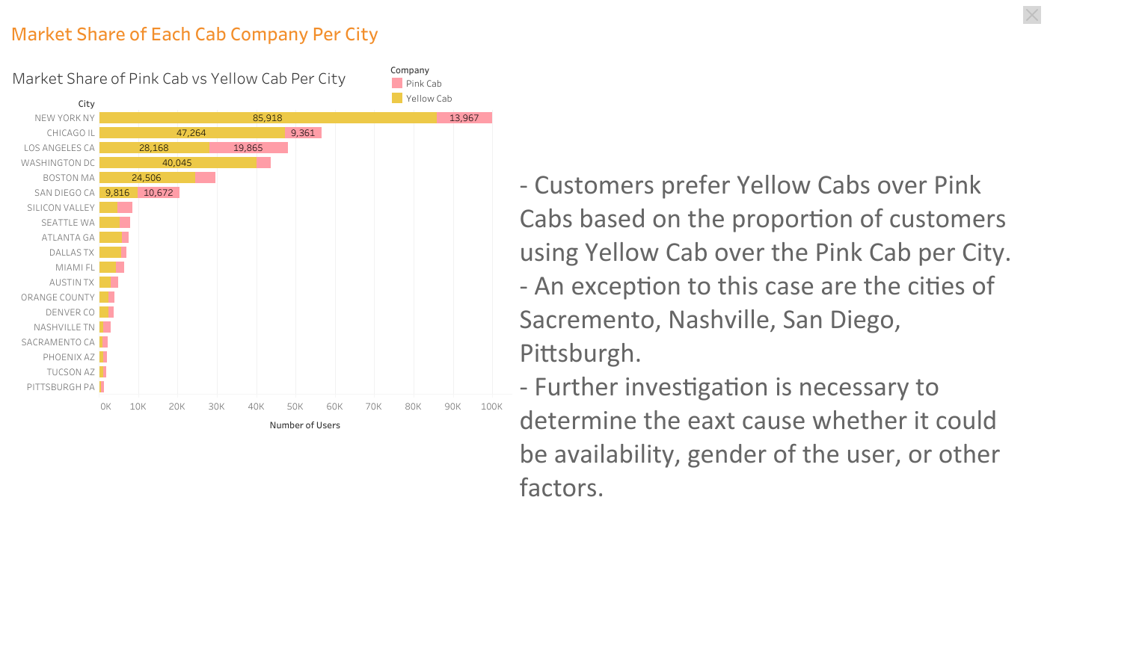
Executive Summary
Problem Statement
Approach
EDA
EDA Summary
Recommendations

Slide 6
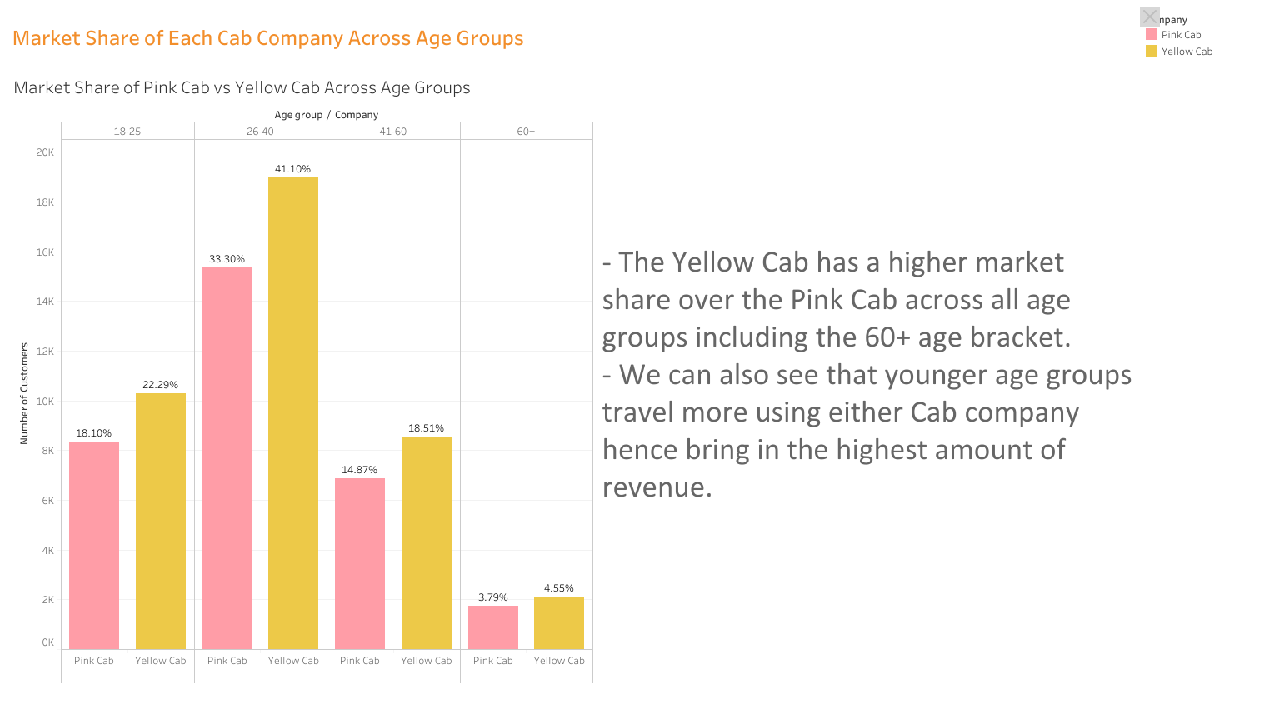
Executive Summary
Problem Statement
Approach
EDA
EDA Summary
Recommendations

Slide 7
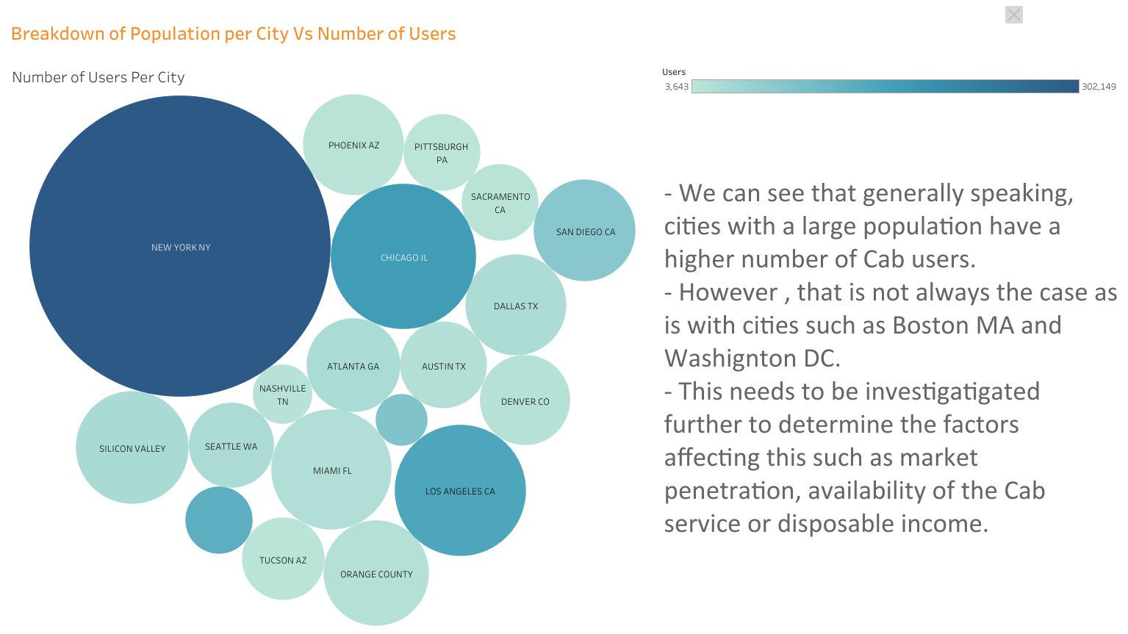
Executive Summary
Problem Statement
Approach
EDA
EDA Summary
Recommendations

Slide 8
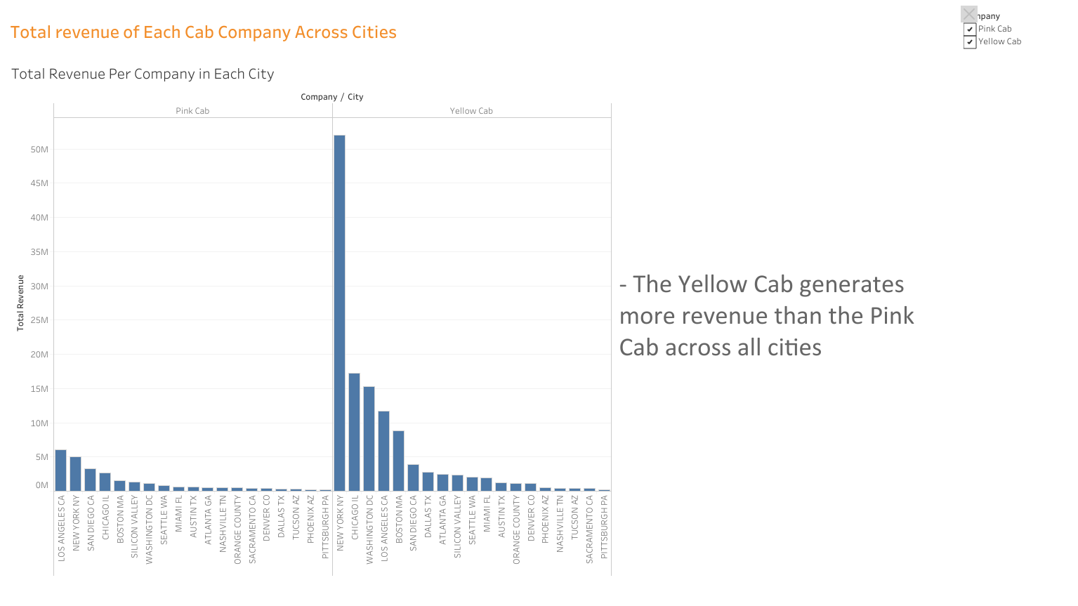

Slide 9
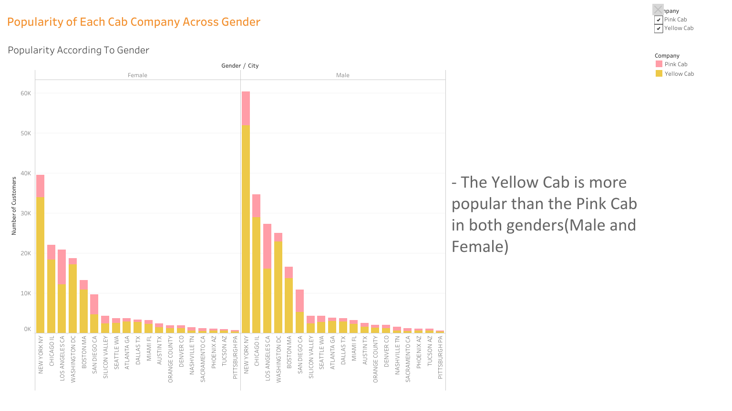

Slide 10
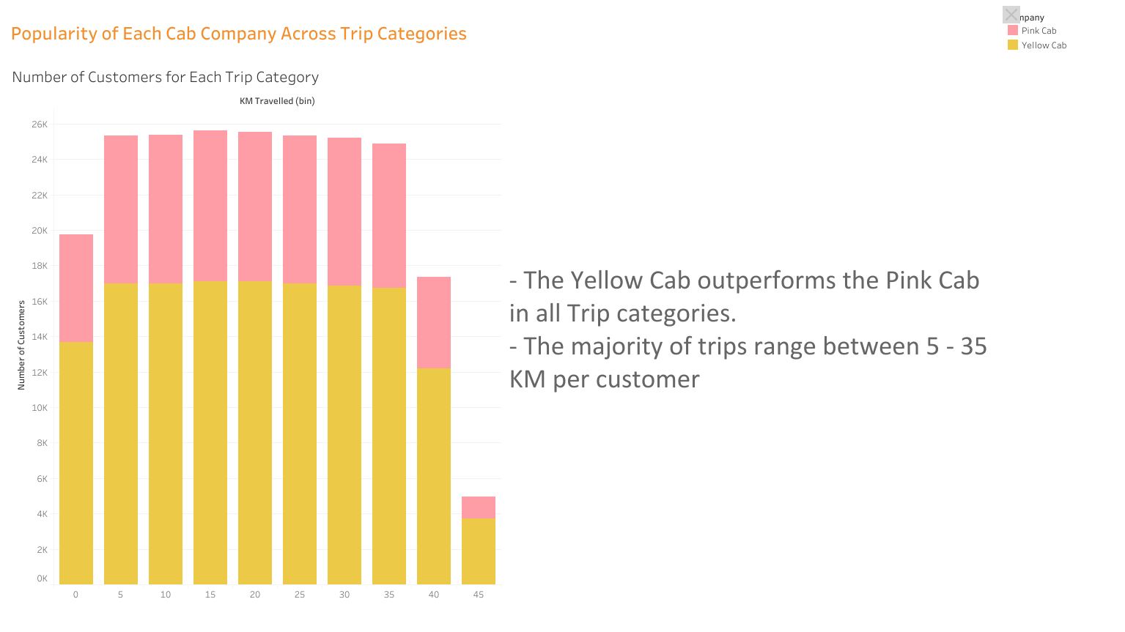

Slide 11
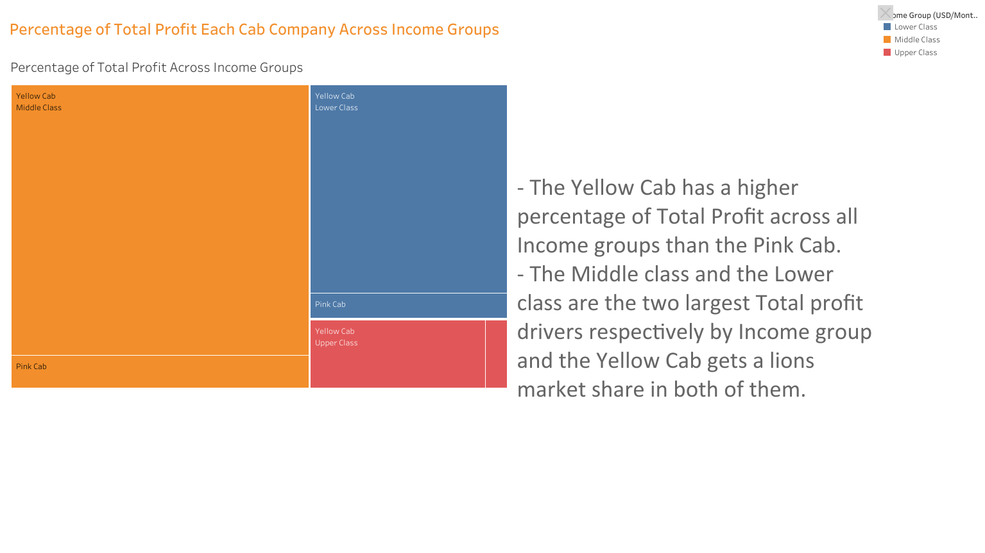

Slide 12
Recommendations for Investment
We have evaluated both companies on the following points and found the Yellow cab better than the Pink Cab on the following aspects:
Age Wise Reach – Yellow Cab company has more customers across all age groups including the younger and older ones.
Customer Reach – Yellow Cab company has more customers in all cities except in four cities.
Total Profit across Income Groups – We observed that the Yellow Cab gets a higher percentage of total profit across all income groups but especially from Lower and Middle income groups.
Popularity across Trip Categories – We observed that the Yellow Cab has a higher market share across each Trip Category.
Preference across Gender roles – The Yellow Cab has more male and female customers than the Pink cab across all Cities.
Revenue Generation – The Yellow Cab nets more revenue than Pink Cab in almost all cities.
On the basis of the above analysis, we recommend the Yellow Cab company for investment.

Slide 13

Questions?
Thank You

