Slide 1
Who we are?

Slide 2

We are group of young man that decide to simplify selling/buying air-tickets.

Slide 3
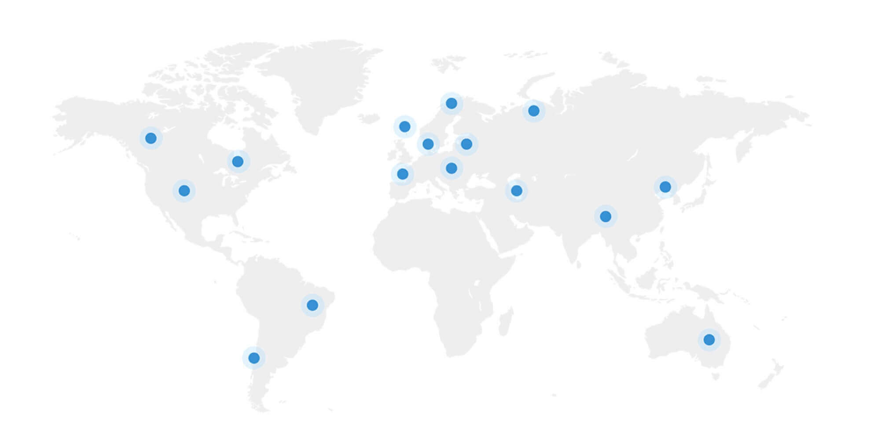
We work in about 15 countries in the world. Our company counts near 500 employees.

Slide 4

We are – decision for your trips!

