Slide 1

Air New Zealand Flight Booking System
Data Process & Software Modelling . Project Phase 1 – Presentation
Christian Cantos - 23188023

Slide 2
Organization Background
Air New Zealand is one of the biggest aviation industry in the Asia-Pacific and also the national airline in New Zealand
Employs 11,700 people globally.
It provides both domestic and international flight services.
Handles large volume of daily operations, including flight scheduling, passenger’s booking, and customer service management.
The airline heavily relies on digital systems to manage flight, bookings, and customer interactions.

Slide 3
Current System
Air New Zealand currently relies on:
fragmented tools
manual processes
Notes:
Fragmented tools – uses multiple, non-integrated applications to manage different business operations.
Manual Processes – processes performed by staffs such as data entry, document handling, manual approvals which causes bottlenecks
Because of this current system it leads to next slide. . .

Slide 4
Challenges & Inefficiencies
Disconnected Systems
Manual Processes
No real-time updates
Data inconsistency
Poor coordination
Weak customer experience
Notes:
The system faces these several challenges
Disconnected systems – results to scattered data
Manual processes – leads to error and consumes a lot of time.
No real-time updates – lack of accuracy
Leads to Data inconsistency & Poor coordination
Affects customer experience
Because of these inefficiencies it causes negative effects in:
staff productivity, high workload, high chance of error, etc.
Customer satisfaction, poor service, loss of trust

Slide 5
Flight Booking System
To addressed these challenges, there is a clear need for a centralized, integrated flight booking system that can:
Provides a single platform for managing flights, bookings, and customer data.
Automate key processes such as booking, cancellations, and seat management
Enable real-time updates and accurate tracking of flight and booking information
Improve coordination between staff and departments
Enhance the overall customer experience through faster and more reliable services.
Notes:
Staff uses one centralized system means no more scattered data.
No more manual updates such as booking status, seat count
No more inaccuracy across staff and departments, also for customers.
Means that all staff across different departments shares the same correct information.
Customer satisfaction

Slide 6
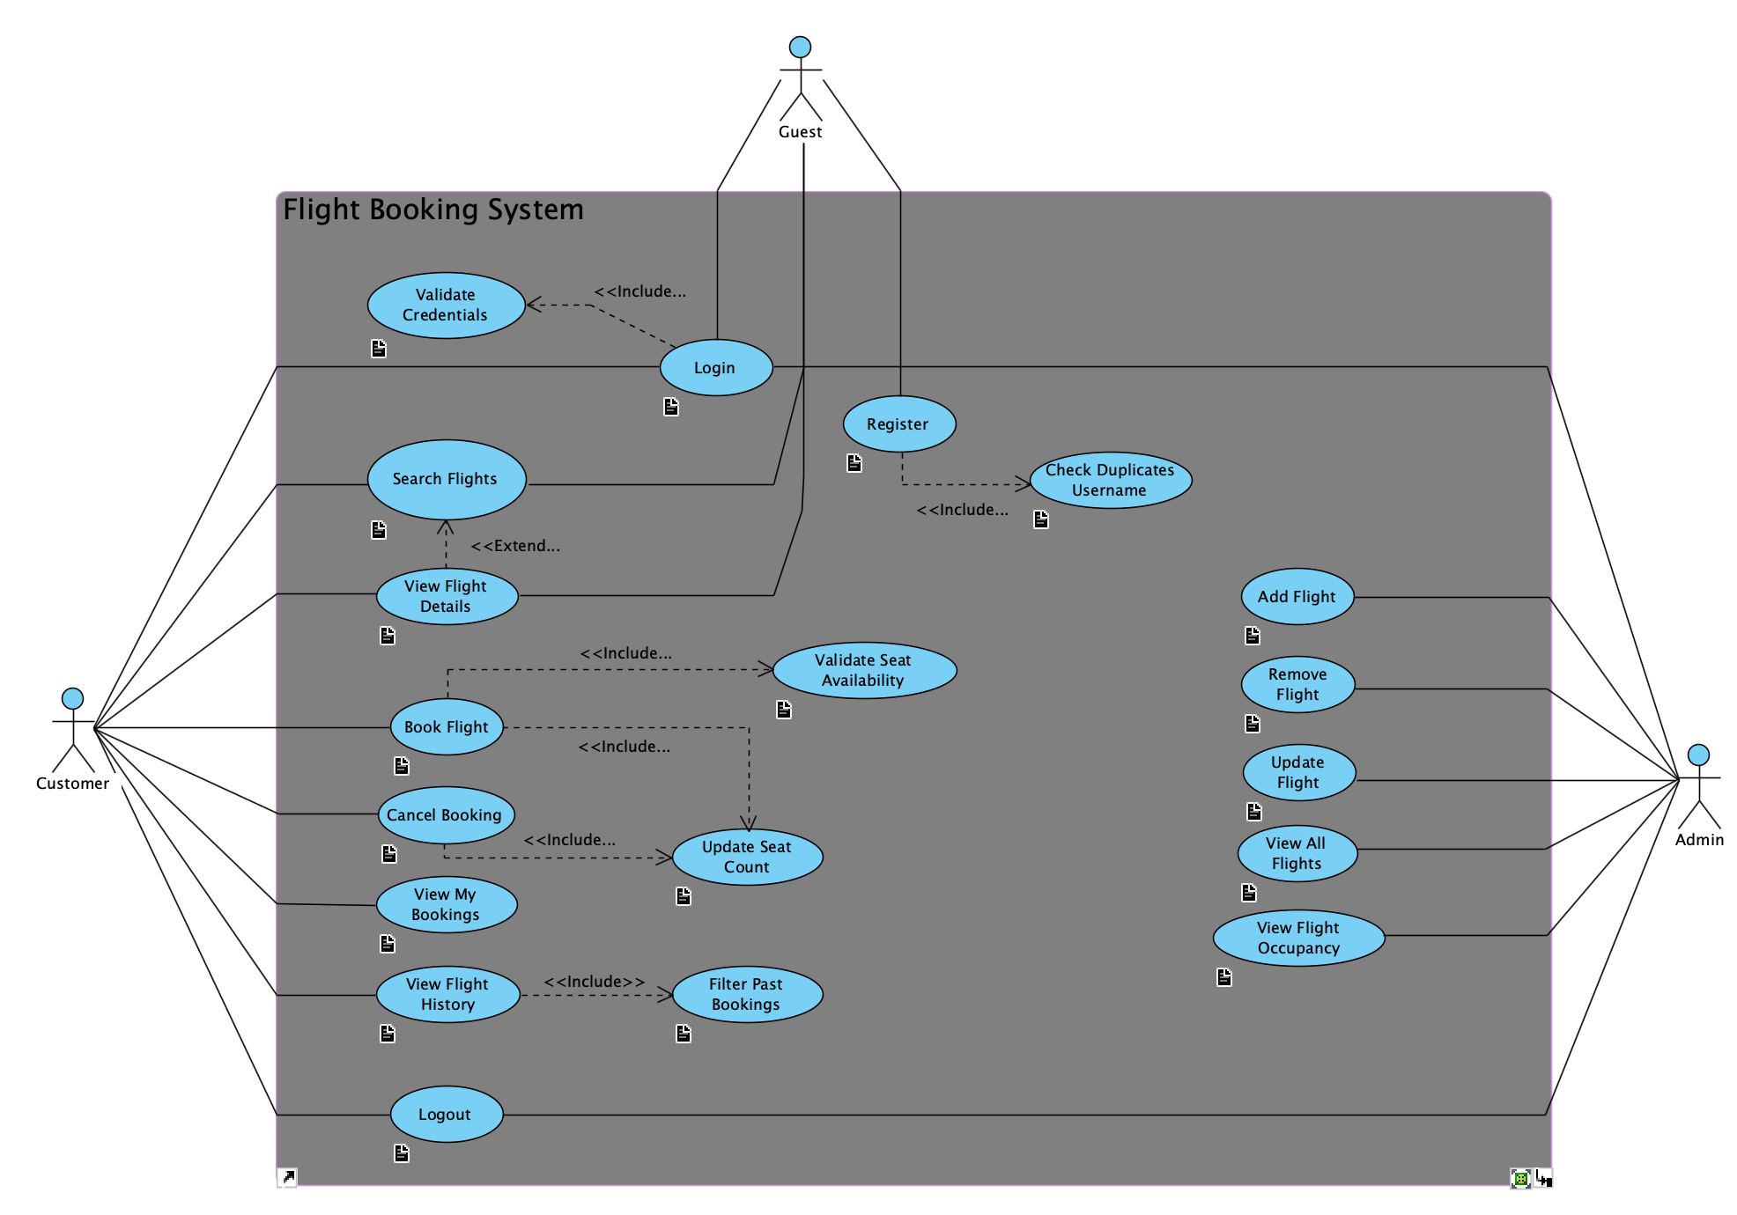
Use Case Diagram

Slide 7
System Design
Layered Architecture
Role-based access
Centralized system
OOP-based design
Notes:
1. Layered architecture – separated by 4 layers where each layer has its specific responsibility
2. Role based access – users are assigned roles where system checks the user’s role and provides specific features.
3. Centralized system – booking and flight management is handled by one system.
4. OOP-based design – system is design using object-oriented principles.

Slide 8
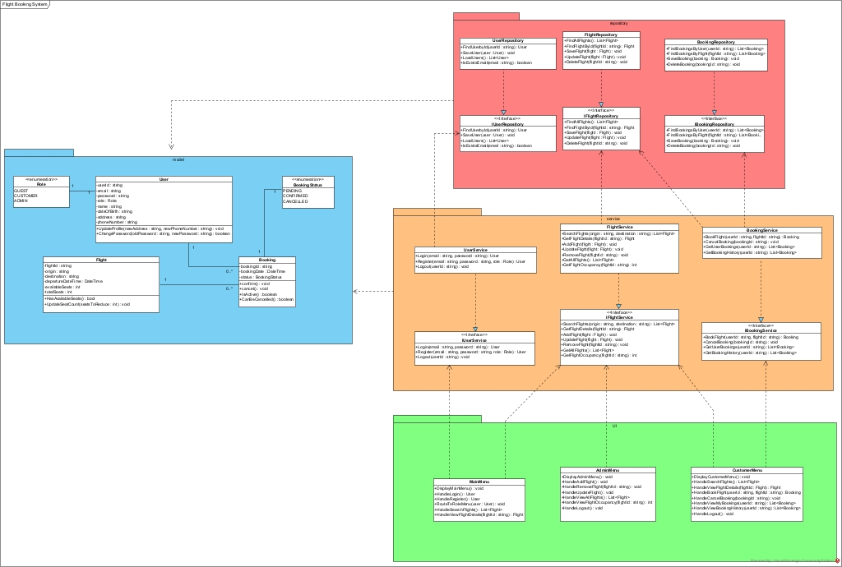
UML Class Diagram
Repository Layer
Model Layer
Service Layer
UI Layer
Notes:
Model Layer – Data & Behaviors
Repository Layer – Persistence
Service Layer – Business Rules
UI Layer – User Interaction

Slide 9
Live Demo
Core Functionalities:
User authentication
Login
Logout
Register
Role-base Access
Flight management
Adding Flight
View all flights
And booking operations
Search flights
View flight details
Book flights
View bookings

Slide 10
Next Phase
Fully functional flight booking system implementing all business rules
Add some users such as (Front Desk Staff, Loyal Customer, Flight Manager)
Database
Ticket Generator
Payment Processing Simulation

