Slide 1
INTEGRATED WEB-BASED RFID: ENABLED STUDENTS’ SECURITY AND MONITORING SYSTEM

Slide 2
OUR TEAM
BACK-END AND DATABASE: SALVA, JOHN IAN
FRONTEND: COMPRA, JANDHEL
PROJECT MANAGER: CABASA, CHRISTIAN DAVE
DOCUMENTATION: VILLAMOR, RAMPHIL FE
RESEARCHER: SENO, BELLE MONIQUE
: CAGULANG, KERVIE

Slide 3
RATIONALE
Educational institutions need effective systems to ensure campus safety.
Traditional and manual ID checking methods are inefficient and prone to errors.
RFID technology can automate identification and monitoring processes.
The system aims to improve campus security, access control, and data management.

Slide 4
Theoretical background
The Diffusion of Innovations Theory (Rogers, 1962)
The General Systems Theory (Bertalanffy, 1968)
The Defense in Depth Theory (Schneier, 2000)
The Privacy Calculus Theory (Dinev and Hart, 2006)
Automatic Identification and Data Capture (AIDC) Theory (Kumar, S., et al., 2022)
RFID Security and Privacy Theory (Kumar, A., Jain, A. K., & Dua, M., 2021)

Slide 5
THE problem
Manual ID checking causes delays and inaccurate records.
There is no centralized database for real-time monitoring.
The system cannot effectively prevent unauthorized access.
Report generation is inefficient for attendance and monitoring.
The system lacks efficiency, usability, accuracy, and reliability.

Slide 6
Objective of the Study
To automate ID checking and recording to reduce delays and errors.
To develop a centralized database for real-time monitoring.
To improve security by preventing unauthorized access using RFID.
To automatically generate accurate attendance and monitoring reports.
To evaluate system performance in efficiency, usability, accuracy, and reliability.

Slide 7
Scope AND limitation
The study develops an RFID-based student identification and monitoring system that enhances campus security by automating entry and exit records using RFID-enabled ID cards, readers, and a centralized database. It is limited to designated school access points, depends on functional hardware, power, and internet connectivity, and is evaluated in a single educational institution.

Slide 8
limitation
Limited to selected campus areas; not full-scale.
No biometrics, facial recognition, or CCTV integration.
Depends on proper card use, power, and internet.
Lost, damaged, or misused cards are not controlled.
Cannot fully eliminate campus security risks.

Slide 9
Significance of the Study
School Administration
Students
Security Personnel
Future Researchers
Parents/Guardian

Slide 10
REVIEW OF
RELATED LITERATURE
RFID Applications and Security Review
- Muñoz-Ausecha et al., (2021)
RFID System for Fixed Asset Monitoring in Universities
- Begmanov and Yenradee (2021)
RFID for Security and Tracking Systems
- Zakaria et al. (2024)
RFID-Based Smart Lock and Attendance Monitoring System
- Imran et al. (2024)
Integration of RFID and IoT for Storeroom Monitoring“
- Ramly and Supirno (2025)

Slide 11
REVIEW OF
RELATED STUDIES
RFID Technology Overview and Applications
- Landt (2005)
RFID-Based Access Control Systems in Institutions
- Karygiannis et al. (2007)
RFID Attendance System for Educational Efficiency
- Hasman and Ahmad (2013)
ICT and RFID for Campus Security and Access Control
- Turcu et al. (2015)
RFID-Based Student Attendance and Monitoring Systems
- Farida et al. (2025)

Slide 12


FRONt-END
DEVELOPMENT TOOLS

Slide 13


FRONt-END
DESIGN
BACK-END
TECHNOLOGY

Slide 14



INTEGRATED DEVELOPMENT
ENVIRONTMENT
DATABASE
MANAGEMENT
SYSTEM
BACK-END FRAMEWORK

Slide 15



API DEVELOPMENT
API URL TEST
BUILD TOOL

Slide 16
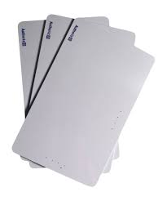
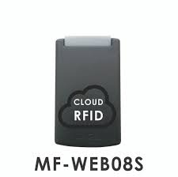
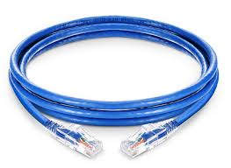

Slide 17
PROJECT FEASIBILITY
The feasibility evaluation of the Integrated Web-Based RFID-Enabled Students' Security and Monitoring System is suitable for implementation at Benedicto College. The system proved technically reliable, operationally effective, economically practical, and was completed within the project timeline. It enables accurate real-time student monitoring, reduces manual work and costs, improves administrative efficiency and campus security, and provides a scalable foundation for future system enhancements.

Slide 18
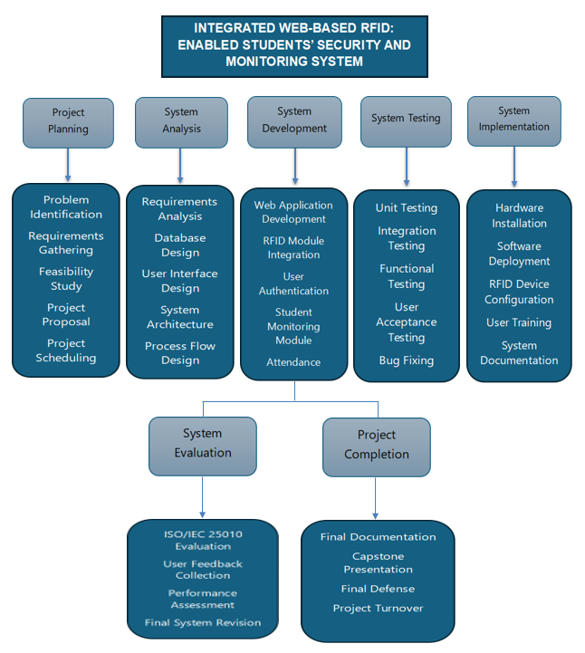
Work breakdown structure

Slide 19
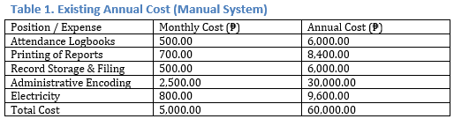
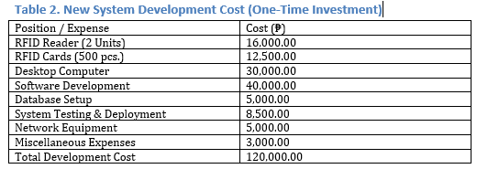
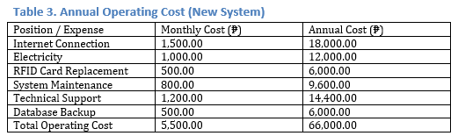
Cost
and benefits

Slide 20
moscow

Slide 21
Must Have:
1. RFID Card Scanning
2. Student Identification
3. Authentication & Authorization
4. Database Integration (CRUD Operations)
5. Attendance Recording
6. Secure Data Storage
7. Logout Function
Should Have:
1. Attendance Dashboard
2. RFID Registration Module
3. Student Profile Page
4. Mobile Compatibility (Responsive Design)
5. Report Generation
6. Notification Alerts

Slide 22
Could Have:
1. Real-Time Monitoring Screen
2. SMS / Email Notifications
3. Dark Mode
4. Activity Logs
Won’t Have:
1. Online Payment Integration
2. Biometric Fingerprint Integration
3. Facial Recognition System
4. GPS Tracking
5. Advanced Analytics / Machine Learning Predictions

Slide 23
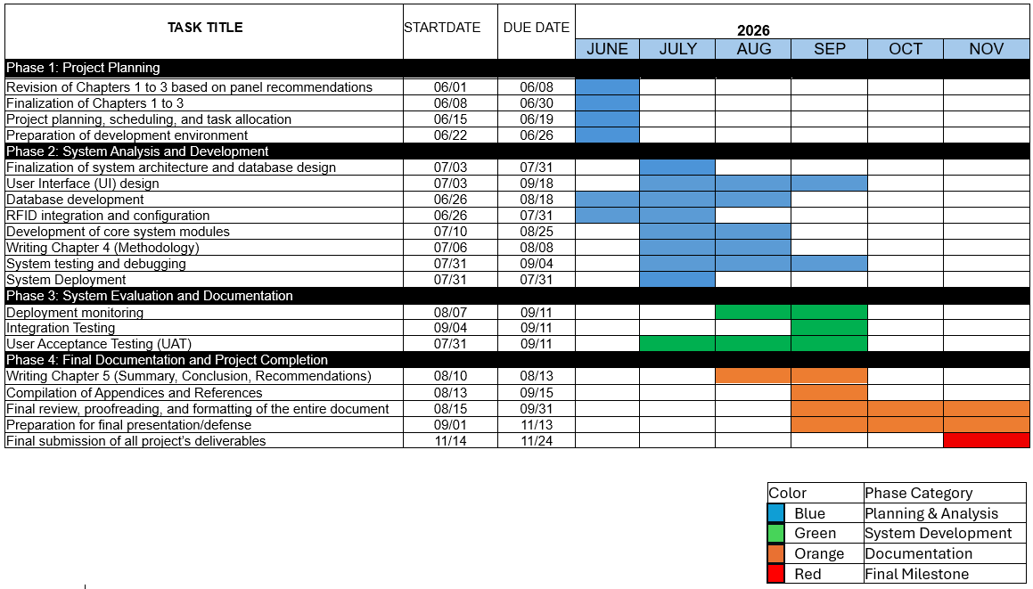
Gantt chart

Slide 24
Critical paTH

Slide 25
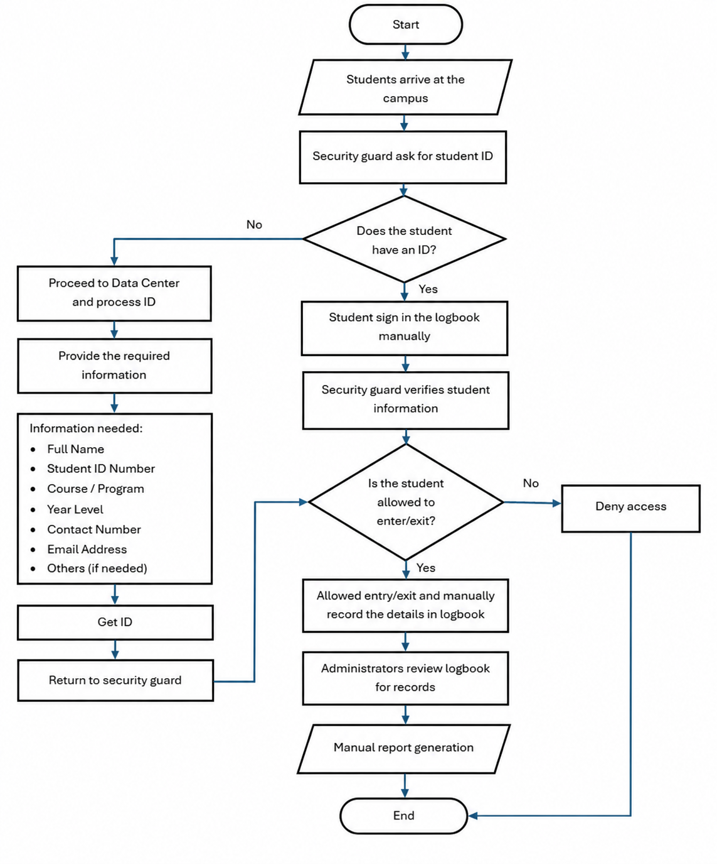
Existing flowchart

Slide 26
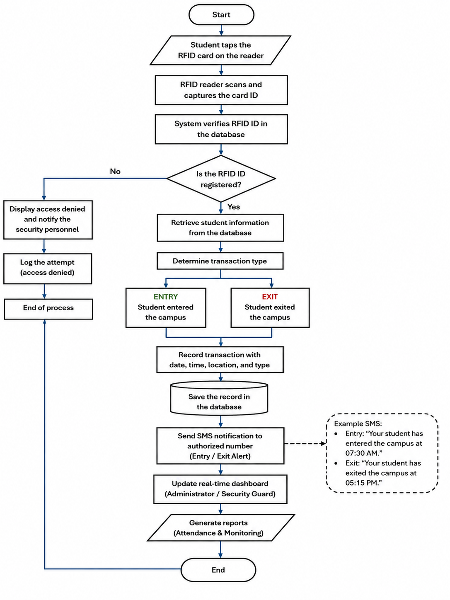
proposed flowchart

Slide 27
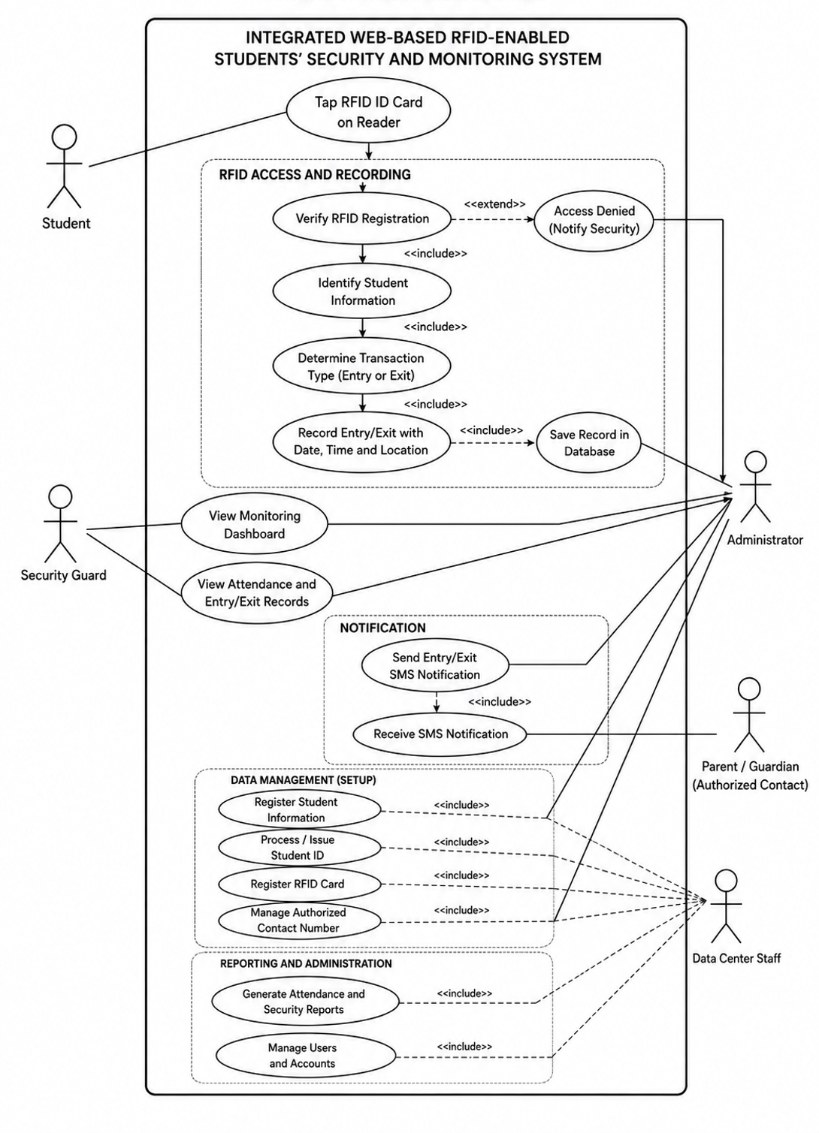
Use case diagram

Slide 28
Field | Details
Use Case | Log In
Summary | Users can log in to the RFID system by scanning their registered RFID card or tag. The system verifies the RFID credentials before granting access.
Actors | Parents/Guardians
Purpose | To provide a secure and efficient way for authorized users to access the RFID system.
Pre-condition | Users have a registered RFID card/tag and valid credentials. The RFID reader and system are operational.
Post-condition | The user's identity is successfully verified, access is granted, and the login/entry record is stored in the database.
Exception | Unregistered RFID card/tag, invalid credentials, RFID reader failure, network failure, or database connection failure.
Login use case

Slide 29
Flow of Events
Actor Response | System Response
1. Open RFID System | 2. Activate RFID Reader
3. Enter Username & Password | 4. Verify Login Credentials 5. Display RFID Dashboard
6. Scan RFID Card/Tag | 7. Read and verify RFID Card/Tag 8. Record user login/attendance and display successful verification
Alternative Flow
Actor Response | System Response
1. Approach RFID Reader | 2. Activate RFID Reader
3. Scan RFID Card/Tag
4. Read RFID Card/Tag
 | 5. Verify RFID Card/Tag against database
 | 6. Grant access and display user information
Login use case

Slide 30
Use Case | Manage Users
Summary | Add new students or users to the RFID system
Actors | Super Admin, Admin
Purpose | To register students and assign their RFID cards to their user accounts
Pre-condition | Admin is logged in and has access to user management
Post-condition | Student/user is successfully registered and RFID card is linked to their account
Exception | Duplicate Student ID, duplicate RFID card, invalid data format, or unreadable RFID card
Use Case | Manage Users
Add users use case

Slide 31
Flow of Events
Actor Response | System Response
1. Click Students Dashboard | 2. Display Students Dashboard
3. Click Add Student | 4. Display Add User Form
5. Upload profile photo, student level, full name, email address, tag id, status, parent name, parent contact number, parent email | 6. Validate entered information
7. Click Add Student | 8. Successfully add user to the dashboard
Alternative Flow
Actor Response | System Response
1. Required field is blank | 2. Cannot add student
3. Student ID already exists | 4. Error: "Student ID already registered"
5. Invalid student information | 6 Error: "Invalid data format"
7. RFID card cannot be detected | 8. Error: "RFID Card not detected"
Add users use case

Slide 32
Field | Details
Use Case | Record Attendance
Summary | Students scan their RFID cards to record their attendance in the school system
Actors | Students
Purpose | To allow students to record their attendance quickly and accurately using their assigned RFID cards
Pre-condition | The student is registered in the system and has an assigned RFID card
Post-condition | Student attendance is successfully recorded in the system
Exception | Unregistered RFID card, duplicate attendance scan, RFID card not detected, or system error
Scanning process use case

Slide 33
Flow of Events
Actor Response | System Response
1. Approach RFID Scanner | 2. Display RFID scanning interface
3. Scan RFID Card | 4. Read and validate RFID Card
5. Wait for verification | 6. Verify student information
7. Attendance verified | 8. Record student attendance
9. Attendance recorded | 10. Display attendance confirmation message
Alternative Flow
Actor Response | System Response
1. RFID card not detected | 2. Error: "RFID Card not detected. Please scan again."
3. Unregistered RFID card | 4. Error: "RFID Card is not registered."
5. Duplicate attendance scan | 6. Error: "Attendance has already been recorded."
7. System/database error | 8. Error: "Invalid data format"
Scanning process use case

Slide 34
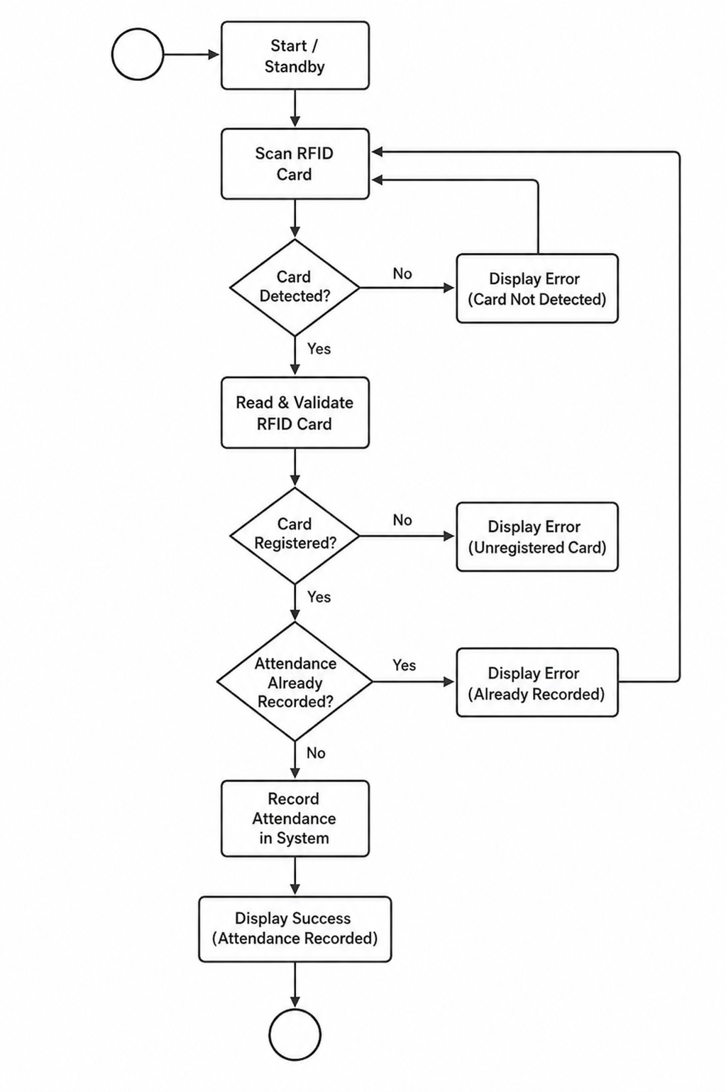
State chart
diagram

Slide 35
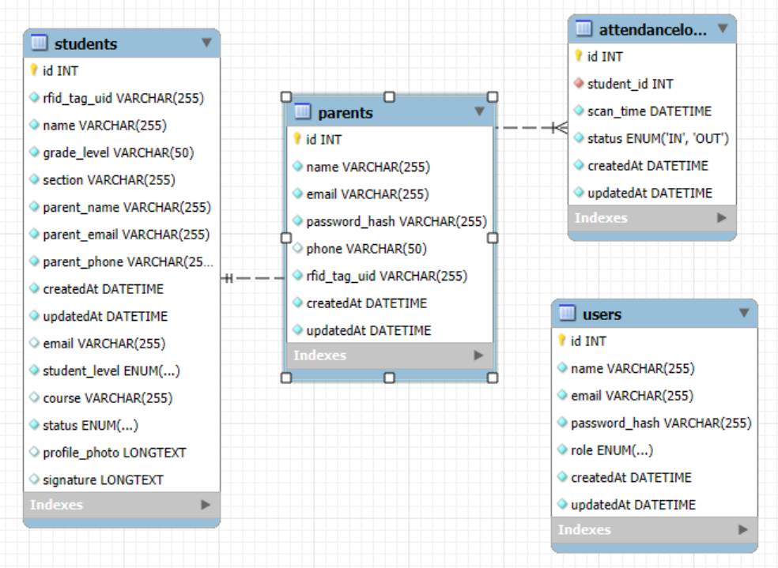
Entity relationship diagram

Slide 36
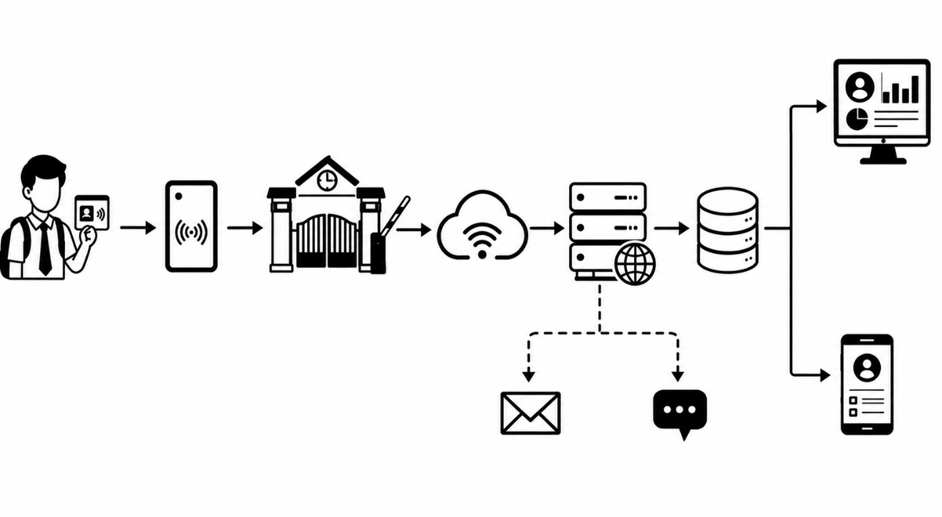
System
architecture

Slide 37
Security implementation
The school monitoring system that uses RFID technology has a security plan to keep student information safe. This includes student details, attendance records and the system itself. Students use RFID cards to show when they come in and go out. Parents or guardians can check their childs attendance. Get messages securely. Administrators handle user accounts, RFID cards, attendance data and system settings. They do this by using role-based access control. Passwords are kept safe by being hashed. Data is protected when it moves over the internet using HTTPS. If an RFID card is lost or used by someone not supposed to it can be turned off. All important actions are written down in a record so that everyone knows what happened. This helps keep everything correct and makes sure that only the right people can access things. It makes the school monitoring system safe and dependable.

Slide 38
Development methodology and implementation
----------------------------------------------------

Slide 39
summary
The system automates student identification and records arrival and departure times in a centralized database, while providing SMS notifications to parents or guardians. It offers a faster, more efficient, and reliable alternative to manual monitoring, with security measures to protect student information.

Slide 40
conclusion
The system enhances student monitoring at Benedicto College through automated entry and exit recording, centralized data management, and efficient attendance reporting. It is technically and operationally feasible, user-friendly, and cost-effective in the long term. However, its effectiveness depends on reliable RFID devices, electricity, access points, and network connectivity.

Slide 41
Recommendation
The study recommends that educational institutions implement RFID-based monitoring, provide stakeholder training, and conduct regular system maintenance. Future enhancements should include expanded RFID coverage, offline data storage, improved notifications, customizable reports, and stronger security. Further research should evaluate the system’s reliability, usability, effectiveness, and data privacy in other educational institutions.

Slide 42
THANK YOU

