Slide 1
DukaSmart
Know your stock. Grow your business.
github.com/Ianodad/dukasmart

Slide 2
The notebook problem
Most Kenyan duka owners run their whole business from memory and a paper notebook.
At the end of the day they can't answer three simple questions:
• How much did I actually sell today — cash vs M-PESA?
• What did today really cost me, and what's my profit?
• Does the cash in my drawer match what it should be?

Slide 3
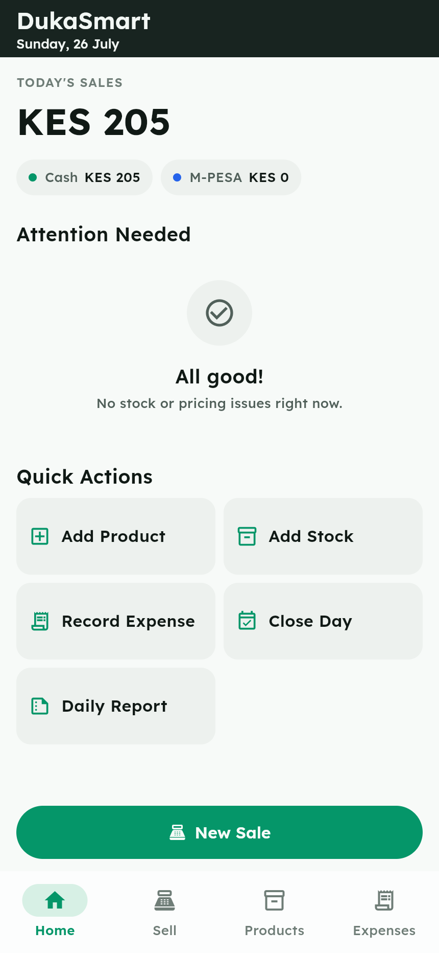
One app. One kiosk. One phone.
• Offline-first — all data lives on the phone
• Products & stock with low-stock alerts
• Fast POS: cash (with change) or M-PESA
• Expenses, incl. till cash-outs for stock
• Close Day: profit + drawer reconciliation
• Plain-language daily report & insight

Slide 4
Today at a glance
Sales, cash vs M-PESA split, and an Attention list for stock and pricing issues.

Slide 5
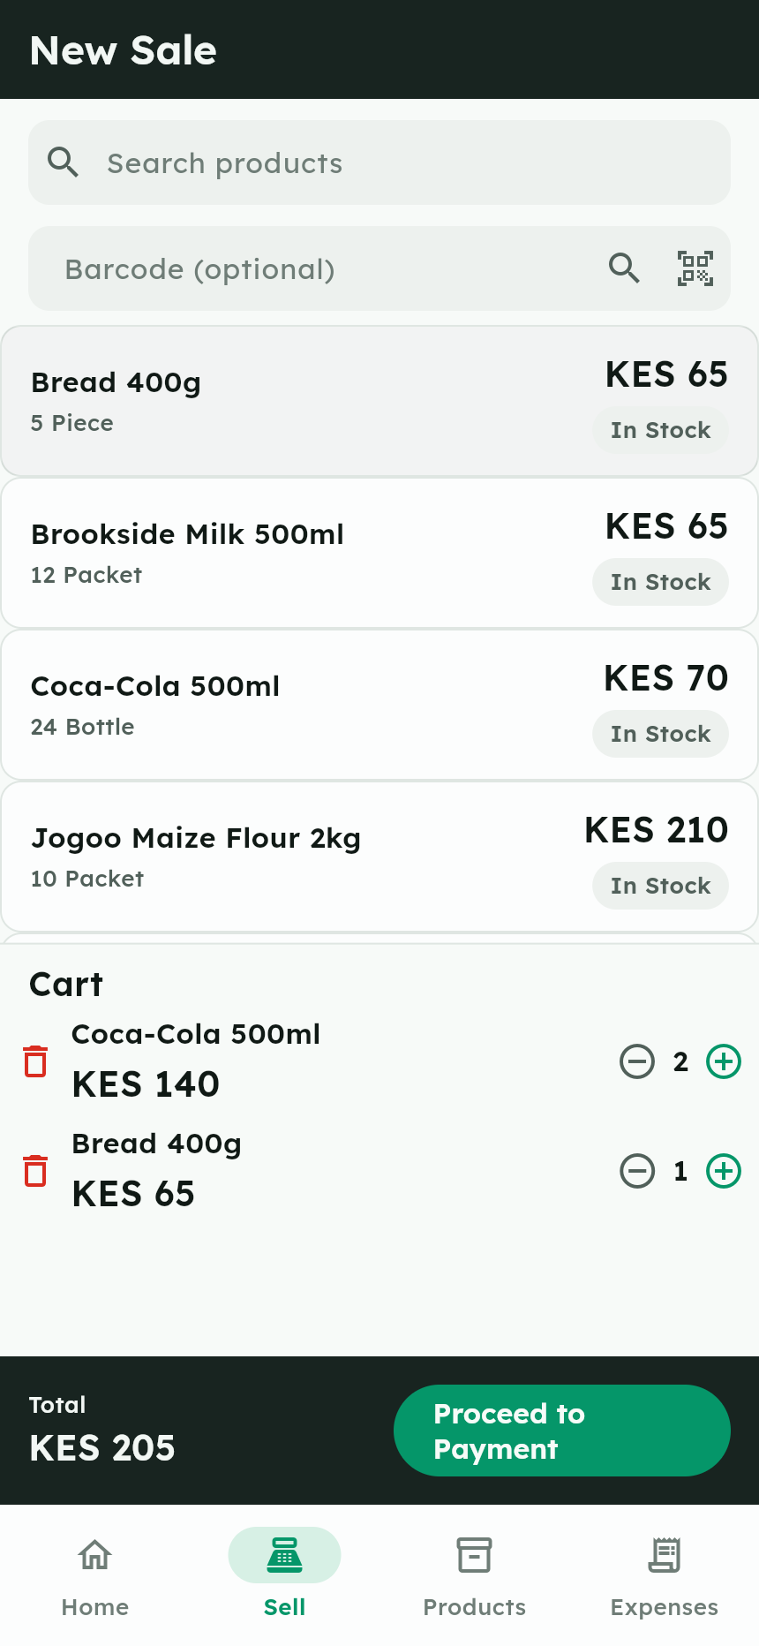
Sell in seconds
Tap products into the cart — live totals, quantity steppers, no overselling.

Slide 6
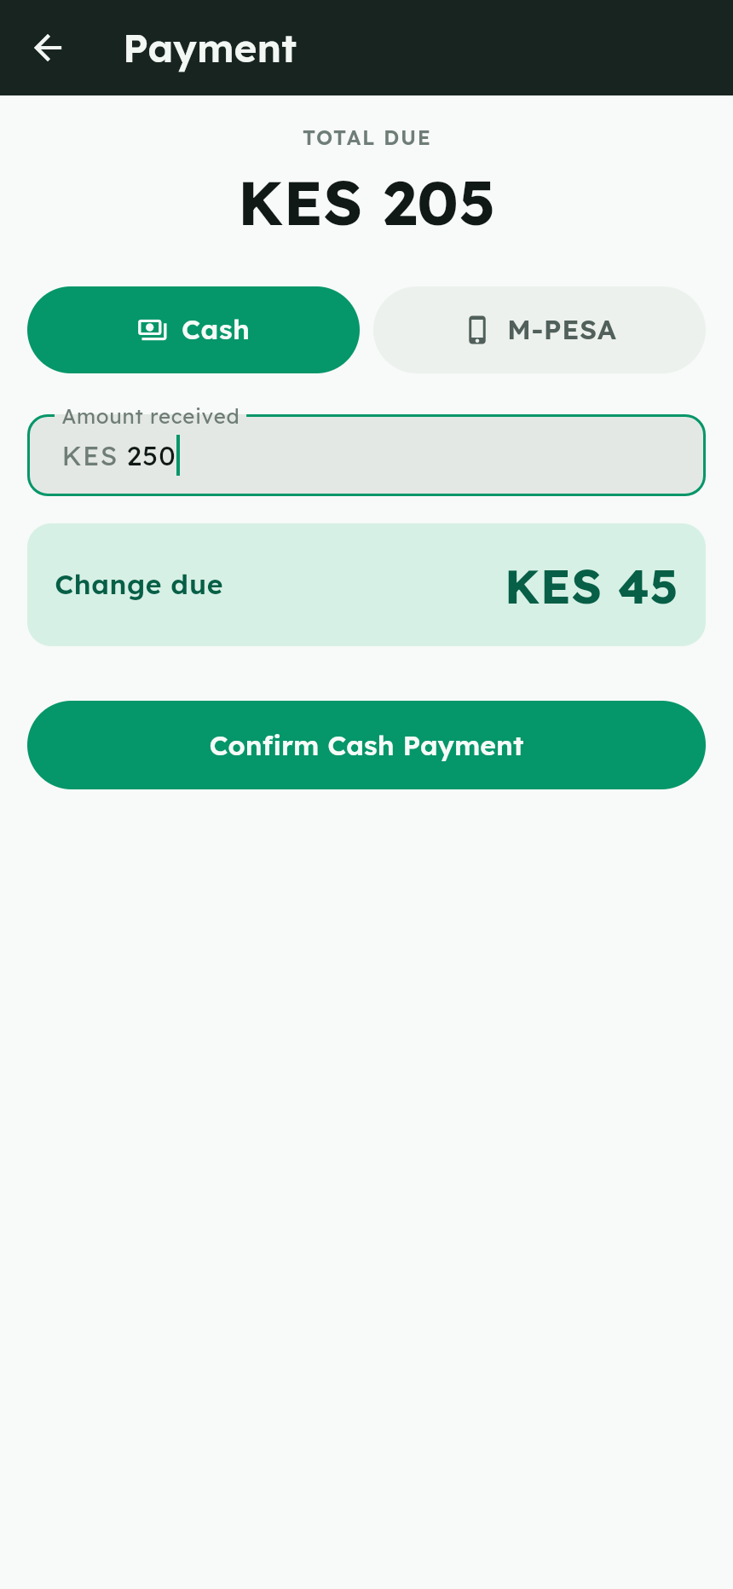
Cash or M-PESA
Change is computed instantly; M-PESA recorded with optional transaction code.

Slide 7
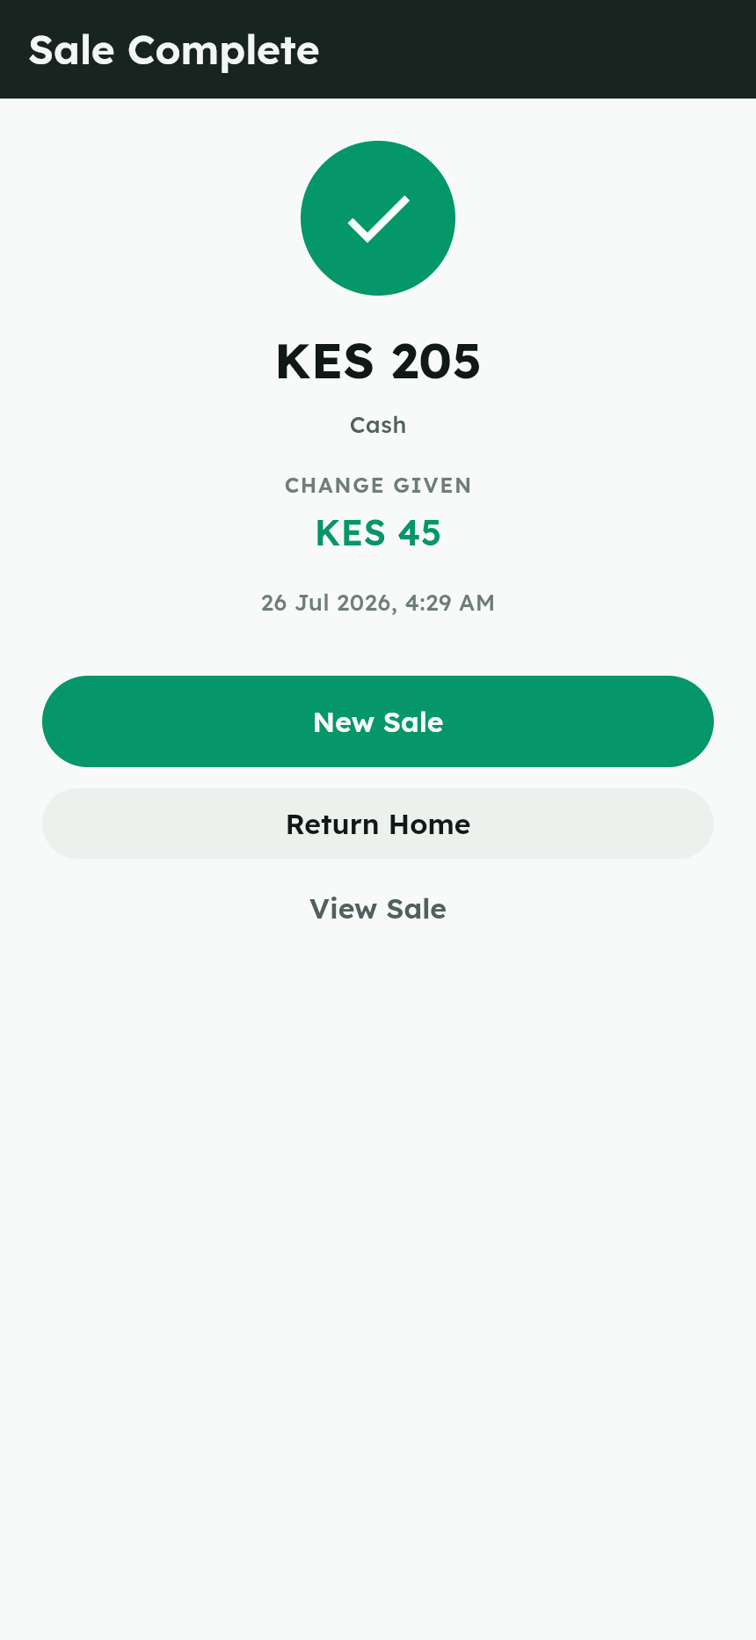
Every sale locks the books
Stock reduces automatically and every movement is recorded for history.

Slide 8
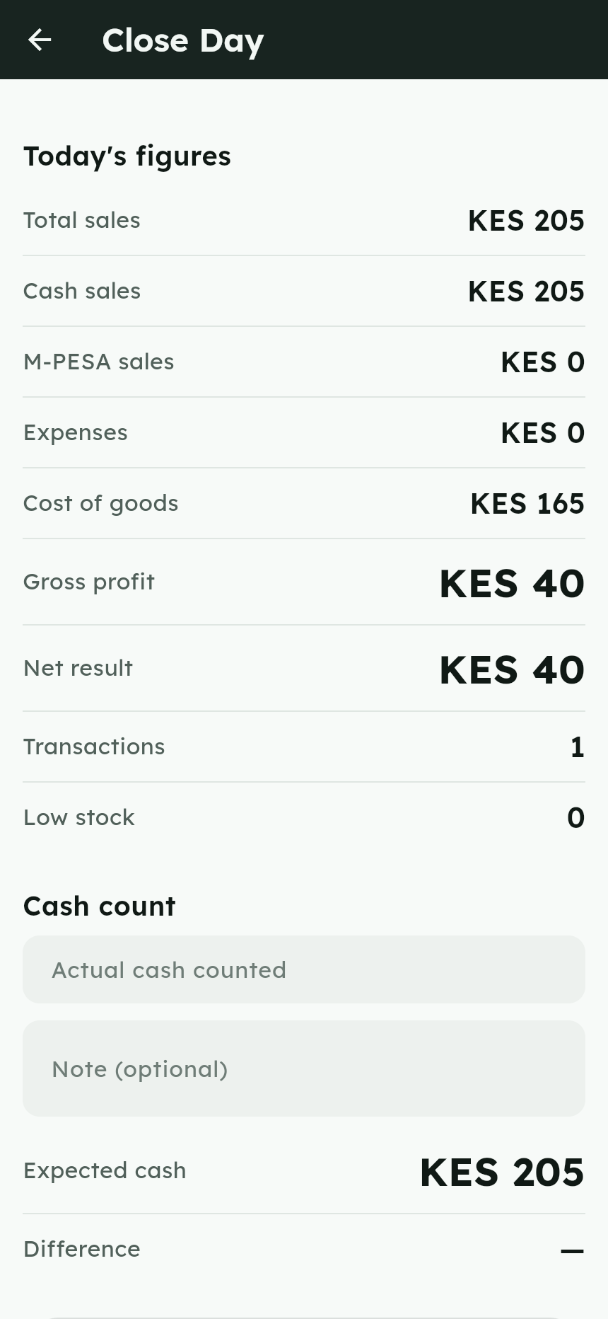
Close the day with confidence
Gross and net profit, expected vs actual cash — short or over, you know.

Slide 9
Under the hood
• Flutter + Riverpod + GoRouter — one codebase, Android-first
• Drift / SQLite — offline, transactional, every shilling stored as integer cents
• 125 automated tests: money math, DAO invariants, day bounds, read models
• Independently code-reviewed (all findings fixed) · MIT licensed

Slide 10
Try it
Source, screenshots & demo video: github.com/Ianodad/dukasmart
Android APK: github.com/Ianodad/dukasmart/releases

