Slide 1
Perceptron
It was invented by Frank Rosenblatt in January 1957 at Cornell Aeronautical Laboratory, Inc at Buffalo, New York.
It was different than we first neuron saw. → Input = binary
TUL → Linear threshold unit
TLU →Threshold logic unit
Task of Good cup of tea → Binary classification Good tea / Bad Tea
1kg Milk → 1kg Tea→ 1kg Sugar

Slide 2
Epoch
Back Prapogation
Y = predicted
1kg Milk
1kg Tea
1kg Sugar
Activation
Function
X1
X2
X3
w1
Good
0.20
w2
f
0.10
w3
0.05
Bad
Threshold = value
Forward

Slide 3
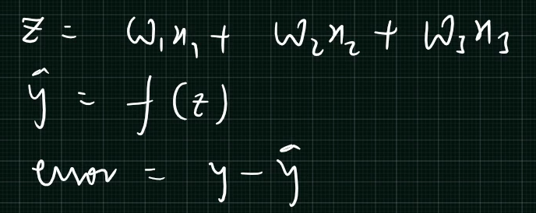
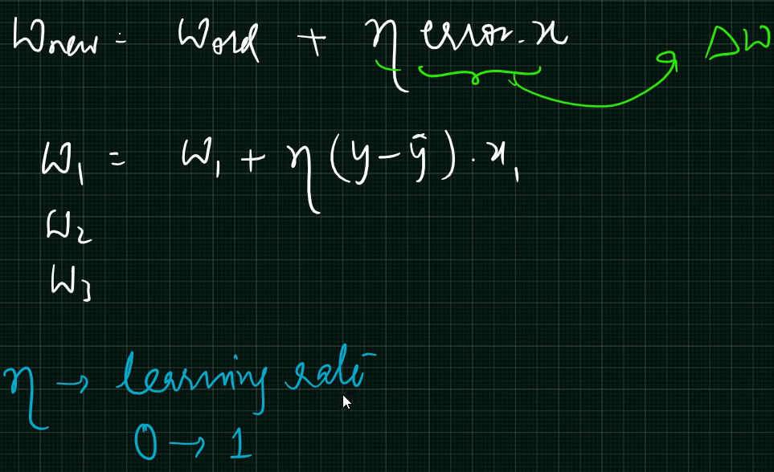
Activation Fun
Perceptron Weight Update Rule

Slide 4
Sigmoid Activation Function
For Binary Classification
Sigmoid = 1/1+e^{–y} = 1/1+e– Σ xiwi
X1
w1
Hidden Layer
X2
Output
w2
1
Σ xiwi
+ Bias
2
Act(y)
Output = 0 or 1
If >= 5 → 1
If <5 → 0
X3
w3
Σ xiwi = w^{T} X

Slide 5
Multi Layarad Neural Network
Multi Layard Hidden Neurons
Inputs
Outputs

Slide 6
Types of Activation Functions
Sigmoid

Slide 7
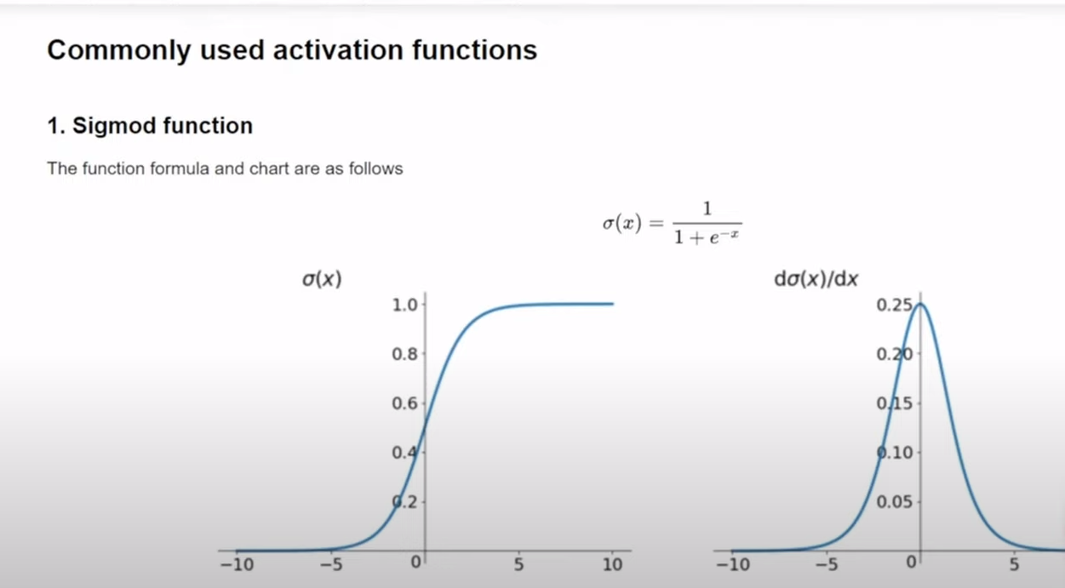
Sigmoid

Slide 8
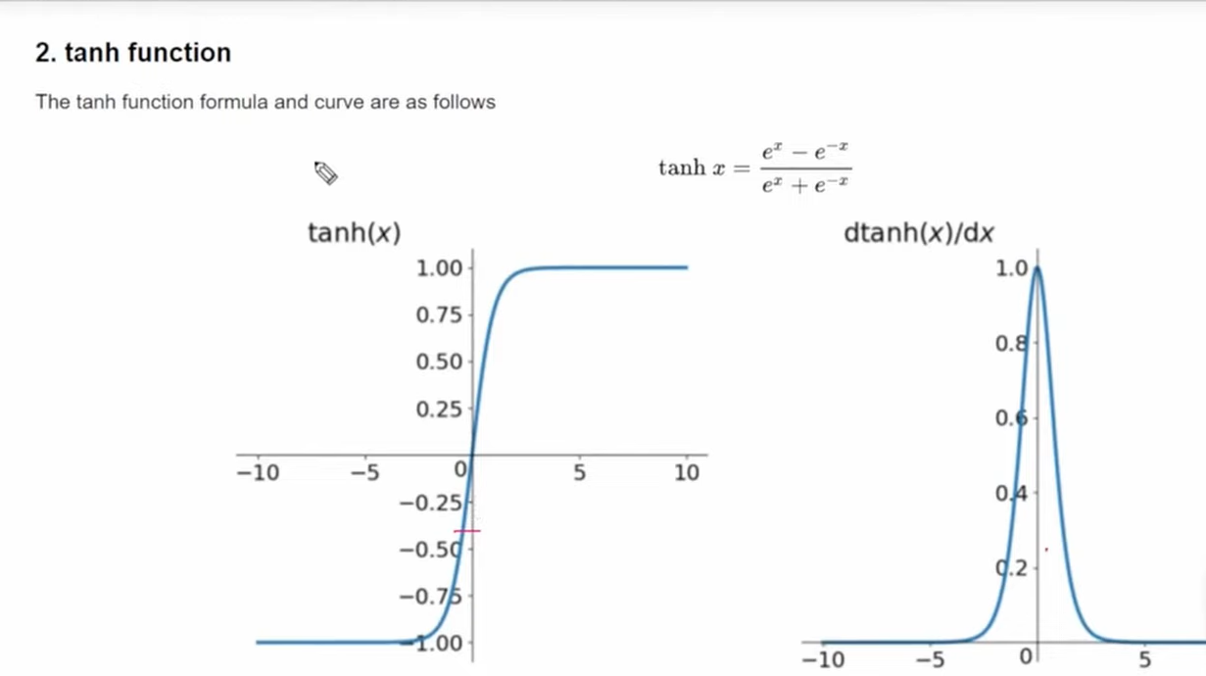
Tanh Function

Slide 9
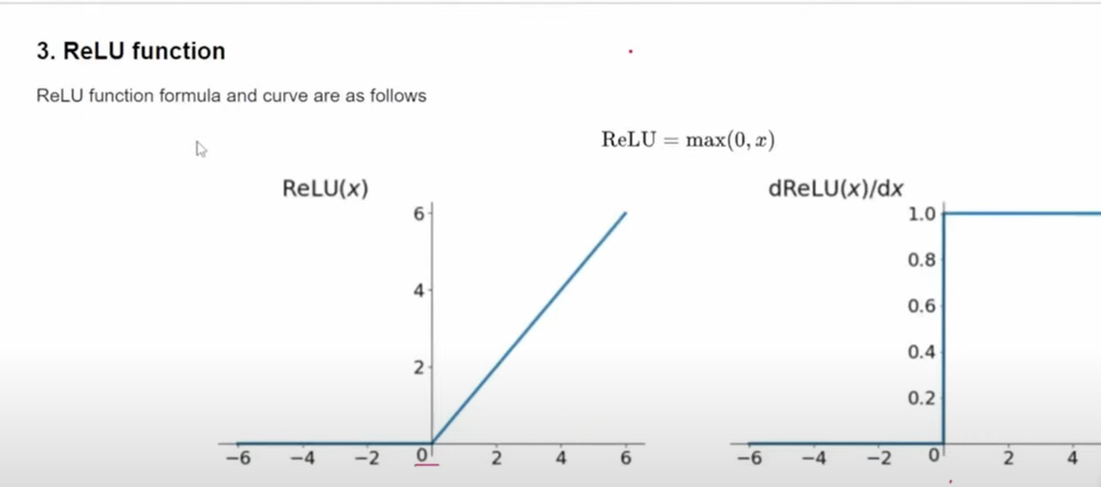
Rectified Linear Unit

Slide 10
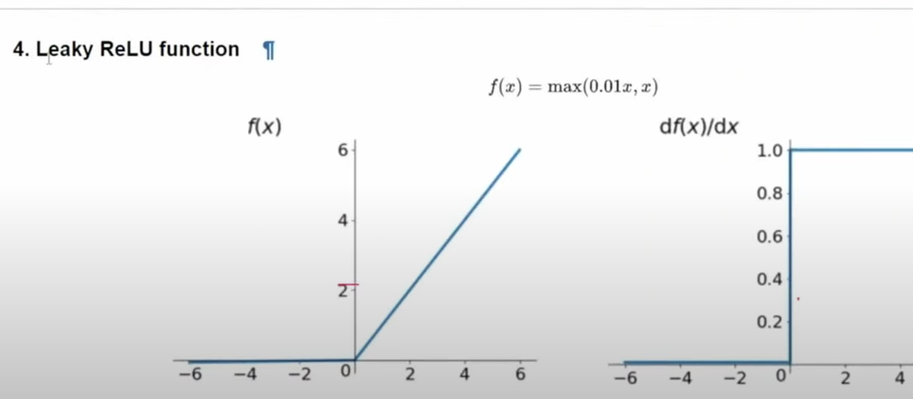
Leaky ReLU Solves Dead Neuron Problem

Slide 11
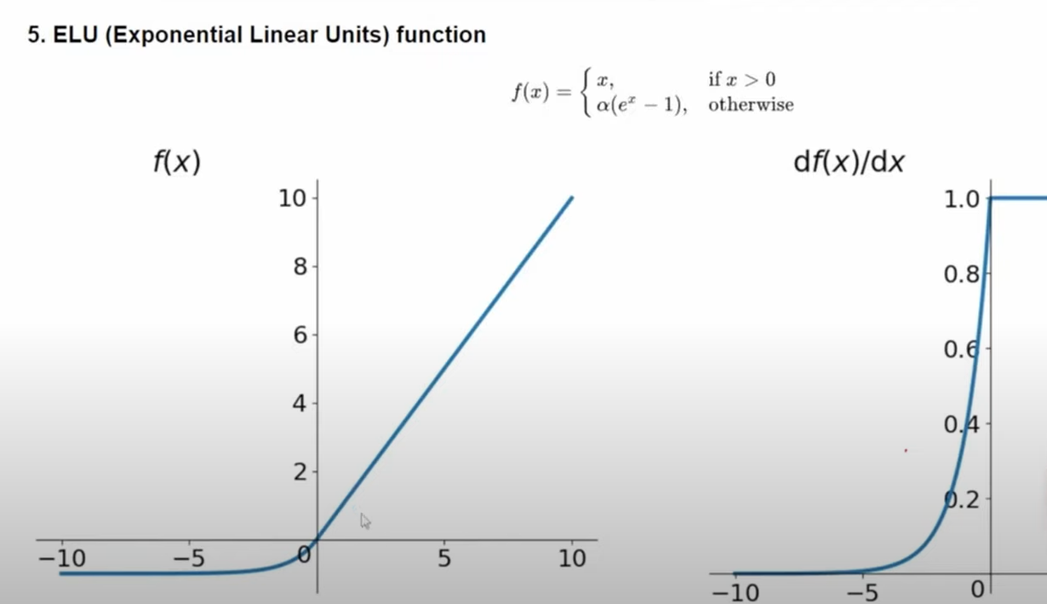
ELU

Slide 12
Multiclass Classification
Here Activation Function For Multiclass Classification is SoftMax
Relu
Soft Max

Slide 13
Regression
Loss Function
Relu
Linear Activation

Slide 14
Loss Function
Deep Learning (ANN)
Regression
Classification
Target column
Continuous values
Target column
Classification values
Loss Functions:-
MSE
MAE
Huber Loss

Slide 15
Cost And Loss Function
Loss = ½ (y-`y`)² for only one value loss is there
Say dataset 100 with 10 records
Cost function = ½ ^{n} _{i = 1} Σ (y-`y`)² for total batch

Slide 16
Loss Function
Mean Squared Error (MSE) :-
Loss Function = ½ * (y-’y’)² Cost Function = ½ * ^{n} _{i = 1} Σ (y-’y’)²
Advantages of Quadratic Equation = Gradient Decent
It will be differential
It has only one local / Global minima
It converges faster
Disadvantages
1. It is Not Robust to outliers

Slide 17
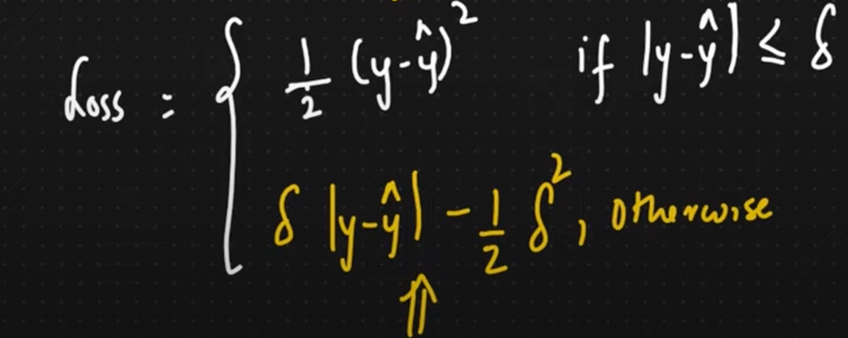
Mean Absolute Error
Loss Function = ½ * (y-’y’) Cost Function = ½ * ^{n} _{i = 1} Σ (y-’y’)
1.Robust to Outliers
-------------------------------------------------------------------------------------------------------------------------------------------------------------------------------------------------------------
Huber Loss:- Combination of MSE and MAE
Hyperparameter
If Outliers are Present

Slide 18
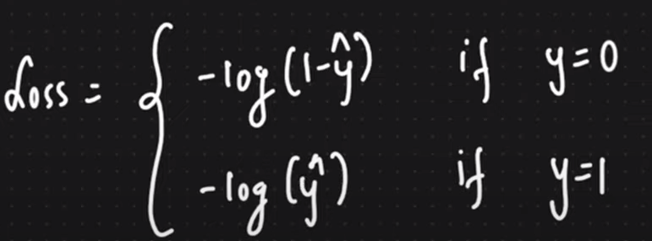
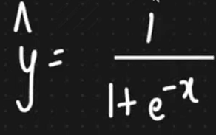
Classification Loss Function
Binary Cross Entropy
Binary
Cross Entropy
Categorical Cross Entropy
Multiclass
Binary Cross Entropy
-y * log(‘y’) – (1-y) * log(1-’y’) → Logistic Regression

Slide 19
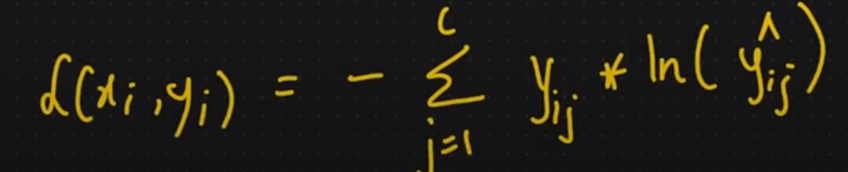
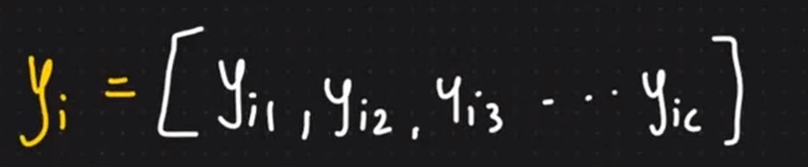
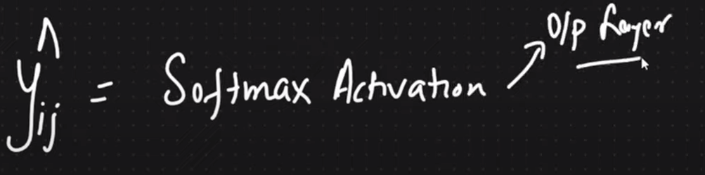
Categorical Cross Entropy
One Hot Encoding
f1 f2 f3 o/p Good Better Best
5 5 7 Good 1 0 0 i = rows, j = columns
6 4 3 Better 0 1 0
7 8 4 Best 0 0 1
Log base e
0 or 1

Slide 20
SoftMax
Interview Questions

Slide 21
Optimizers
1. Gradient Decent
Requires Lots of ram
2. Stochastic Gradient Decent
All datasets in Epochs
Ram Low but
Takes Time for convergence
Complexity High
Noise High
3.Mini batch Stochastic GD
3.Mini batch Stochastic GD
Epochs in batch size
Convergence Better
Time Complexity Improve
Less Noise
. How to remove noise
4. SGD with momentum
Smoothly by using Expo Weighted Avg.

Slide 22
Expo Weighted Mov Avg
Time Series → Forecasting
t1 t2 t3 t4 …tn
a1 a2 a3 a4 …an
Vt1 = a1
Vt2 = B(hyperparameter 0 – 1) * Vt1 + (1-B) * a2
= (0.97) * Vt1 + (0.03) * a2
Reduce Noise
Quicker Conversion
Also Work For Mini Batch

Slide 23
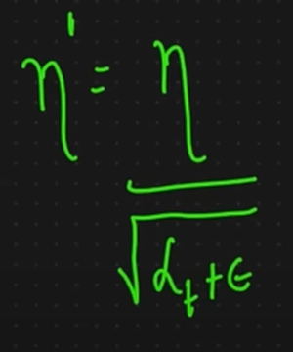
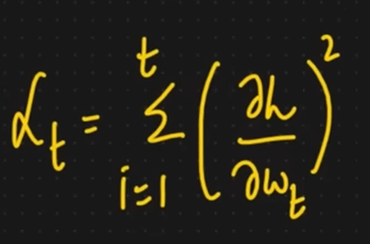
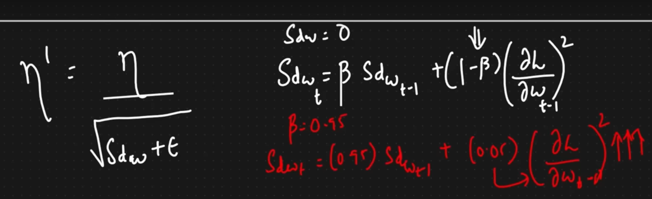
6.Adagrad
-Adaptive GD
-Imp Par – Learning Rate
As we go towards
Learning rate will decrease
-Learning rate n will change
In formula with n’ eta
7.RMSprop
-Controlling b-1
Small Number

Slide 24
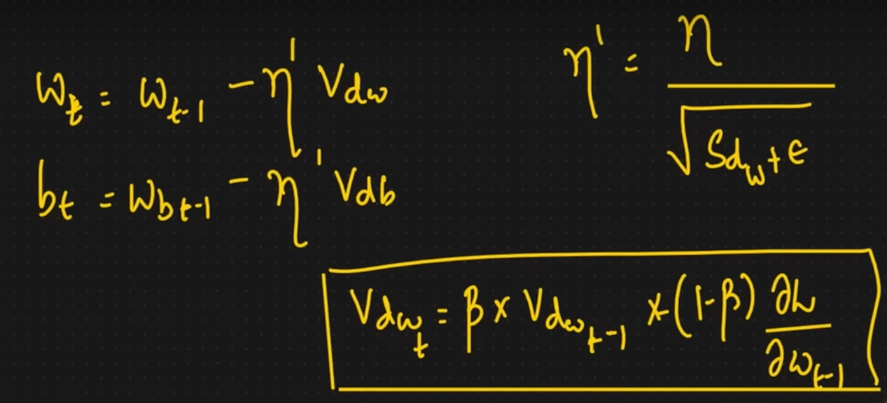
Adam optimizer
Momentum + RMSPROP (Adaptive Learning rate) – Smoothening ,Learning rate →Adaptive
+

