Slide 1
Perceptron
It was invented by Frank Rosenblatt in January 1957 at Cornell Aeronautical Laboratory, Inc at Buffalo, New York.
It was different than we first neuron saw. → Input = binary
TUL → Linear threshold unit
TLU →Threshold logic unit
Task of Good cup of tea → Binary classification Good tea / Bad Tea
1kg Milk → 1kg Tea→ 1kg Sugar

Slide 2
Epoch
Back Prapogation
Y = predicted
1kg Milk
1kg Tea
1kg Sugar
Activation
Function
X1
X2
X3
w1
Good
0.20
w2
f
0.10
w3
0.05
Bad
Threshold = value
Forward

Slide 3
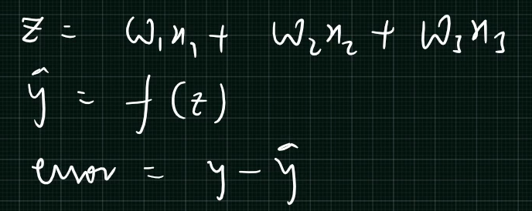
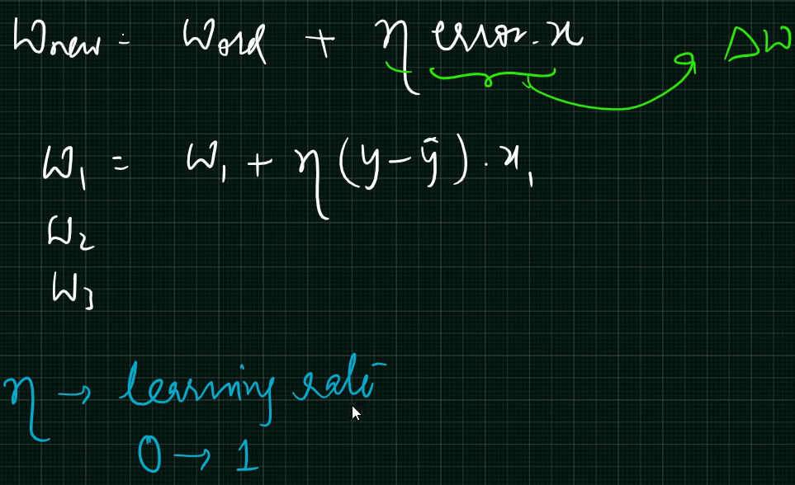
Activation Fun
Perceptron Weight Update Rule

Slide 4
Sigmoid Activation Function
For Binary Classification
Sigmoid = 1/1+e^{–y} = 1/1+e– Σ xiwi
X1
w1
Hidden Layer
X2
Output
w2
1
Σ xiwi
+ Bias
2
Act(y)
Output = 0 or 1
If >= 5 → 1
If <5 → 0
X3
w3
Σ xiwi = w^{T} X

Slide 5
Multi Layarad Neural Network
Multi Layard Hidden Neurons
Inputs
Outputs

Slide 6
Types of Activation Functions
Sigmoid

Slide 7
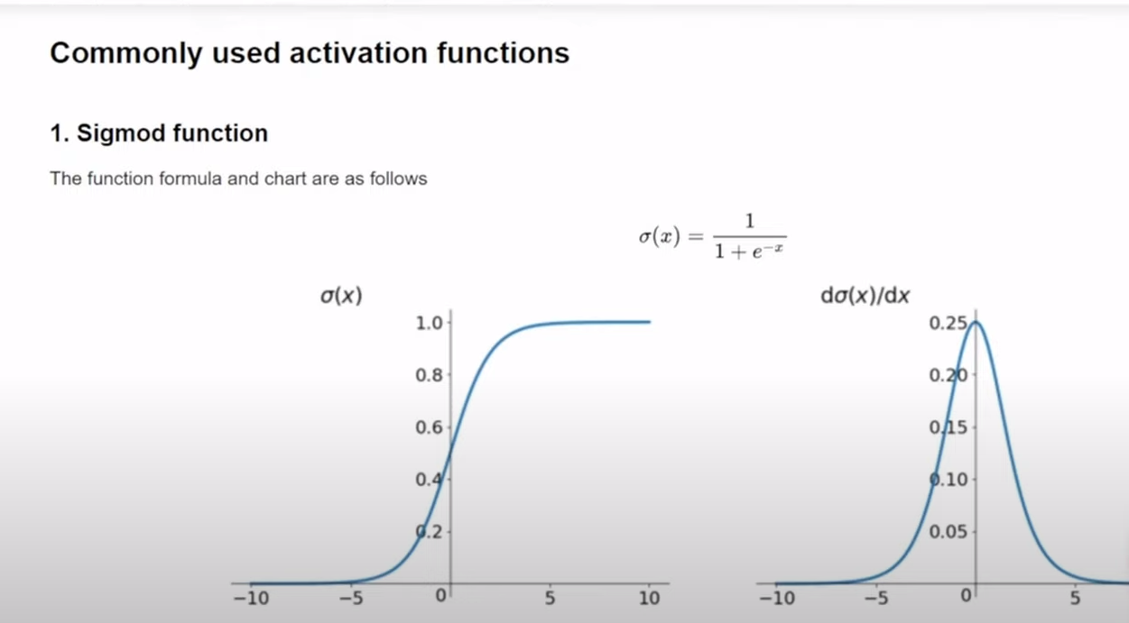
Sigmoid

Slide 8
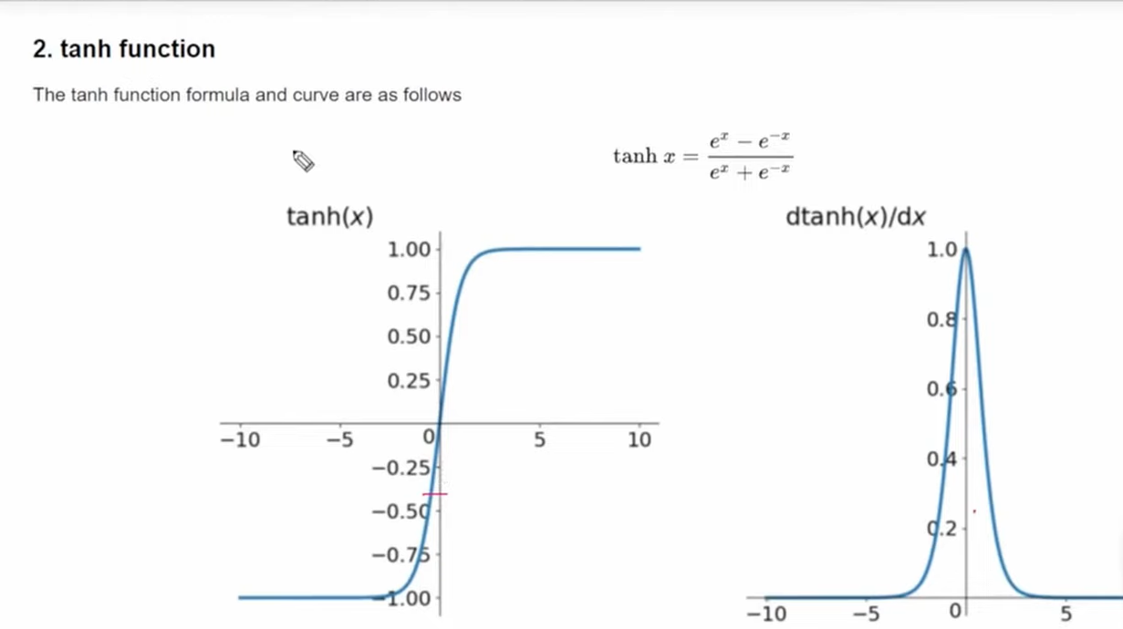
Tanh Function

Slide 9
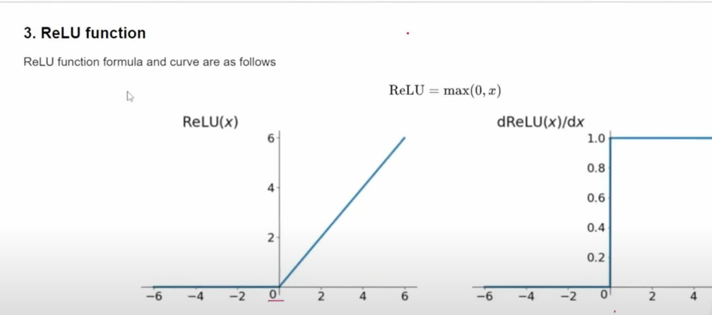
Rectified Linear Unit

Slide 10
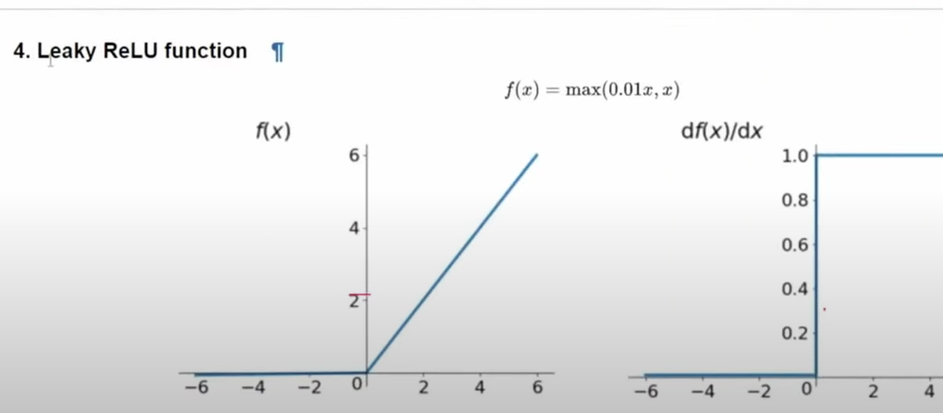
Leaky ReLU Solves Dead Neuron Problem

Slide 11
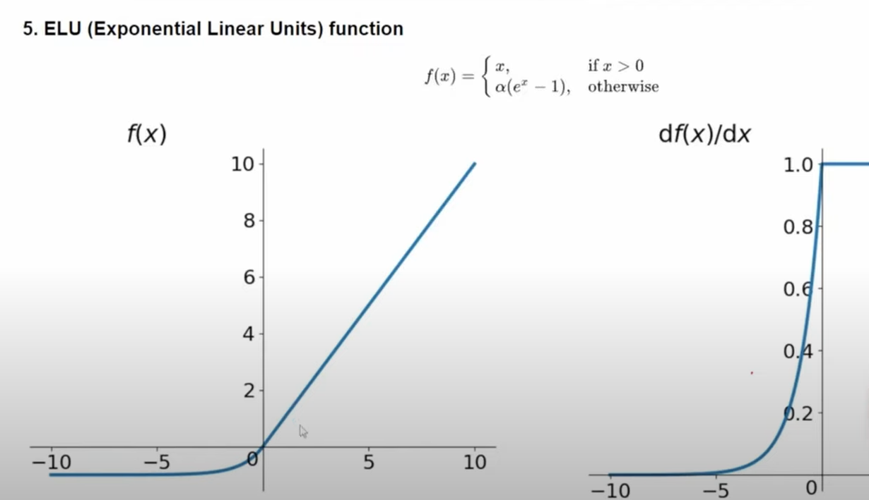
ELU

Slide 12
How to use

