Slide 1
Logistic Regression
No of Study Hrs | Pass/Fail
0 | 0
1 | 0
2 | 0
3 | 0
2 | 0 [outliers]
4 | 1
5 | 1
Used For solving Classification problems
Binary
Multiclass
classification
Aim:-
train
Target Column[dependent]
Have 2 categories
Model
Target →Have more than 2 categories
test
→ pass/fail
Accuracy

Slide 2
Can we solve above problem by Linear regression?
Aim: Error Should be minimal. Actual-Predicted
1
Many
outliers
P
Or
F
0.5
Threshold = 0.5
0
1
2
3
4
5
6
No of study Hrs

Slide 3
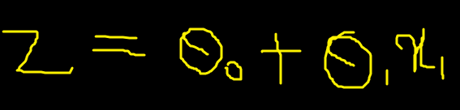
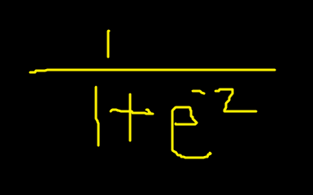
Best fit Line
Squash the line by sigmoid function →0-1 formula
exponential

Slide 4
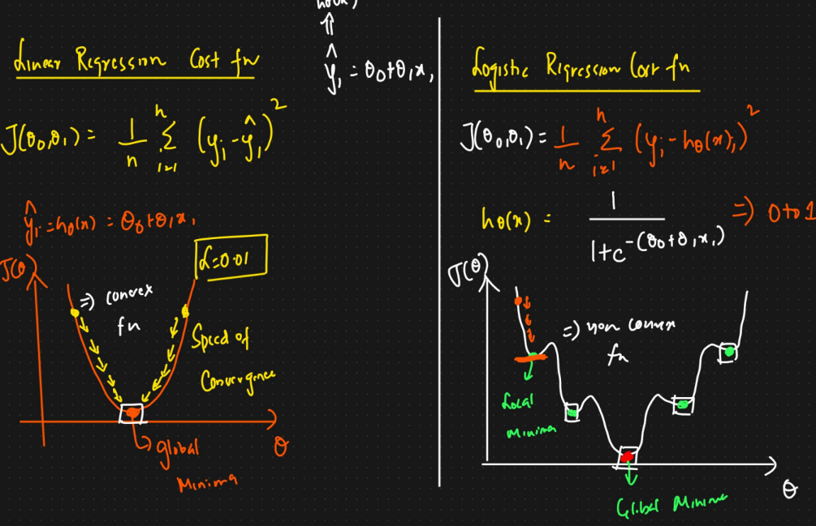

Slide 5
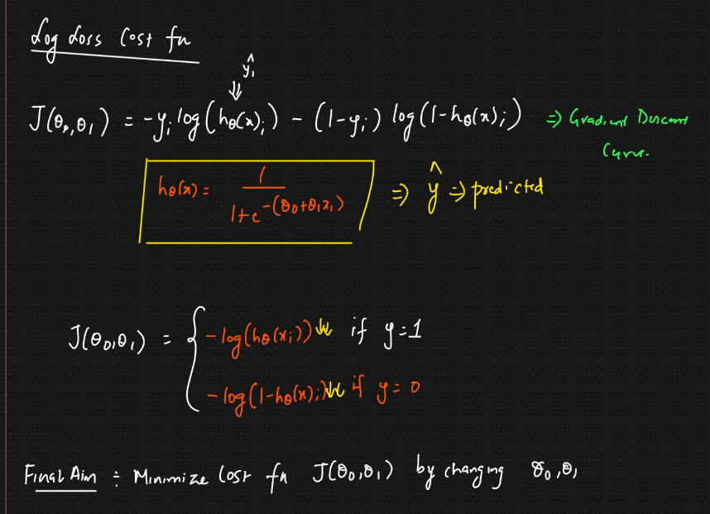

Slide 6
Multiclass Logistic Regression
A | B | C
1 | 0 | 0
0 | 1 | 1
0 | 0 | 1
0 | 0 | 1
Model m1 | m2 | m3
0.20 | 0.35 | 0.60

Slide 7
Performance matrices , Accuracy, pression, recall, F-beta
Confusion matrix
x1 | x2 | y | Y pred
 |  | 0 | 1
 |  | 1 | 1
 |  | 0 | 0
 |  | 1 | 1
 |  | 1 | 1
 |  | 0 | 1
 |  | 1 | 0
wrong
right
wrong
Actual
1 0
1
0
TP
FP
FN
TN
Predicted
Accuracy = TP+TN/FP+TP+FN+TN

Slide 8
Precision
Out of all the actual values how many are correctly predicted
TP/TP+FP
Recall
Out of all the predicted values how many are correctly predicted with actual values
TP/TP+FN

