Slide 1
What is statistics ?
Statistics is the science of collecting , Organizing and Analyzing data
What is data?
Facts of peace of Data
Eg :- Heights of the students , Iq of students

Slide 2
Types of Statistics
Descriptive Statistics
It consists of Organizing and Summarizing Data
Measure Of central Tendency
{Mean , Median , Mode }
2. Measure of Dispersion
{Variance Standard Deviation}
3.Different Types of Distribution of data
{ Histogram , Pdf, Pmf , Cmf}
Inferential Statistics
It consists of data you have measured to form conclusion
Conclusion
By doing Hypothesis Testing
Z-test, T-test, Chi-Square test , Annova test, F-test
Population
Sample

Slide 3
Example
There are 20 classes in your college. And you have collected the heights of Students in the class
Heights are [175cm, 180cm, 140cm, 135cm , 160cm , 170cm]
Descriptive Q
What is the average heights of the students in the classroom ?
Mean → 160 cm
Infrentical Q
Are the height of the students in the classroom similar to what you expected in the college ?
College data is my Population Data
Students Data is my Sample Data

Slide 4
Population And Sample Data
Sample Size = 500
Population

Slide 5
Types Of Data
Data
+ - / *%
Quantitative
Qualitative
Discrete
Continuous
Ordinal
Nominal
Whole Numbers Within Some Range
Any Value
Rank
Good – Better –best,
No Rank
Male, Female-
Blood –
Colours
Weight, Height,Temperature
No of Bank Accounts of People

Slide 6
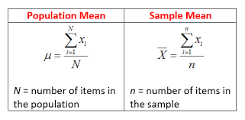
Descriptive Statistics Measure Of central Tendency
Mean :-
X = {5,8,9,6,7,6,2,5,8}
Population mean = 5+8+9+6+7+6+2+5+8/9
= 6.22

Slide 7
Median
X = {4,8,2,5,9,6,7}
First sort the random variable = 2,4,5,6,7,8,9
No of elements = 7
If number of elements or counts is even
X = 2,4,5,6,7,8,9,10 → count = 8 → 6+7/2 → median
If number of elements or counts is odd
X = 2,4,5,6,7,8,9 → 6 → median
Outliers
Median is used to find out the central tendency when the outlier is present

Slide 8
Mode → Maximum Frequency
Used in Eda and Feature Engineering
Missing values → Handle
Used for fill Categorical values

Slide 9
Measure of dispersion Spread of the data
Variance = sigma square

Slide 10
Standard Deviation = sigma
Root of variance(sigma)
Same variance process just make root of variance
How far away from std
How well data is spread
- Std std vale + std

Slide 11
Percentage and Percentile
Eg :- x = 1,2,3,4,5,6
% of odd num in x = odd num/total no = 3/6=1/2 = 50 %
Percentile :- A percentile is value below which certain Parentage of data point lie
X = { 2 , 3, 3 , 4, 6, 6, 6, 7, 8, 8, 9, 9, 10 , 11 , 12 }
Percentile of 10 = No of value below 10 / No of data points * 100
= 12 / 15 * 100
80 Percentile 80% of the distribution fall below value below 10

Slide 12
Q :- What value Exists at 25 Percentile ?
→
Percentile / 100 * ( n + 1) ---n = No of data points
28 / 100 * 16 → 4 Element

Slide 13
Quartiles
5 Num Summery
Minimum
First Quarter
Median
Third Quarter
Maximum
Q1 → 25 Percentile
Q2 → Median → 50 Percentile
Q3 → 75 Percentile
Removing the Outliers

Slide 14
Removing the Outliers
X = { 1,2,2,2,3,3,4,5,5,5,6,6,6,6,7,8,8,9,29}
[Lower Fence ← ----------------------→ Higher Fense]
Lower Fence = Q1 – 1.5 (IQR) IQR = Inter Quartile Range = Q3-Q1
Higher Fence = Q3 + 1.5(IQR)
---------------------------------------------------------------------------------------------------------------------------------------
Q1 = 25 Percentile = 25 / 100 * 20 = 5 th value = 3
Q3 = 75 Percentile = 75 / 100 * 20 = 15th value = 7
IQR = Inter Quartile Range = Q3-Q1 = 7 – 3 = 4
Lower Fence = Q1 – 1.5 (IQR) = 3 – 15 (4)
= -3
Higher Fence = Q3 + 1.5(IQR) = 7 + 1.5(4)
= 7+6 = 13

Slide 15
X = { 1,2,2,2,3,3,4,5,5,5,6,6,6,6,7,8,8,9,29}
Lower Fence = Q1 – 1.5 (IQR) = 3 – 15 (4)
= -3
Higher Fence = Q3 + 1.5(IQR) = 7 + 1.5(4)
= 7+6 = 13
5 Num Summery
Minimum = 1
First Quarter = Q1 = 3
Median = Q2 = 5
Third Quarter = Q3 = 7
Maximum = 9
* Don’t Consider Outliers
No less than -3 will be outliers
No Greater than 13 will be outliers
Boxplot [To visualize Outliers ]

Slide 16
Eg :- { -13,-12, -5 ,-6,3,4,5,6,7,7,8,10,10,11,24,55}
Q1 = 25 Percentile = 25 / 100 * 20 = 5 th value = 3
Q3 = 75 Percentile = 75 / 100 * 20 = 15th value = 7
IQR = Inter Quartile Range = Q3-Q1 = 7 – 3 = 4
Q1 = 25 / 100 * 17 = 3
Q2 = 8.5 Ele → 6
Q3 = 12.75 → 10

Slide 17
Correlation
X y
2 3
4 5
6 7
8 9
Y= x +1

Slide 18
Different Types Of Distributions
PDF :- Probability Distribution Function
PMF :- Probability Mass Function
CMF :- Cumulative Distribute Function
PMF
1.Discrite Random Variable
Eg :- Rolling A dice {1,2,3,4,5,6}
Pr(1 or 2) = 1/6 + 1/6 = 2/6 = 1/3
2/6
1/6
1 2 3 4 5 6

Slide 19
Cumulative Distribution Function
6/6
5/6
4/6
3/6
2/6
1/6
Cumulative = Combine / additional
0 1 2 3 4 5 6
Pr(x<=4) = Pr(X=1) + pr(x=2)+ pr(x=3)+pr(x=4)

Slide 20
Probability Density Function
Distribution of continuous random variables
Eg :- Height
0.05
0.04
0.03
0.02
0.01
1
0.9
0.8
0.7
0.6
0.5
0.4
0.3
0.2
0.1
0.58-0.50/
160-164
= 0.08/2= 0.04
0.58
0.50
PDF
164
CDF
166

Slide 21
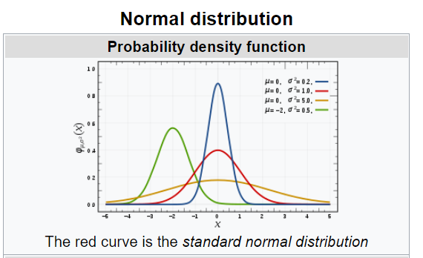
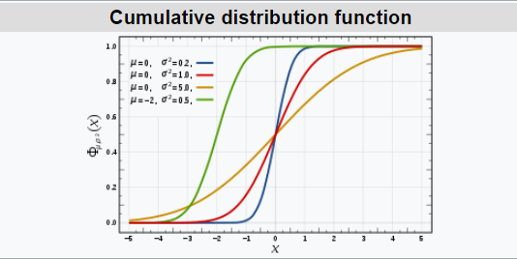
Normal Distribution
X → Continuous Random variable
Follows Bell Curve
Eg :- Height, Weight, IRIS dataset
Emperical Rule = 68-95-99.7% Rule

Slide 22
Standard Normal Distribution
Mue =3, sigma = 1
Transformation
Mue =0, sigma = 1
0 1 2 3 4 5 6 7
Zscore
=
Xi –mue/
sigma
How much away from mean

Slide 23
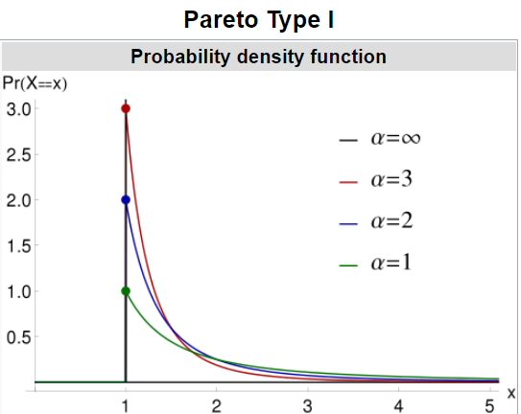
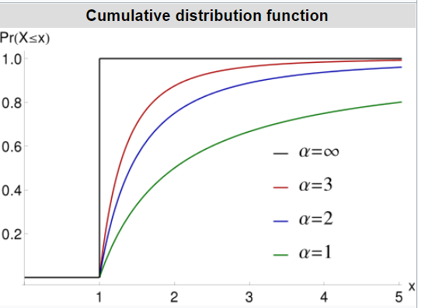
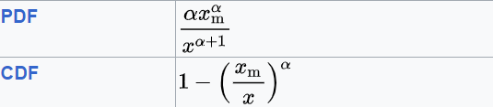
Pareto Distribution

Slide 24
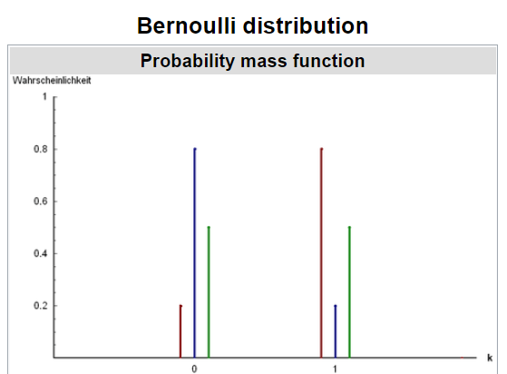
Bernoulli Distribution
For Discreate Binary outcome
Eg Probablity

Slide 25
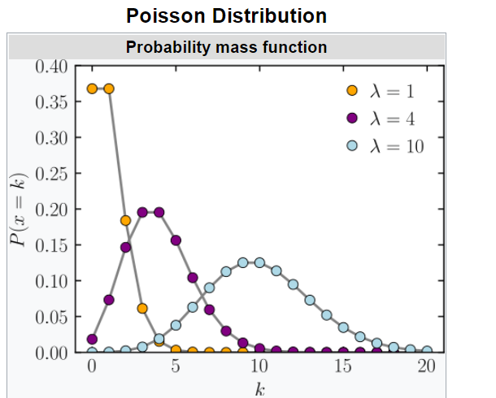
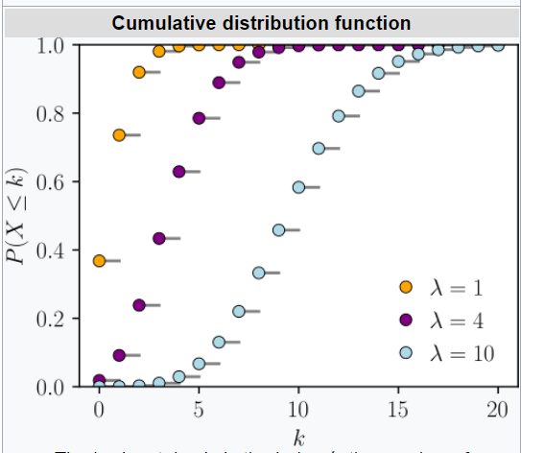
Poisson Distribution

Slide 26
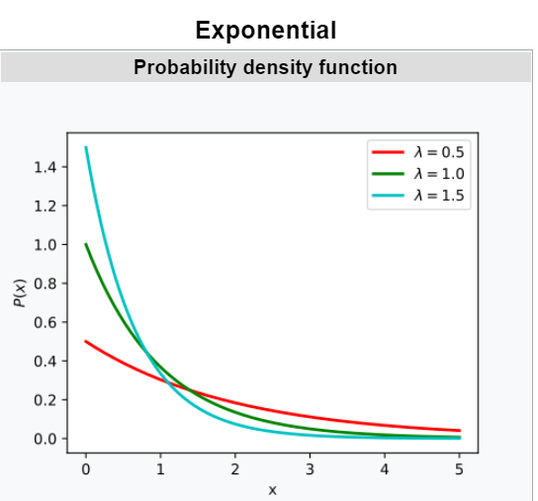
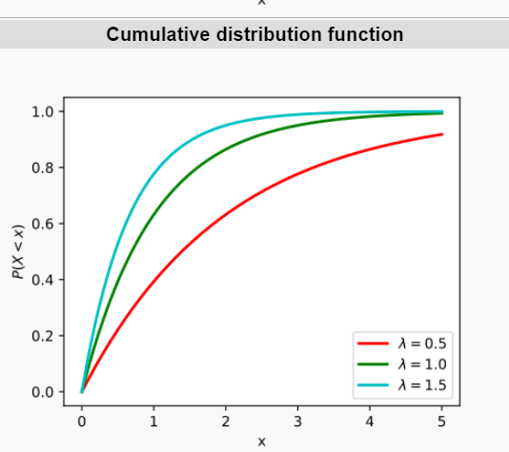
Exponential Distribution

