Slide 1
Data science
AI Product Tesla
Deep Learning
NLP
Machine Learning

Slide 2
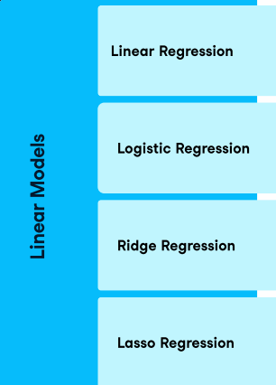
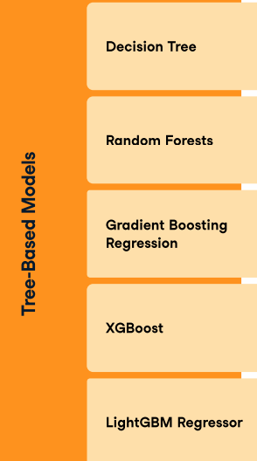
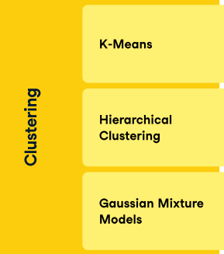
Machine Learning Types:
Supervised Machine Learning
Unsupervised Machine Learning

Slide 3
Supervised Machine Learning
Unsupervised Machine Learning
We focus on grouping of similar data types.
Relationship b/w x and y
x1 | x2 | x3 | y
Eg:- In Dmart there is category of every items.
Cloths
Shoes
Notebooks
Grocery

Slide 4
Semi Supervised Approach
Grouping / Clustering
Here we Use both Machine learning Approach

Slide 5
Unsupervised Machine Learning
K-means
hierarchical clustering
DB scan

Slide 6
K-means
Costumer segmentation :- home_loan,car_loan data stored in banks
Data Analysis
Data outliers
Google search engine stored data
Speech / images segmentation

Slide 7
K=value
K-means
Centroid of the point
wcss = within cluster summation of square
Ss1=
Ss2
Ssn=

Slide 8
Wcss Formula
= ∑ ∑ (c-p1)²+(c-p2)²+(c-p3)²+(c-p4)²
K=1 dist max
K = 2 dist less
K = 3 dist less than k = 2
+
(c-p1)²+(c-p2)²+(c-p3)²+(c-p4)²
(c-p1)²+(c-p2)²+(c-p3)²+(c-p4)²
C
C
+

Slide 9
ELBOW graph
K = 5
w
c
S
S
Interview Question:- What is the drawback of k-mean cluster
0 1 2 3 4 5 6 7 8
k

Slide 10

K-mean ++
There should be minimum distance b/w two k points
Interview question:- K-mean default uses k-mean ++ algorithm

Slide 11
hierarchical clustering
Agglomerative Approach → n data → n clusters → HC
Divisive → K-mean approach

Slide 12
Agglomerative Approach → n data → n clusters → HC
We have n data
First we create as it is n clusters
Marge similar clusters

Slide 13
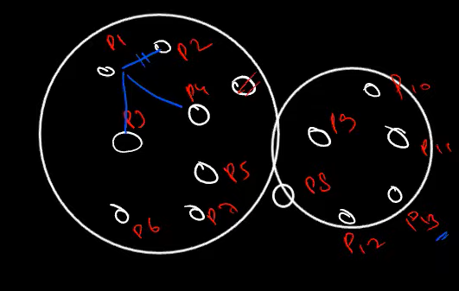
Dendogram Graph
D
I
S
T
A
N
C
E
Biggest line
Cluster 1
Mean of this
line
Cluster 2
Mean line crossing how many points
= 2 points
p1 p2 p3 p4 p5 p6 p7 p8 p9

Slide 14
DBSCAN
D –Density
B- Based
S-Special
C-Clustering
A-Application
N-Noise
Density based special clustering of application with noise

Slide 15
Epsilon :- Distance [radius] Min- Points :- Minimum no of points Core points :-Satisfying min point criteria Border Points :- Some conditions Noise :- A point which is not of any cluster
hyperparameters in DBSCAN

Slide 16
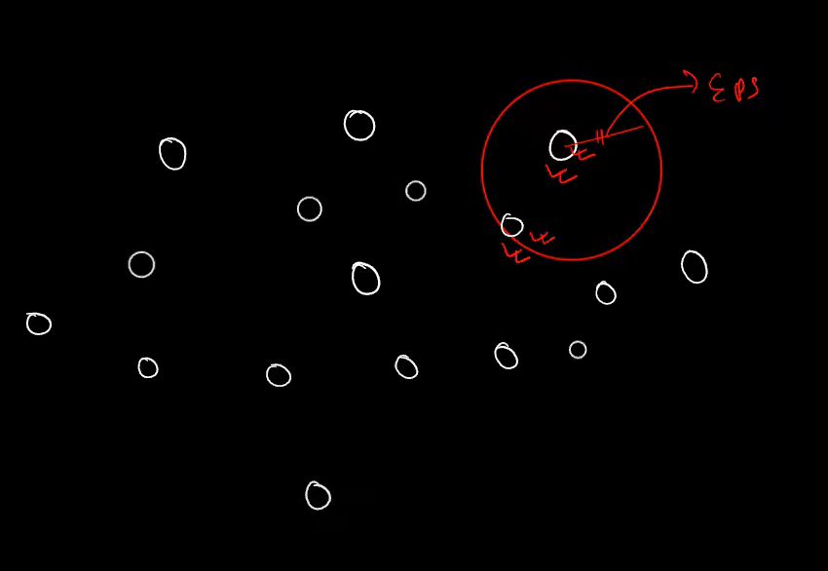
Random point
Eps = 1 [Dist b/w cluster and point]
Min Points = 3

Slide 17
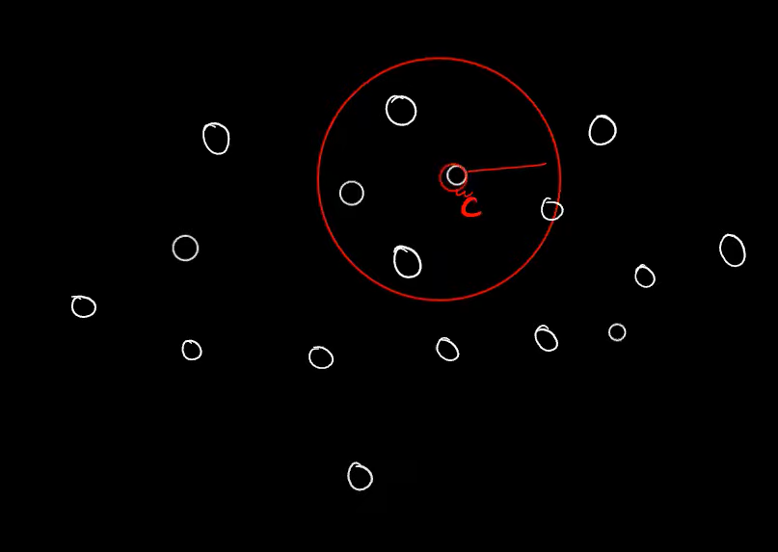
C =Core point
Min points = 3 [But here we have ]
Border points :- Point in cluster but not able to plot cluster
Noise :- Not in any core and neighbour cluster

Slide 18
Validation of clusters

