Slide 1
Displaying Information and Performing Actions
Iaru Cristina

Slide 2
Overview / What will be presented
Understand LCD displays and their connection
Learn the most important things we must consider when choosing LCD display.
Take advantage of the upm library with LCD displays and actuators.
Use an LCD display with an RGB backlight that works with the I2C bus.
Display and update text in a 16x2 LCD screen.
Use an OLED display that works with the I²C.
Display and update text on a 96-by-96 dot matrix OLED display.
Wire a standard servo motor to be controlled with PWM.
Display a value with a servo motor and a shaft.

Slide 3
Understanding LCD displays and their connection types
We can use different kinds of electronic components, shields, or breakout boards to provide information to the user via any connected device.
Examples:
Different colored LEDs for temperature thresholds. (RED - Hot, BLUE - Cold)
Single RGB LED where we change it’s PWM to get different colors.
Sometimes LEDs are not enough (humidity % - we don’t have 100 GPIO slots for 100 LEDs) so we want to use an LCD Display.

Slide 4
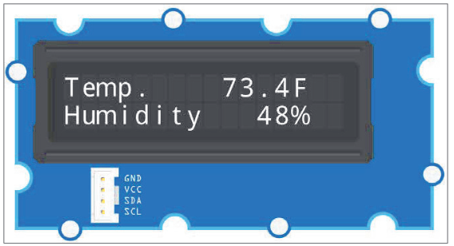
Example of a 16x2 LCD Module
We display the temperature on the first line and the humidity level on the second one.

Slide 5
Important characteristics when getting an LCD Module
Compatibility (Intel Galileo Gen 2 board).
The voltage supply that we are using (5V or 3.3V).
Connection type.
Operating range and special environment requirements.
Dimensions - depending on your project.
Number of columns and rows.
Response time.
Protocol, support in the upm library and Python bindings.
Supported character set and built-in fonts.
Different colors. (backlight, text, contrast)

Slide 6
Wiring an LCD RGB backlight to the I²C bus

Slide 7
Info
The LCD RGB backlight breakout board will also be connected to the same I2C bus to which the temperature and humidity digital sensor is connected.
We can connect many slaves to the I2C bus in the Intel Galileo Gen 2 board as long as their have different I2C addresses.
In fact, the LCD RGB backlight breakout board has two I2C addresses: one for the LCD display and the other for the backlight.

Slide 8
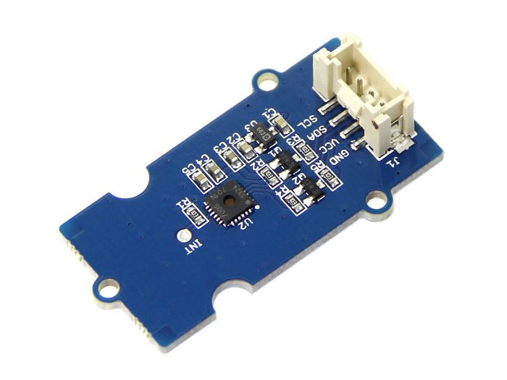
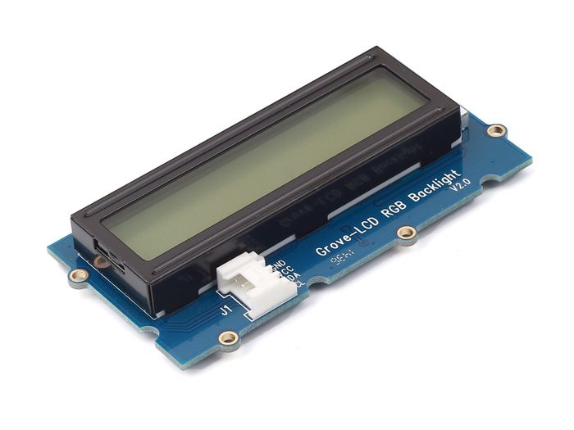
Necessary parts/ components
SeeedStudio Grove temperature and humidity sensor.
SeeedStudio Grove LCD RGB backlight breakout.

Slide 9
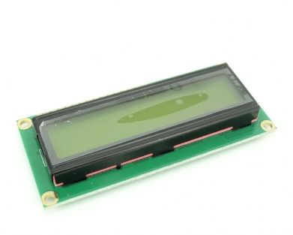
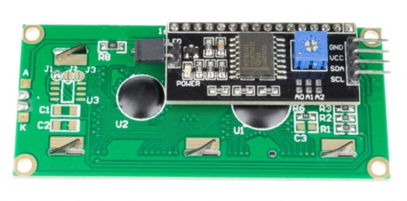
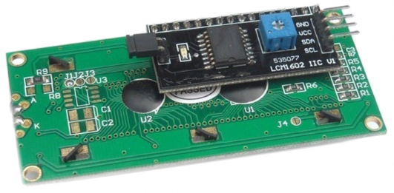
1602 LCD with I²C Interface and Yellow-Green backlight
Specifications:
Input Voltage Range: 4.5 V to 5.5 V
Supply Current: 1.5 mA
Operation Voltage for LCD: 5 V
Backlight Forward Current: 120 mA
Backlight Forward Voltage Range: 4.1 V to 4.3 V

Slide 10
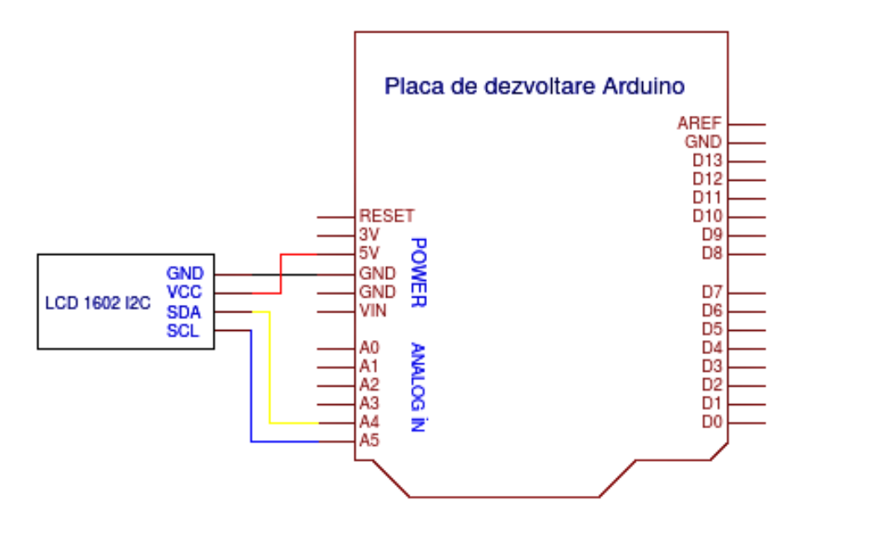
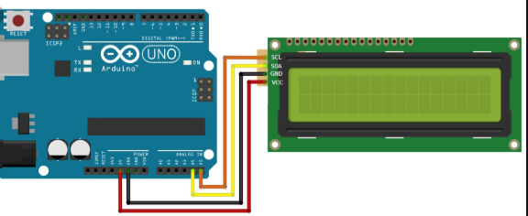
Connection

Slide 11
Displaying text on an OLED display

Slide 12
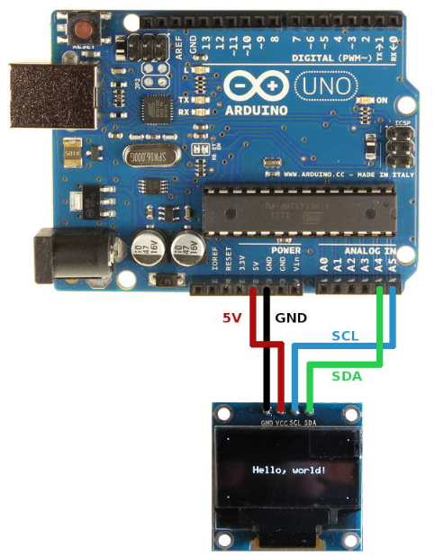
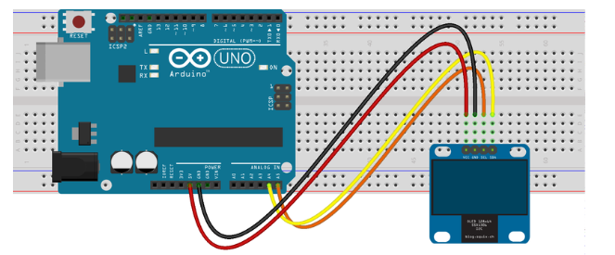
OLED Connection

Slide 13
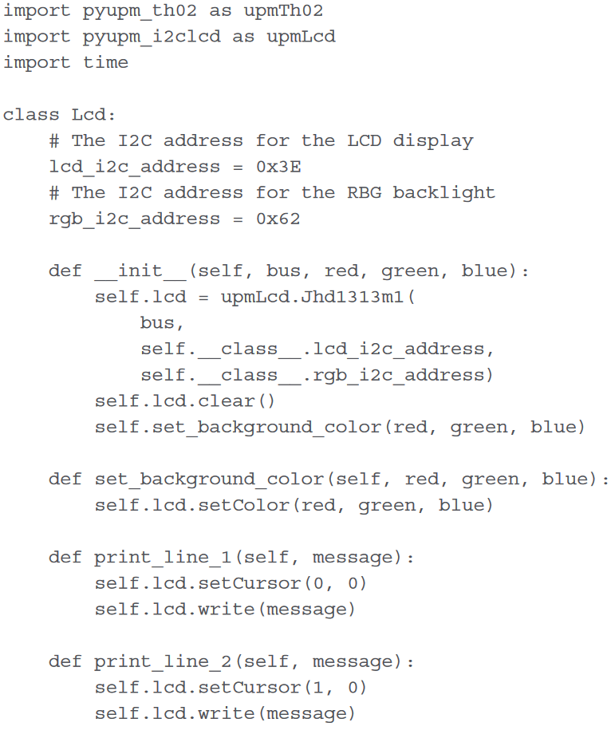
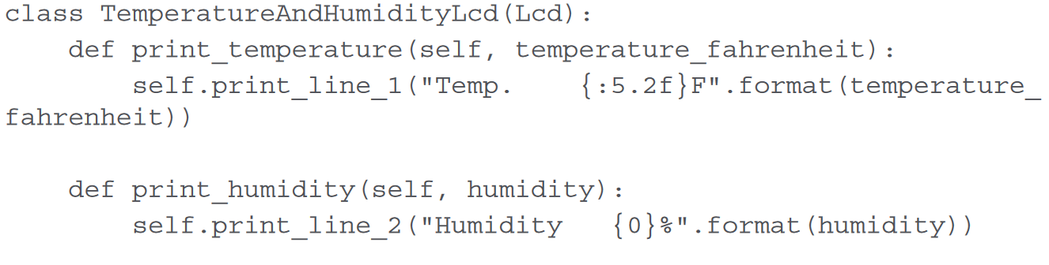
The LCD Class
Represents the 16X2 LCD RGB Backlight.
Enables changes like background color and writing text.
The TemperatureAndHumidityLcd Subclass
Specialises in easy printing of the temperature
(expressed in degrees Fahrenheit)

Slide 14
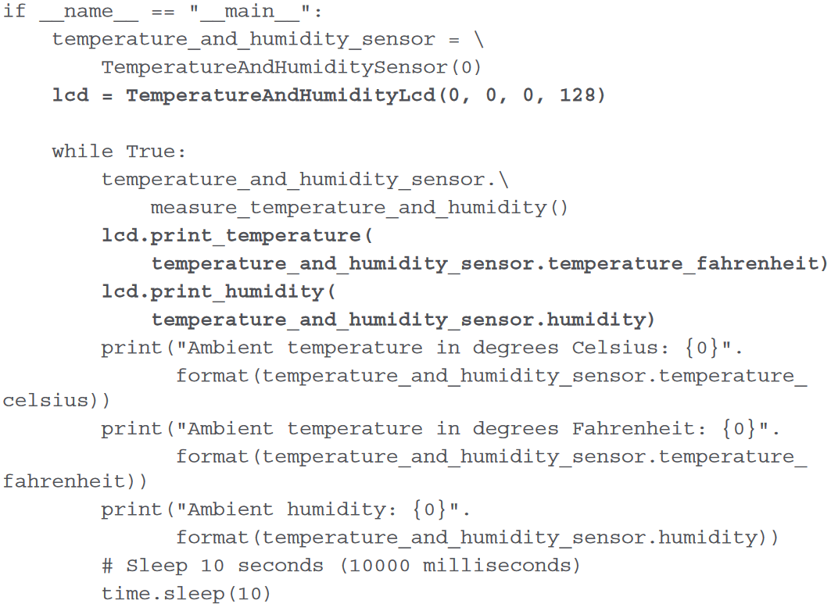
The Main Function
Displays the ambient temperature expressed in degrees Fahrenheit (ºF) and the humidity value in the LCD screen, every 10 seconds.

Slide 15
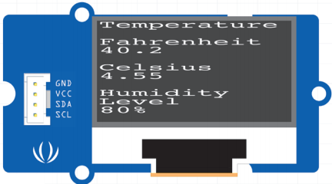
Displaying text on an OLED display
Knowledge part:
The upm library ( support for the SeeedStudio Grove OLED display 0.96", 16 grayscale 96-by-96 dot matrix OLED display breakout board )
OLED display uses SSD1327 driver integrated circuit ( the SSD1327 class represents a 96-by-96 dot matrix OLED display ; this class works with mraa.I²C class)
Oled class ( will represent the 96-by-96 dot matrix OLED ) will use its default 8-by-8 character box to display text
SSD1327 class interact with the OLED display

Slide 16
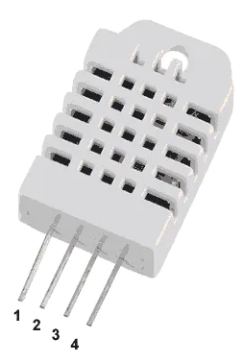
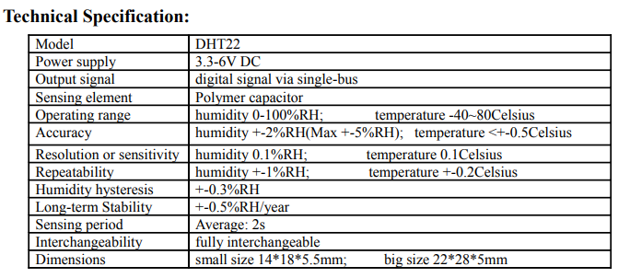
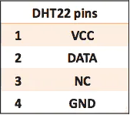
DHT22 Temperature and Humidity sensor

Slide 17
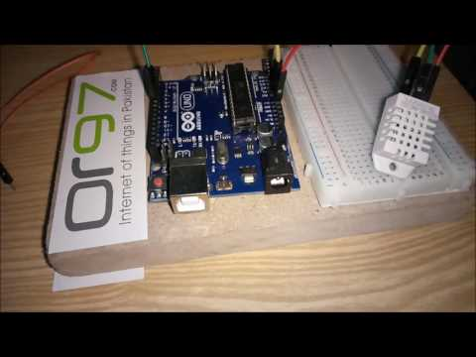
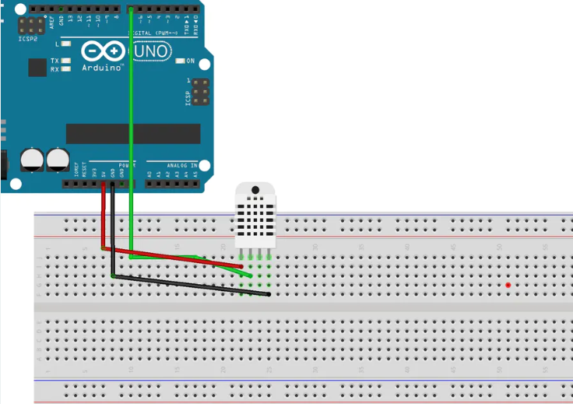
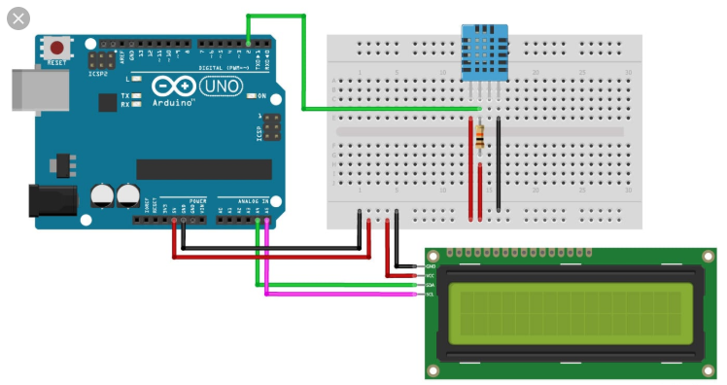
Connection:

Slide 18
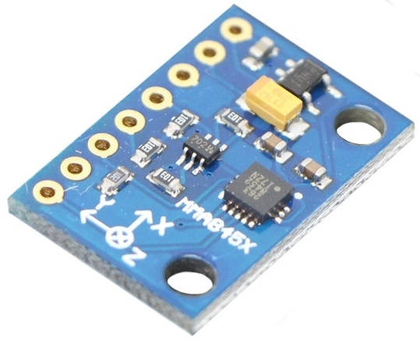
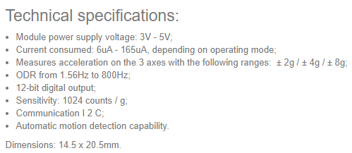
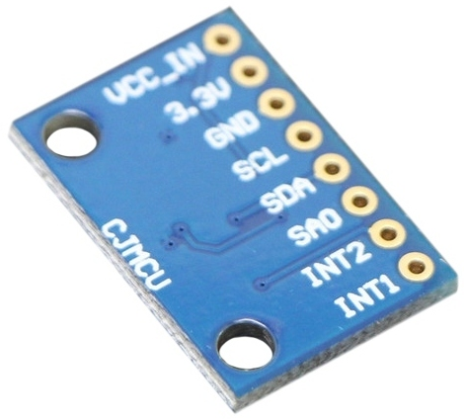
Digital Accelerometer Module
Example:
-> you can detect the movement,
-> shocks
-> space orientation of an object.

Slide 19
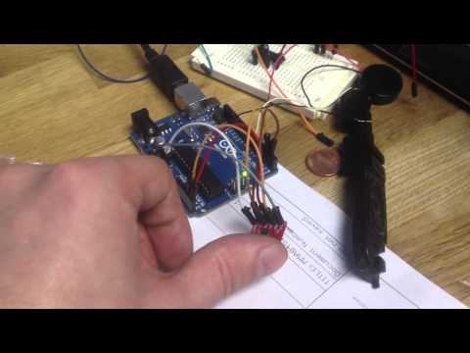
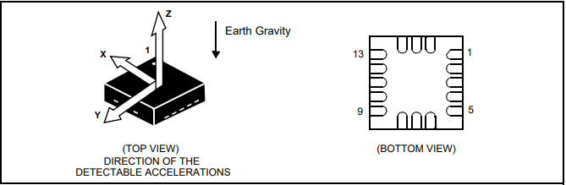
Connection:

Slide 20
Positioning a shaft to indicate a value with a servo motor
mraa.Pwm class - control PWM on the PWM capable GPIO pin labeled ~3
upm library ( support for SeeedStudio Grove Servo and EMAX 9g ES08A High Sensitive Mini Servo in the pyupm_servo module )
ES08A class - represents any of the two mentioned servos connected to the board
TemperatureServo class - represent the servo [ for positioning the shaft in a valid angle (from 0 to 180 degrees) based on the temperature expressed in ºF ]
ES08A class - interact with the servo

Slide 21
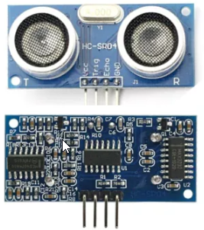
Ultrasonic Ranging
Power Supply :+5V DC
Quiescent Current : <2mA
Working Current: 15mA
Effectual Angle: <15°
Ranging Distance : 2cm – 400 cm/1″ – 13ft
Resolution : 0.3 cm
Measuring Angle: 30 degree
Trigger Input Pulse width: 10uS
Dimension: 45mm x 20mm x 15mm

Slide 22
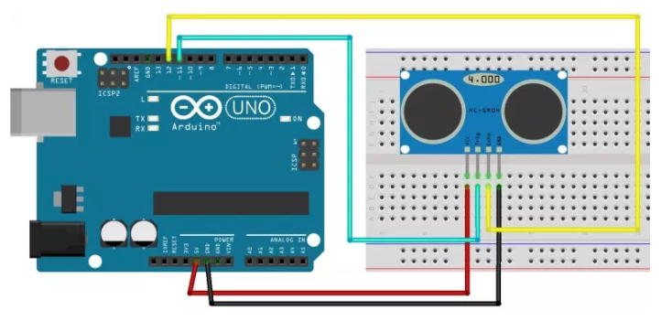
Connection

Slide 23
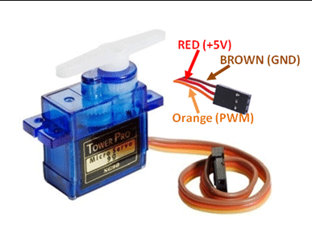
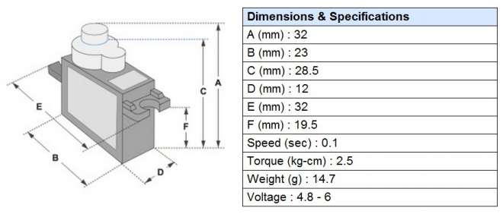
Micro Servomotor SG90 90°

Slide 25
THE END

