Slide 1























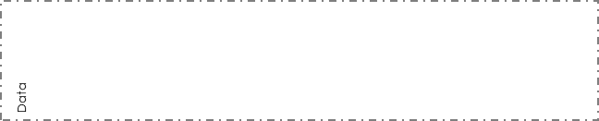











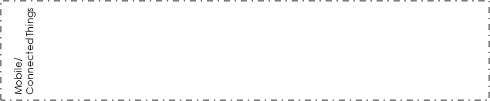


















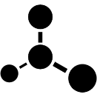





How will things connect?
Do the connections have to be reliable?
HTTP(S)
SMTP
SMS
IM
SOAP
REST
AMQP|MQTT
RDP
SSH
Bluetooth
WIFI
Lo-Power WIFI
3G/4G/5G
LAN/WAN
How can this be enhance with cognitive services?
What could we do if?
What are people doing that AI could do better?
Vision
Speech
Language
Knowledge
Search
Insights/
Relationships
Decision-making
How will we identify people?
How will we identify devices?
How do we secure information in-flight/at-rest?
How do we secure our endpoints?
How will we audit what’s happened?
How do we define/protect the edges?
Person
Identity
Device
Identity
Access
Controls
Claims
Biometrics
Certificates
API Security
Partitioning
Encryption
Audit
Data
Processing
Data
Streaming
Data
Mining
Data
Analytics
Business Activity
Data Quality
App Store
Notification
Hub
Mobile
Analytics
Event
Hub
IoT
Hub
What do you need to build this service?
How will you manage and analyse data?
How will you deliver APIs?
How will you handle mobile/things scenarios?
Queue
Logic App
Workflow App
Orchestration
Batch
Rules &
Policy
API Mgmt
API App
Discovery
Adapters
Transform
Router
Validator
Designed By: Gar Mac Críosta Agent ∆ supported by IASA Global
This work is licensed under a Creative Commons Attribution-ShareAlike 4.0 International License. http://creativecommons.org/licenses/by-sa/4.0
Notes:
MODERN ARCHITECTURE LANDSCAPE TWO CARD-057

