Slide 1
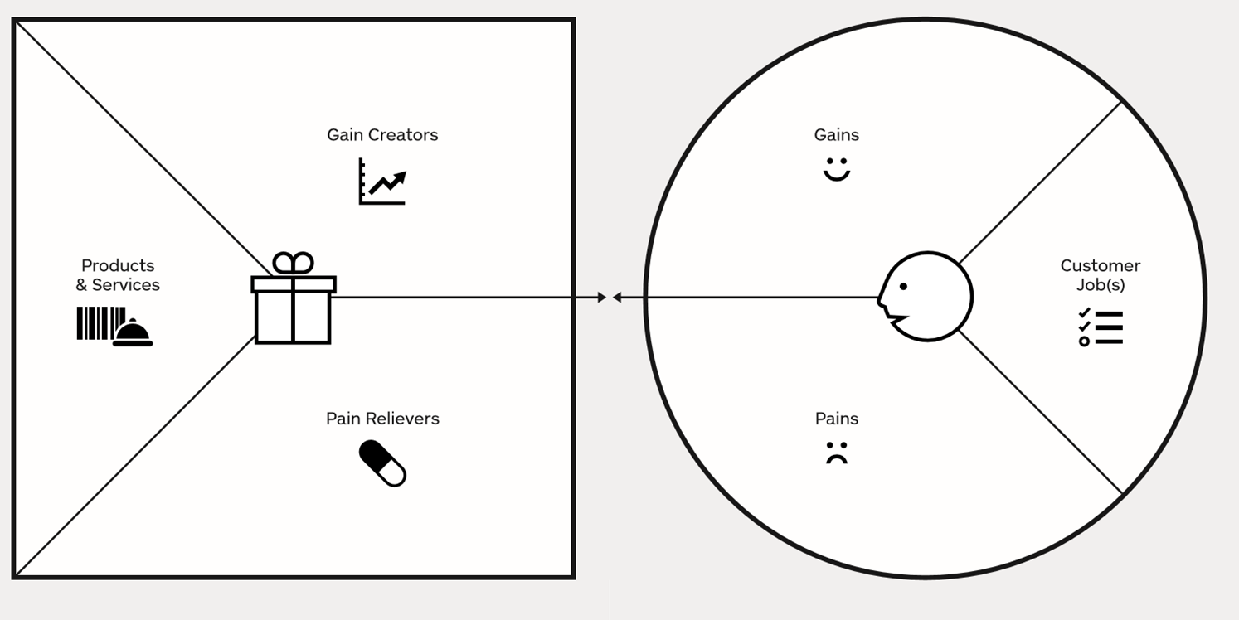
Value Proposition Canvas

