Slide 1
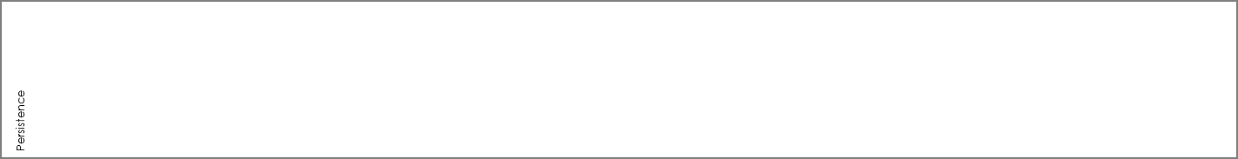

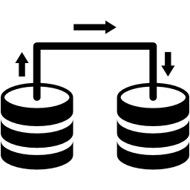












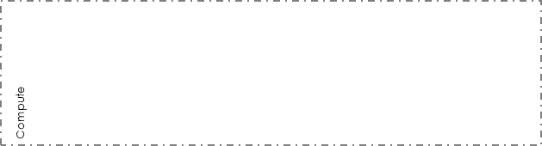
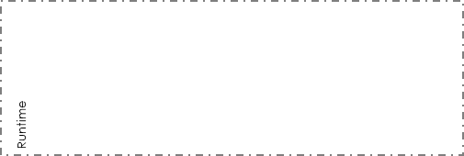







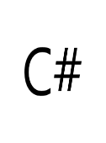








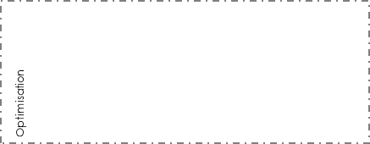
















Where will you put the data?
What data do you need to keep?
What’s the best way to store?
How will you read, write?
Do you have fast read data?
How will you analyse?
Do you need to store safely?
Relational
Data Store
Non-Relational
Data Store
Cache
Replication
Lake
Blob Store
Warehouse
Log
MDM
Queue
Vault
How will we execute the runtime?
What services and dependencies do we need?
How will we package for deployment?
What runtime are we targeting?
Windows
Linux
Container
Hypervisor
Serverless
What resources do we need to run?
What profile resource will you need?
Where will you acquire these resources?
Compute
Optimised
Memory
Optimised
Graphics
Optimised
Storage
Optimised
Data Centre
Private Cloud
Public Cloud
Small
Medium
Large
X-Large
Traffic
Manager
Firewall
Elastic
Isolation
CDN
Name
Resolution
Data Transfer
Backup/Recovery
Operations
Mgmt.
Metering &
Allocation
Licence
Mgmt.
We need it
We might need it
?
We have it
☺
We have to pick one
Designed By: Gar Mac Críosta Agent ∆ supported by IASA Global
This work is licensed under a Creative Commons Attribution-ShareAlike 4.0 International License. http://creativecommons.org/licenses/by-sa/4.0
Notes:
MODERN ARCHITECTURE LANDSCAPE THREE CARD-058

