Slide 1
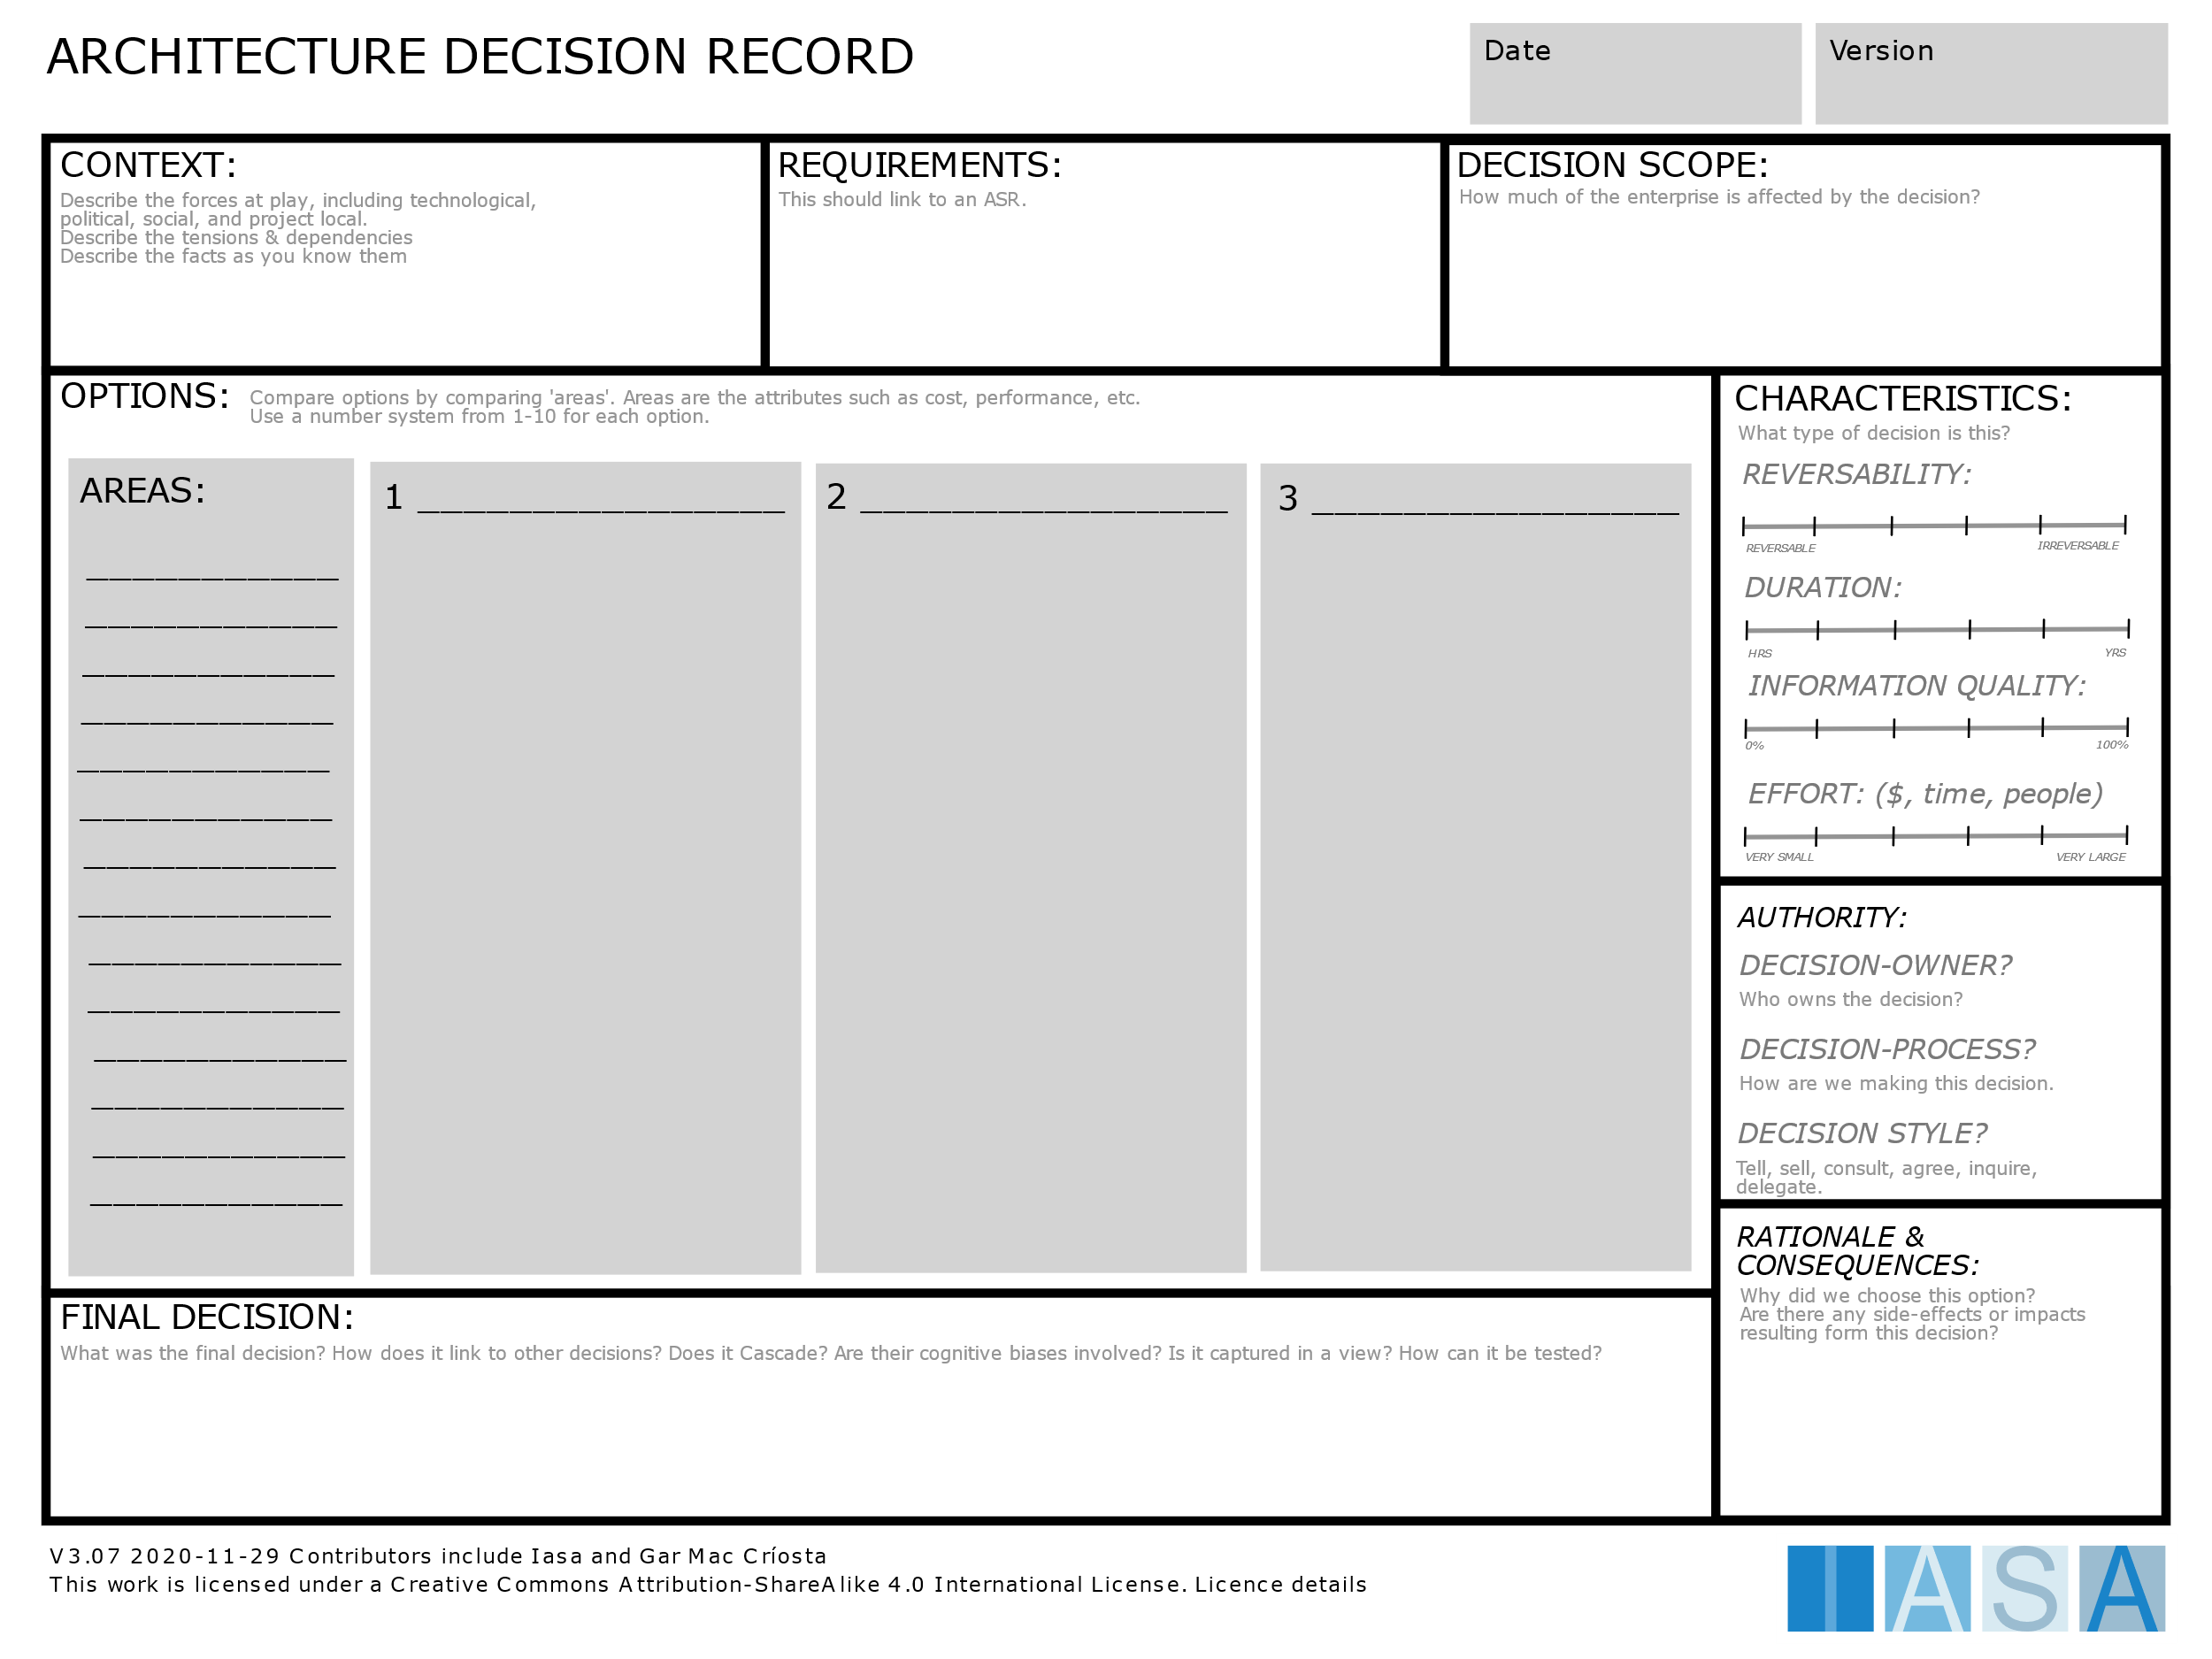
Notes:
ARCHITECTURE DECISION RECORD CARD-014

