Slide 1
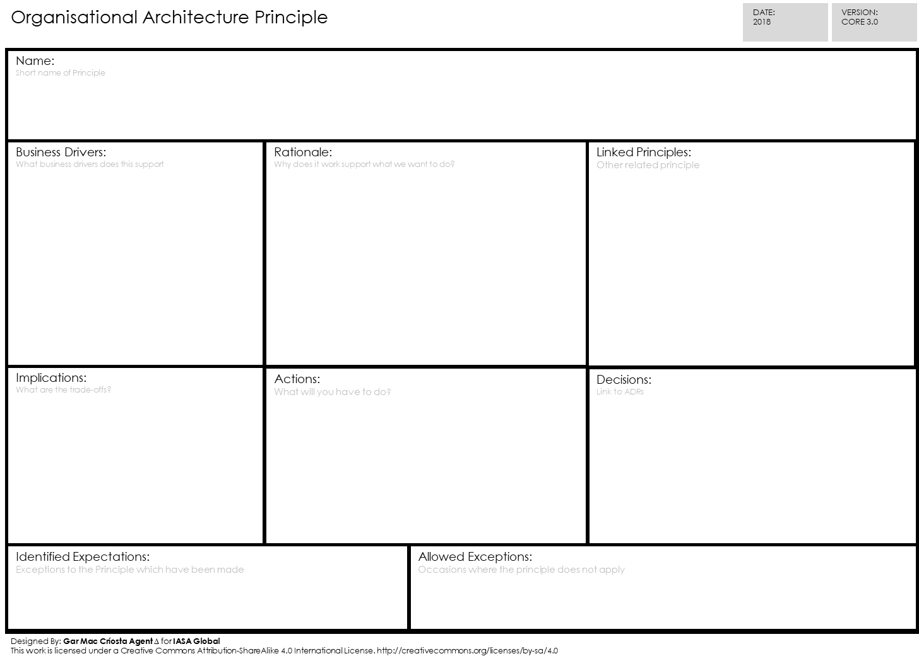
ORGANIZATIONAL ARCHITECTURE PRINCIPLE CARD
Notes:
ORGANIZATIONAL ARCHITECTURE PRINCIPLE CARD-088

