Slide 1
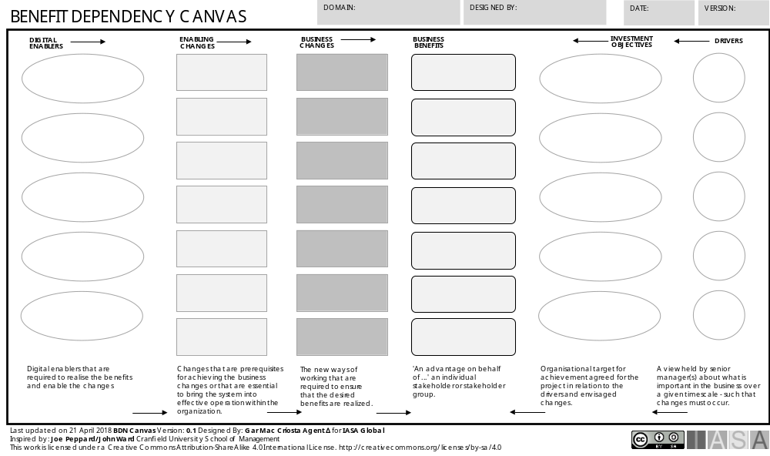
Notes:
BENEFITS DEPENDENCY NETWORK CANVAS-002

