Slide 1
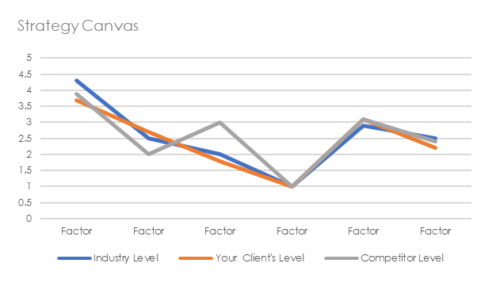
Blue Ocean Canvas
DATE:
VERSION:
Four Actions / ERRC Grid
Eliminate
Which features that the industry has long competed on should be eliminated?
Raise
Which features should be raised well above the industry’s standard?
What will your client
Reduce
Which features should be reduced well below the industry’s standard?
Create
Which features should be created that the industry has never offered?
Six Paths Framework
How will you transition
Buyer Utility Map
From
To
 | Purchase | Delivery | Use | Supplements | Maintenance | Disposal
Customer Productivity
Simplicity
Convenience
Risk
Fun and Image
Environmental Friendliness
Industry
Focuses on rivals within its industry | Looks across alternative industries
Focuses on competitive position within strategic group | Looks across strategic groups within industry
Focuses on better serving the buyer group | Redefines the industry buyer group
Focuses on maximizing the value of product and service offerings within the bounds of its industry | Looks across to complementary product and service offerings
Focuses on improving the price performance within the functional-emotional orientation of its industry | Rethinks the functional-emotional orientation of its industry
Focuses on adapting to external trends as they occur | Participates in shaping external trends over time
Strategic Group
Buyer Group
Scope of product
or service offering
Functional-emotional
Orientation
Time
Current Industry Focus
Your Client’s New Offering
Designed By: Andy Ruth Agent ∆ for IASA Global
This work is licensed under a Creative Commons Attribution-ShareAlike 4.0 International License. http://creativecommons.org/licenses/by-sa/4.0
Notes:
BLUE OCEAN CANVAS-003

