Slide 1









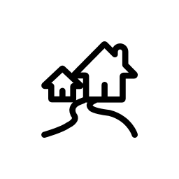































































MODERN ARCHITECTURE LANDSCAPE
Who/what is going to use the service?
Do we know them?
Are they important to us?
VIPs
Known
Everyone Else
Connected Things
Intelligent Agents
Home/
Residential
Public
Transport
Car
Walk
Air
Warehouse
Construction
Factory
Office
Where will your users be?
What are they thinking?
What do they have access to?
How does time play a part in their
usage or decision-making?
How important is this to them
Urban(Town)
City
Rural
Remote
Driving
Weather
Danger
Noise
Light
Ability
Work Conditions
Video
Team
Comms
Location
Where will your users be?
What are they thinking?
What do they have access to?
How does time play a part in their
usage or decision-making?
How important is this to them
Voice
Proximity
Gesture
Search
Mobile App
Desktop App
Chat
Gaze
Pen
Ambient
Email
Magic
Notification
Augmented
Browser App
Where do I get this?
Do I get or is it given?
Is it public or private?
Public App Store
Enterprise App Store
Public Website
Public Folder
Social Website
Plugin
Smart Hub
URL
API
What devices/hardware will they use?
Is it theirs our ours?
Do we have control over it?
Can we push to it?
Mobile ‘Phone’
Tablet
Wearable
Laptop
Display
Desktop
Kiosk
Smart Thing
AR/VR
Designed By: Gar Mac Críosta Agent ∆ supported by IASA Global
This work is licensed under a Creative Commons Attribution-ShareAlike 4.0 International License. http://creativecommons.org/licenses/by-sa/4.0
Notes:
MODERN ARCHITECTURE LANDSCAPE ONE CARD-056

