Slide 1
Prism

Slide 2
PRISM
“A tool for crowdsourcing interpretation”

Slide 3
Short History
Originally a pen and paper game developed in SpecLab of University of Virginia.
Concept used as inspiration by University of Virginia’s Scholarslab for project among graduate students of the Paraxis program in the programs inaugural year (2011-2012 team).
Developed further by future students to make the platform public and user-friendly (2012-2013 team).

Slide 4
What is it?
Text analysis tool.
For academic and non-academic purpose.
Aims to get a general opinion about a written work in relation to facets outlined by the creator.

Slide 5
Main Features
Create: Make new prisms using a piece of text and assigning facets to be checked for in the text.
Play: Highlight existing prisms using the facets assigned to create a general subjective interpretation of a piece of text.

Slide 6
Problem Solving
Often a writer’s work is misunderstood or misinterpreted for something else entirely. Prism offers writers a critical reflection of their work as seen by the audience showing how much of their intention is being transmitted in their writing and what’s deterring them, helping them improve their work.
Prism also helps us understand a piece of text better by using the perspective of the other users.

Slide 7
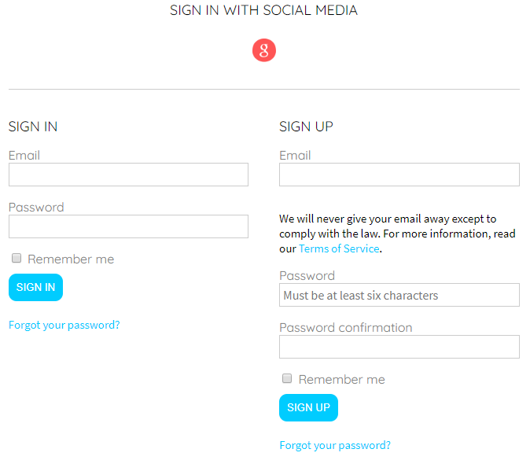
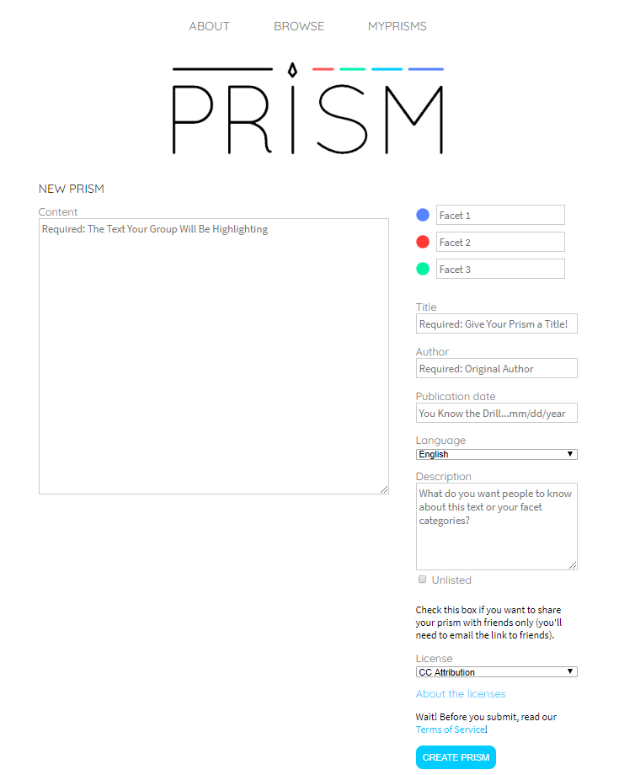
CREATE
Clean layout
Easy to navigate
Clear instructions
Quick setup
Easily shareable

Slide 8
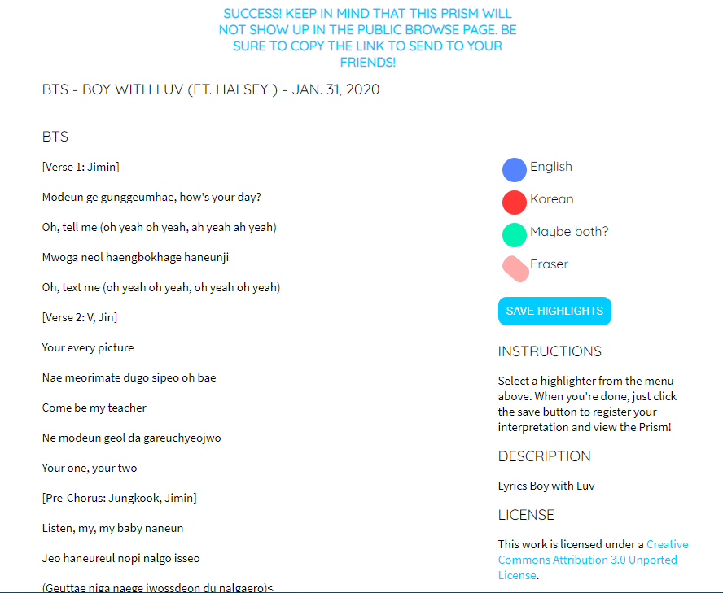
CREATE: EXAMPLE

Slide 9
PLAY
The play feature presents the text provided and after being highlighted regarding the specific facets alongside the text, we see the general subjective interpretation of the text.
Let’s get to a sample.

Slide 10
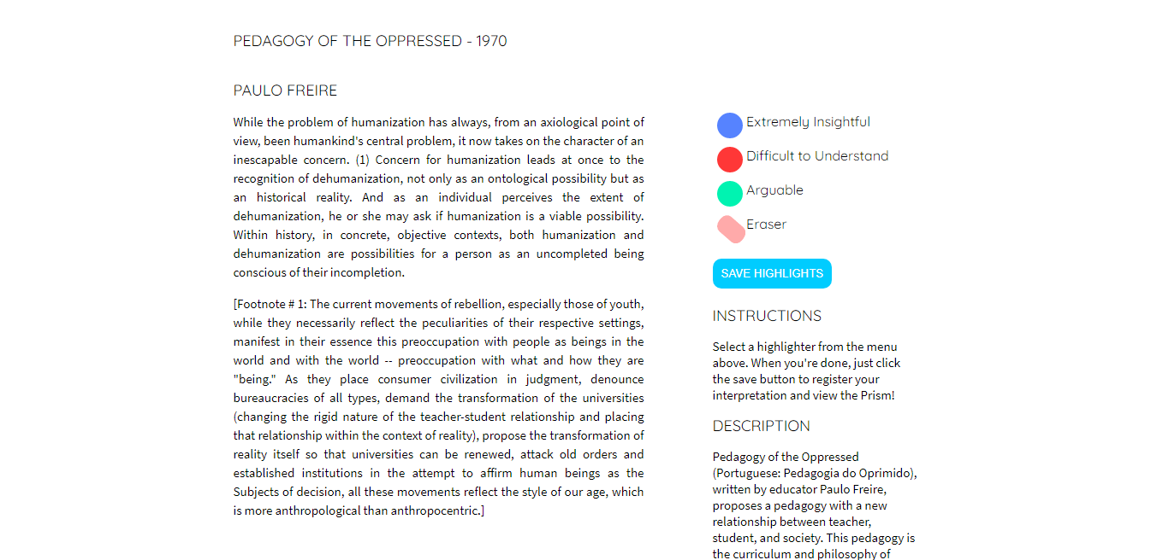
PLAY EXAMPLE (BEFORE TEXT HIGHLIGHT)

Slide 11
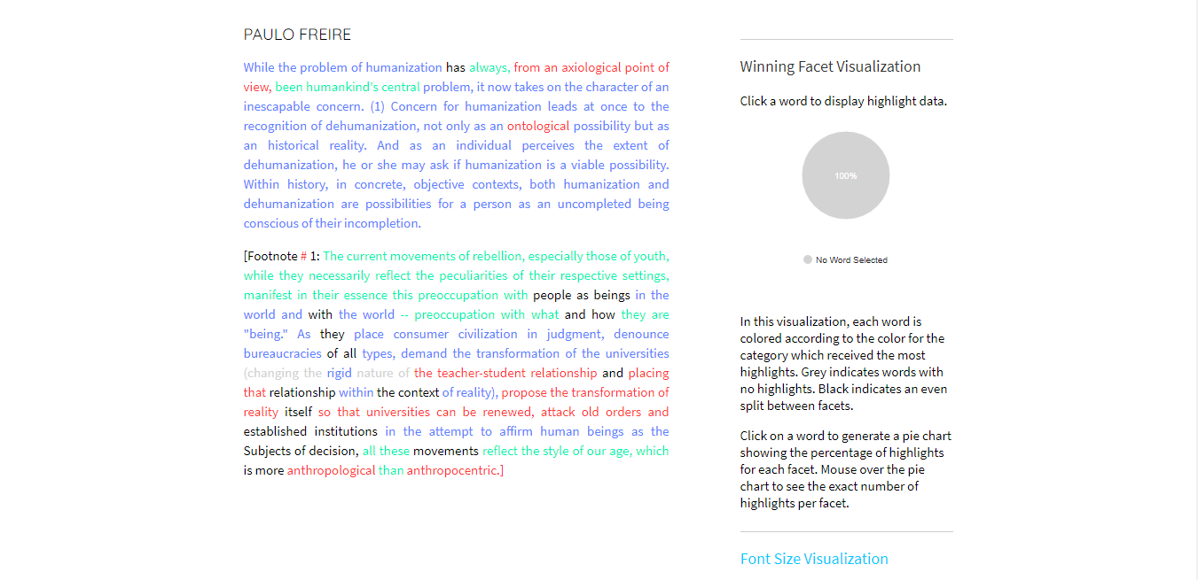
AFTER TEXT HIGHLIGHT
Link to the prism
http://prism.scholarslab.org/prisms/be55b2a2-ba2a-11e2-bd10-165f8a148f9b/highlight?locale=en

Slide 12
MORE INFO
PROS:
Expansive view on text in relation to the stated facets
Convenient for understanding the text that falls under a specific facet
More than one facet can be applied to the same text.
CONS:
Limited number of facets (three)
Erasing the highlighted text can be an inconvenience if more than one facet was used

Slide 13
Theoretical Discussion of Prism
Can be used as a tool to interpret data in a much more accessible manner, like discussed in our Drucker reading.
Prism can be used as a way to foster discussion among a large group of people as well as used to focus on the difficulties individuals have with certain portions of readings.
Like was mentioned during the drucker article discussion, some of the text was rather dense and harder to understand, the usage of Prism would allow the dense text to be broken down.
Notes:
http://prism.scholarslab.org/prisms/f3a4f196-4440-11ea-b26a-005056b3784e/highlight?locale=en

Slide 14
THE END

