Slide 1
Company Profile
FiniteMax Integrated Services Limited
RC Number: 1873183
Bauchi State, Nigeria

Slide 2
Introduction
FiniteMax Integrated Services Limited is a dynamic and innovative company based in Bauchi State, Nigeria. We specialize in delivering comprehensive construction and consultancy services that empower clients to achieve operational excellence.

Slide 3
Mission Statement
FiniteMax Integrated Services Limited is committed to providing comprehensive and innovative solutions to our clients to maximize their operational efficiency, productivity, and growth. We strive to deliver exceptional services that exceed expectations and contribute to the success of our clients' businesses.

Slide 4





Services Offered
  General Construction
  Supply of All Kinds of Building Materials
  Mineral Exploration & Mining Consulting
  Real Estate Development & Management
  Borehole Drilling & Installation

Slide 5
Target Market
We serve individuals, businesses, and organizations seeking professional and reliable construction, supply, consultancy, and real estate services. Our ideal clients value quality, attention to detail, and personalized solutions tailored to their specific needs.

Slide 6
Company History
Founded in December 2021, FiniteMax Integrated Services Limited is driven by a vision to exceed expectations in all aspects of our services. Our goal is to provide exceptional solutions and deliver results that surpass our clients' anticipations. With a commitment to excellence, we are dedicated to setting new standards of quality and customer satisfaction in the industry.

Slide 7
Vision
To be recognized as a leading provider of integrated services within our industry.

Slide 8
Core Values
Expertise and Experience
Quality and Excellence
Client-Centric Approach
Reliability and Timeliness
Comprehensive Services

Slide 9
Achievements
We have successfully built various houses and boreholes that meet the satisfaction of our clients, reflecting our commitment to quality and excellence.

Slide 10
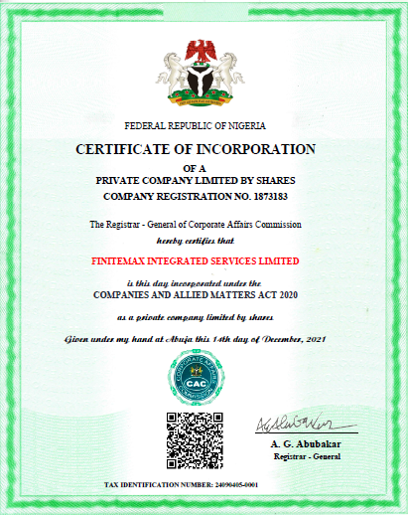
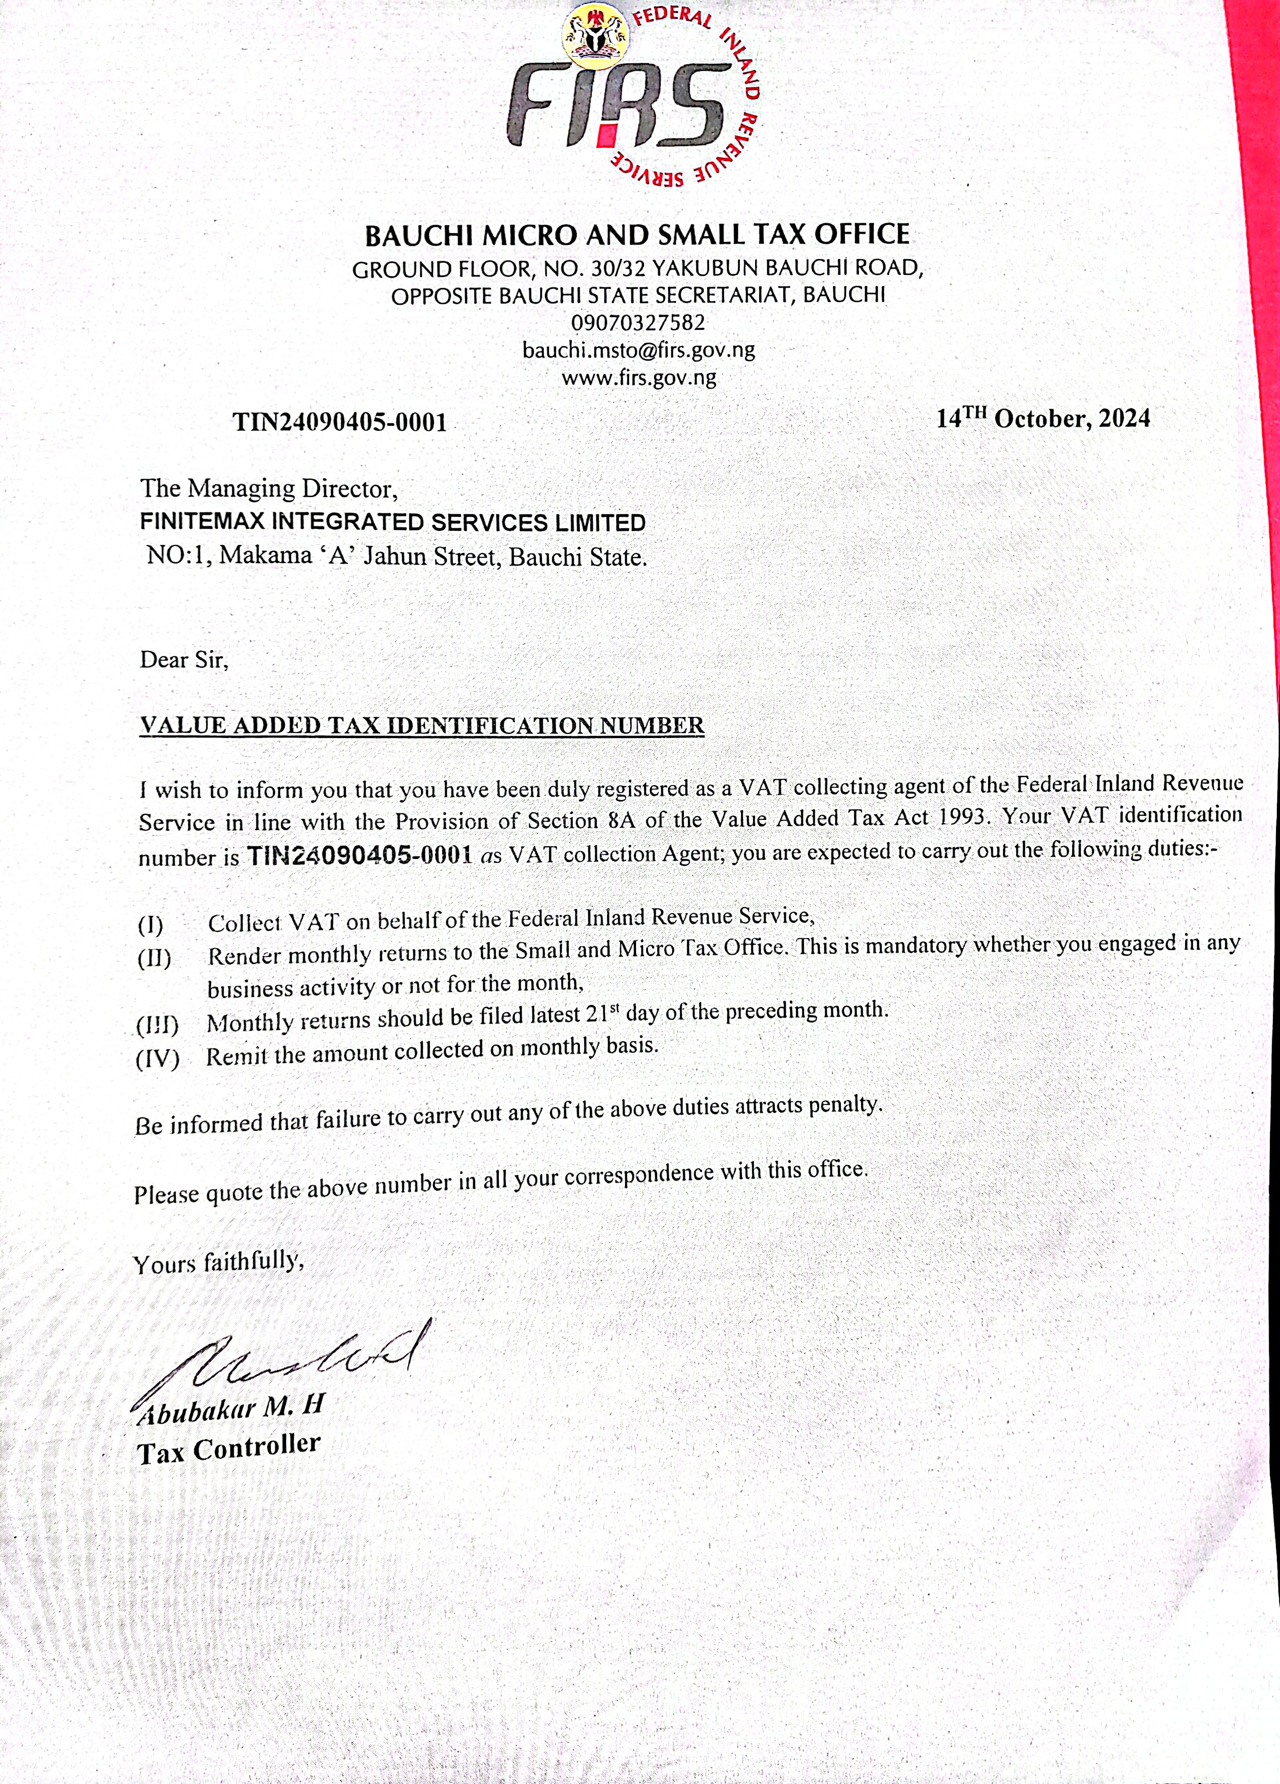
Evidence of Registration

Slide 11
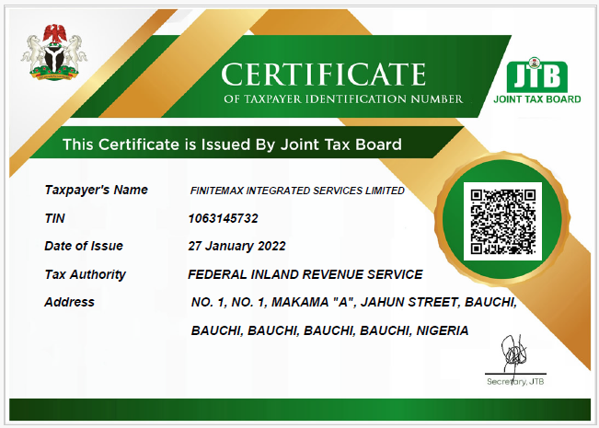

Slide 12
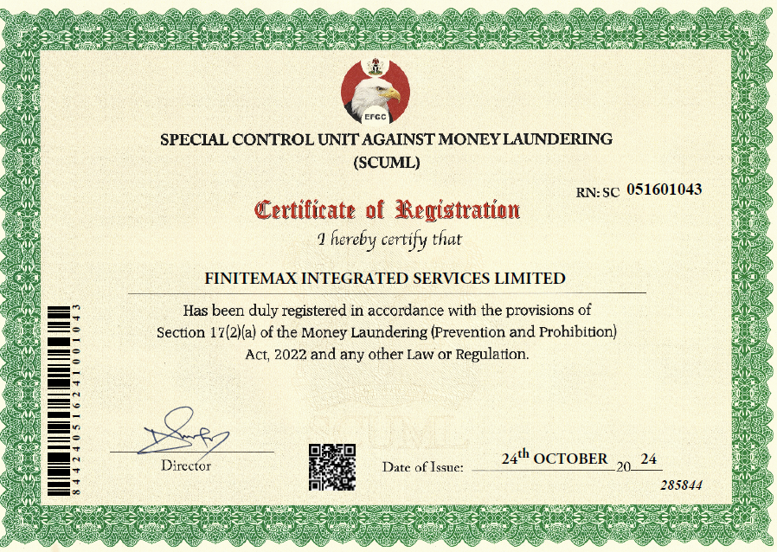

Slide 13
Contact Information
Email: finitemax21@gmail.com
Phone Numbers: +2348161780829, +2348033709970, +2348093931717
Social Media:
Facebook: FiniteMax
Twitter: @FiniteMax
Instagram: FiniteMax

Slide 14
Future Plans
As we grow, we are committed to expanding our portfolio to include sustainable building practices that contribute to a greener future.

Slide 15
Conclusion
We invite you to partner with FiniteMax Integrated Services Limited, where your vision becomes our priority, and together, we can achieve remarkable results.

