Slide 1
Mean Variance Optimization
Theory, and an application to sovereign debt currency choice
ZAR debt frontier — wb-debt-simulation / optimization

Slide 2
What is Mean Variance Optimization?
Markowitz (1952) — portfolio selection as a quadratic program
• Pick portfolio weights x that trade off expected return against risk.
• Risk is measured by variance of portfolio return: xᵀ Σ x.
• Expected return is linear in weights: μᵀ x.
• Solutions sweep a risk-aversion parameter λ to trace the efficient frontier.
• The same machinery applies to debt-cost minimization — just flip the sign of the linear term.

Slide 3
The optimization problem
Quadratic objective, linear constraints — solved as a QP
Asset allocation form (return maximization):
minimize (1 − λ) · xᵀ Σ x − λ · μᵀ x
Subject to:
• Σ xᵢ = 1 (fully invested)
• bounds_min ≤ x ≤ bounds_max (box constraints, e.g. no short, sector caps)
• Optional linear inequalities wᵀ x ≤ c (e.g. domestic-share floor)
Cost-minimization form (debt frontier): swap the sign of the linear term — + λ · μᵀ x.

Slide 4
The efficient frontier — debt-cost framing
Sweep λ ∈ [0, 1] → one optimal funding mix per risk-aversion level
• λ = 0: pure risk minimization — the minimum-variance funding mix.
• λ = 1: pure cost minimization — cheapest mix, ignores FX risk.
Expected debt cost
λ = 0 min-variance
• Intermediate λ: Pareto-optimal trade-offs between debt cost and FX volatility.
efficient frontier
• Plot (risk, expected cost) for each solution to trace the lower envelope of feasible mixes.
A
current mix
• Two-fund property: every point on the frontier is a linear combination of any two other frontier points — pick A and B, sweep α ∈ [0, 1], and α·A + (1−α)·B traces the curve between them.
B
• Current funding mix sits above the frontier — the gap shows the cost or risk reduction available.
λ = 1 min-cost
Risk (xᵀ Σ x, FX variance)

Slide 5
From asset allocation to debt management
Same QP, different sign — minimize cost instead of maximizing return
• A sovereign issuing in multiple currencies faces the same trade-off:
• • Expected cost = interest rate + expected FX appreciation against the base currency.
• • Risk = variance of debt-servicing cost driven by FX moves against the base.
• Weights x are now funding shares per currency, not asset weights.
• Covariance Σ is built from historical log-returns of FX rates against the base (here ZAR).
• Set maximize=False so λ tilts the objective toward cost reduction rather than return.

Slide 6
The ZAR debt frontier pipeline
optimization/exchangerates_get.py end-to-end
1. Fetch
ECB SDMX → daily EUR-cross FX → cached locally in optimization/currency/
2. Rebase
convert_base_currency(fx, base='zar') → columns become ZAR_USD, ZAR_GBP, ...
3. Returns
get_fx_returns(...) — log-diffs, drop the first NaN row.
4. Covariance
get_fx_covariance(returns) — pandas .cov() with a missing-data report.
5. Assumptions
DataFrame: interest_rate, expected_appreciation, min/max_share, current_share.
6. Solve
mv_from_dataframes(cov_df, assumptions, n_points=101) — 101 QPs along λ.
7. Plot
plot_debt_frontier_labeled(...) — cost–risk frontier + funding-share panels.

Slide 7
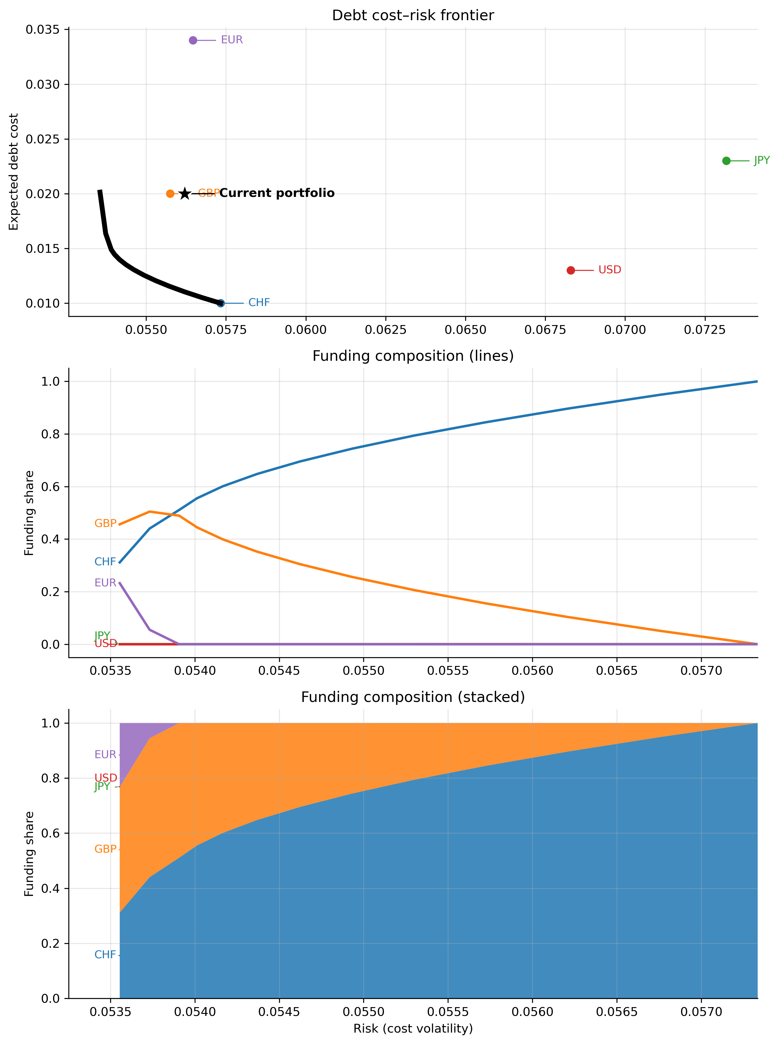
ZAR debt frontier — worked example
USD, GBP, JPY, CHF, EUR funding for a ZAR-based debt manager
Source: optimization/zar_debt_frontier.png — regenerated by python exchangerates_get.py

Slide 8
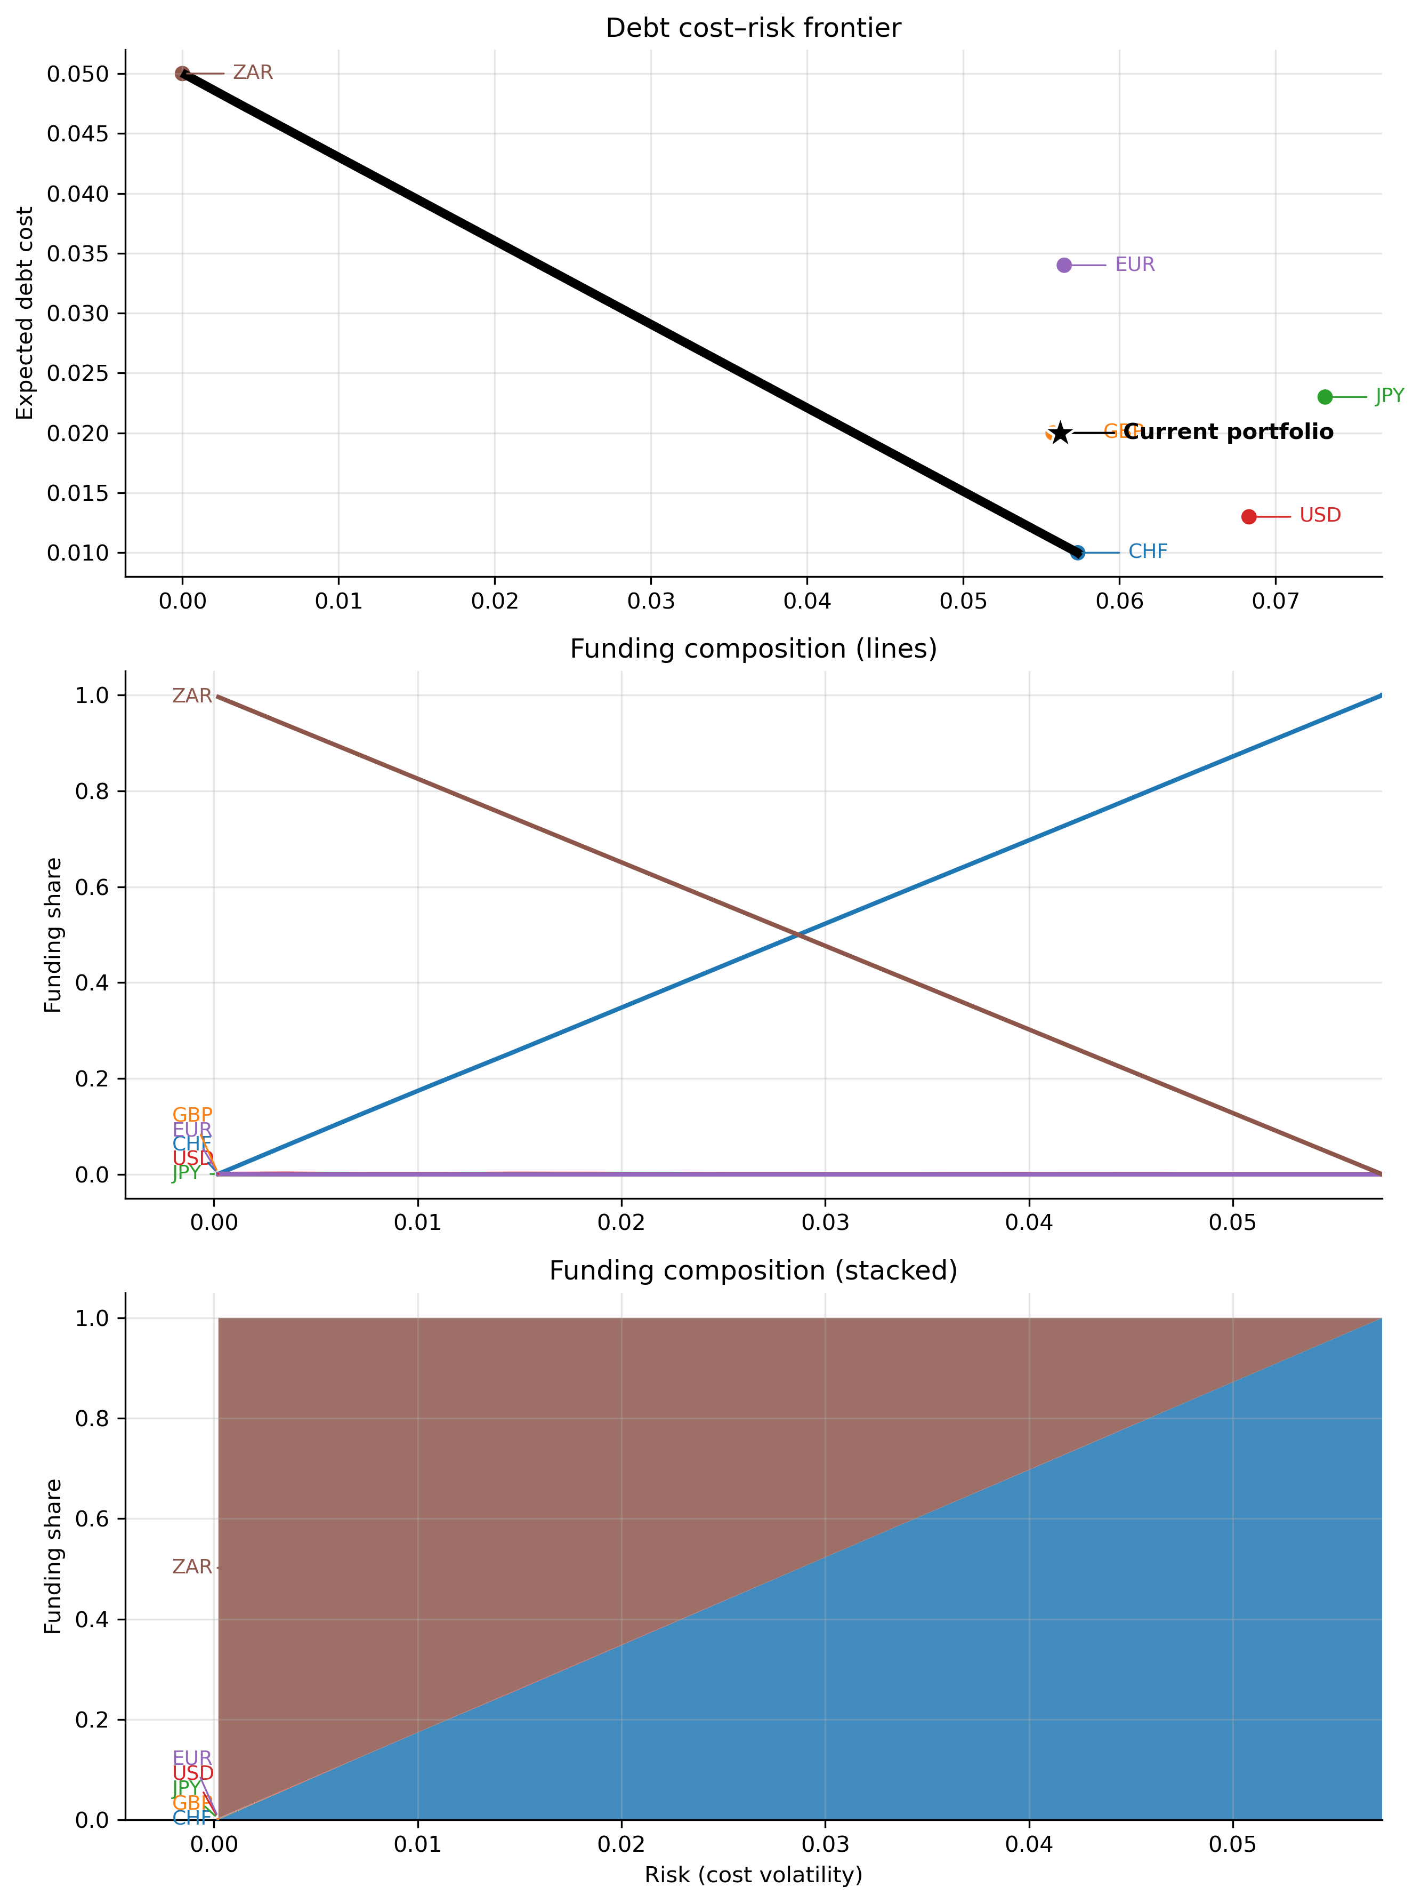
Adding domestic debt to the choice set
A ZAR-denominated option: zero FX risk, 5% interest rate (placeholder)
What changes
• Extend cov_df with a ZAR row/column of zeros — domestic debt has no FX variance.
• Add a ZAR row to assumptions: interest_rate = 5%, current_share = 0.
• The QP now picks among 6 instruments — 5 foreign + 1 domestic.
• Min-variance corner shifts to ~100% ZAR (riskless, but expensive).
• Min-cost corner is still the cheapest foreign currency, with FX risk.
• The widget auto-renders the extra ZAR row — no UI changes needed.
Source: optimization/zar_debt_frontier_with_domestic.png — generated from the notebook’s additional-frontier cell

Slide 9
Reading the three panels
What the plotter shows you
• Panel 1 — cost vs risk: the efficient frontier, plus the current portfolio marker. If the marker sits below-and-right of the frontier, there is a same-cost / lower-risk move available.
• Panel 2 — funding shares as lines: each currency’s optimal share as λ moves left (risk-averse) to right (cost-min).
• Panel 3 — stacked area: the same shares as a 100% composition view — easier to read the mix at any given risk-aversion level.
• Row 0 of the result frame is the current composition (off the frontier). Rows 1..n_points are the frontier sweep.

Slide 10
DebtFrontierInputs — the editable entry point
Dataclass wrapping covariance + assumptions, with a widget
Construct, edit, solve, plot:
inp = er.DebtFrontierInputs(cov_df=cov_df, assumptions=assumptions,
name='basis', chartfolder='graph/')
inp.widget() # interactive grid in a notebook
inp.solve() # 102-row DataFrame (row 0 = current)
inp.plot() # writes graph/basis.svg
• Loop scenarios by mutating inp.assumptions['interest_rate'] and setting inp.name before each plot().
• Live Σ current_share indicator in the widget turns green at exactly 1.0.
• Default export is SVG only; pass export_formats=('png','pdf','svg') to override.

Slide 11
Caveats and extensions
What to know before pushing this further
• Historical covariance is backward-looking. FX regimes shift — stress with alternative Σ (e.g. crisis-period covariance).
• Expected appreciation defaults to 0 in the worked example. Provide a view (forwards, UIP, model output) for production use.
• Add constraints via the weights / weigthtedsum slots of mv_opt (note the upstream typo). E.g. domestic-share floor, regional caps.
• n_points=101 is fast (<1s for 5 assets). Bump for smoother lines; cost is linear.
• Yields here are debt cost, not asset return. Don’t rename the result column — plotter labels are hardcoded.
• External dep: mv_opt comes from model_cvx, bundled with ModelFlowIb (not on PyPI).

Slide 12
Summary
• MVO is a one-paragraph idea: minimize a quadratic risk term, with a linear return/cost term, under linear constraints.
• Sweeping the risk-aversion weight λ traces the efficient frontier.
• The debt-manager version is the same QP with the sign flipped on the linear term — cost replaces return.
• This repo wires ECB FX data → covariance → QP → labeled frontier plot, with a notebook widget for editing assumptions.
• Output: a single chart that makes the cost–risk trade-off across currency mixes legible.

