Slide 1
DATA MINING
PATTERN DISCOVERY
Engr. Dr. Huma Jamshed

Slide 2
Introduction
Considering massive shopping transaction data, pattern discovery may help answer the following questions:
What groups of items are frequently bought together?
If a person buys diapers at night, what is the probability of this person buying beer as well?
If a customer buys an iPhone 5 or iPhone 7, what other electronic products will the customer be most likely to buy in the next 3 months?

Slide 3
The Value of Pattern Discovery
What is the value of pattern discovery? Pattern discovery helps you find hidden and inherent data patterns in massive data
Pattern mining will play a unique and critical role in mining massive data!
What roles does pattern discovery play in the Data Mining Specialization? You will learn scalable methods to find patterns (e.g., the set of data items strongly correlated to each other) from massive data
You will learn how to mine a large variety of patterns
You will also learn how to evaluate the value of patterns
Pattern discovery will help classification, clustering and other data mining tasks

Slide 4
Broad Applications of Pattern Discovery
Predicting shopping transaction data: For a customer who buys products A and B, what is the likelihood of the customer buying product C?
Predicting webpage click streams: Now, which webpage is most likely to be clicked next?
Mining software bugs: Where is the likely bug in this program?
Identifying objects or sub-structures in images, videos, and social media
Finding quality phrases, entities, and attributes in massive text
Finding repeating DNA and protein sequences in genomes
Finding “hidden” communities in a massive social network

Slide 5
What Is Pattern Discovery?
What are patterns?
Patterns: A set of items, subsequences, or substructures that occur frequently together (or strongly correlated) in a data set
Patterns represent intrinsic and important properties of datasets
Pattern discovery: Uncovering patterns from massive data sets
Motivation examples:
What products were often purchased together?
What are the subsequent purchases after buying an iPad?
What code segments likely contain copy-and-paste bugs?
What word sequences likely form phrases in this corpus?

Slide 6
Pattern Discovery: Why Is It Important?
Finding inherent regularities in a data set
Foundation for many essential data mining task
Association, correlation, and causality analysis
Mining sequential, structural (e.g., sub-graph) patterns
Pattern analysis in spatiotemporal, multimedia, time-series, and stream data
Classification: Discriminative pattern-based analysis
Cluster analysis: Pattern-based subspace clustering
Broad applications
Market basket analysis, cross-marketing, catalog design, sale campaign analysis, Web log analysis, biological sequence analysis

Slide 7
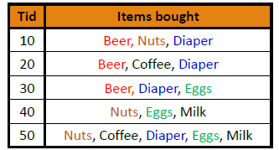
From Frequent Itemsets to Association Rules
Association rules:
X Y (s, c)
Support: s
The probability that a transaction contains X ∪ Y
Confidence: c
The conditional probability that a transaction containing X also contains Y
c = sup(X ∪ Y) / sup(X)
Association rule mining:
Find all of the rules, X Y, with minimum support and confidence

Slide 8
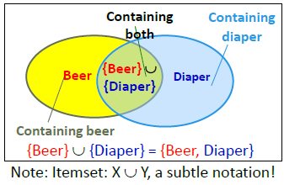
Frequent itemsets:
Let minsup = 50%
Freq. 1-itemsets: Beer: 3, Nuts: 3, Diaper: 4, Eggs: 3
Freq. 2-itemsets: {Beer, Diaper}: 3
Association rules:
Let minconf = 50%
Beer Diaper (60%, 100%)
Diaper Beer (60%, 75%)

Slide 9
Challenge: There Are Too Many Frequent Patterns!
A long pattern contains a combinatorial number of sub-patterns
How many frequent itemsets does the following TDB1 contain? TDB1: T1: {a1, …, a50}; T2: {a1, …, a100}
Assuming (absolute) minsup = 1
Let’s have a try
1-itemsets: {a1}: 2, {a2}: 2, …, {a50}: 2, {a51}: 1, …, {a100}: 1,
2-itemsets: {a1, a2}: 2, …, {a1, a50}: 2, {a1, a51}: 1 …, …, {a99, a100}: 1,
…, …, …, …
99-itemsets: {a1, a2, …, a99}: 1, …, {a2, a3, …, a100}: 1
100-itemset: {a1, a2, …, a100}: 1
In total: (¹⁰⁰₁) + (¹⁰⁰₂) + … + (¹⁰⁰₁₀₀) = 2¹⁰⁰ – 1 sub-patterns!
Notes:
What are Proper Subsets? Set A is considered to be a proper subset of Set B if Set B contains at least one element that is not present in Set A. Example: If set A has elements as {12, 24} and set B has elements as {12, 24, 36}, then set A is the proper subset of B because 36 is not present in the set A.

Slide 10
Expressing Patterns in Compressed Form: Closed Patterns
How to handle such a challenge?
Solution 1: Closed patterns: A pattern (itemset) X is closed if X is frequent, and there exists no super-pattern Y כ X, with the same support as X
Let Transaction DB TDB1: T1: {a1, …, a50}; T2: {a1, …, a100}
Suppose minsup = 1. How many closed patterns does TDB1 contain?
Two: P1: “{a1, …, a50}: 2”; P2: “{a1, …, a100}: 1”
Closed pattern is a lossless compression of frequent patterns
Reduces the # of patterns but does not lose the support information!
You will still be able to say: “{a2, …, a40}: 2”, “{a5, a51}: 1”
Notes:
Closed Patterns: In data mining, particularly in the context of frequent pattern mining, closed patterns are a type of frequent pattern. A closed pattern is a frequent pattern that cannot be extended by adding items to it while preserving its support count. In other words, if a pattern is closed, there is no super-pattern with the same support count.
Lossless Compression: Lossless compression is a method of reducing the size of data without losing any information. The original data can be perfectly reconstructed from the compressed data.

Slide 11
Example
A closed pattern is
a frequent pattern. So it meets the minimum support criteria.
In addition to that, all super-patterns of a closed pattern are less frequent than the closed pattern.
Suppose, the minimum support count is 2. For the first example, suppose there are a total of 3 items: a, b, c.
Suppose a pattern ab has support count of 2 and a pattern abc has support count of 2.
Is the pattern ab is a closed pattern?
For the second example,
Suppose there are a total of 3 items: x, y, z. suppose a pattern xy has support count of 3 and a pattern xyz has support count of 2.
Is the pattern xy is a closed pattern?
Notes:
Pattern ab is a frequent pattern, but it has a super-pattern that is NOT less frequent than ab.
Pattern xy is a frequent pattern and also the only super-pattern xyz is less frequent than xy.
Therefore, xy is a closed pattern.

Slide 12
Expressing Patterns in Compressed Form: Max-Patterns
Solution 2: Max-patterns: A pattern X is a max-pattern if X is frequent and there exists no frequent super-pattern Y כ X
Difference from close-patterns?
Do not care the real support of the sub-patterns of a max-pattern
Let Transaction DB TDB1: T1: {a1, …, a50}; T2: {a1, …, a100}
Suppose minsup = 1. How many max-patterns does TDB1 contain?
One: P: “{a1, …, a100}: 1”
Max-pattern is a lossy compression!
We only know {a1, …, a40} is frequent
But we do not know the real support of {a1, …, a40}, …, any more!
Thus in many applications, mining close-patterns is more desirable than mining max-patterns

Slide 13
Example
A max pattern is
a frequent pattern. So it also meets the minimum support criteria like closed pattern
In addition, but unlike closed pattern, all super-patterns of a max pattern are NOT frequent patterns.
Suppose, the minimum support count is 2.Like before, for the first example, suppose there are a total of 3 items: a, b, c.
Suppose a pattern ab has support count of 3 and a pattern abc has support count of 2.
Is the pattern ab is a max pattern?
Suppose there are a total of 3 items: x, y, z. Suppose a pattern xy has support count of 3 and a pattern xyz has support count of 1.
Is the pattern xy is a max pattern?
Notes:
Pattern ab is a frequent pattern, but it has a super-pattern that is a frequent pattern as well. So, pattern ab is NOT a max pattern.
Pattern xy is a frequent pattern and also the only super-pattern xyz is NOT a frequent pattern. Therefore, xy is a max pattern.

Slide 14
The Downward Closure Property of Frequent Patterns
If an itemset I is frequent, then every subset of I must also be frequent.
This property is crucial because it allows for a more efficient search for frequent itemsets.
If a certain itemset is not frequent, there is no need to consider any of its supersets.
Observation: From TDB1: T1: {a1, …, a50}; T2: {a1, …, a100} We get a frequent itemset: {a1, …, a50}
Also, its subsets are all frequent: {a1}, {a2}, …, {a50}, {a1, a2}, …, {a1, …, a49}, …
There must be some hidden relationships among frequent patterns!

Slide 15
The downward closure (also called “Apriori”) property of frequent patterns
If {beer, diaper, nuts} is frequent, so is {beer, diaper}
Every transaction containing {beer, diaper, nuts} also contains {beer, diaper}
Apriori: Any subset of a frequent itemset must be frequent
Efficient mining methodology
If any subset of an itemset S is infrequent, then there is no chance for S to be frequent—why do we even have to consider S!?

Slide 16
Algorithms used for frequent pattern mining
There are several different algorithms used for frequent pattern mining, including:
Apriori algorithm: This is one of the most commonly used algorithms for frequent pattern mining. It uses a “bottom-up” approach to identify frequent itemsets and then generates association rules from those itemsets.
ECLAT algorithm: This algorithm uses a “depth-first search” approach to identify frequent itemsets. It is particularly efficient for datasets with a large number of items.
FP-growth algorithm: This algorithm uses a “compression” technique to find frequent patterns efficiently. It is particularly efficient for datasets with a large number of transactions.

Slide 17
The Apriori Algorithm
An algorithm for mining Frequent Itemsets
for Boolean Association Rules
using Candidate Generation.
The algorithm uses prior knowledge of frequent itemset properties.
Apriori employs an iterative approach known as a level-wise search where
k-itemsets are used to explore (k+1)-itemsets.
First, the set of frequent 1-itemsets is found.
This set is denoted L₁.
L₁ is used to find L₂, the set of frequent 2-itemsets, which is used to find L₃ and so on, until no more frequent k-itemsets can be found.
The finding of each L_{k} requires one full scan of the database.

Slide 18
To improve the efficiency of the level-wise generation of frequent itemsets,
an important property called the Apriori property is used to reduce the search space.
All nonempty subsets of a frequent itemset must also be frequent.
This property is based on following observation:-
By definition, if an itemset I does not satisfy the minimum support threshold, min_sup, then
I is not frequent i.e. P(I) < min_sup.
If an item A is added to itemset I, then the resulting itemset (i.e. I U A) cannot occur more frequently than I i.e., P(I U A) < min_sup.

Slide 19
Two-steps of Algorithm
How is the Apriori property used in the algorithm?
To understand this, let us look at how L_{k-1} is used to find L_{k}.
A two-step process is followed, consisting of
join and
prune actions

Slide 20
The join step
To find L_{k}, a set of candidate k-itemsets is generated by joining L_{k-1} with itself
This set of candidates is denoted C_{k}.
C_{k} = L_{k-1} ⋈ L_{k-1}
Let l₁ and l₂ be itemsets in L_{k-1}.
The notation l_{i}[j] refers to the jth item in l_{i} (e.g. l₁[k-2] refers to the second to the last item in l₁).
The join L_{k-1} ⋈ L_{k-1}, is performed, where members of L_{k-1} are joinable if their first (k-2) items are in common.

Slide 21
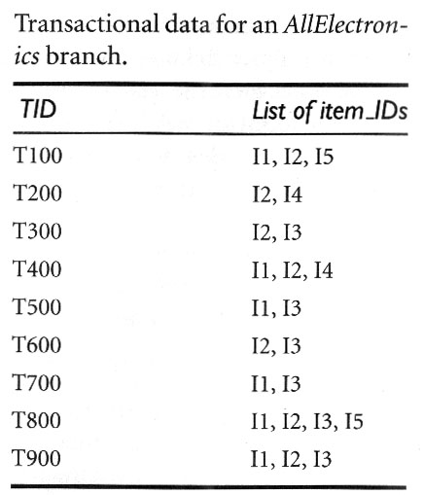
Example 1
Consider the AllElectronics transaction database, D, of fig 1.
There are nine transactions in this database, that is, |D|=9.
Fig 4

Slide 22
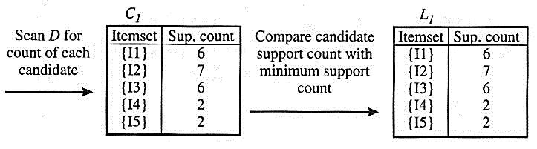
First iteration
Finding C1 - set of candidate 1-itemsets.
The algorithm simply scans all of the transactions in order to count the number of occurrences of each item.
Suppose the min transaction support count is 2
(i.e. min_sup = 2/9 = 22%).
Now finding L1 - the set of frequent 1-itemsets.
It consists of the candidate 1-itemsets satisfying minimum support.
Fig 5

Slide 23
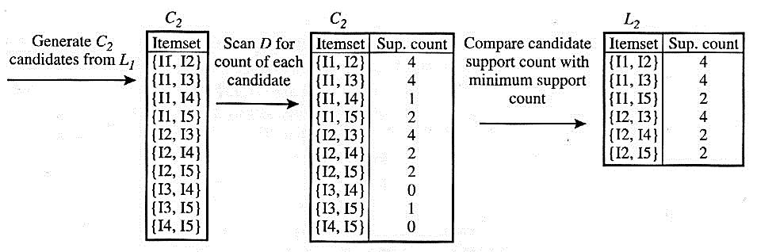
Second iteration
Now finding C2 - set of candidate 2-itemsets.
C₂ = L₁ ⋈ L₁
Next the transactions in D are scanned and the support count of each candidate itemset in C2 is accumulated
The set of frequent 2-itemsets, L2, is then determined, consisting of those candidate 2-itemsets in C2 having minimum support.
Fig 6

Slide 24
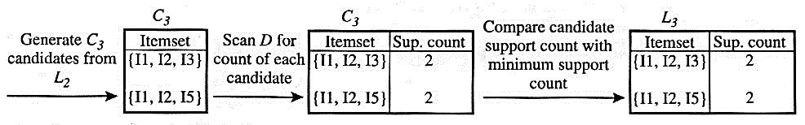
Third iteration
Next finding C3 - set of candidate 3-itemsets
C₃ = L₂ ⋈ L₂
The generation of the set of candidate 3-itemsets, C3, is detailed in fig 6.
Here C₃ = L₂ ⋈ L₂ = {{I1, I2, I3}, {I1, I2, I5}, {I1, I3, I5}, {I2, I3, I4}, {I2, I3, I5}, {I2, I4, I5}}
Next the transactions in D are scanned and the support count of each candidate itemset in C₃ is accumulated.
Fig 7

Slide 25
Third iteration (cont’d)
Based on the Apriori property that all subsets of a frequent itemset must also be frequent,
we can determine that the four later candidates cannot possibly be frequent.
We therefore remove them from C3, thereby saving the effort of unnecessarily obtaining their counts during the subsequent scan of D to determine L3.
The set of frequent 2-itemsets, L2, is then determined,
consisting of those candidate 2-itemsets in C2 having minimum support.
Note that when given a candidate k-itemset,
we only need to check if its (k-1)-subsets are frequent
since the Apriori algorithm uses a level-wise search strategy.

Slide 26
Third iteration (cont’d)
The transactions in D are scanned in order to determine L3, consisting of those candidate 3-itemsets in C3 having minimum support. (fig 4).
Fourth iteration
Now finding C4 - set of candidate 4-itemsets.
C₄ = L₃ ⋈ L₃
The join results in {{I1, I2, I3, I5}},
this itemset is pruned since its subset {{ I2, I3, I5}} is not frequent.
Thus, C4 = φ, and the algorithm terminates, having found all of the frequent itemsets.

Slide 27
Generating Association Rules from Frequent Itemsets
The strong association rules must satisfy both minimum support and minimum confidence.
Use following equation for confidence,
where the conditional probability is expressed in terms of itemset support count:

Slide 28
Based on this equation, association rules can be generated as follows:-
For each frequent itemset l, generate all nonempty subsets of l.
For every nonempty subset s of l, output the rule s ⇒ (l – s) if , where min_conf is the minimum confidence threshold.
Since the rules are generated from the frequent itemsets, each one automatically satisfies minimum support.
Frequent itemsets can be stored ahead of time in hash tables along with their counts so that they can be accessed quickly.

Slide 29
Example
Consider the transactional data. Suppose the data contains the frequent itemset l {I1, I2, I5}.
What are the association rules that can be generated from l?
The nonempty subsets of l are {I1,I2}, {I1,I5}, {I2,I5}, {I1}, {I2}, and {I5}.
The resulting association rules are as shown below, each listed with its confidence:
I1 ^ I2 ⇒ I5, confidence = 2/4 = 50%
I1 ^ I5 ⇒ I2, confidence = 2/2 = 100%
I2 ^ I5 ⇒ I1, confidence = 2/2 = 100%
I1 ⇒ I2 ^ I5, confidence = 2/6 = 33%
I2 ⇒ I1 ^ I5, confidence = 2/7 = 29%
I5 ⇒ I1 ^ I2, confidence = 2/2 = 100%
If the minimum confidence threshold is, say, 70%, then only the second, third and last rules above are output, since these are the only ones generated that are strong.

