Slide 1
DATA MINING
PATTERN DISCOVERY
Engr. Dr. Huma Jamshed

Slide 2
ECLAT
The ECLAT algorithm stands for Equivalence Class Clustering and bottom-up Lattice Traversal.
It is a more efficient and scalable version of the Apriori algorithm.
This vertical approach of the ECLAT algorithm makes it a faster algorithm than the Apriori algorithm.
Notes:
While the Apriori algorithm works in a horizontal sense imitating the Breadth-First Search of a graph, the ECLAT algorithm works in a vertical manner just like the Depth-First Search of a graph.
ECLAT algorithm is a frequent pattern mining algorithm just like the apriori algorithm. We can say that the ECLAT algorithm is an efficient and scalable version of the apriori algorithm with the following improvements.
The apriori algorithm and the fp-growth algorithm work with the horizontal transaction dataset. On the contrary, the ECLAT algorithm works on a vertical data format.
ECLAT algorithm uses a depth-first search approach to traverse the itemsets. The Apriori algorithm uses a breadth-first approach to traverse the transaction dataset.

Slide 3
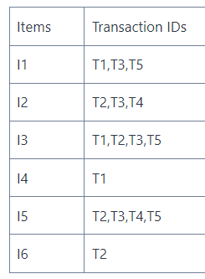
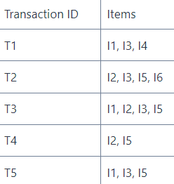
Step 1: Convert Transaction Data to Vertical Format
Normally, the transactions in a dataset are stored in horizontal format. It means that each row in the dataset contains a transaction ID and the corresponding items in the transaction as shown below.
In vertical format, the rows in the transaction data contain an item and the corresponding transactions in which the item is present. The dataset in the vertical format looks as follows.

Slide 4
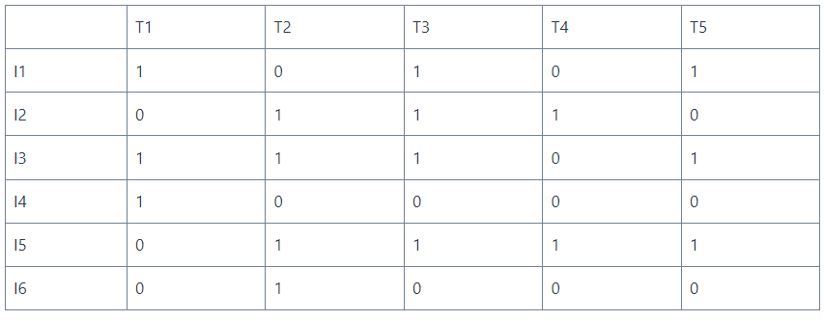
Now use Eclat algorithm to find association rules from the above dataset. For our numerical example, use the minimum support count of 2 and minimum confidence of 75 percent.
Calculate the support of the itemsets, we will create a matrix representing the presence of items in a transaction as shown below.
Notes:
The above matrix contains Items on the vertical axis and transaction IDs on the horizontal axis. If an item is present in a transaction, the corresponding cell is set to 1. Otherwise, it is set to 0. We will use this matrix to calculate the support count of itemsets as it is easier to scan this matrix compared to the transaction dataset.

Slide 5
Step 2: Candidate Generation From the Dataset
Use the candidate generation step to generate itemsets that can possibly be frequent itemsets.
start by creating sets containing single items.
If there are N items in the dataset, create N candidate sets.
Use the minimum support count to select frequent itemsets containing one item. Then iteratively join them to create larger sets containing 2, 3, 4, 5, or more items.
Notes:
In the candidate generation process, we generate the candidate itemsets containing k items by joining the frequent itemsets with k-1 items in common. This process is repeated until no new frequent itemsets can be generated.

Slide 6
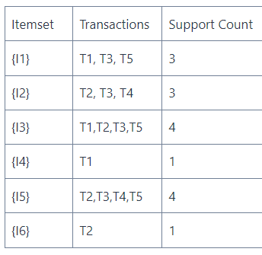
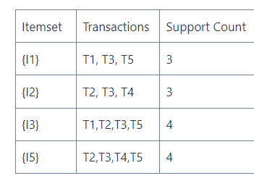
The itemsets {I4} and {I6} have support count 1 which is less than the minimum support count 2.
Omit these itemsets from the candidate table.
Notes:
The above table contains the support count of candidate itemsets with one item. Here, you can observe that the itemsets {I4} and {I6} have support count 1 which is less than the minimum support count 2. Hence, we will omit these itemsets from the candidate table. After this, we will get the table containing frequent itemsets with a single item as shown below.

Slide 7
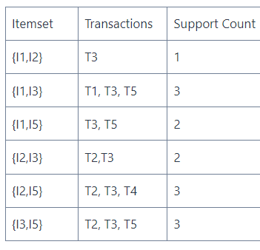
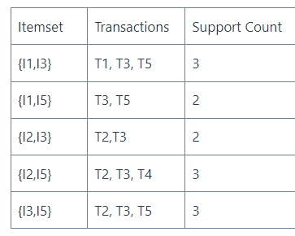


Slide 8
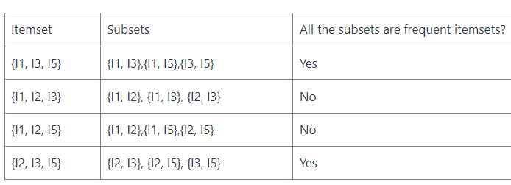
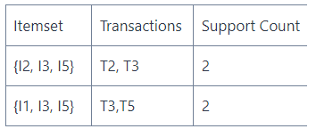
Step 3: Pruning the Candidate Itemsets
The pruning step in the ECLAT algorithm is derived from the apriori algorithm.
It is based on the concept that a subset of a frequent itemset must also be a frequent itemset.
Notes:
In other words, if we have an itemset having a subset that is not a frequent itemset, the itemset cannot be a frequent itemset.
We use pruning to remove the candidate sets before even scanning the dataset to calculate the support count and minimize the time taken in executing the algorithm. After creating itemsets of K items, we use the following steps to prune the candidate set.
In the table, you can observe that the itemset {I1,I2 , I3} and {I1, I2, I5} contain the itemset {I1, I2} which is not a frequent itemset. Hence, we will prune the itemsets {I1, I2, I3} and {I1, I2, I5}. After this, we will get the itemsets {I1, I3, I5} and {I2, I3, I5} as candidate itemsets for the itemsets having three items. Let us calculate their support count.

Slide 9
Frequent Pattern Growth Algorithm
The two primary drawbacks of the Apriori Algorithm are:
At each step, candidate sets have to be built.
To build the candidate sets, the algorithm has to repeatedly scan the database.
These two properties certainly make the algorithm slower.
To overcome these redundant steps, a new association-rule mining algorithm was developed named Frequent Pattern Growth Algorithm.
It overcomes the disadvantages of the Apriori algorithm by storing all the transactions in a Tree Data Structure.

Slide 10
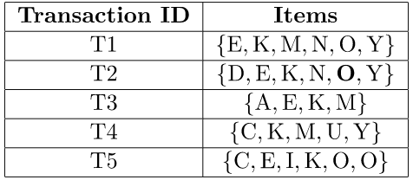
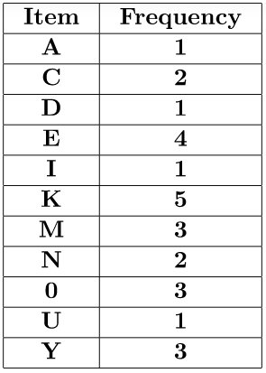
Consider the following data:-
The data is a hypothetical dataset of transactions with each letter representing an item. The frequency of each individual item is computed:-
Assuming the minimum support is set to 3, a Frequent Pattern set is constructed. This set comprises elements with frequencies equal to or higher than the minimum support. The elements are organized in descending order based on their respective frequencies. Upon adding the relevant items, the resulting set L appears as follows
L = {K : 5, E : 4, M : 3, O : 3, Y : 3}

Slide 11
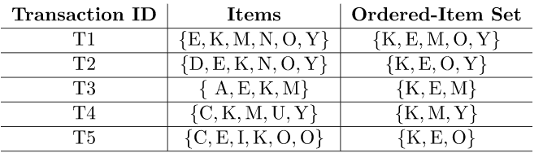
Subsequently, an Ordered-Item set is constructed for each transaction. This process involves iterating through the Frequent Pattern set and verifying if the current item is present in the transaction under consideration. If the item is found, it is added to the Ordered-Item set for that particular transaction. The ensuing table is generated to encompass all transactions
Notes:
an "ordered itemset" refers to a set of items that are ordered based on their frequency of occurrence in a dataset.

Slide 12
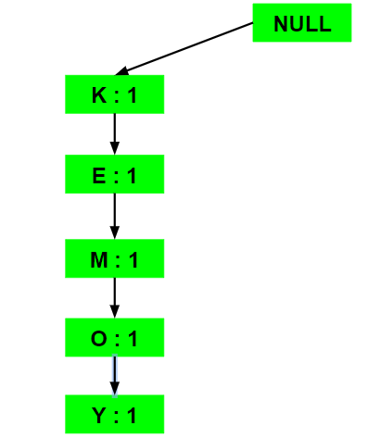
Inserting the set {K, E, M, O, Y}:

Slide 13
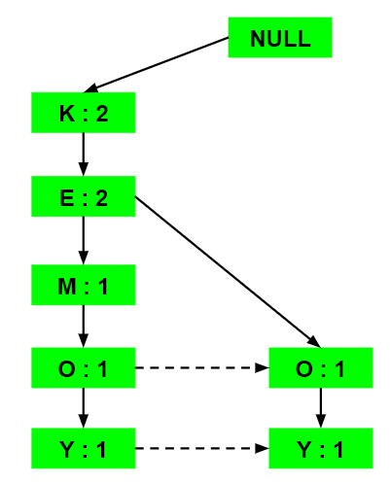
Inserting the set {K, E, O, Y}:
Notes:
Till the insertion of the elements K and E, simply the support count is increased by 1. On inserting O we can see that there is no direct link between E and O, therefore a new node for the item O is initialized with the support count as 1 and item E is linked to this new node. On inserting Y, we first initialize a new node for the item Y with support count as 1 and link the new node of O with the new node of Y.

Slide 14
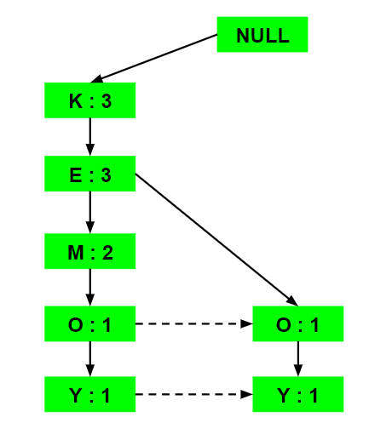
Inserting the set {K, E, M}:

Slide 15
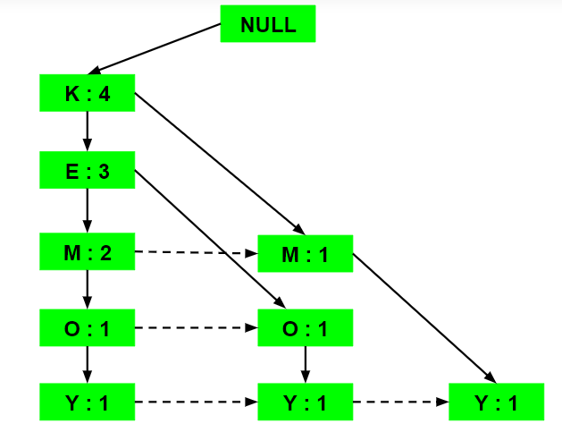
Inserting the set {K, M, Y}:

Slide 16
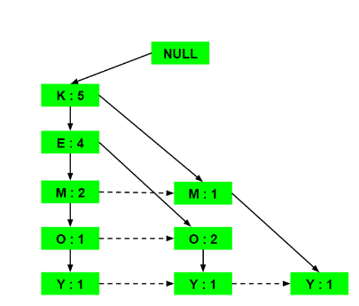
Inserting the set {K, E, O}:
Notes:
Here simply the support counts of the respective elements are increased. Note that the support count of the new node of item O is increased.

Slide 17
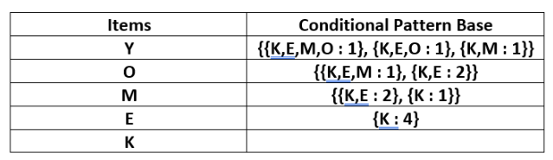
Next, the Conditional Pattern Base is calculated for each item, comprising the path labels of all paths that lead to any node associated with the given item in the frequent-pattern tree. It is important to note that the items in the table below are arranged in ascending order based on their frequencies
Notes:
A Conditional Pattern Base is essentially a set of prefix paths in the FP-tree that correspond to a specific item. These paths represent the transactions in which the item occurs.

Slide 18
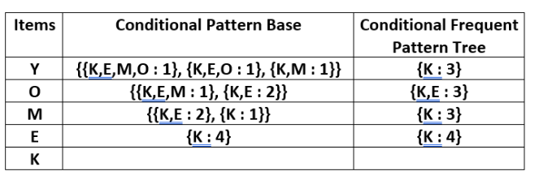
For each item, the Conditional Frequent Pattern Tree is constructed. This involves identifying the set of elements that appear in all paths within the Conditional Pattern Base for that item. The support count of this set is then computed by summing the support counts of all the paths in the Conditional Pattern Base
Notes:
Along with the Conditional Pattern Base, the algorithm constructs a Conditional FP-tree for each frequent item. This tree contains the conditional patterns extracted from the Conditional Pattern Base

Slide 19
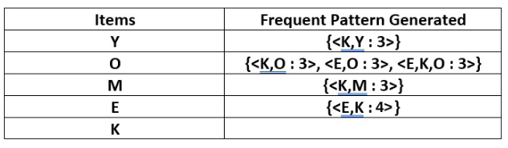
From the Conditional Frequent Pattern tree, the Frequent Pattern rules are generated by pairing the items of the Conditional Frequent Pattern Tree set to the corresponding to the item as given in the below table.
For each row, two types of association rules can be inferred for example for the first row which contains the element, the rules K -> Y and Y -> K can be inferred. To determine the valid rule, the confidence of both the rules is calculated and the one with confidence greater than or equal to the minimum confidence value is retained.

Slide 20
Advantages of the FP-tree Structure
The most significant advantage of the FP-tree
Scan the DB only twice and twice only.
Completeness:
The FP-tree contains all the information related to mining frequent patterns (given the min-support threshold).
Compactness:
The size of the tree is bounded by the occurrences of frequent items
The height of the tree is bounded by the maximum number of items in a transaction

