Slide 1
DATA MINING
Limitation of the Support Confidence Framework
Engr. Dr. Huma Jamshed

Slide 2
How to Judge if a Rule/Pattern Is Interesting?
Pattern-mining will generate a large set of patterns/rules
Not all the generated patterns/rules are interesting
Interestingness measures: Objective vs. subjective
Objective interestingness measures
Support, confidence, correlation, …
Subjective interestingness measures: One man’s trash could be another man’s treasure
Query-based: Relevant to a user’s particular request
Against one’s knowledge-base: unexpected, freshness, timeliness
Visualization tools: Multi-dimensional, interactive examination
Notes:
The first thing we want to discuss is, The Limitation ofthe Support Confidence Framework.
As we know, pattern mining may generate a large number of rules but not all of the patterns and rules generated are interesting.
In general we can classify the interesting measures into two classes, objective versus subjective.
For objective measure like support, confidence, correlation are defined by mathematical formulas, not change from person to person.
But the subjective measure may change from person to person, because one man's trash could be another man's treasure.
So the first thing, is we may want a user to say, what do you like to see? So it's query based. Another thing is we may base on user's knowledge base, try to mine something unexpected, fresh or recent. Or we can map patterns and rules into two-dimensional space, let user to interactively pick some interesting things.

Slide 3
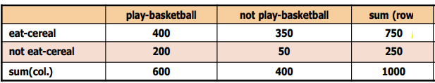
Limitation of the Support-Confidence Framework
Are s and c interesting in association rules: “A ⇒ B” [s, c]?
Example: Suppose one school may have the following statistics on # of students who may play basketball and/or eat cereal:
2-way contingency table
Association rule mining may generate the following:
play-basketball ⇒ eat-cereal [40%, 66.7%] (higher s & c)
But this strong association rule is misleading: The overall % of students eating cereal is 75% > 66.7%, a more telling rule:
¬ play-basketball ⇒ eat-cereal [35%, 87.5%] (high s & c)
Notes:
So we know we have support and confidence as two interestingness measures in association rules. So we may be careful about this, because not all the strong support and confidence rules are interesting.
For example, take the following table, a 2-way contingency table, to look at this to see how to interpret things we found.
For example, in this table, 400 out of 1000 students play basketball and eating cereal, but 200 students, they play basketball but they may not eat cereal.
In this one, you may derive association rule like this. Playing basketball implies eating cereal. You probably will get a 40% support because it's 400 over 1,000. You will get two thirds of the confidence because you get 400 over 600.
So this is pretty high support and confidence. Is this really interesting? Let me try another rule regenerated. Actually you will see, if we say not playing basketball, eating cereal. You will see not playing basketball is 35%, with the confidence even higher, because they have 350 eating cereal out of 400 people. So this one is even higher. So, if you recommend these two rules to the cereal company, they will get confused. They'll say, the first rule say that I better give some free basketball because if they play basketball, eating cereal. The second rule say I better take their basketball away, because if they do not play basketball they actually eat cereal even more. Which one is right?

Slide 4
Interestingness Measures: Lift and χ²
Notes:
We have learned support and confidence.
These two measures are not sufficient to describe association.
So the problem becomes what additional interesting measures are good enough to describe their relationships?
So that's the reason we want to examine a little more like lift and chi square whether they are good enough to describe additional interesting measures.

Slide 5

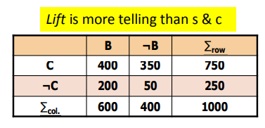
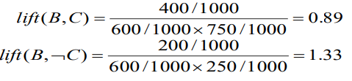
Interestingness Measure: Lift
Measure of dependent/correlated events:
Lift(B, C) may tell how B and C are correlated
Lift(B, C) = 1: B and C are independent
> 1: positively correlated
< 1: negatively correlated
For example for given data
Thus, B and C are negatively correlated since lift(B, C) < 1;
B and ¬C are positively correlated since lift(B, ¬C) > 1
Notes:
So lift has been properly used in statistics as well.
We look at the same table, the same table we can think B means playing basketball, C means eating cereal.
So we have the exact same distribution. Then for this continuous table, we use lift to compute it.
The lift is defined as this: B and C are two item sets. For rule B implies C, that confidence if its divided by C support, we get lift.
Or we can say if BC this lose support divided by B support times C support.
So for this lift, the general rule is if the lift is one, then these two items are independent.
If it's greater than one, they are positively correlated. If it is less than one, they are negative correlated.
For our example data set, we will calculate a lift of B and C and B and not C. We divide 0.89 and 1.33. Then from those data sets and the rules we've broken C, B and C should be negative correlated because the lift is less than one. B and not C are positive co-related because the lift is greater than one. This actually fix our problem because we know B and C should be negative correlated, B and not C should be positive correlated. So this looks very nice.

Slide 6
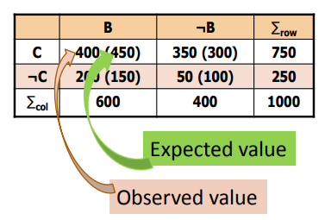

Interestingness Measure: χ²
Another measure to test correlated events: χ²
General rules
χ² = 0: independent
χ² > 0: correlated, either positive or negative, so it needs additional test
χ² shows B and C are negatively correlated since the expected value is 450 but the observed is only 400
χ² is also more telling than the support-confidence framework
Notes:
Let's look at another measure popularly used in statistics as well called chi square.
In chi square, the definition, we need to calculate the expected value. How to calculate the expected value?
If we can see this 400 is a real value, it's observed value. But expect value is just based on the distribution.
For example C and not C the distribution is 750 over 250. This is three to one and all 600 students with three to one you get 450 versus 150.
In that case, we probably can't see, we still can't use the popular, the rules like if chi square is zero, they are independent.
It's greater than zero, they are correlated either positively or negatively. So we need additional test to see whether they are positively or negatively correlated. Now for our example, we can easy calculate chi square should be almost 76. So B and C should be correlated. Further, we can say they are negatively correlated because the expected value is 450. The observed value is only 400.

Slide 7
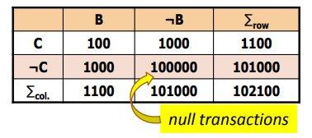
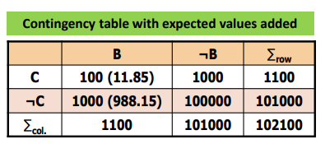
Lift and χ² : Are They Always Good Measures?
Null transactions: Transactions that contain neither B nor C
Let’s examine the dataset D
BC (100) is much rarer than B¬C (1000) and ¬BC (1000), but there are many ¬B¬C (100000)
Unlikely B & C will happen together!
But, Lift(B, C) = 8.44 >> 1 (Lift shows B and C are strongly positively correlated!)
χ² = 670: Observed(BC) >> expected value (11.85)
Too many null transactions may “spoil the soup”!
Notes:
But the problem becomes whether lift and chi square are good in all the cases.
Let's examine some interesting case.
In this case, you probably can see this not B not C actually is quite big. There are 100000. These actually called null transactions because the transactions contain neither B nor C.
And if we just look at a B and C relationship, we first see B and C should be negative correlated because it's not easy to get B and C together.
B and not C is far bigger. C and not B is also far bigger. But if we use a lift, we compute a lift B and C, we will get this 8.44 which is far bigger than one.
That shows B and C should be strongly positive correlated.
This seems not right. Either we tried to use this same contingency table. We add the expected value. We do the computation. We will find chi square is bigger than zero.
In the meantime, you observed value is far bigger than the expected value.
So we also should say B and C are strongly positively correlated. This seems to be wrong. What's the problem? Actually, there are too many null transactions. That may make things distorted. We need to fix it.

Slide 8
Null Invariance Measures

Slide 9
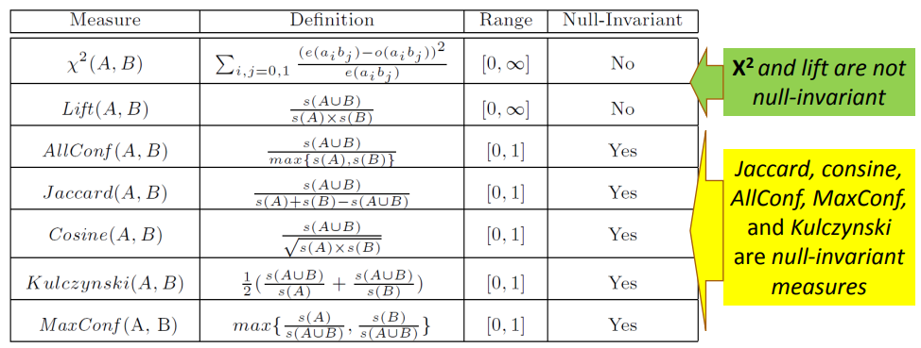
Interestingness Measures & Null-Invariance
Null invariance: Value does not change with the # of null-transactions
A few interestingness measures: Some are null invariant
Notes:
We already seen Lift and a chi-square may not be very good measures, examining the transaction data that contain lots of null transactions.
So, what we may like to see is, what are good measures? They do not influence much by number of null transactions. Let's look at those different measures. Some measure, they have the property called null-invariance, that means their values may not change with a number of null transactions. Let's see what measures are null-invariant, what measures are not null-invariant. We already know chi-square and a Lift, they are not null-invariant. Their value change with number on null transactions.
But, people have found that the folding five measures, if you check their formula, their definition, they are actually null-invariant measures.
So, you probably know Jaccard coefficient and cosine measure quite well. These two measures are popularly used, they're null-invariant.
But all confidence which actually take the smaller value among A and B as the denominator, the numerator is just the transaction support of the rule. So, the max confidence is try to find the maximum one of them. These two actually proposed in the study of measuring association rules.

Slide 10
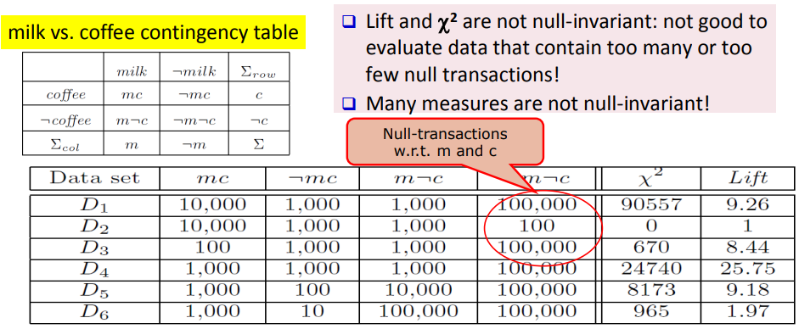
Null Invariance: An Important Property
Why is null invariance crucial for the analysis of massive transaction data?
Many transactions may contain neither milk nor coffee!
Notes:
That means why in analysis massive transaction data, the null-invariance is so critical, because in many many transactions, the transaction set contain particular sets of item.
The chance actually is very rare like a warm up transactions. They may contain neither milk nor coffee.
We will try to analyze milk and coffee using the following contingency table.
So, this m_c means the number of transactions that contain both milk and coffee.
This not m nor c means the number of transactions that contain neither milk nor coffee.
So, this not m nor c is the number of no transactions.
Then, we see Lift and chi-square, they are not null-invariant. So they are not good at evaluating data that contain too many or too few null transactions.
For example, we just look at this, for this dataset D1, m_c means number of transactions that contain both milk and coffee; not m_c means the number of transactions contain no milk but coffee; m no c means that number of transactions that contains milk but not coffee; not m nor c means the number of null transactions, they contain neither me nor coffee.
So, you'll probably go to like a Walmart, it's kind of shopping market, you probably see there could be the cases you get 10,000 transactions that contain milk and a coffee, but 1,000 contain not milk but coffee, 1,000 contain milk but not coffee.
In that case, you probably say actually likely if people buy milk, they would buy coffee as well because there are 10,000 such cases.
Buy only one of them, there's only 1,000. But, if you have a lot of a null transactions, this value could be quite positive.
If you have very few null transactions, it turn out they are independent. You probably look at the value they are not independent. On the other hand, if you see there's only 100 cases, you're got a milk and coffee together.
There are many more cases, they buy it alone. But once you have many null transactions, it turns out to be very positive. The number is quite big. So, no matter you get a very many null transactions, so very few null transactions, something may go wrong. So, we do need to analyze such data using some null-invariance measures. We'll examine this in more detail.

Slide 11
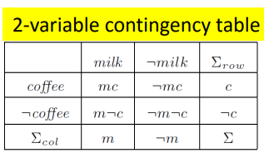
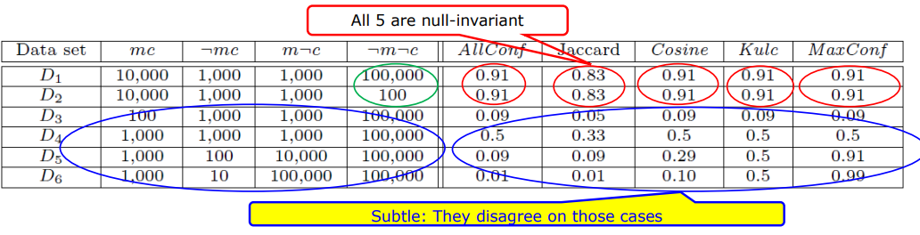
Comparison of Null-Invariant Measures
Not all null-invariant measures are created equal
Which one is better?
D4—D6 differentiate the null-invariant measures
Kulc (Kulczynski 1927) holds firm and is in balance of both directional implications
Notes:
Now, we come down to compare these null invariant measures.
So, which one is better?
We know, we can sense not all those null-invariant measures are created equal so, we want to see which one's better in all the cases.
Let's examine the two variable contingency table of the transactions containing milk and coffee. Let's look at the case in this data set.
So the first, you look at D1 andD2, D1 and D2, you probably can see the difference is only on the number of null transactions.
But you also can see very likely, milk and coffee should get together, they should be positive. In that sense, you can see all of those five, null-invariant measures, they give equal value. In this sense, no matter how many transactions on the null part. Okay, they do not change their value. And also they are very close to one, in the sense, these are possibly getting together.
When you look at D3,D3 means mc getting together is quite rare because they get along more frequent. In that sense, all their values are very close to zero.
Then you look at the D4, D4 says mc getting together or mc alone, they are all like 1,000 and1,000 and 1,000 cases. No matter how many null transactions, they actually got things right in the middle this 0.5, 0.5.
Only Jaccard's 0.33,actually just in Jaccard, this one means its balance is right in the middle.
Then we look at cases, it could be D5 and D6. D5, if you see this is 1,110 solved cases. So what you probably can see ,is from coffee point of view, like a coffee guy may say,mc are likely getting together, because they get along as 100 cases buying coffee but not milk.
1000 cases we're buying both coffee and milk. But for milk guy, they probably say, they are very unlikely getting together, because I got 10,000 cases buying milk but not coffee. But only 1000 case buying milk and coffee. So, in that case you look at different measures. It's interesting to see, All Confidence and Jaccard they also say it's closer to zero, unlikely getting together.
But Max Confidence says it's close to one, they are very likely getting together. Then we look at a Kulczynski said, I'm right in the middle, because the tug of the war on each side is ten to one. Then Cosine said, I'm a little prone to unlikely getting together.
Now, we change this one even more. This is 1,000 to ten, or 1,000 to 100,000. The coffee guys said they are very, very likely getting together. But the milk guy said, they are very unlikely getting together. Now in this case, you probably can see All Confidence and Jaccard drop down to 0.01, and even cosine dropped down to 0.1.
But if Max Confidence says, I am very confident they are very close to one, because they are very likely getting together. But in Kulcyzynski said, I'm still in the neutral because this is 100 to one, the other is one to 100,they have the equal ratio. So, which one do you like? So, probably we can see D4 to D6. The real case is, that differentiate that five null-invariant measures. But we probably can see, Kulcyzynski measure holds firm when in these very imbalanced cases. But the ratio is balanced on both sides, and it holds firm at 0.5. That looks interesting.

