Slide 1
Case Study Project - Boat Sales

Slide 2
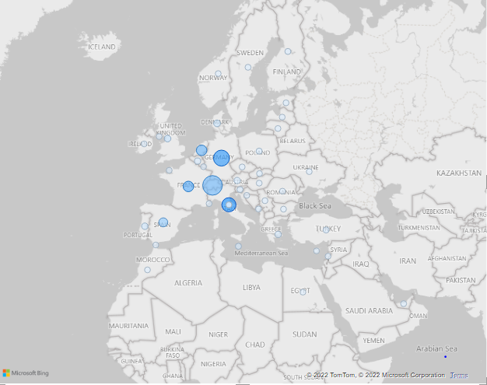
Views summary
Total views = 1.40 M
Average Views = 150.24
Min Views = 3263
Max Views = 13
Median = 108
Standard Deviation = 154.67
Most views are from Switzerland, Germany and Italy.

Slide 3
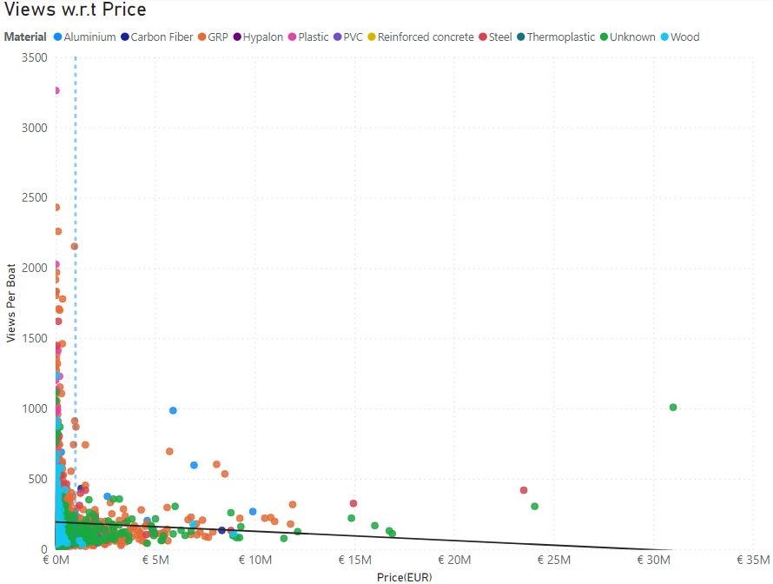
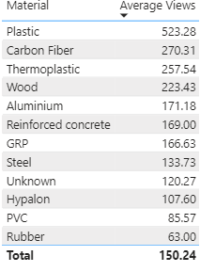
Relationship Between Price and Views

Slide 4
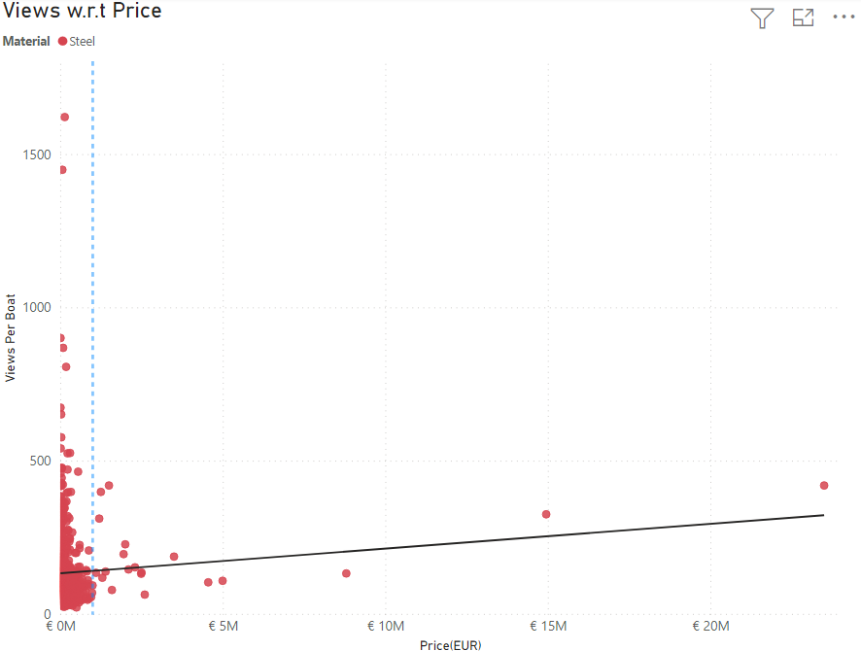
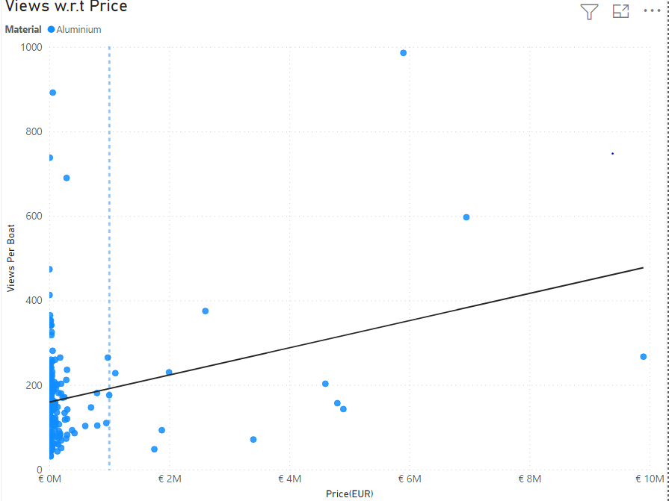
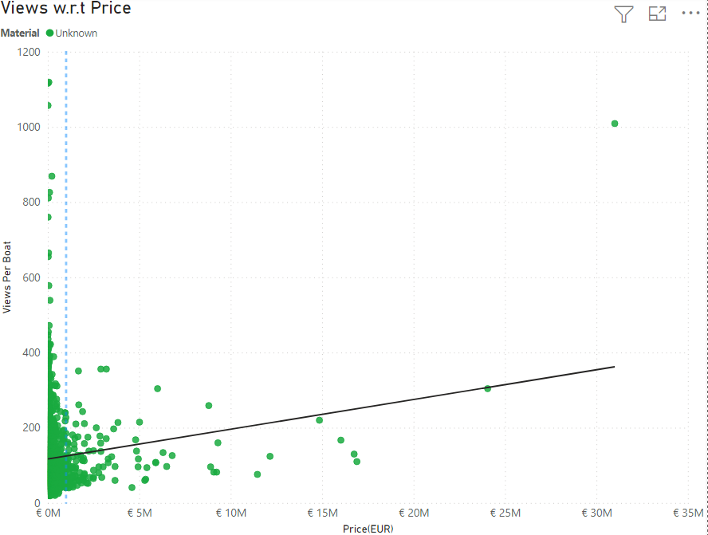
Continue….
These are exception
Steel
Aluminum
Unknown

Slide 5
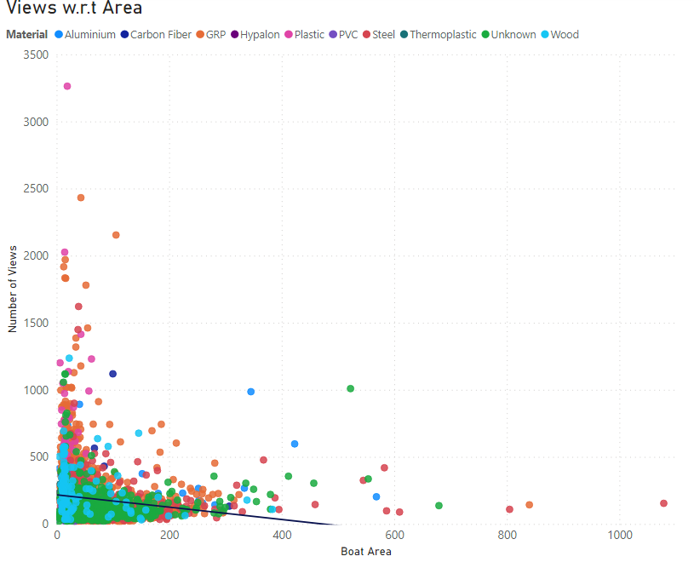
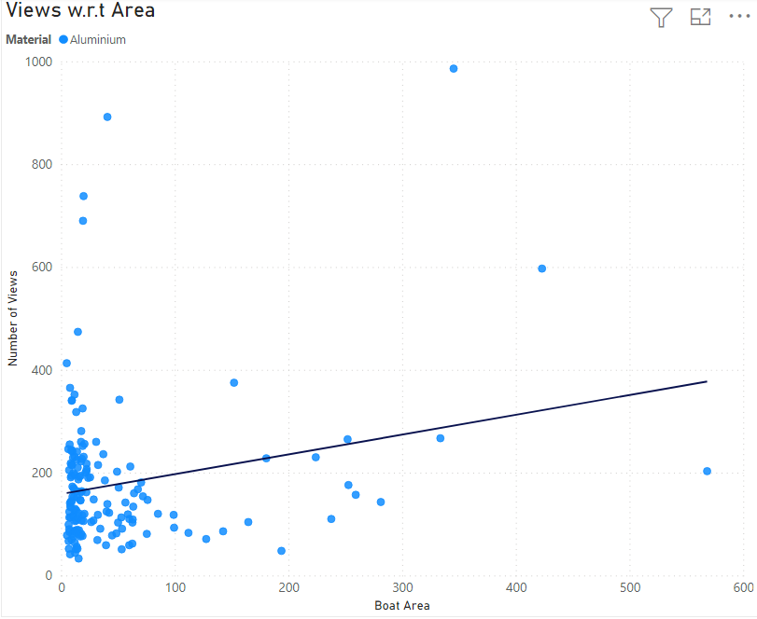
Relationship Between Area and Views
Showing All types Material
Aluminum with Positive corr
Positive or almost zero corr with Carbon Fiber and Unknown
Aluminum

Slide 6
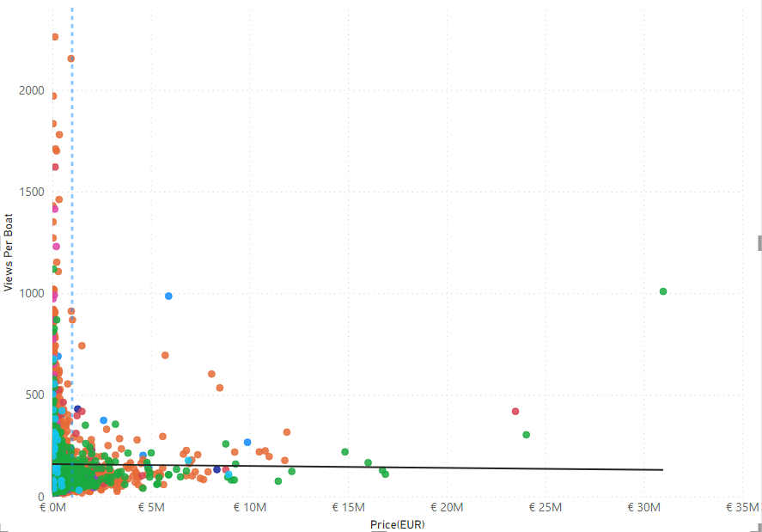
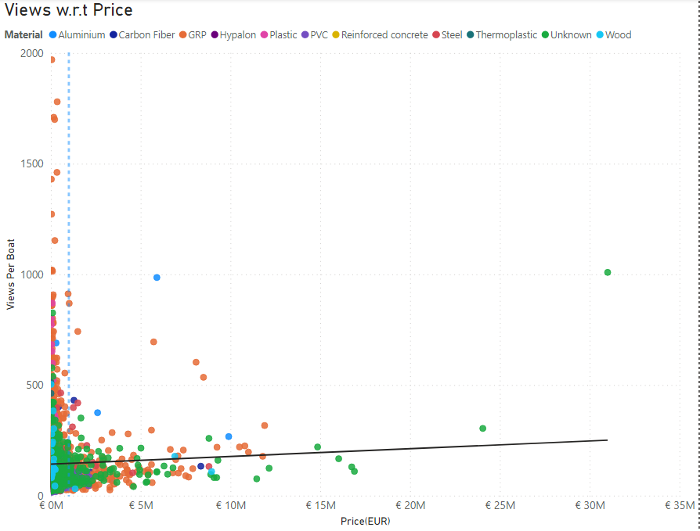
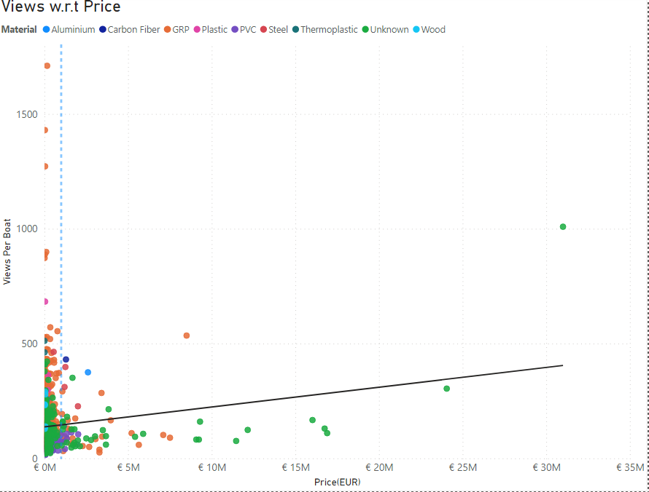
Corr w.r.t price and year
1885-2021
2000-2021
2010-2021
2020-2021

Slide 7
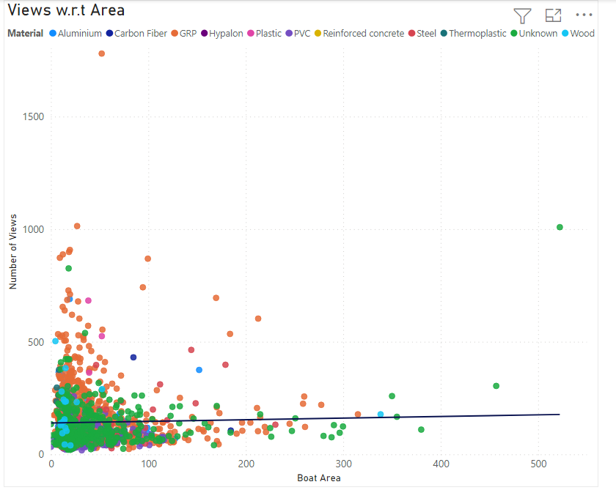
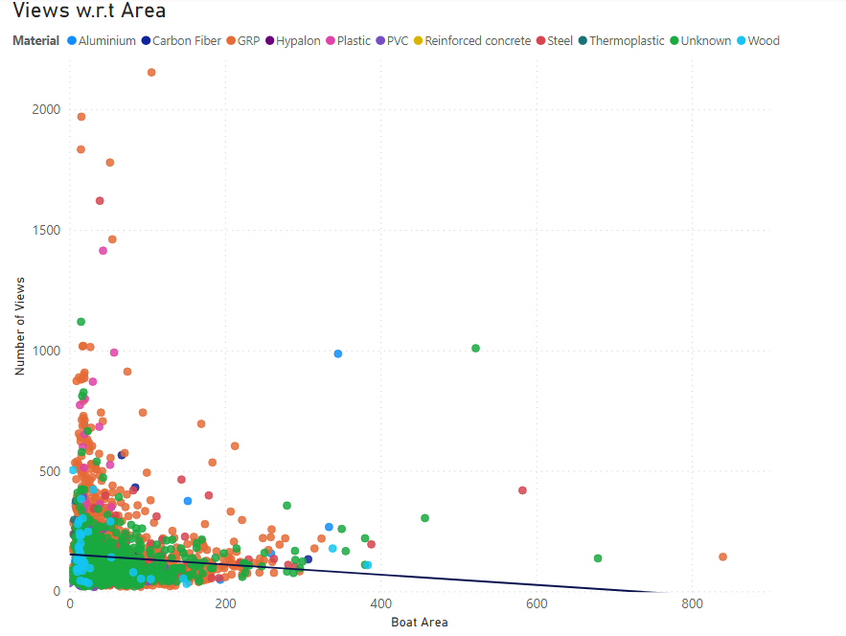
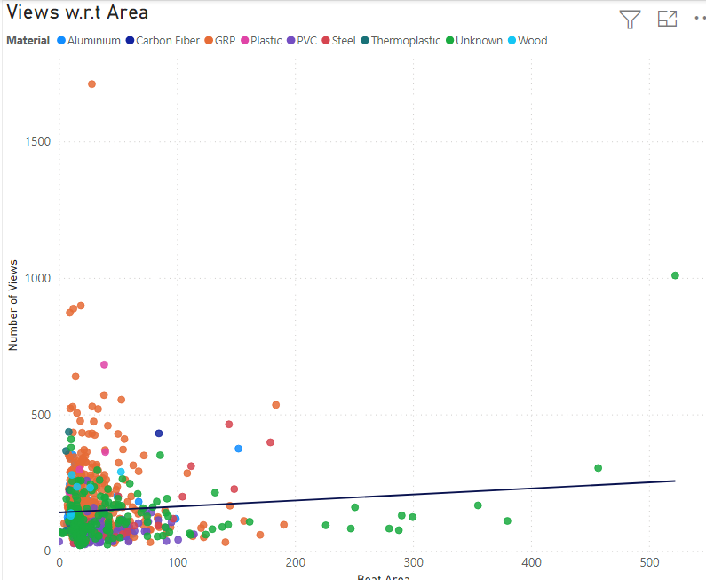
Corr w.r.t Area and Year
1885-2021
2015-2021
2005-2021
2020-2021

Slide 8
Conclusion
Aluminum, Steel with high price with get more number of views.
All other should have less price in order to get more views.
Aluminum and unknown with big area are likely to get more views.
People don’t care about the area of steel.
All other should have small size to get more views.

