Slide 1
PREDICTIVE MAINTENANCE
Enterprise Predictive Maintenance &
Industrial Equipment Failure Intelligence
Case Study ML-004 · Model Evaluation & Technical Presentation
Ezitech Engineering Framework Internship · Team of 2 ML Engineers · 4-Week Sprint

Slide 2
THE PROBLEM
Fixed maintenance schedules are costing the factory floor
1
2
3
4
Unplanned Downtime
High Maintenance Cost
Poor Spare-Parts Planning
No Real-Time Visibility
Machines fail between scheduled checks, halting production lines without warning.
Fixed-interval servicing replaces parts that still have useful life left.
No forecast of which parts will be needed, or when.
1,200 engineers across 45 factories have no live view of equipment health.
Goal: Move from fixed-interval to condition-based maintenance using live sensor data — predict failures before they happen.
02

Slide 3
THE DATA
24,042 sensor readings across a 20-machine fleet
24,042
20
9
14.8%
Sensor readings
Machines, 4 types
Sensor channels
Failure rate (24h)
Sensor channels
Two prediction targets
Vibration RMS
Motor Temperature
Current
rul_hours — continuous, Remaining Useful Life
Pressure Level
RPM
Ambient Temp
Humidity
Voltage
Machine Load
failure_within_24h — binary, 24-hour failure alert
2-4% missing values per sensor (dropout) — imputed per-machine via forward/backward fill
03

Slide 4
SYSTEM DESIGN
End-to-end pipeline architecture
Sensor
Ingestion
Feature
Engineering
Equipment
Health Engine
Explainability
& MLOps
Serving
Layer
CSV / streaming
IoT data
38 engineered
features
XGBoost RUL +
Failure models
SHAP, MLflow,
drift checks
FastAPI +
Dashboard
Backend stack: Python · FastAPI · (PostgreSQL + Redis planned for production scale)
Outputs per machine, per reading:
Health Score
Failure Probability
RUL
Recommendation
0-100
24h window
hours
5 action tiers
04

Slide 5
FEATURE ENGINEERING
From raw sensor stream to a 38-feature matrix
Rolling mean & std (6-reading window) — vibration, temp, current, pressure, RPM
Trend slope — local linear degradation direction for vibration & temperature
Vibration energy (RMS²) — standard severity measure
Temperature gradient — motor temp minus ambient
Utilization rate & operating hours since last service
Cumulative prior failures per machine
Maintenance interval bucket — recent / moderate / overdue / critical
One-hot encoded machine type & operating mode
Leakage-safe imputation: missing sensor values (2-4% per channel) filled per-machine via forward/backward fill, median fallback.
05

Slide 6
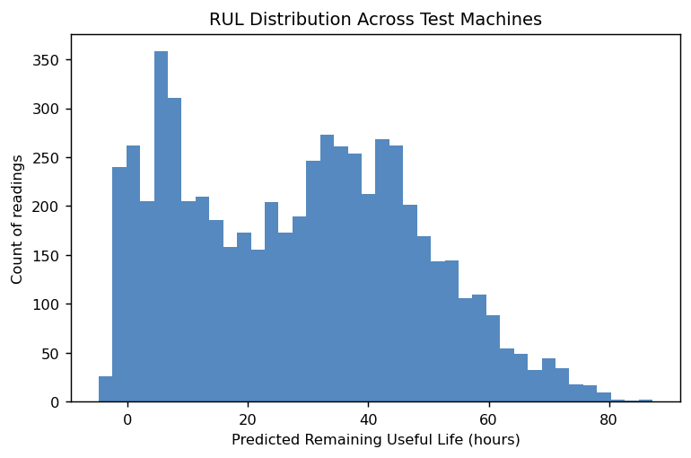
EQUIPMENT HEALTH ENGINE · MODEL 1
Remaining Useful Life — XGBoost Regression
MAE
17.8 hrs
RMSE
23.3 hrs
R²
0.263
Machine-level train/test split (15 vs. 5 machines) — no machine's readings appear in both sets, giving an honest read on unseen equipment.
06

Slide 7
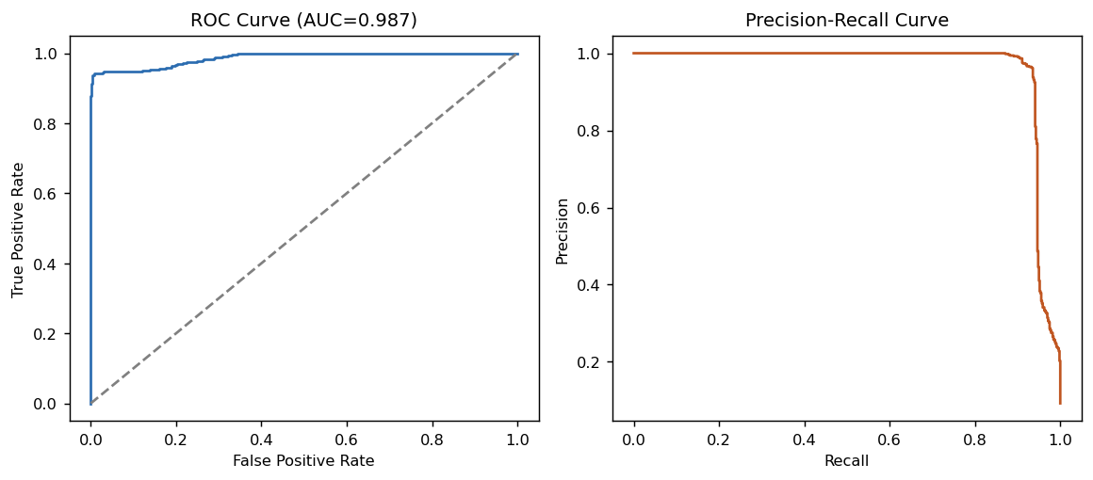
EQUIPMENT HEALTH ENGINE · MODEL 2
24-Hour Failure Classification — XGBoost
ROC-AUC
0.987
Recall
94.6%
Precision
58.8%
Tuned for recall over precision
A missed failure costs far more than a false alarm — class-weighting catches 94.6% of true failures at the cost of some extra inspections.
07

Slide 8
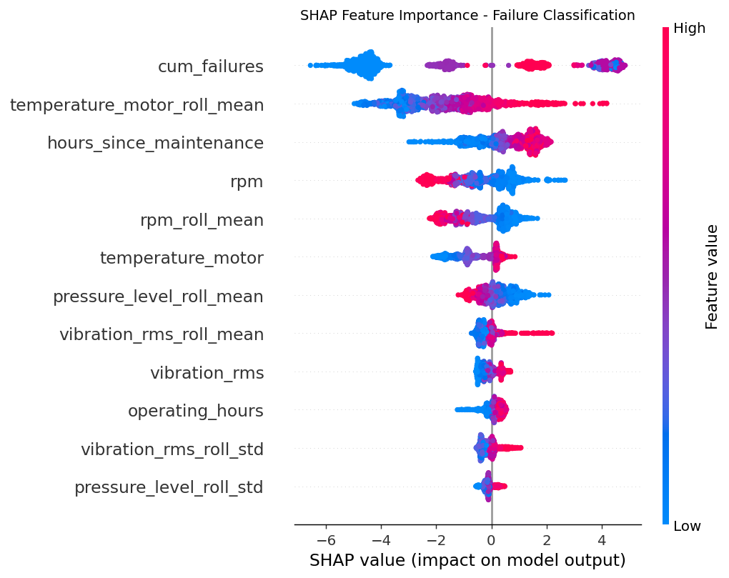
EXPLAINABLE AI
What drives each prediction — SHAP analysis
Top failure-risk drivers
Cumulative prior failures
Machines with a failure history are flagged as higher risk
Rolling motor temperature
Sustained heat is a classic pre-failure signal
Hours since maintenance
Overdue service time raises risk sharply
These per-prediction explanations feed the dashboard's “Top Risk Factors” panel for engineers.
08

Slide 9
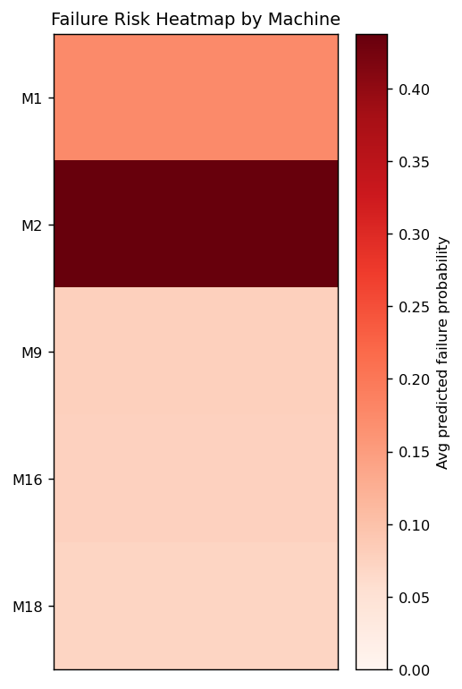
DECISION LAYER
Maintenance Recommendation Engine
Emergency
Shutdown
Immediate
Repair
Scheduled
Maintenance
Continue
Monitoring
Normal
Operation
Fail prob ≥ 80% or
Health < 20
Fail prob ≥ 50% or
Health < 40
Fail prob ≥ 25% or
Health < 60
Health < 80
Health ≥ 80
Failure Risk Heatmap (test fleet)
Every prediction from the API maps directly to one of these five tiers — turning a probability into an action an engineer can execute immediately.
09

Slide 10
MLOPS
Production-readiness beyond the notebook
1
2
Experiment Tracking
Model Registry
Both models logged to MLflow — params, metrics, and artifacts versioned per run.
Trained models persisted as versioned artifacts alongside their feature schema for reproducible inference.
3
4
Sensor Drift Detection
CI Pipeline
Recent vs. overall feature-mean comparison flags shifts beyond a 15% threshold per sensor.
GitHub Actions runs the full test suite and a pipeline smoke-test on every push.
10

Slide 11
SERVING LAYER
Prediction API & Operations Dashboard
FastAPI — POST /predict
Streamlit Operations Dashboard
POST /predict
{
"vibration_rms": 4.2,
"temperature_motor": 95,
"hours_since_maintenance": 580,
...
}
→ 200 OK
{
"health_score": 6.8,
"failure_probability": 0.9668,
"predicted_rul_hours": 51.4,
"recommendation": "Emergency Shutdown"
}
Fleet-wide risk table, color-coded by health score
Per-machine drill-down with health trend
Live “what-if” predictor for manual sensor entry
Health-by-machine-type comparison view
streamlit run src/dashboard.py
11

Slide 12
BUSINESS IMPACT & NEXT STEPS
From condition-based maintenance to fleet-wide savings
Reduced unplanned downtime
Extended equipment lifespan
Smarter spare-parts planning
Earlier safety intervention
Next steps for the team
Cost-based threshold tuning once false-alarm cost is known precisely
LSTM sequence model on raw sensor windows to lift RUL R²
Multi-factory validation across the full 18,000-machine fleet
PostgreSQL + Redis for live reading persistence and prediction caching
Thank you — questions welcome

