Slide 1
MEANS OF ROBOTICS UTILIZATION FOR HEALTHCARE TECHNOLOGY PLATFORM
University: ASOIU
Faculty: ZU
Specialty: Mechatronics and Robotics Engineering
Students: Ibadat Ismayilov
Group: ZU-048
Instructor: Rauf Malikov
My Topic: Means of robotics utilization for healthcare technology platform

Slide 2

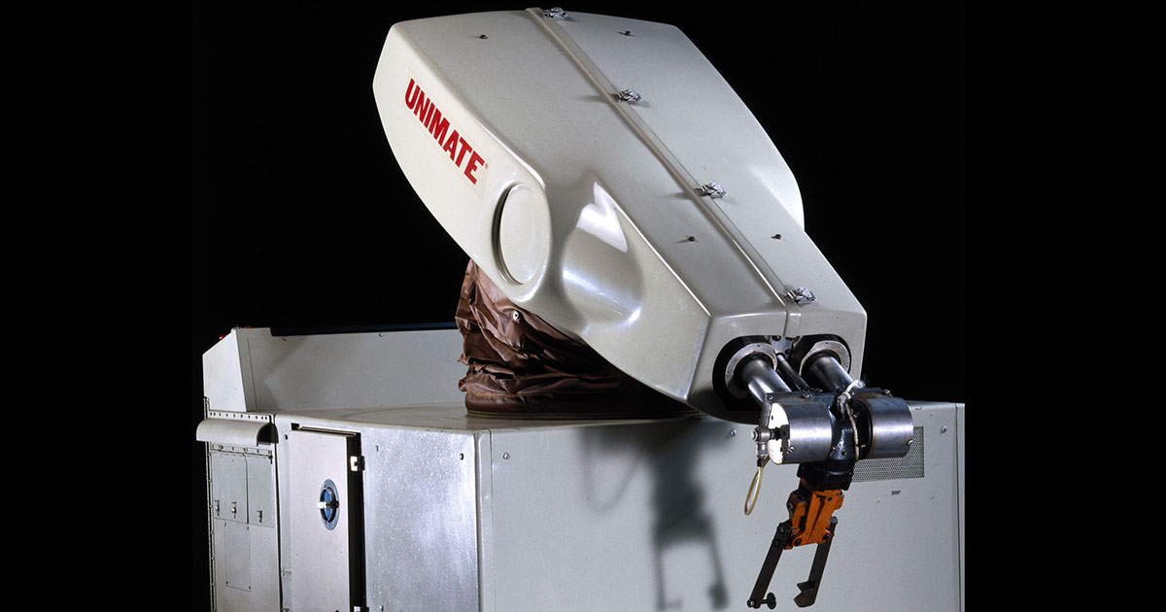
HOW PEOPLE IMAGINE ROBOTS

Slide 3
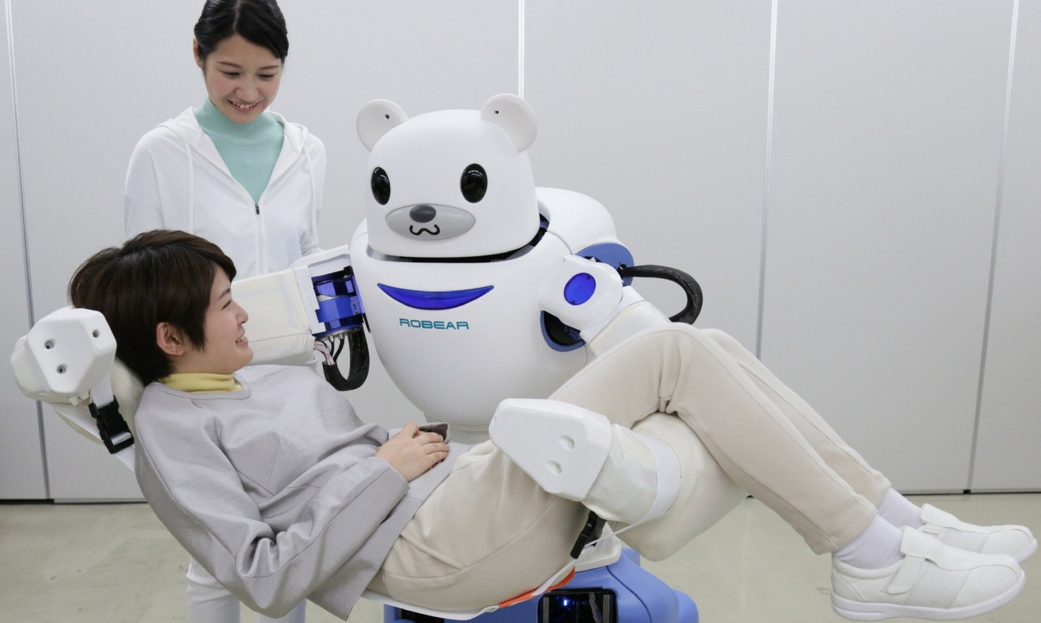
ROBOTICS IN HEALTHCARE

Slide 4
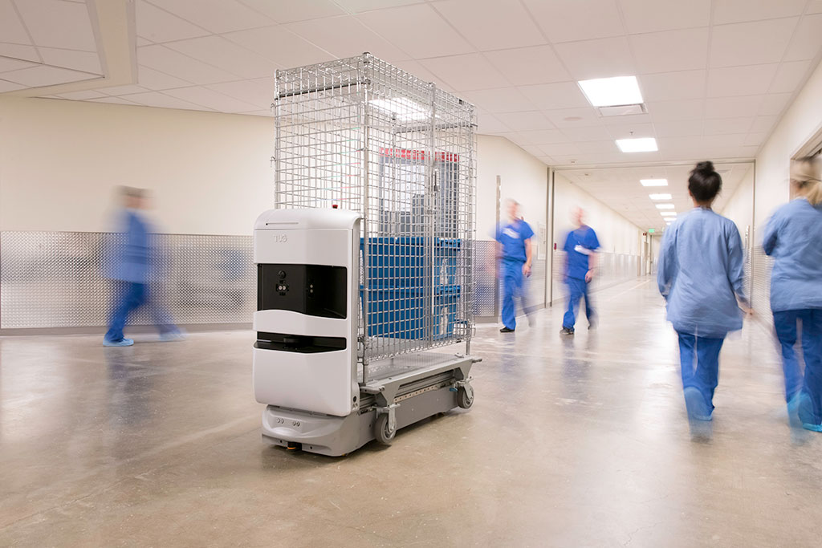
SERVICE ROBOTS

Slide 5
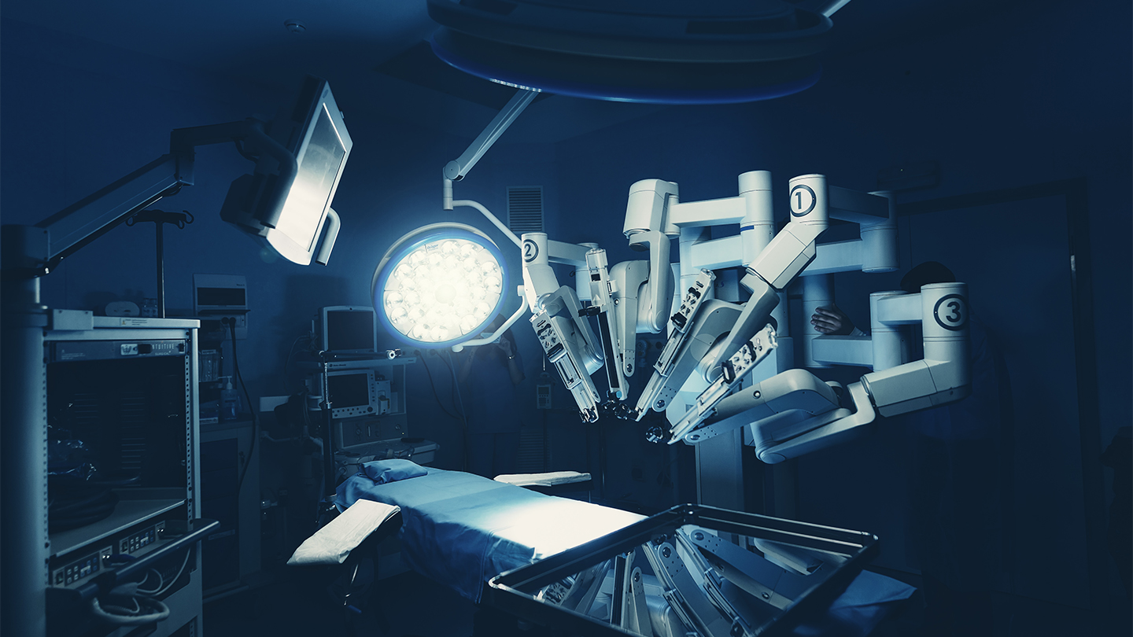
SURGICAL ROBOTS

Slide 6
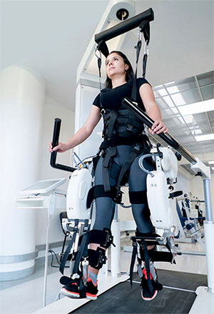
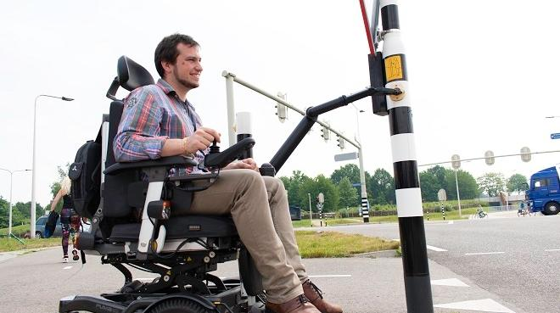
REHABILITATION ROBOTS
Assistive Robot (Manus ARM)
Rehabilitation Robot

Slide 7
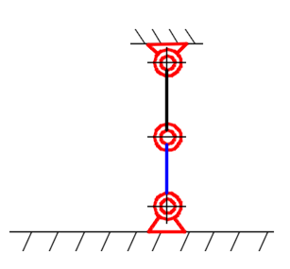

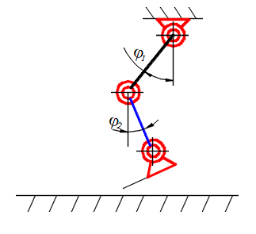
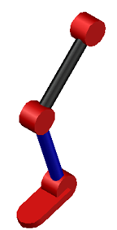


ALGORITHM OF OPERATION OF THE DEVICE AND STAGES OF MOVEMENT
$$1^{st} stage$$
$$2^{nd} stage$$

Slide 8
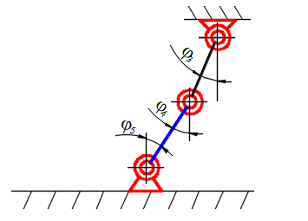
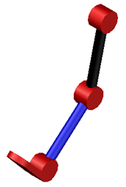


ALGORITHM OF OPERATION OF THE DEVICE AND STAGES OF MOVEMENT
$$3^{rd} stage$$
$$4^{th} stage$$

Slide 9

THANKS FOR ATTENTION!

