Slide 1
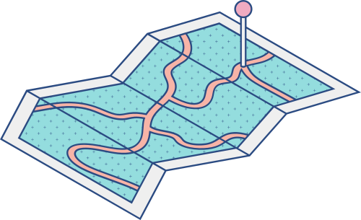





TECHTASTIC

Slide 2



HACKER
M. IQBAL SALEH 201931117
DWI PUTRI 201931123
HUSTLER
NUR INTAN PRATIWI 20193114
HIPSTER
SALSABILA GHAISANI 201931116
ALTHAFIAN NURHERLIANTO
202031157

Slide 3
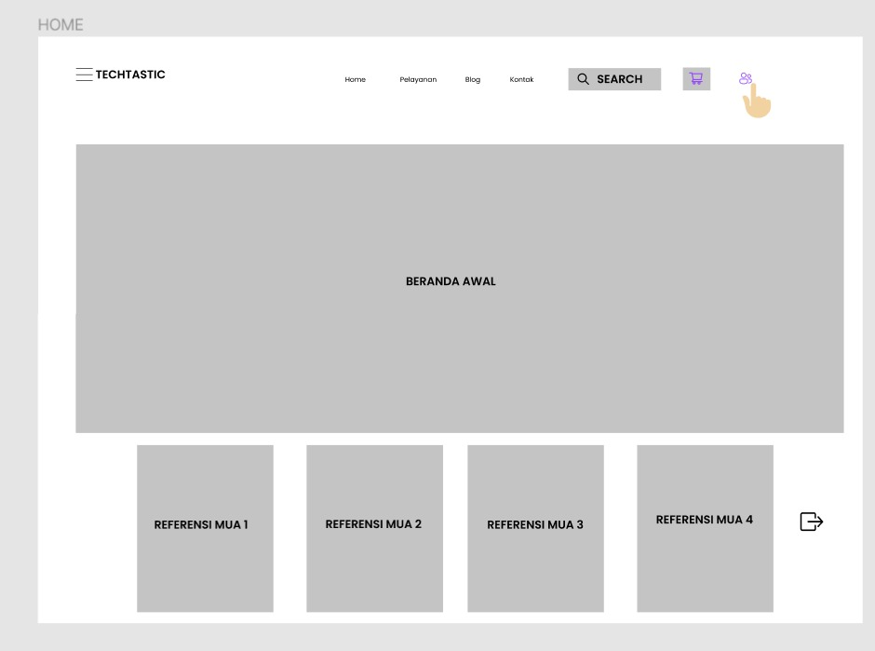
STORYBOARD

Slide 4
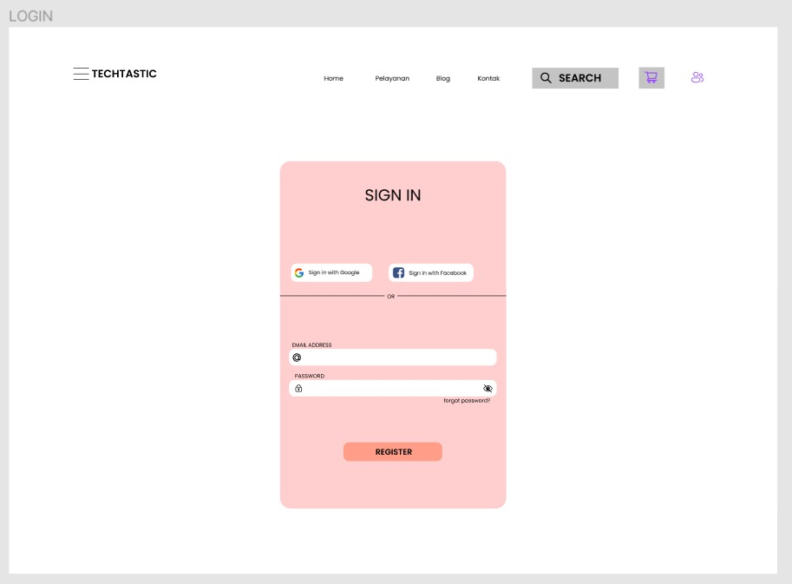

Slide 5
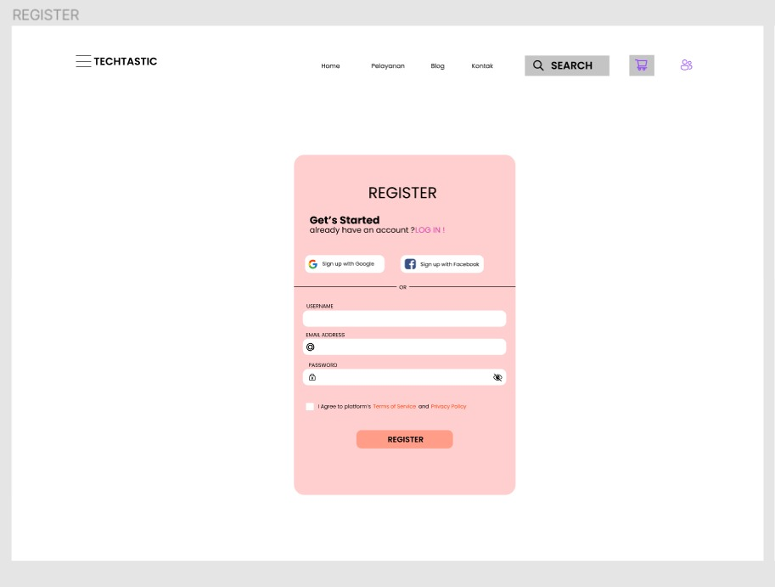

Slide 6
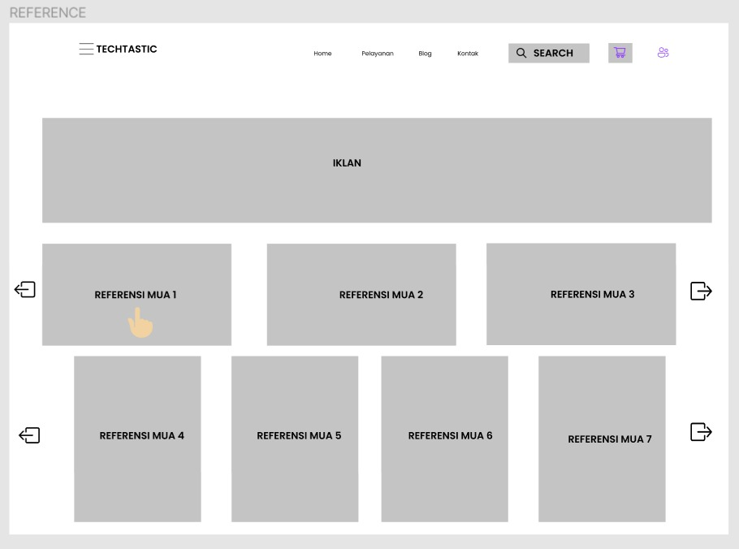

Slide 7
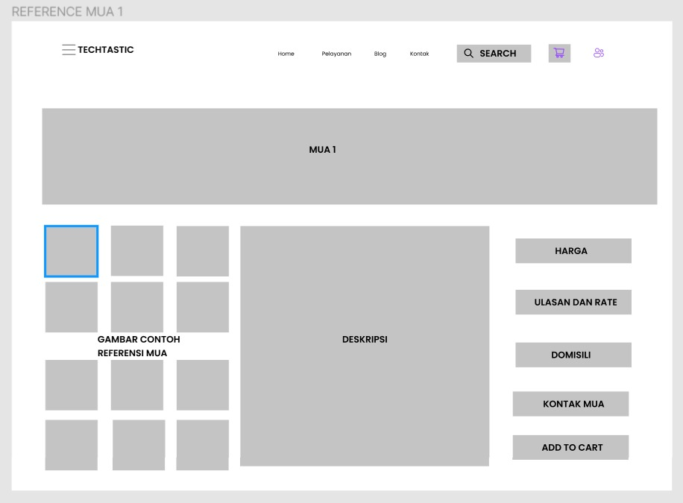

Slide 8
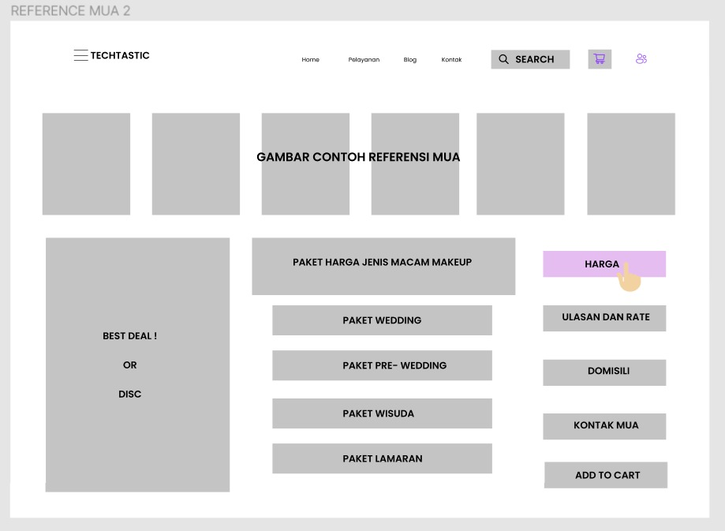

Slide 9
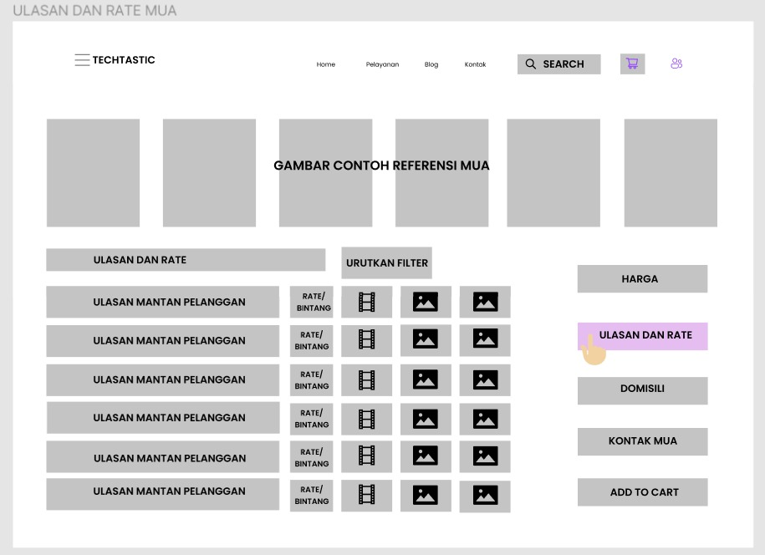

Slide 10
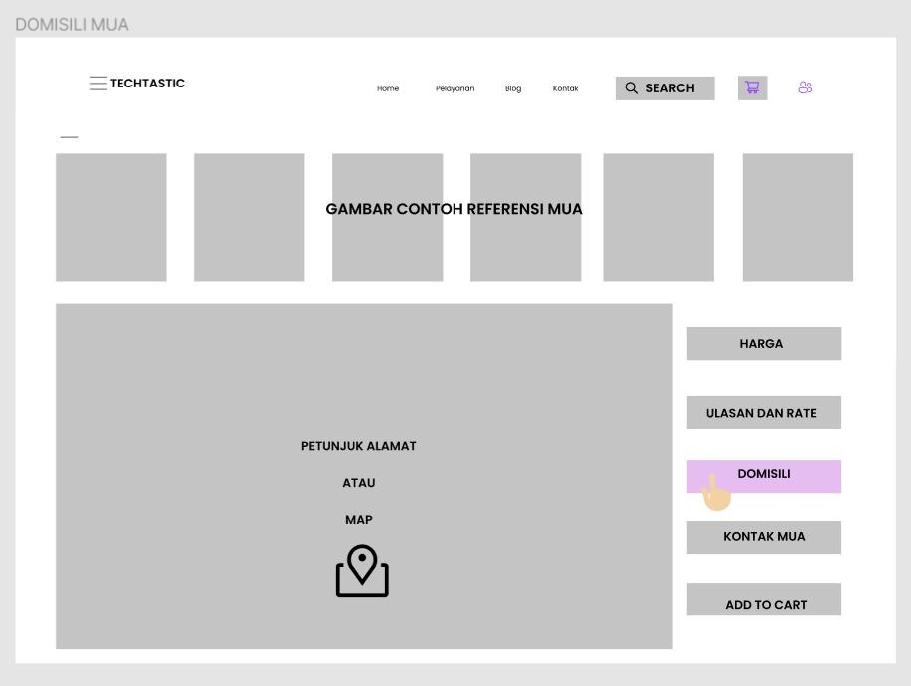

Slide 11
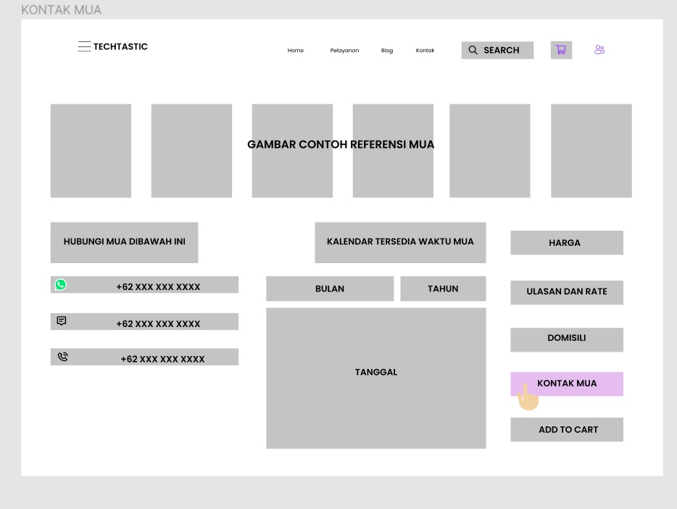

Slide 12
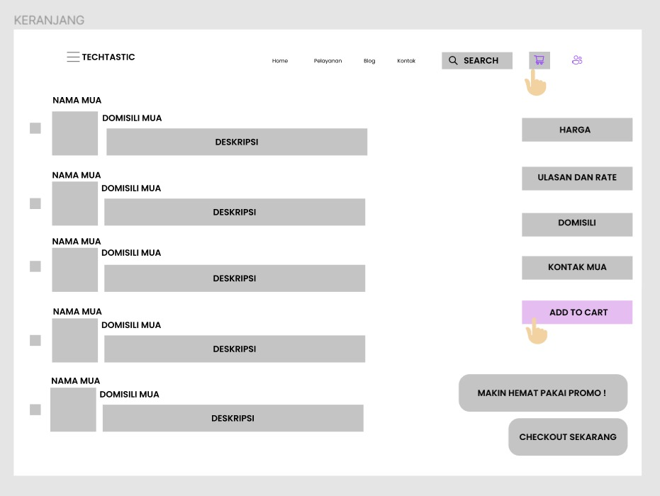

Slide 13
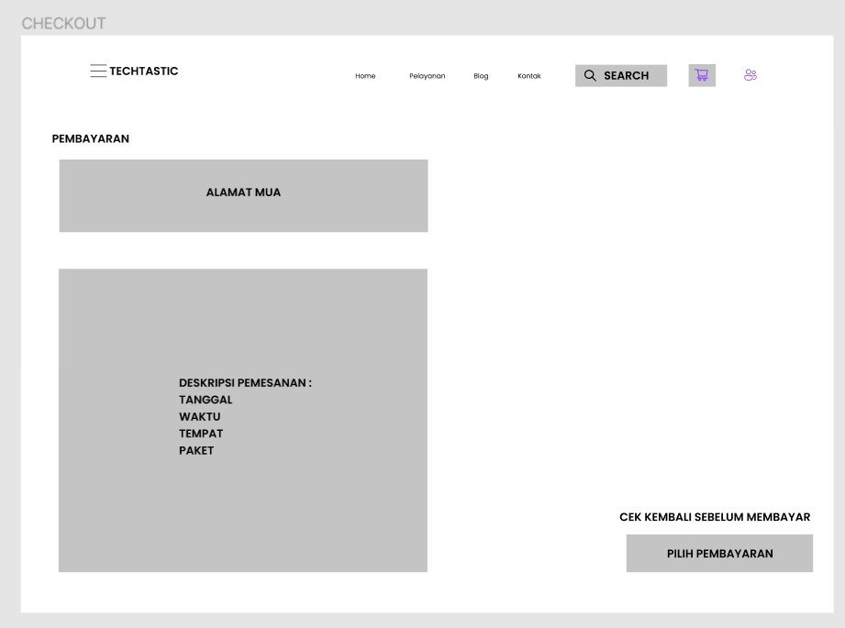

Slide 14
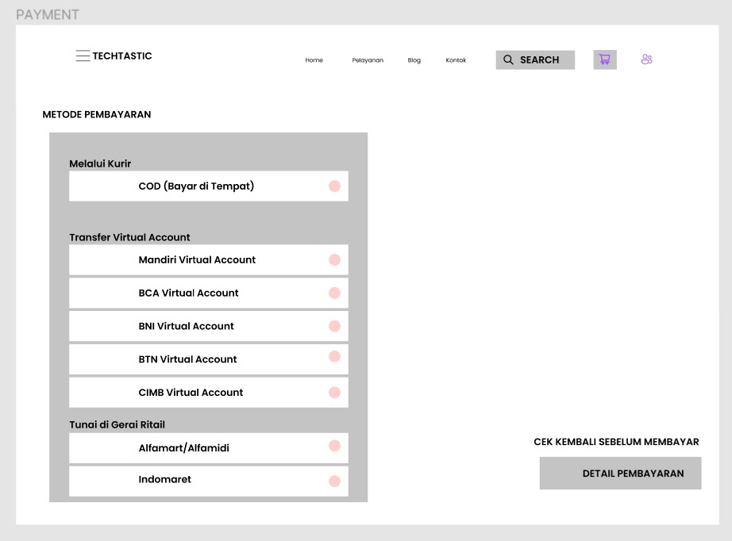

Slide 15
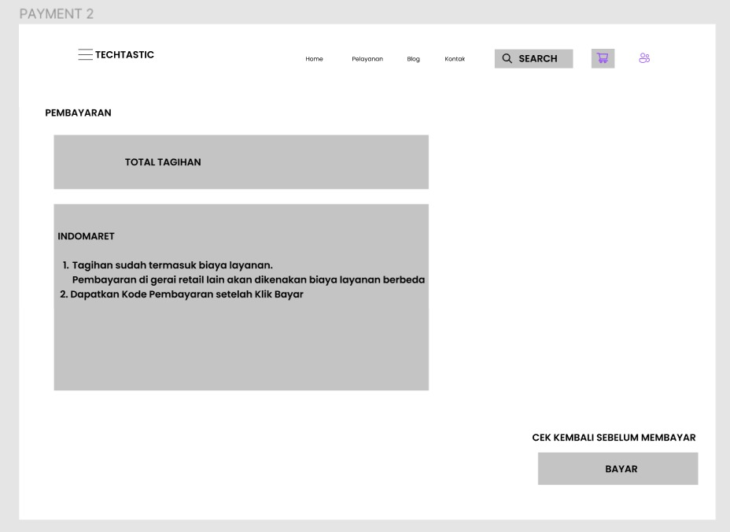

Slide 16
