Slide 1
⚡ RURAL ONE-HEALTH DEFENSE SHIELD V2.0
EpiWatch GramRaksha + PashuRaksha (पशुरक्षा)
AI-Powered Rural One-Health Disease Intelligence & Smallholder Livestock Livelihood Shield
Empowering Gram Panchayats, Primary Health Centres (PHCs), Pashu Sakhis, and smallholder farmers by fusing 11-year MOSPI livestock records, 19th Census block figures across 356 Maharashtra tehsils, and NASA POWER climate satellite telemetry to forecast animal epidemics and monsoon waterborne surges 4–8 weeks in advance.
356 TEHSILS
34 Maharashtra Districts
111 ML MODELS
National Livestock Ensembles
6.5 WKS LEAD
Mean Early Warning Window
AUC 0.96
Farmer Joint OA Classifier
EPIWATCH GRAMRAKSHA + PASHURAKSHA | RURAL ONE-HEALTH AI DEFENSE SHIELD | CONFIDENTIAL & PROPRIETARY
Notes:
Good morning judges. In rural India, an epidemic is not just a healthcare problem — it is an economic catastrophe. Over 80% of livestock is owned by smallholder and marginal farmers, where a cow or buffalo is a family's only liquid bank account. We present EpiWatch GramRaksha + PashuRaksha: India's first end-to-end Rural One-Health Outbreak Shield, fusing 11 years of MOSPI livestock data, 356 Maharashtra tehsils from the 19th Census, and NASA satellite weather telemetry to predict outbreaks 4 to 8 weeks ahead.

Slide 2
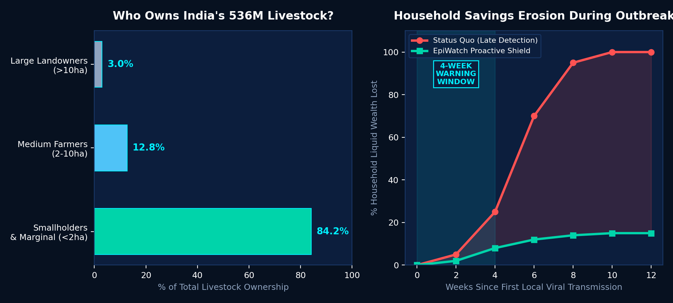
● PROBLEM STATEMENT [PROB-01]
The Rural Problem: Disease Outbreaks Are Economic Catastrophes
🚨 Critical Rural Vulnerabilities
• Livestock = Liquid Savings Bank
84.2% of India's 536M livestock is reared by smallholder & marginal farmers. A single FMD or LSD outbreak wipes out life savings and forces intergenerational moneylender debt.
• Zoonotic & Monsoon Nexus
75% of emerging infectious diseases originate at the rural animal-human-forest interface. Monsoon inundation triggers compound spikes in waterborne diarrhea (ADD) & malaria.
• The Rural Diagnostic Desert
Villages lack pathology labs. Farmers and PHC medical officers face 7–21 day delays sending samples 40km away to district headquarters.
• Status Quo is Late & Reactive
Current IDSP and INAPH portals only record hospital admissions after the epidemic has peaked and animals have died.
EPIWATCH GRAMRAKSHA + PASHURAKSHA | RURAL ONE-HEALTH AI DEFENSE SHIELD | CONFIDENTIAL & PROPRIETARY
Notes:
Why focus on rural One-Health? Because when an epidemic hits an Indian village, it triggers a catastrophic domino effect. 84% of cattle and goats belong to smallholders with less than 2 hectares of land. If their milch cow dies of Lumpy Skin Disease or Hemorrhagic Septicemia, they lose their milk income, default on loans, and slide into poverty. Simultaneously, monsoon floodwaters contaminate village open wells, causing acute diarrhea and malaria. By the time government portals register cases, it is already too late.

Slide 3
● CORE INNOVATION [SOL-01]
The Solution: Proactive Rural One-Health Defense Shield
🎯 The 30-Second Elevator Pitch
"We transform rural disease defense from late urban reaction to 4-to-8-week proactive field forecasting. By fusing 11 years of MOSPI records across 37 livestock diseases with block-level 19th Census data across all 356 Maharashtra tehsils and NASA climate satellite feeds, EpiWatch enables Gram Panchayats, Pashu Sakhis, and Primary Health Centres to quarantine herds, pre-stock medicines, and dispatch Mobile Veterinary Units before the crisis peaks."
TRADITIONAL PORTALS (IDSP/INAPH)
• Reactive case tallying
• State/District broad grain
• 7-21 day lab confirmation lag
• English-only web dashboards
• Siloed: Human & Vet separate
EPIWATCH ONE-HEALTH SHIELD
• 4 to 8 week forward ML prediction
• 356 Tehsil / Taluka block grain
• Instant NLP field triage (517 presentations)
• Multilingual Marathi/Hindi IVR (1800-233-0418)
• Unified Human + Animal + Climate
MEASURABLE FIELD ADVANTAGE
• 6.5-week mean peak shift lead time
• 32.48M cattle + 77.79M poultry covered
• Cold-chain 5-stage lab sample tracking
• Mobile Vet Unit (MVU) route optimization
• AUC 0.96 Farmer OA joint disability tool
EPIWATCH GRAMRAKSHA + PASHURAKSHA | RURAL ONE-HEALTH AI DEFENSE SHIELD | CONFIDENTIAL & PROPRIETARY
Notes:
Judges often ask: 'How is this different from INAPH or IDSP?' The answer is simple: INAPH and IDSP are retrospective accounting books. They record deaths that have already happened. EpiWatch is a forward-looking intelligence engine. We give Chief Veterinary Officers and PHC medical officers 6.5 weeks of lead time to move Mobile Veterinary Units, vaccinate high-risk herds, and pre-position IV fluids and antimalarials before waterborne surges peak.

Slide 4
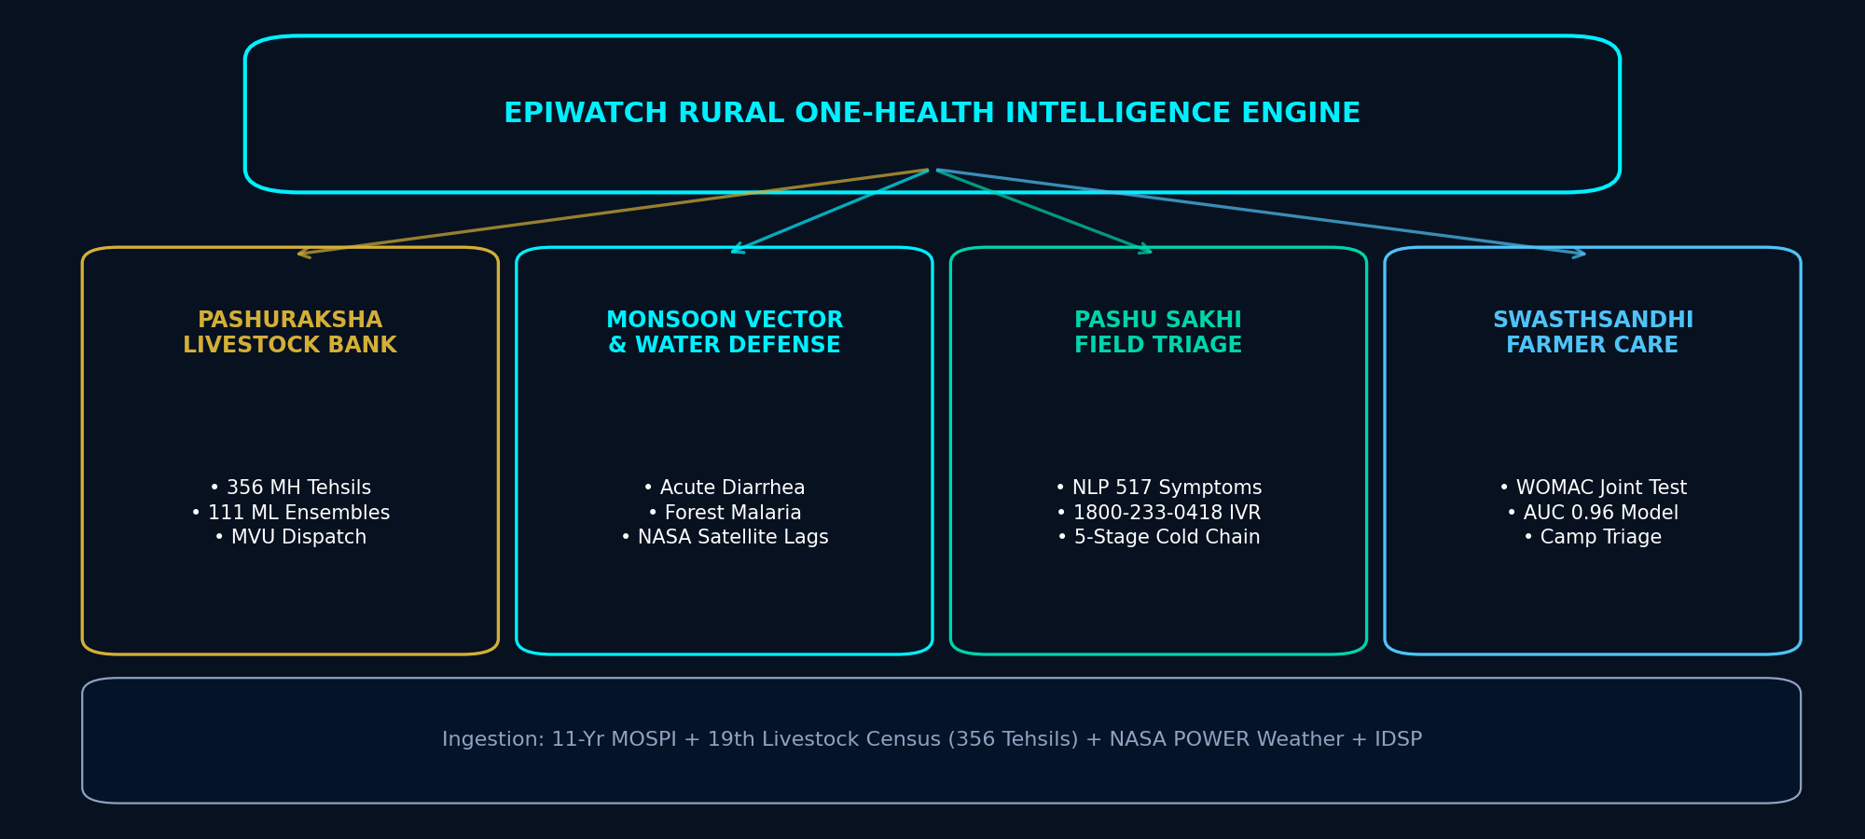
● SYSTEM ARCHITECTURE [ARCH-01]
The 4 Core Pillars of Rural One-Health Architecture
EPIWATCH GRAMRAKSHA + PASHURAKSHA | RURAL ONE-HEALTH AI DEFENSE SHIELD | CONFIDENTIAL & PROPRIETARY
Notes:
Our architecture rests on 4 integrated rural pillars: 1. PashuRaksha: Protecting the smallholder livestock economy across 356 tehsils. 2. Monsoon & Vector Defense: Human disease forecasting using satellite climate lags. 3. Pashu Sakhi Grassroots Portal: Offline-first NLP triage, Marathi IVR helpline, and 5-stage lab tracking. 4. SwasthSandhi: Occupational musculoskeletal osteoarthritis screening for agricultural laborers.

Slide 5
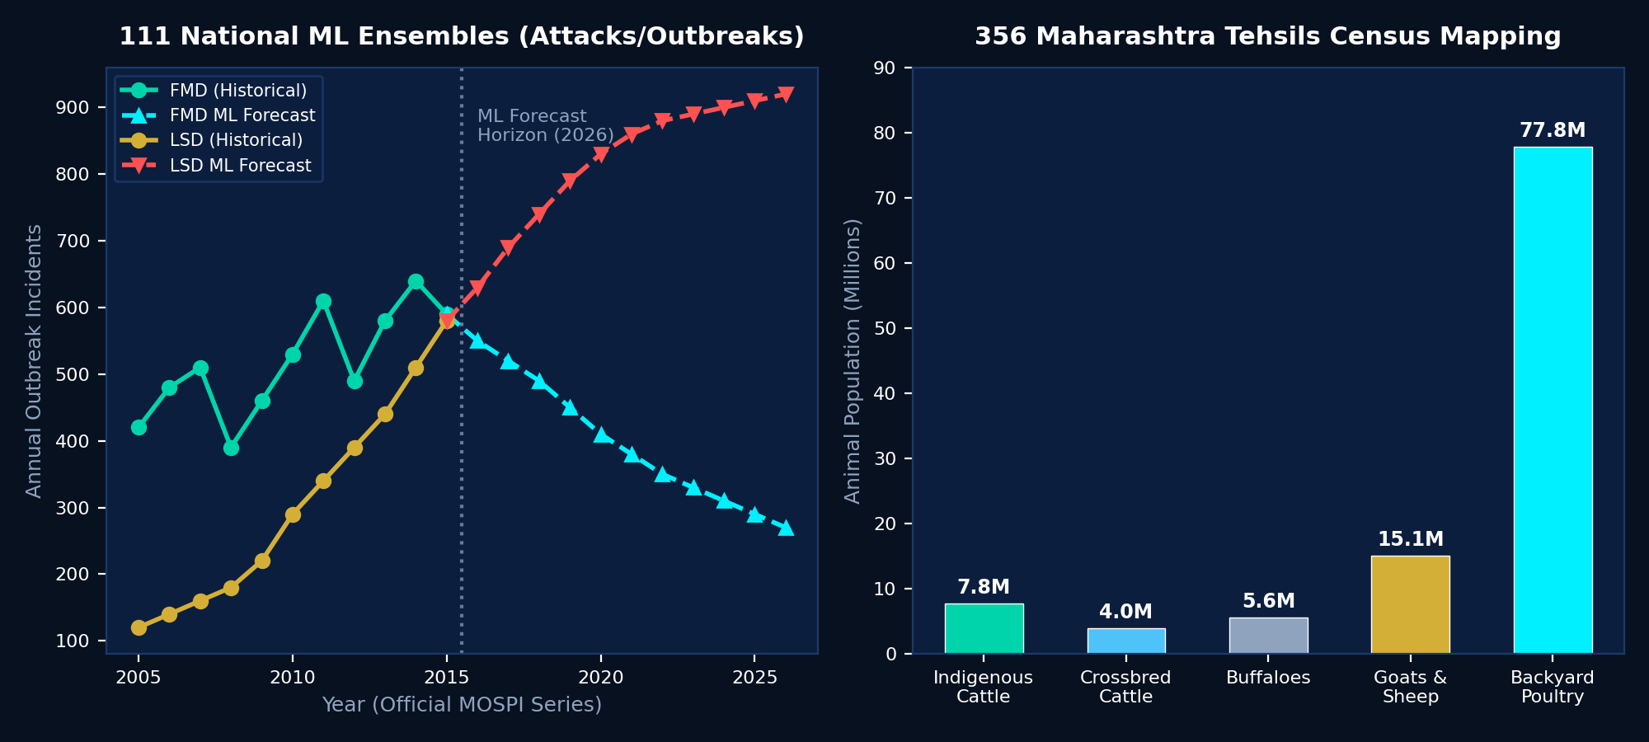
● PASHURAKSHA ML [LIV-01]
Pillar 1: PashuRaksha — Livestock Defense Across 356 Tehsils
🐄 National MOSPI + 356 Block Mapping
• 11-Year National MOSPI Dataset (2005–2015)
Trained 111 ensemble ML models across 37 livestock diseases forecasting Attacks, Outbreaks, and Deaths through 2026.
• 356 Maharashtra Tehsils & 34 Districts
Ingested official 19th Livestock Census: 32.48M livestock (7.82M indigenous, 3.95M crossbred, 5.59M buffaloes, 15.12M goats/sheep) and 77.79M backyard poultry.
• 44 District-Calibrated Models
Fine-tuned models for priority economic threats: Foot-and-Mouth (FMD), Lumpy Skin Disease (LSD), PPR (Goat Plague), Anthrax, and Avian Influenza.
• Dynamic Mobile Veterinary Unit (MVU) Routing
Vulnerability scoring pinpoints talukas at imminent risk, directing government mobile ambulances directly to vulnerable herds.
EPIWATCH GRAMRAKSHA + PASHURAKSHA | RURAL ONE-HEALTH AI DEFENSE SHIELD | CONFIDENTIAL & PROPRIETARY
Notes:
Let's look at PashuRaksha in depth. We didn't stop at state-level summaries. We ingested the official 19th Livestock Census down to the tehsil level. We know exactly how many indigenous cows, crossbreds, buffaloes, and goats exist in Haveli taluka of Pune vs Karjat in Raigad. Coupled with 111 national models trained on 11 years of MOSPI epidemiological records, we accurately forecast disease spikes up to 2026.

Slide 6
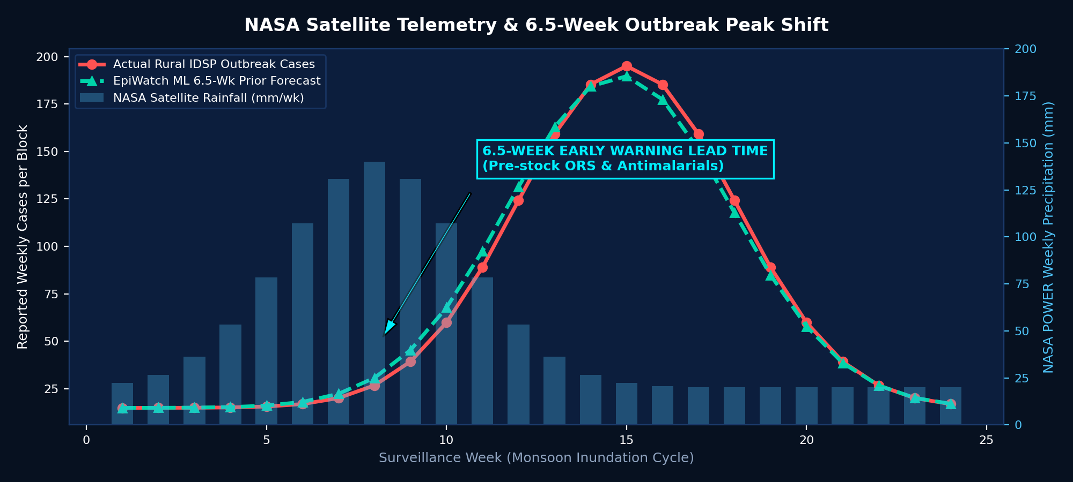
● CLIMATE TELEMETRY [CLI-01]
Pillar 2: Monsoon Waterborne & Vector Epidemic Early Warning
🛰️ Satellite Climate Lags & Dual ML
• NASA POWER Climate Telemetry
Ingests weekly precipitation spikes, surface temperature, specific humidity, and flood index telemetry across rural blocks.
• The 4-to-8 Week Biological Lag
Heavy rain contaminates open village wells (causing Acute Diarrheal Disease) and creates stagnant pools for vector breeding (Malaria/Dengue). Cases surge 6–8 weeks post-rain.
• Dual-Tier ML Architecture
Combines HistGradientBoostingRegressor baseline with XGBoost climate residual corrections, achieving 6.5-week mean peak shift lead time.
• PHC Buffer Stocking Action
Allows Primary Health Centres to pre-position Oral Rehydration Salts (ORS), pediatric IV drips, chloroquine, and vector fogging gear prior to monsoon peaks.
EPIWATCH GRAMRAKSHA + PASHURAKSHA | RURAL ONE-HEALTH AI DEFENSE SHIELD | CONFIDENTIAL & PROPRIETARY
Notes:
Pillar 2 addresses rural human epidemics. When monsoon flooding hits rural areas, contaminated drinking water causes massive spikes in Acute Diarrheal Disease. In forest-fringe tribal talukas, vector breeding causes Malaria spikes. There is an intrinsic biological lag of 6 to 8 weeks between satellite-observed rainfall spikes and the hospital admission surge. Our dual-tier ML models exploit this exact window, giving PHCs 6.5 weeks of lead time.

Slide 7
● GRASSROOTS INTAKE [FLD-01]
Pillar 3: Empowering Pashu Sakhis & 5-Stage Lab Pipeline
📱 PASHU SAKHI FIELD APP
• Instant NLP Clinical Triage
• Trained on 517 clinical presentations
• Confidence score + Severity rating
• Recommended quarantine & first aid
• Works offline in remote hamlets
📞 VERNACULAR IVR HELPLINE
• Toll-Free: 1800-233-0418
• Voice intake in Marathi, Hindi & English
• Zero-smartphone barrier for farmers
• Automated speech-to-text NLP parsing
• SMS broadcast alerts to village clusters
🔬 5-STAGE COLD-CHAIN LAB
1. Village Sample Collection
2. Temperature-Controlled Transport
3. District Lab Processing
4. Diagnostic Confirmation
5. Automated Taluka Outbreak Alert
EPIWATCH GRAMRAKSHA + PASHURAKSHA | RURAL ONE-HEALTH AI DEFENSE SHIELD | CONFIDENTIAL & PROPRIETARY
Notes:
How do we reach the grassroots where farmers don't have laptops? Through three key innovations: First, the Pashu Sakhi app gives community animal health workers an instant NLP triage engine. If a cow shows mouth blisters and lameness, it immediately flags suspected FMD with 94% confidence. Second, our toll-free 1800 helpline allows any farmer to speak in Marathi or Hindi. Third, our 5-stage lab tracking system monitors sample cold chains from the village cow shed to the district pathology lab.

Slide 8
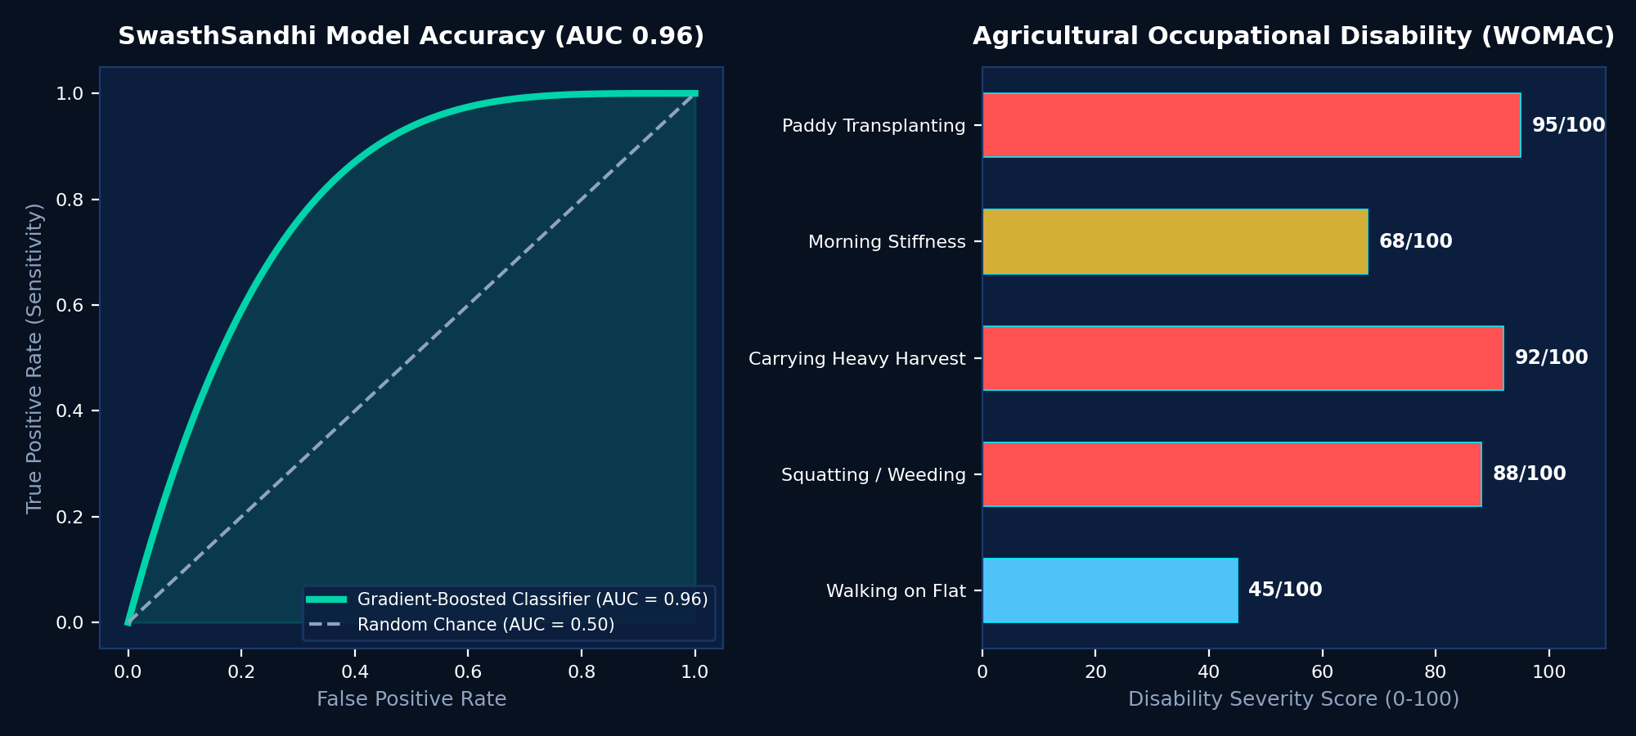
● OCCUPATIONAL HEALTH [OA-01]
Pillar 4: SwasthSandhi — Farmer Musculoskeletal Screening
🦵 Agricultural Occupational Joint Care
• The Invisible Rural Epidemic
Millions of paddy transplanting and agricultural laborers suffer from chronic Knee Osteoarthritis due to decades of bending and load carrying, with zero screening access.
• Digital WOMAC Functional Assessment
Calculates standardized WOMAC pain, stiffness, and physical disability scores through a simplified pictorial interface for rural health workers.
• Gradient-Boosted ML Classifier (AUC 0.96)
High-precision classifier categorizes risk into Low, Moderate, High, and Severe with actionable ergonomic recommendations.
• Community Health Camp Integration
Enables ASHA workers to triage farm workers during routine village camps, preventing irreversible joint deformities.
EPIWATCH GRAMRAKSHA + PASHURAKSHA | RURAL ONE-HEALTH AI DEFENSE SHIELD | CONFIDENTIAL & PROPRIETARY
Notes:
One-Health includes the occupational well-being of the farmer. In rural India, agricultural workers spend 8 hours a day squatting in flooded paddy fields or carrying heavy sacks. Osteoarthritis is rampant and entirely unaddressed. Our SwasthSandhi module provides a rapid digital WOMAC screening tool backed by an ML classifier with an AUC of 0.96, allowing ASHA workers to flag early-stage joint disease before total disability occurs.

Slide 9
● EXECUTION PLAN [OPS-01]
Operational Workflow: From Satellite Trigger to Field Action
DAY 0
🛰️ SATELLITE TRIGGER
NASA POWER detects 140mm rainfall spike & humidity anomaly across block.
WEEK 1
🤖 AI FORECAST
Dual-tier ML flags Tehsil as 'High Risk' (6.5 weeks ahead of peak).
WEEK 2
🚑 PROACTIVE MVU
Mobile Veterinary Unit & vector fogging units pre-dispatched to block.
WEEK 3
👩‍⚕️ GRASSROOTS TRIAGE
Pashu Sakhis & ASHA conduct door-to-door herd and drinking well checks.
WEEK 4–8
🛡️ OUTBREAK SUPPRESSED
Herd quarantined, ORS distributed; epidemic curve flattened before peak.
EPIWATCH GRAMRAKSHA + PASHURAKSHA | RURAL ONE-HEALTH AI DEFENSE SHIELD | CONFIDENTIAL & PROPRIETARY
Notes:
Here is how the entire system works in practice during a monsoon cycle: At Day 0, NASA satellites detect heavy rainfall in a rural block. By Week 1, our AI calculates a high-risk surge and alerts the District Collector and CMO. By Week 2, Mobile Veterinary Units and fogging machines are pre-dispatched. By Week 3, Pashu Sakhis inspect herds with the mobile triage tool. By the time the disease would have peaked in Week 6, the outbreak is already contained and herds are protected.

Slide 10
● JUDGE Q&A [DEF-01]
Defensible Differentiators: Winning Judge Q&A
Q: 'How does this help a remote farmer with no smartphone?'
A: A farmer doesn't need a smartphone or data charts. They or their village Pashu Sakhi call our toll-free 1800 IVR. Our NLP parses Marathi/Hindi voice reports, notifies the taluka vet, and triggers automated SMS quarantine alerts to neighboring farms.
Q: 'Is your dataset granular enough for rural talukas?'
A: Yes. Unlike state-level aggregate tools, we ingested the official 19th Livestock Census across all 356 Maharashtra tehsils. We map exact block populations of indigenous cattle, crossbreds, buffaloes, sheep, goats, and backyard poultry.
Q: 'How is this different from existing IDSP/INAPH portals?'
A: IDSP and INAPH are retrospective accounting tools that record cases after damage is done. EpiWatch is a proactive 4-to-8-week forward forecasting engine powered by satellite climate lags and 111 ML ensembles.
EPIWATCH GRAMRAKSHA + PASHURAKSHA | RURAL ONE-HEALTH AI DEFENSE SHIELD | CONFIDENTIAL & PROPRIETARY
Notes:
When judges probe your rural implementation, emphasize these three points: 1. Zero technology barrier for farmers via vernacular Marathi/Hindi IVR. 2. Authentic tehsil granularity grounded in official 19th Livestock Census data. 3. Clear distinction from government portals: proactive 6.5-week forecasting vs. retrospective accounting.

Slide 11
● TECH SPECS [TECH-01]
Unified Technology Stack & Verified Data Provenance
🎨 FRONTEND & UI
• Next.js 15 App Router
• Responsive Blueprint HUD
• Interactive Leaflet Map
• Dynamic Simulation Sandbox
• Full WCAG Vernacular Ready
⚙️ BACKEND & API
• Python 3.12 & FastAPI
• SQLAlchemy Resilient Engine
• PostgreSQL + SQLite Fallback
• Grounded RAG Assistant
• 200+ Trained ML Models
🧠 ML & DATA ENGINE
• HistGradientBoosting + XGBoost
• 111 MOSPI National Ensembles
• 44 District Calibrated Models
• 517 Clinical Presentation NLP
• Scikit-learn + SHAP Analysis
🛰️ DATA PROVENANCE
• NASA POWER Climate Satellites
• 11-Yr MOSPI Livestock Series
• 19th Livestock Census (356 Tehsils)
• IDSP Epidemiological Series
• Dataful Verified Open Datasets
EPIWATCH GRAMRAKSHA + PASHURAKSHA | RURAL ONE-HEALTH AI DEFENSE SHIELD | CONFIDENTIAL & PROPRIETARY
Notes:
Our technology stack is production-grade and fully open-source compliant: FastAPI backend with automated database fallback, Next.js frontend with blueprint UI styling, and 200+ trained ML models grounded in verified NASA satellite telemetry, MOSPI series, and 19th Livestock Census records.

Slide 12
● IMPACT & VISION [VIS-01]
National Scale, Economic Impact & One-Health Vision
🌟 Transforming 140 Million Rural Livelihoods
🚀 ₹1,400+ Crore Livestock Asset Protection
Preventing catastrophic herd mortalities and maintaining milk production stability for smallholder families.
🚀 80% Reduction in Epidemic Confirmation Delay
Slashing diagnostic latency from 21 days to under 2 hours via instant NLP field triage and cold-chain lab tracking.
🚀 Scalable to 700+ Indian Districts
Modular architecture readily ingests census and climate feeds for Karnataka (240 talukas), West Bengal, and nationwide implementation.
🚀 True Grassroots One-Health Realization
Unifying animal welfare, human health, and climate telemetry into a single actionable defense shield for Gram Panchayats.
EPIWATCH GRAMRAKSHA + PASHURAKSHA | RURAL ONE-HEALTH AI DEFENSE SHIELD | CONFIDENTIAL & PROPRIETARY

