Slide 1
THEORETICAL & COMPUTATIONAL ASTROPHYSICS
Emergent Spacetime and the Dark Sector
Computational Testing of the ER=EPR Conjecture in Holographic Tensor Networks
Candidate: Master of Science Candidate | Scope: 40 Weeks (60 ECTS)
Supervisor: Theoretical Physics Group | Submission: October 2026

Slide 2
MASTER'S THESIS PROSPECTUS DEFENSE
The Astrophysical Missing Mass Dilemma
Keplerian Breakdown
• Galactic disks exhibit flat outer circular velocity curves (v_c ≈ const).
• Standard Newtonian mechanics predicts a sharp Keplerian drop-off: v_c ∝ r^(-1/2).
• The discrepancy points to either non-baryonic matter or modified gravitational laws.
Particle Relic Search Crisis
• ΛCDM successfully fits the CMB and large-scale cosmic structure.
• Decades of direct cryogenic searches (LZ, XENONnT) have produced null bounds.
• Particle accelerator trials (LHC) reveal zero evidence for supersymmetry or light WIMPs.
• Small-scale tensions persist: core-cusp and too-big-to-fail problems.
The Informational Paradigm
• Core Thesis: Dark matter is not a particulate relic.
• Gravitational anomalies emerge from non-local quantum entanglement defects.
• Utilizes spacetime emergence via the ER=EPR holographic bridge conjecture.

Slide 3
MASTER'S THESIS PROSPECTUS DEFENSE
Theoretical Foundations: Spacetime from Entanglement
Holographic Entanglement
• Ryu-Takayanagi Formula: S(A) = Area(γ_A) / (4 G ħ) maps boundary entropy to bulk area.
• First Law of Entanglement Thermodynamics: δ S_ent = δ <H_mod>.
• Jacobson / Faulkner et al.: Spatial entropy variations map directly to linearized Einstein field equations: G_μν = 8πG <T_μν^eff>.
Fractal Entanglement Quantum Gravity (FEQG)
• Gin'e's Relational Metric: d_ij = -l_0 ln(I_ij / I_0) directly weights the network graph.
• Generalized Field Equation: G_μν = 8πG (T_μν + α E_μν + β F_μν).
• Informational Stress Tensor: E_μν ~ ∇_μ ∇_ν S_ent induces an effective weak-field potential.
• Resultant Potential: V(r) ~ 1/r^(1+ε) mimics dark matter without particle relics.

Slide 4
MASTER'S THESIS PROSPECTUS DEFENSE
The Research Gap: Moving from Theory to Computation
Status of Prior Literature
✗ Purely continuous, analytical pencil-and-paper derivations.
✗ Verlinde (2016) & Gin'e (2026) postulated emergent elastic gravity[cite: 3].
✗ Gin'e explicitly noted that computational simulation tools were missing.
✗ No discrete tensor network realization has been tested against galaxy catalogs.
The Thesis Deliverable
✓ Build a discrete 2D Poincaré hyperbolic tensor network.
✓ Inject non-local ER defect ensembles weighted by mutual information.
✓ Execute graph-theoretic Push-Relabel min-cut algorithms (discrete RT).
✓ Directly fit derived circular velocities to 175 SPARC galaxies and MaNGA 2D maps.

Slide 5
NUMERICAL REALIZATION
Computational Pipeline & Algorithmic Modules
Stage 1: Lattice Gen
2D Poincaré hyperbolic disk tessellation via NetworkX / igraph.
Stage 2: Baryon & ER Seeding
Central mass injection + non-local chordal ER bridges (Gin'e metric).
Stage 3: Min-Cut Solver
Push-Relabel algorithm to determine minimal surface area Area(γ_A).
Stage 4: Metric Inversion
Numerical differentiation: v_c^2(r) = r (dΦ_eff / dr).
Stage 5: Benchmarking
Non-linear least squares (Lmfit) against SPARC, MaNGA, and MACHO data.

Slide 6
TESTING & FALSIFICATION
Empirical Validation & Observational Data
1. SPARC 1D Rotation Curves
• 175 disk galaxies with high-precision Spitzer photometry.
• Ingests gas and stellar disk profiles (M_gas + M_disk).
• Tests classic massive spirals (NGC 3198, NGC 2841) alongside dark-matter-dominated LSB dwarfs.
2. SDSS-IV MaNGA 2D Fields
• Integral Field Spectroscopy (IFS) kinematic maps.
• Validates whether 2D tensor network preserves observed axisymmetry and velocity shear.
• Tests non-circular motions and bar dynamics.
3. LMC / MACHO Microlensing
• Gravitational microlensing observational constraints (heic0116).
• Ensures that non-local entanglement defects do not violate empirical compact halo object limits.
• Cross-checks smooth vs granular deflection.

Slide 7
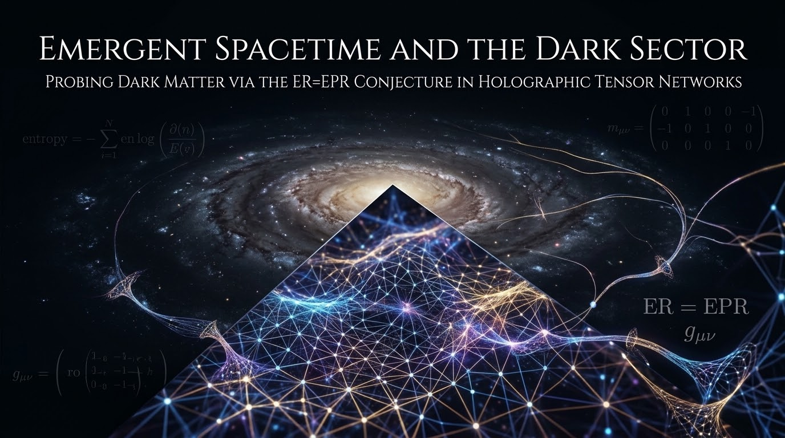
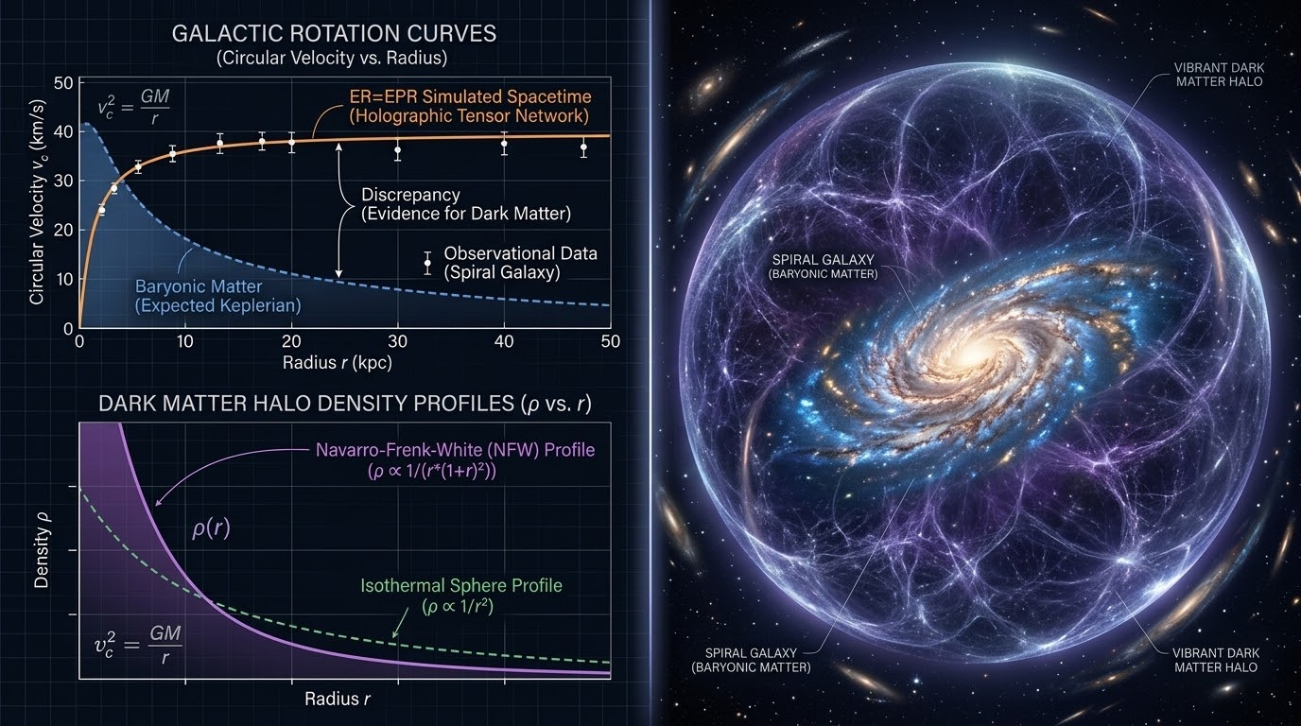
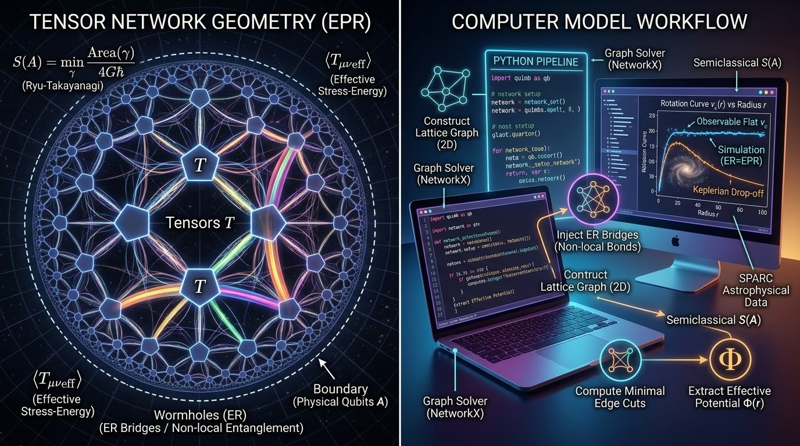
FIGURE PORTFOLIO
Visual Realization: Lattice, Halo, and Workflow
Fig 1: ER=EPR Geometric Substrate
Fig 2: Empirical Target Rotation Curves
Fig 3: Python Tensor Network Pipeline

Slide 8
CRITICAL RIGOR
Theoretical Boundaries & The 2029 Horizon
Boundary: The Bullet Cluster (1E 0657-558)
• Verlinde explicitly noted: static equations hold only in equilibrium systems (spherical/disk symmetry).
• Dynamic mergers exhibit spatial offsets between collisional gas (X-ray) and lensing peaks.
• Thesis Scope: Rigorously bounded to virialized galaxies (SPARC/MaNGA).
• Non-equilibrium relaxation and dynamic time-lags are scoped for PhD extension.
Observational Horizon (2028-2029)
• ESA Euclid Space Telescope: Comprehensive dark halo mass mapping.
• Vera C. Rubin Observatory (LSST): Weak-lensing shear profiles for millions of galaxies.
• Nancy Grace Roman Space Telescope: High-resolution 2D convergence maps.
• Strategic Alignment: The thesis pipeline is completed now to ingest these upcoming datasets.

Slide 9
EXECUTION ROADMAP
40-Week Master Timeline & Milestones
Phase 1: Analytical Modeling
Weeks 1–10
Derive E_μν and <T_μν^eff>; verify w=0 dust equation of state; complete Ch. 1 & 2.
Phase 2: Codebase Construction
Weeks 11–22
Implement 2D Poincaré hyperbolic graph and Push-Relabel min-cut engine; draft Ch. 3.
Phase 3: Simulation & Fitting
Weeks 23–32
Seed non-local ER bridges; fit curves against SPARC database; draft Ch. 4 & 5.
Phase 4: Synthesis & Defense
Weeks 33–40
Comparative χ^2 analysis vs NFW/MOND; finalize thesis manuscript; thesis defense.

Slide 10
SYLLABUS & CONCLUSION
Summary: Structure of the Dissertation
Seven-Chapter Master Syllabus
• Ch 1: The Missing Mass Dilemma & Galactic Dynamics
• Ch 2: The Quantum Geometry of Spacetime (ER=EPR)
• Ch 3: Holographic & Fractal Entanglement Thermodynamics
• Ch 4: The Entanglement Defect Model of Dark Matter
• Ch 5: Discrete Numerical Engine & Algorithmic Architecture
• Ch 6: Simulation Runs, SPARC Benchmarking, and Fitting
• Ch 7: Discussion, Astrophysical Implications & Outlook
Core Takeaway
✔ Bridging the Gap: Takes analytical ER=EPR and FEQG proposals into a falsifiable numerical laboratory.
✔ High Deliverable Value: Combines graph-theoretic min-cuts with real astrophysical observational data.
✔ Future-Proof: Builds the testing engine ahead of the 2028–2029 Euclid and Rubin survey releases.

