Slide 1
PYTHON
Considered a high-level language
It’s easier to use a high-level language
Programs must be processed before they can run
Low-level languages are known as Machine Learning which is encoding of instructions in binary are easily executed by the computer.
Takes less time to write
Shorter and easier to read
More likely to be correct

Slide 2
Two Programs to Process Code
Interpreter
Compiler
Reads a high-level program and executes it, meaning it does what the program says.
Processes a little at a time, reading lines and performing computations
Reads the program and translates it completely before starting to run it.

Slide 3
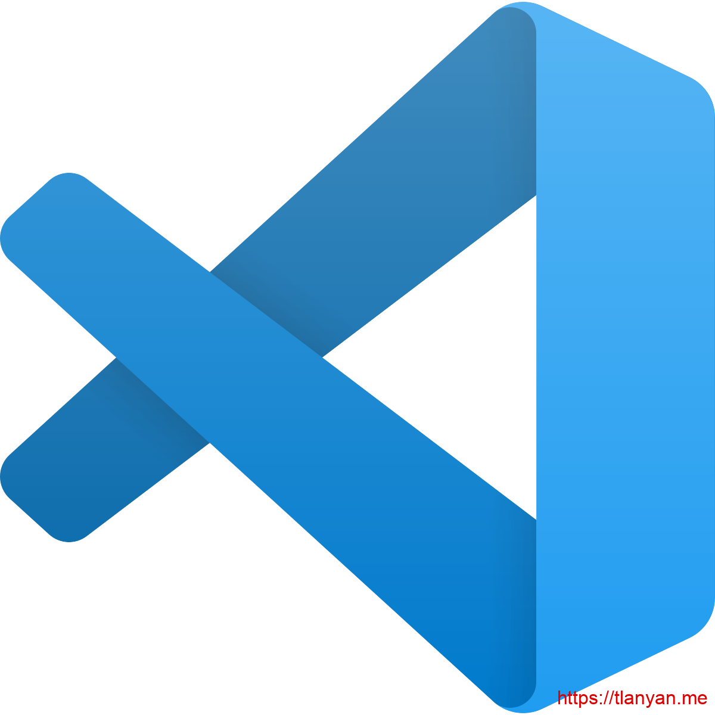

Two Ways to use the Python
Shell
Files

Slide 4
Common Vocabulary
Value – a number or string (or other things to be named later) that can be stored in a variable or computed in an expression.
Variable – a name that refers to a value
Variable Name - A name given to a variable. Variable names in Python consist of a sequence of letters and digits that begins with a letter. In best programming practice, variable names should be chosen so that they describe their use in the program, making the program self documenting.

Slide 5
Str = a Python data type that holds a string of characters
Operators = special symbols that represent a simple computation
Data Type = a set of values
Comment = information in a program that is meant for other programmers (used with ## infront)
Input = a command in a program that prompts the user to put in an answer
Output = the result of a program

Slide 6
Algorithms
What is an algorithm?
Programming is the skill that allows a computer scientist to take an algorithm (those steps to solving a problem) and represent that solution in what’s called a notation (aka program) that can be followed by a computer! Those programs are written in programming languages such as Python, html, JavaScript etc.
Series of steps to solve the problem at hand

Slide 7

You’ve chosen to learn another language!

Slide 8
Types of Languages
Natural
Formal
Form on their own
Are designed by people!
Programming languages fall under this
There are rules about syntax

Slide 9
Let’s write Your First Program!

Slide 10
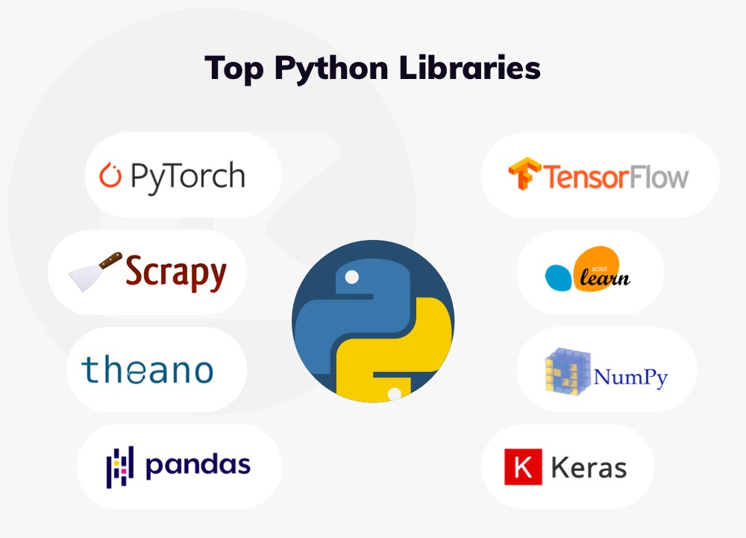
What are modules?
LIBRARIES THAT ARE WITHIN PYTHON TO ACCOMPLISH DIFFERENT GOALS WITHOUT WRITING A LOT OF CODE.

Slide 11
There are 137,000 Python Libraries!
TensorFlow - NumPy
SciPy -BeautifulSoup
Pandas - Scrapy
Matplotlib - PyTorch
Keras - SciKit-Learn

Slide 12
What you’ll use
Pandas = (Python Data Analysis) used for data analysis and cleaning of data
NumPy = (Numerical Python) use for numerical computation.
Matplotlib = a plotting library
Math = functions normally found on calculator
Random = play game of chance, possibilities
BeautifulSoup = used for web crawling and data scraping

Slide 13
Variable Names
Containers for storing data values
No command for declaring a variable
YOU create it as soon as you assign a value to it!
x = 8
y = brothers
print(x)
print(y)

Slide 14
Multi Word Variable Names
fruits = [“apple”, “banana”, “cherry”]
x = y = z = fruits
print(x)
print(y)
print(z)
x, y, z = “Orange”, “Banana”, “Cherry”
print(x)
print(y)
print(z)
x = y = z = “Orange”
print(x)
print(y)
print(z)

Slide 15
Output Variables
x = “awesome”
print(“Python is “ + x)
x = “Python is “
y = “awesome”
z = x + y
print(z)
x = 5
y= 10
print(x+y)
x = 5
y = “John”
Print(x + y)

Slide 16
Global Variables
It holds its value throughout the lifetime of the program.
x = "awesome" def myfunc(): print("Python is " + x) myfunc()
def myfunc():
x = "fantastic"
print("Python is " + x)
myfunc()

Slide 17
Data Types
x = “Hello World” string (str)
x = 20 integer (int)
x = 20.5 float
x = [“apple”, “banana”, “cherry”] list
x = (“apple”, “banana”, “cherry”) tuple
x = range(5) range
x = {“name” : “John”, “age” : 36} dictionary (dict)
x = True boolean

Slide 18
You can put the data type in front if you want to specify
x = str(“hello, world!”)
print(x)
y = int(20.5)
print(y)
z = float(20)
print(z)
Also known as
Casting!
You can check the data type of a value by writing this:
x = 1
y = 4.5
print(type(x))
print(type(y))

Slide 19
Strings
are surrounded by either single quotation marks or double
You can assign a variable to them a = “Hello”
print(a)
Multi-line strings are designated with “””””/”””” or ‘’’/’’’

Slide 20
Finding the length of a string
a = “Hello World!”
print(len(a))
Getting the character
position of a string
a = “Hello World!”
print(a[1])
print(a[-1])
Try with another number!
Counting in Python starts with 0
It includes ALL spaces inside the “ “
Exemption: when you are counting backwards.

Slide 21
Checking a string
txt = “The best class in Saint Louis”
if “best” in txt:
print(“Yes, ‘best’ is present.”)

Slide 22
Slicing a string:
Return a range of characters
Ranges start at the number on the left but doesn’t include the number on the right.
b = “Hello World!”
print(b[2:5])
Slicing a string
From the start
No number on the
left? Means count
starts at the
beginning.
b = “Hello World!”
print(b[:5])

Slide 23
Slicing to the end
b=“Hello World!”
print(b[2:])
Output starts
at position 2
Negative Indexing
Count back 5
DO NOT include
the last 2
b=“Hello World!”
print(b[-5:-2])

Slide 24
Replace in a string
c = “Hello World!”
print(c.replace(“H” , “J”))
Concatenation
a = "Hello" b = "World" c = a + b print(c)

Slide 25
Formatting a String
age = ”36” txt = "My name is John, I am " + age print(txt)
age = 36 txt = "My name is John, and I am {}" print(txt.format(age))
quantity = 3 itemno = 567 price = 49.95 myorder = "I want {} pieces of item {} for {} dollars." print(myorder.format(quantity, itemno, price))

Slide 26
Logical Operators
Operator | Name
== | Equal
!= | Not equal
> | Greater than
< | Less than
>= | Greater than or equal to
<= | Less than or equal to

Slide 27
Booleans represent one of two values: True or False
You often need to know if an expression is true or false
You can evaluate any expression and get one of two answers
When you compare two values, the expression is evaluated and Python returns the BOOLEAN answer.
print(10 > 9)
print(10 == 9)
print(10 < 9)

Slide 28
Checking a string = boolean
txt = “The best class in Saint Louis”
Print(“best” in txt)

Slide 29
Lists
There are 3 other types: tuple, set and dictionary
Used to store multiple items inside a variable
Created always with []
There is always a strict order BUT they can be modified
You CAN have duplicates in a list
You can make lists out of any data type
thislist = ["apple", "banana", "cherry"]

Slide 30
thislist = ["apple", "banana", "cherry"]
print(len(thislist))
print(thislist[1])
thislist[1] = "blackcurrant“
thislist[1:3] = ["blackcurrant", "watermelon"]
thislist.append("orange")
thislist.insert(1, "orange")

Slide 31
thislist = ["apple", "banana", "cherry"]
tropical = ["mango", "pineapple", "papaya"] thislist.extend(tropical)
thislist.remove("banana")
thislist.pop(1)
thislist.pop()
del thislist[0]

Slide 32
thislist = ["apple", "banana", "cherry"]
del thislist
thislist.clear()
thislist.sort()
thislist.sort(reverse = True)
mylist = thislist.copy()

Slide 33
list1 = ["apple", "banana", "cherry"] list2 = [“kiwi", “strawberry", “grape"] list3 = list1 + list2 print(list3)

Slide 34
Tuples
A collection which is ordered and UNCHANGEABLE
Written with ()
thistuple = ("apple", "banana", "cherry“)
You can then go about finding length and indexing.
You CANNOT change, add or remove once it’s created
(there are workarounds but that’s for a later time)

Slide 35
thistuple = ("apple", "banana", "cherry“)
Let’s pack a tuple (assign a value)
fruits = ("apple", "banana", "cherry")
(green, yellow, red) = fruits
print(green)
print(yellow)
print(red)

Slide 36
thistuple = ("apple", "banana", "cherry“)
You can add tuples together like you do with lists
You can multiple by doing this:
mytuple = fruits * 2
print(mytuple)

Slide 37
Sets
A collection which is UNORDERED, UNCHANGEABLE & UNINDEXED
Written in {}
thisset = {"apple", "banana", "cherry“}
Do not allow duplicates
No particular order
Unchangeable

Slide 38
thisset = {"apple", "banana", "cherry“}
Can find the length the same way
Can be any data type
You can access values the same way
.pop() and .clear() work the same
thisset.add("orange")
Mylist = [“kiwi”, “orange”]
thisset.update(mylist)

Slide 39
thisset = {"apple", "banana", "cherry“}
thisset.remove("banana")
thisset.discard("banana")
thisset1 = {“apple”, “banana”, “cherry”}
thisset2 = {“kiwi”, “grape”}
thisset3 = thisset1.union(thisset2)
OR replace .union with .update

Slide 40
Dictionaries
Used to store data values in key:value pairs.
A collection which is ordered, changeable & do not allow duplicates.
Written with {}

Slide 41
print(thisdict["brand"])
You can change dictionaries
NO duplicates allowed
print(len(thisdict))
x = thisdict["model"]
print(x)
x = thisdict.get("model")
print(x)
thisdict = { "brand": "Ford", "model": "Mustang", "year": 1964 } print(thisdict)

Slide 42
thisdict["year"] = 2018
print(thisdict)
thisdict["color"] = "red" print(thisdict)
thisdict.update({"color": "red"})
print(thisdict)
thisdict.pop("model") print(thisdict)
thisdict.popitem() print(thisdict)
thisdict = { "brand": "Ford", "model": "Mustang", "year": 1964 }

Slide 43
Practice
Create a file and name is listpractice
Create a list, find the length, replace a part of it with something else and append it
Create a tuple and multiply it by 3
Create a set, add your list to it and remove a string
Create a dictionary and print out 1 value, replace another one
Save your file and send it to me in Slack via private message

Slide 44
IF Statements
Used with the logical operators
==
!=
<
>
<=
>=
a = 45
b = 68
If b > a:
print(“b is greater”)

Slide 45
Elif Statement
Python’s way of saying, “If the previous conditions were not true, then try this condition”
A = 55
B = 55
If b > a:
print(“b is greater than a”)
elif b == a:
print(“a and b are equal”)

Slide 46
ELSE Statement
A = 200
B = 55
if b > a:
print(“b is greater than a”)
elif b == a:
print(“a and b are equal”)
else:
print(“a is greater than b”)
Else statements are used to catch anything that wasn’t already caught in the previous two conditions.

Slide 47
A = 200
B = 55
if b > a:
print(“b is greater than a”)
else:
print(“a is greater than b”)
You can have an else without the elif!

Slide 48
Using “And”
Considered a logical operator
It combines conditional statements together
a = 200 b = 33 c = 500
if a > b and c > a: print("Both conditions are True")

Slide 49
Using “or”
Considered a logical operator
It combines conditional statements together
a = 200 b = 33 c = 500
if a > b or a > c: print(“At least one of the conditions is True”)

Slide 50
Nested IF Statement
If a statement is inside of a statement, then that means it is considered nested
X = 55
If x > 10:
print(“It’s above 10,”)
if x < 20:
print(“and also about 20!”)
else:
print(“but not above 20”)

Slide 51
While Loop
i = 1
while i < 6:
print(i)
i += 1 🡨 ? = i+1
1
2
3
4
5
You can execute a set of statements as long as
a condition is true.

Slide 52
For Loops
fruits = [“apple”, “banana”, “grape”]
for x in fruits:
print(x)
Used for iterating over a
sequence ( like a list, tuple, dictionary, set
or a string.)

Slide 53
Break Statement
i = 1
while i < 6:
print(i)
if i == 3:
break
i += 1
We can stop the loop even if the while condition is true

Slide 54
Break Statement
fruits = [“apple”, “banana”, “grape”]
for x in fruits:
print(x)
if x == “banana”:
break
We can stop the loop before it goes through all the items.

Slide 55
Another Break Example
fruits = [“apple”, “banana”, “grape”]
for x in fruits:
if x == “banana”:
break
print(x)

Slide 56
Nested Loops
Goal: print each adj for every fruit
adj = [“red”, “big”, “juicy”]
fruits = [“apple”, “orange”, “pineapple”]
for x in adj:
for y in fruits:
print(x,y)

Slide 57
Else Statement
i = 1
while i < 6:
print(i)
i += 1
else:
print(“i is no longer less than 6”)
We can run a block of code once when the condition is no longer true.

Slide 58
range() function as a loop
Used to loop through a set of code a specified number of times.
It returns a sequence of numbers, starting from 0 by default, and increments of 1 (by default) and ends at a specified number
For x in range(6):
print(x)

Slide 59
range() function as a loop
It is possible to specify the starting value by adding a parameter, telling python to start at that first number and go to the second (but not include it)
for x in range (2,6):
print(x)

Slide 60
range() function as a loop
It is possible to specify the increment value by adding a third parameter:
for x in range (2, 50, 5):
print(x)

Slide 61
range() function as a loop
The else keyword in a for loop specifies a block of code to be executed when the loop is finished:
for x in range(10):
print(x)
else:
print(“Finally finished!”)

Slide 62
range() function as a loop
Now, let’s break the loop and see what happens.
for x in range(10):
if x == 5: break
print(x)
else:
print(“Finally finished!”)

Slide 63
Practice
Create a file and name it statements
Create an if statement
Create an if statement using else
Create a nested loop
Create a for loop and include a break
Loop through a string
Send the file to me via Slack

Slide 64
Exceptions
Python will normally generate an error message when an error or exception occurs in a called block of code.
You can write a try statement
try: print(x) except: print("An exception occurred")

Slide 65
Other Exception examples
try: print(x) except NameError: print("Variable x is not defined") except: print("Something else went wrong")
try: print("Hello") except: print("Something went wrong") else: print("Nothing went wrong")

Slide 66
Other Exception examples
This will be executed regardless if
the try block raises an error or not.
try: print(x) except: print("Something went wrong") finally: print("The 'try except' is finished")

Slide 67
Datetime
Not a data type of its own
We import the module datetime to work with dates and date objects
%a = weekday, abrev.
%A = weekday, full name
%w = weekday, number
%d = day of month
%b = month, abrev.
%B = month, full name
%m = month as a number
%y = year, short
%Y = year, full

Slide 68
Datetime
import datetime
x = datetime.datetime.now()
import datetime x = datetime.datetime(2020, 5, 17) print(x)

Slide 69
Datetime
import datetime x = datetime.datetime.now() print(x.year) print(x.strftime("%A"))
import datetime x = datetime.datetime(2018, 6, 1) print(x.strftime("%B"))

Slide 70
Things to remember
Python is an object-oriented programming language
Almost everything in Python is an object, with its properties & methods
A class is like an object constructor, like a blueprint for object creation.

Slide 71
Functions
Block of code that only runs when it’s called
Established by using def and then the name followed by ()
Example:
def my_message(): (command)

Slide 72
You call the function by simply writing the function name
def my_message():
print(“I am enjoying class”)
my_message()

Slide 73
Another example of a function
def familyname(lname):
print(fname + “ Smith”)
familyname(“Jerry”)
familyname(“Amy”)
familyname(“Chad”)

Slide 74
Remember Modules?
LIBRARIES THAT ARE WITHIN PYTHON TO ACCOMPLISH DIFFERENT GOALS WITHOUT WRITING A LOT OF CODE.

Slide 75
Anytime you use a module, you will have to IMPORT it into your program to use it.

Slide 76
Math Module
Basic Operators
+ = addition
- = subtraction
/ = division
* = multiplication

Slide 77
x = 39
x += 5
print(x)
y = 100
y -= 75
print(y)
print(math.pi)
Import math

Slide 78
Random Module
Allows you to use random numbers when needed
import random
prob = random.random()
print(prob)
diceThrow=random.randrange(1,10)
Print(diceThrow)

