Slide 1
Data Analytics + Python
Week 2
Day 2

Slide 2
Questions & an Ice Breaker
What’s the best piece of advice
you’ve ever been given?

Slide 3
Dictionaries
Used to store data values in {“key” : “value”} pairs.
A collection which is ordered*, changeable & do not allow duplicates.
Written with {}

Slide 4
print(thisdict["brand"])
You can change dictionaries
NO duplicates allowed
print(len(thisdict))
x = thisdict["model"]
print(x)
x = thisdict.get("model")
print(x)
thisdict = { "brand": "Ford", "model": "Mustang", "year": 1964 } print(thisdict)

Slide 5
thisdict["year"] = 2018
print(thisdict)
thisdict["color"] = "red" print(thisdict)
thisdict.update({"color": "red"})
print(thisdict)
thisdict.pop("model") print(thisdict)
thisdict.popitem() print(thisdict)
thisdict = { "brand": "Ford", "model": "Mustang", "year": 1964 }

Slide 6
Review
What’s the difference between a tuple and a set?
What’s the difference between a dictionary and a tuple?
What can you do with a list that you can’t with a tuple or set?
What is an example of a Boolean?

Slide 7
Practice
Create a file and name is listpractice
Create a list, find the length, replace a part of it with something else and append it
Create a tuple and multiply it by 3
Create a set, add your list to it and remove a string
Create a dictionary and print out 1 value, replace another one
Save your file and send it to me in Slack via private message

Slide 8
IF Statements
Used with the logical operators
==
!=
<
>
<=
>=
a = 45
b = 68
If b > a:
print(“b is greater”)

Slide 9
Elif Statement
Python’s way of saying, “If the previous conditions were not true, then try this condition”
A = 55
B = 55
If b > a:
print(“b is greater than a”)
elif b == a:
print(“a and b are equal”)

Slide 10
ELSE Statement
A = 200
B = 55
if b > a:
print(“b is greater than a”)
elif b == a:
print(“a and b are equal”)
else:
print(“a is greater than b”)
Else statements are used to catch anything that wasn’t already caught in the previous two conditions.

Slide 11
A = 200
B = 55
if b > a:
print(“b is greater than a”)
else:
print(“a is greater than b”)
You can have an else without the elif!

Slide 12
Using “And”
Considered a logical operator
It combines conditional statements together
a = 200 b = 33 c = 500
if a > b and c > a: print("Both conditions are True")

Slide 13
Using “or”
Considered a logical operator
It combines conditional statements together
a = 200 b = 33 c = 500
if a > b or a > c: print(“At least one of the conditions is True”)

Slide 14
Nested IF Statement
If a statement is inside of a statement, then that means it is considered nested
X = 55
If x > 10:
print(“It’s above 10,”)
if x < 20:
print(“and also about 20!”)
else:
print(“but not above 20”)

Slide 15
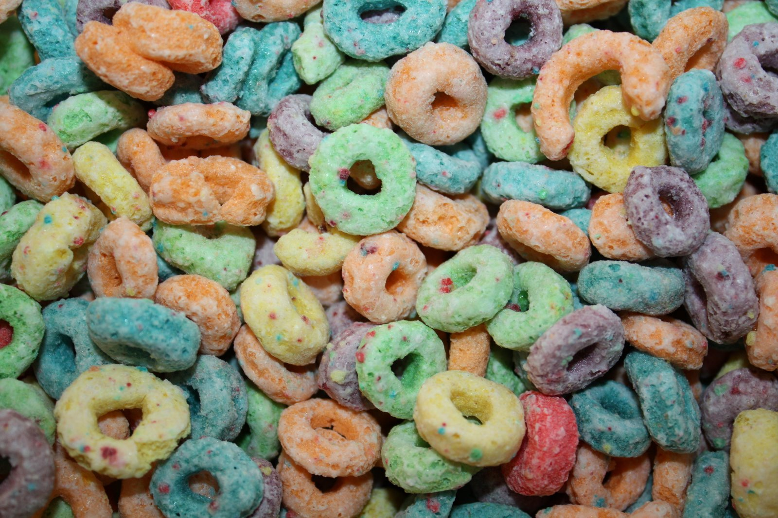
While Loop
i = 1
while i < 6:
print(i)
i += 1 ← ? = i+1
1
2
3
4
5
You can execute a set of statements as long as a condition is true.

Slide 16
Break Statement
i = 1
while i < 6:
print(i)
if i == 3:
break
i += 1
We can stop the look even if the while condition is true

Slide 17
Else Statement
i = 1
while i < 6:
print(i)
i += 1
else:
print(“I is no longer less than 6”)
We can run a block of code once when the condition is no longer true.

