Slide 1

Data Analytics + Python
DAY 2

Slide 2

Ice Breaker

Slide 3

Questions?

Slide 4
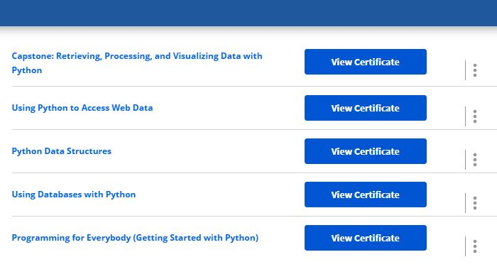

Slide 5
cd = changes the directory that you’re currently working in
clear = clears the terminal screen of all previous commands
mkdir = create a directory
ls = lists what’s in your directory
The up arrow accesses your history of commands

Slide 6
Review
What kind of language is Python considered?
What’s a natural language?
What is the program we use to write Python in?
What’s the file extension of a Python file?
What is the area called where we put in our commands?

Slide 7

Show and Tell

Slide 8

Debugging
Process of detecting and removing of existing and potential errors (also called as 'bugs') in a software code that can cause it to behave unexpectedly or crash.

Slide 9
Examples of Error Types
Syntax – Issues in the programs structure or rules about that structure
Runtime – Displayed after you run the program.
Semantic – Program will run but will be a bit off because it was written semantically wrong.
Logic – program runs but doesn’t product the output you wanted due to you accidently writing it wrong (ex: writing 3-5= / 3+5=)

Slide 10

It is a VERY useful skill in programming!
It’s a science
Think of yourself as a detective looking for the clues as to what went wrong
Sometimes issues are minor and are quick, but others can take a while to find/fix.

Slide 11
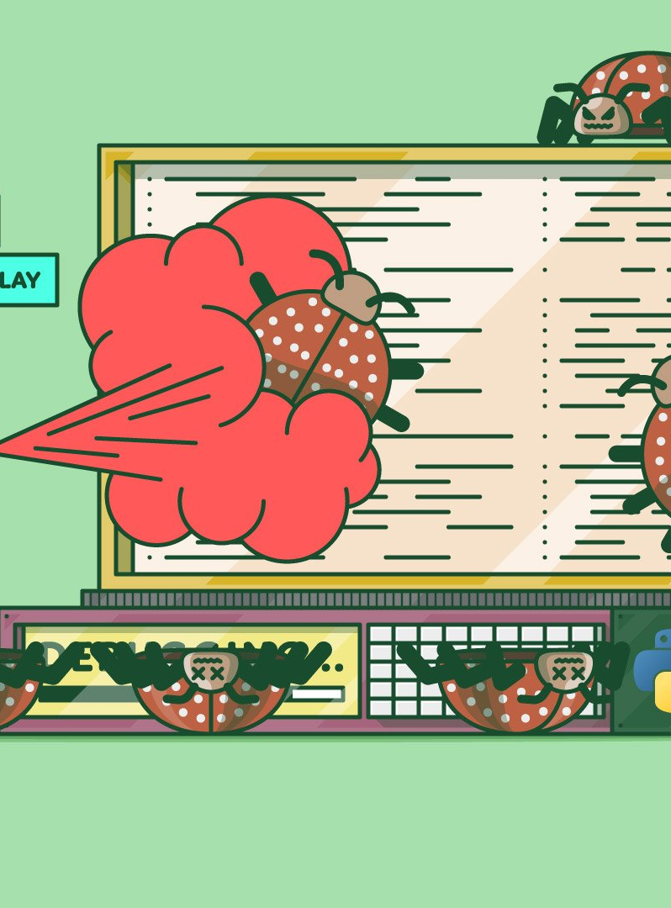
Helpful debugging tips
Review your code as you are writing it
If you can’t find the error after a while, have someone else look at it
Work backward to try to find the issue

Slide 12
print(“Hello, World!”
print(Hello, World!”)
(“Hello, World!”)

Slide 13
Input(What is your name?”)
inputHow you?)
input(“What you names?”)

Slide 14


Slide 15
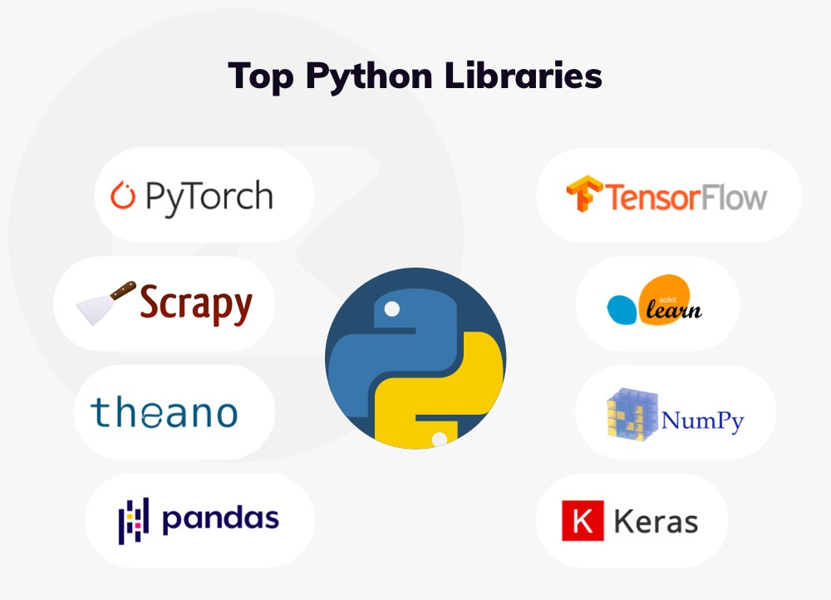
What are modules?
LIBRARIES THAT ARE WITHIN PYTHON TO ACCOMPLISH DIFFERENT GOALS WITHOUT WRITING A LOT OF CODE.

Slide 16
There are 137,000 Python Libraries!
Some popular Libraries …
We’ll be using …
TensorFlow - NumPy
SciPy - BeautifulSoup
Pandas - Scrapy
Matplotlib - PyTorch
Keras - SciKit-Learn
Pandas
NumPy
Matplotlib
Math
Random
BeautifulSoup

Slide 17
Breaking it all down
Pandas = (Python Data Analysis) used for data analysis and cleaning of data
NumPy = (Numerical Python) use for numerical computation.
Matplotlib = a plotting library
Math = functions normally found on calculator
Random = play game of chance, possibilities
BeautifulSoup = used for web crawling and data scraping

Slide 18
Math Module
You ALWAYS want to IMPORT a module
Basic Operators
+
-
/
*

Slide 19
x = 39
x += 5
print(x)
y = 100
y -= 75
print(y)
print(math.pi)

Slide 20
Random Module
prob = random.random()
print(prob)
diceThrow=random.randrange(1,10)
Print(diceThrow)
Allows you to use random numbers when needed
import random

Slide 21
Functions
Block of code that only runs when it’s called
Established by using def and then the name followed by ()
Example:
def my_message(): (command)

Slide 22
You call the function by simply writing the function name
def my_message():
print(“I am enjoying class”)
my_message()

Slide 23
Another example of a function
def familyname(lname):
print(fname + “ Smith”)
familyname(“Jerry”)
familyname(“Amy”)
familyname(“Chad”)

Slide 24
Practice
Basic print program (including input)
Math Module
Random Module
Writing different functions
Challenge
Use two or more at the same time creating a program

