Slide 1
Data Analytics + Python
Week 2 – Day 3

Slide 2
Questions & an Ice Breaker
What was the worst job you ever had?

Slide 3
Review
When do you use and/or in a statement?
When do you use a nested if?
What is the purpose of using else?
What is a for loop?
When do you use a while loop?

Slide 4
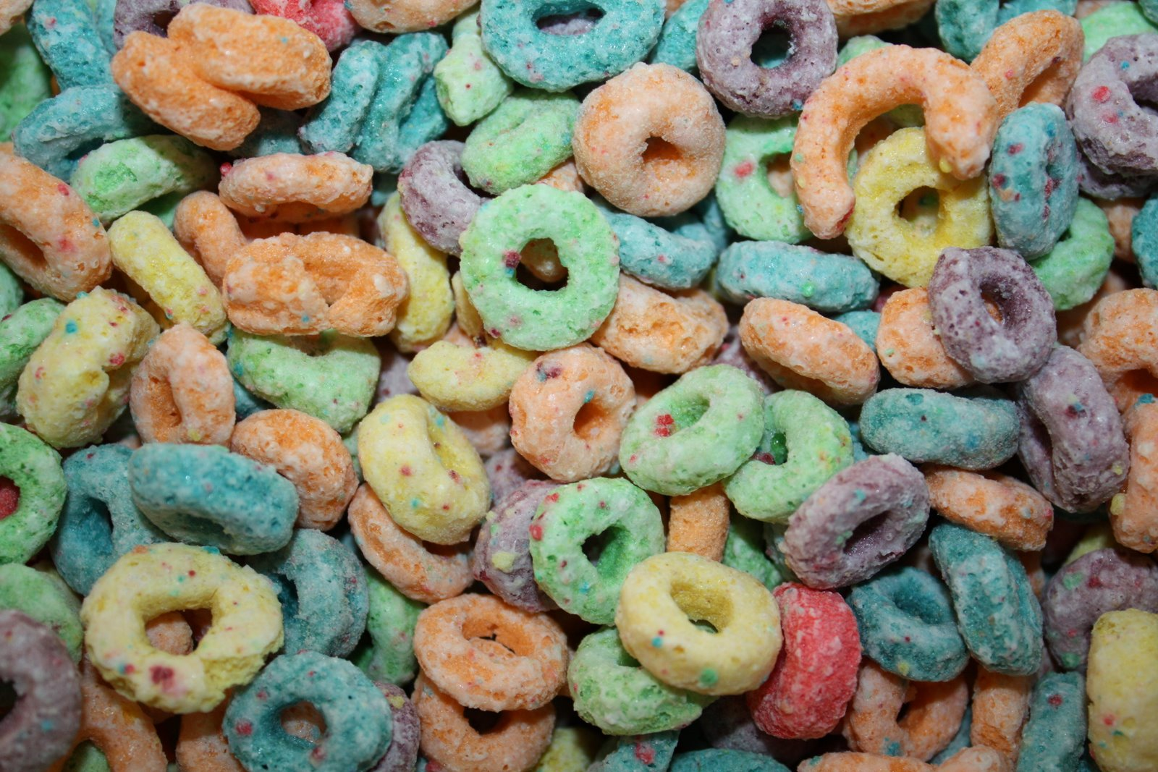
For Loops
fruits = [“apple”, “banana”, “grape”]
for x in fruits:
print(x)
Used for iterating over a
sequence ( like a list, tuple, dictionary, set
or a string.)

Slide 5
Looping through a string
for x in “banana”:
print(x)
Even strings are objects,
They contain a sequence of characters

Slide 6
Break Statement
fruits = [“apple”, “banana”, “grape”]
for x in fruits:
print(x)
if x == “banana”:
break
We can stop the loop before it goes through all the items.

Slide 7
Another Break Example
fruits = [“apple”, “banana”, “grape”]
for x in fruits:
if x == “banana”:
break
print(x)

Slide 8
Nested Loops
Goal: print each adj for every fruit
adj = [“red”, “big”, “juicy”]
fruits = [“apple”, “orange”, “pineapple”]
for x in adj:
for y in fruits:
print(x,y)

Slide 9
range() function as a loop
Used to loop through a set of code a specified number of times.
It returns a sequence of numbers, starting from 0 by default, and increments of 1 (by default) and ends at a specified number
For x in range(6):
print(x)

Slide 10
range() function as a loop
It is possible to specify the starting value by adding a parameter, telling python to start at that first number and go to the second (but not include it)
for x in range (2,6):
print(x)

Slide 11
range() function as a loop
It is possible to specify the increment value by adding a third parameter:
for x in range (2, 50, 5):
print(x)

Slide 12
range() function as a loop
The else keyword in a for loop specifies a block of code to be executed when the loop is finished:
for x in range(10):
print(x)
else:
print(“Finally finished!”)

Slide 13
range() function as a loop
Now, let’s break the loop and see what happens.
for x in range(10):
if x == 5: break
print(x)
else:
print(“Finally finished!”)

Slide 14
Practice
Create a file and name it statements
Create an if statement
Create an if statement using else
Create a nested loop
Create a for loop and include a break
Loop through a string
Send the file to me via Slack

Slide 15
Exceptions
Python will normally generate an error message when an error or exception occurs in a called block of code.
You can write a try statement
try: print(x) except: print("An exception occurred")

Slide 16
Other Exception examples
try: print(x) except NameError: print("Variable x is not defined") except: print("Something else went wrong")
try: print("Hello") except: print("Something went wrong") else: print("Nothing went wrong")

Slide 17
Other Exception examples
This will be executed regardless if
the try block raises an error or not.
try: print(x) except: print("Something went wrong") finally: print("The 'try except' is finished")

Slide 18
Datetime
Not a data type of its own
We import the module datetime to work with dates and date objects
%a = weekday, abrev.
%A = weekday, full name
%w = weekday, number
%d = day of month
%b = month, abrev.
%B = month, full name
%m = month as a number
%y = year, short
%Y = year, full

Slide 19
Datetime
import datetime
x = datetime.datetime.now()
import datetime x = datetime.datetime(2020, 5, 17) print(x)

Slide 20
Datetime
import datetime x = datetime.datetime.now() print(x.year) print(x.strftime("%A"))
import datetime x = datetime.datetime(2018, 6, 1) print(x.strftime("%B"))

Slide 21
Things to remember
Python is an object-oriented programming language
Almost everything in Python is an object, with its properties & methods
A class is like an object constructor, like a blueprint for object creation.

Slide 22
Classes and objects in their easiest form:
Creating a Class
Creating an Object
class = MyClass
x = 5
print(MyClass)
p1 = MyClass()
x = 5
print(p1.x)

Slide 23
_init_() Function
class Person: def __init__(self, name, age): self.name = name self.age = age p1 = Person("John", 36) print(p1.name) print(p1.age)
Create a named Person, use the function to assign values for name and age.

